Slide 1




Input
Latent
$$W_{1}$$
$$W_{2}$$
$$z$$
$$x$$

Slide 2
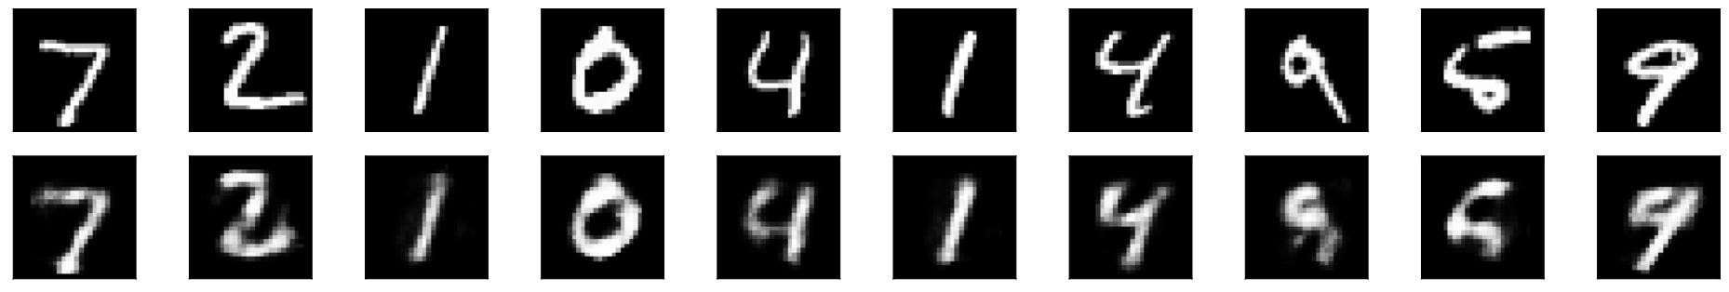



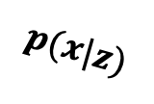
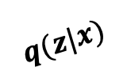
Input
Reconstruction
Latent
$$W_{1}$$
$$W_{2}$$
$$W_{3}$$
$$W_{4}$$
$$z$$
$$q(z|x)$$
$$p(x|z)$$
$$x$$
$$\hat{x}$$

Slide 3



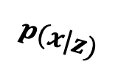
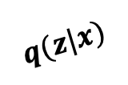



Input
Reconstruction
Latent
$$W_{1}$$
$$W_{2}$$
$$W_{3}$$
$$W_{4}$$
$$log σ$$
$$∼z$$
$$μ$$
$$z$$
$$q(z|x)$$
$$p(x|z)$$
$$x$$

