Slide 1

DS-GA 1011 Fall 2017
Lab 2
Forward Neural Network
Artie Shen | Center Data Science

Slide 2
Recap
In the last lab we learned:
  Set up the development environment
  Tensor
  Autograd
In this lab we will learn:
  MNIST Handwritten digit classification problem
  Simple Feed Forward Neural Network
  Implementation of ML Model in PyTorch

Slide 3
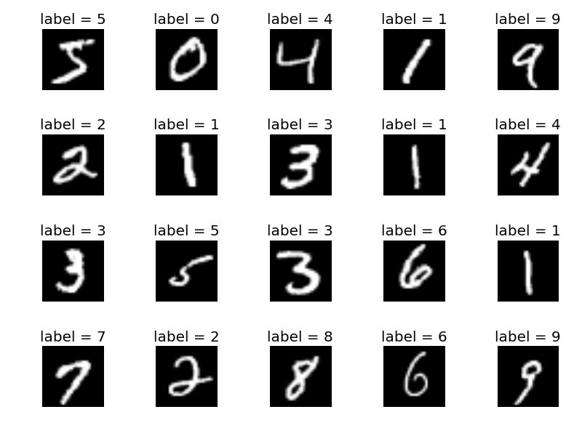
MNIST
Given a 28 * 28 grey-scale image, predict the digit that this image represents
60k training data, 10k test data
Output space = {0,1,…,9}
[LeCun et al., 1998a] Y. LeCun, L. Bottou, Y. Bengio, and P. Haffner. "Gradient-based learning applied to document recognition." Proceedings of the IEEE, 86(11):2278-2324, November 1998. [on-line version]

Slide 4
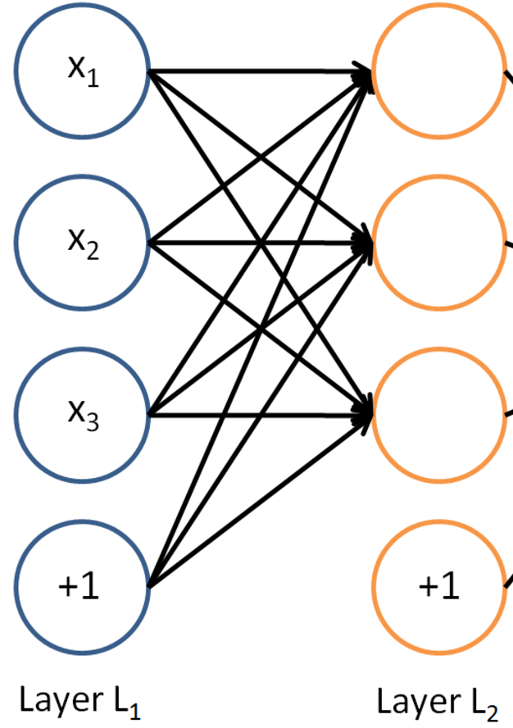
Linear Unit
torch.nn.Linear(in_features, out_features, bias=True)
Each output unit is a linear combination of all input units

Slide 5
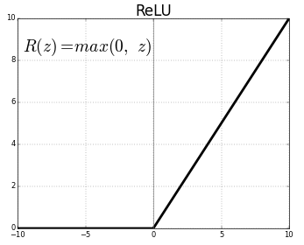
ReLU
Rectified Linear Unit
Why ReLU?
Why do we need non-linearity?

Slide 6
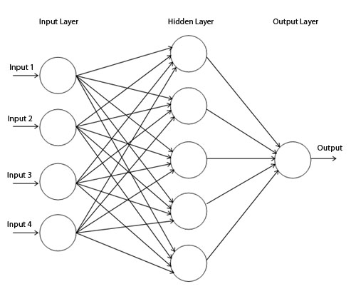
Feed Forward Neural Network
What’s the input dimension for MNIST?
What’s the output dimension?

Slide 7


