Slide 1
Master branch
Merge
New feature!
New new feature!

Slide 2
Project folder
* Changes not tracked *
Staging
Local repository
txt
R
csv

Slide 3
Project folder
Staging
*about to be committed*
Local repository
txt
R
csv
git add -A

Slide 4
Project folder
Staging
Local repository
*changes are integrated*
txt
R
csv
git commit –m “my message”

Slide 5
git pull
Project folder
Staging
Local repository
Remote repo (GitHub)
txt
R
csv
txt
R
csv
git push

Slide 6
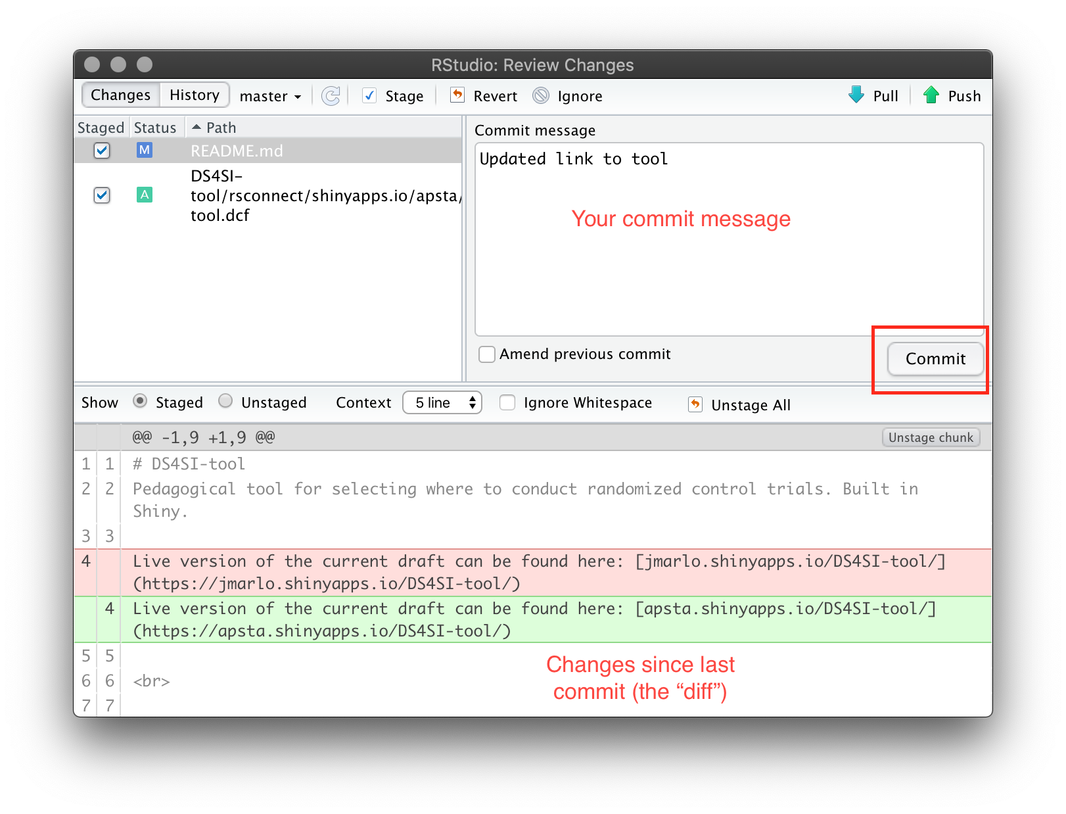
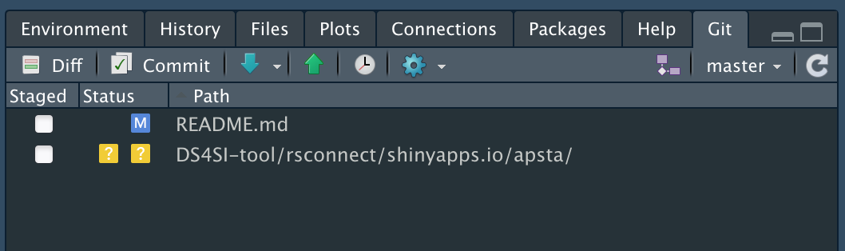
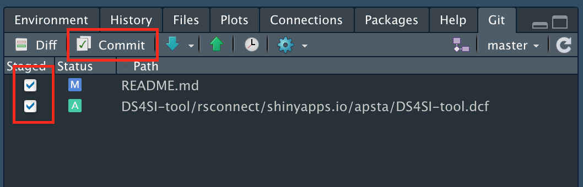
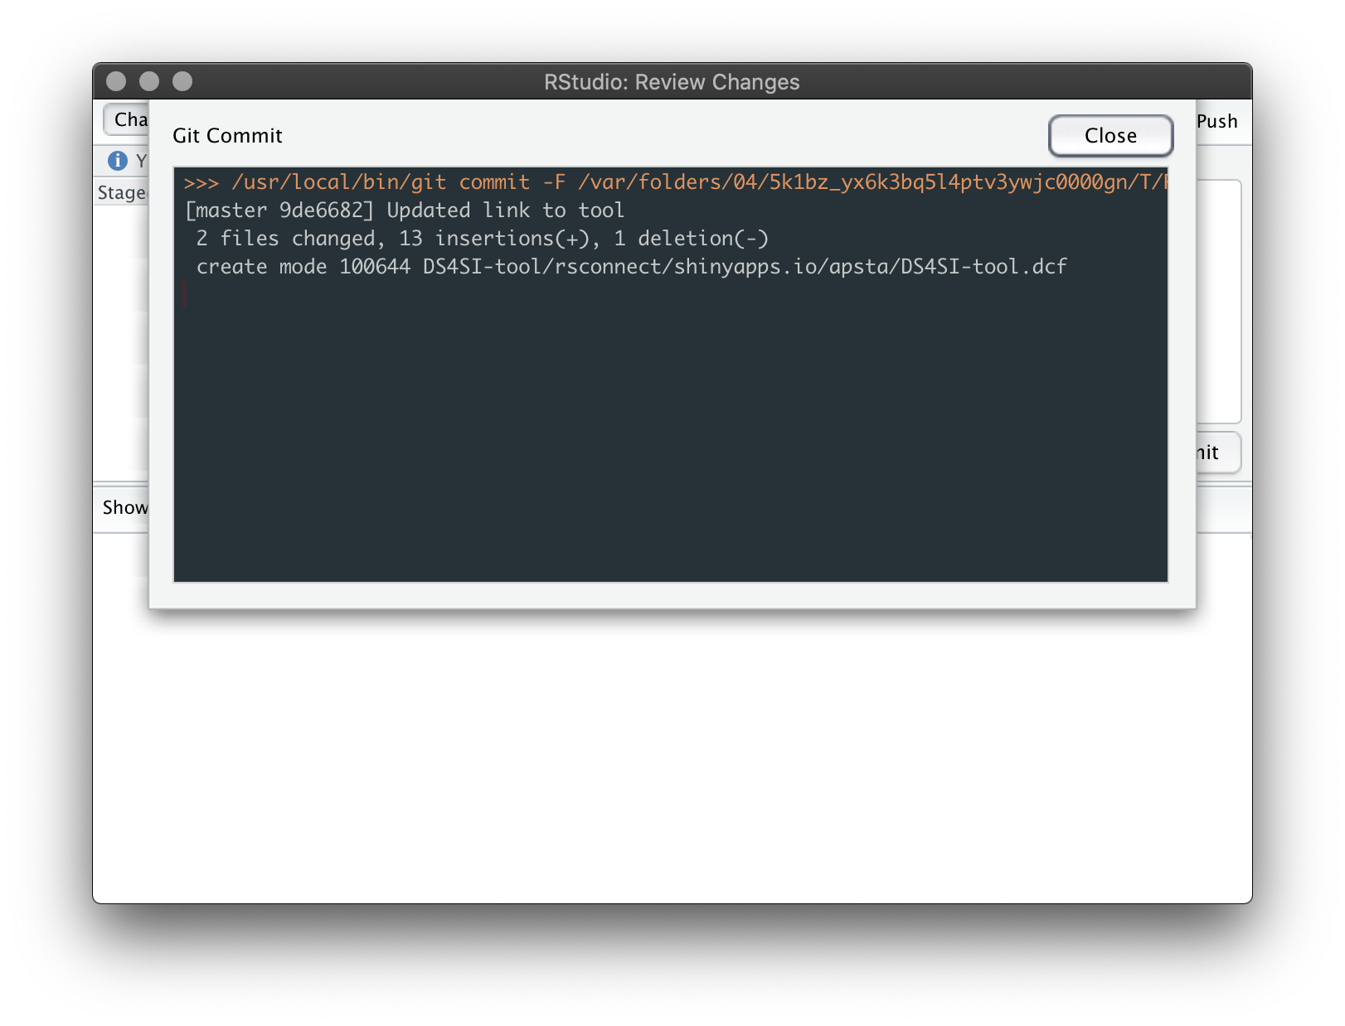
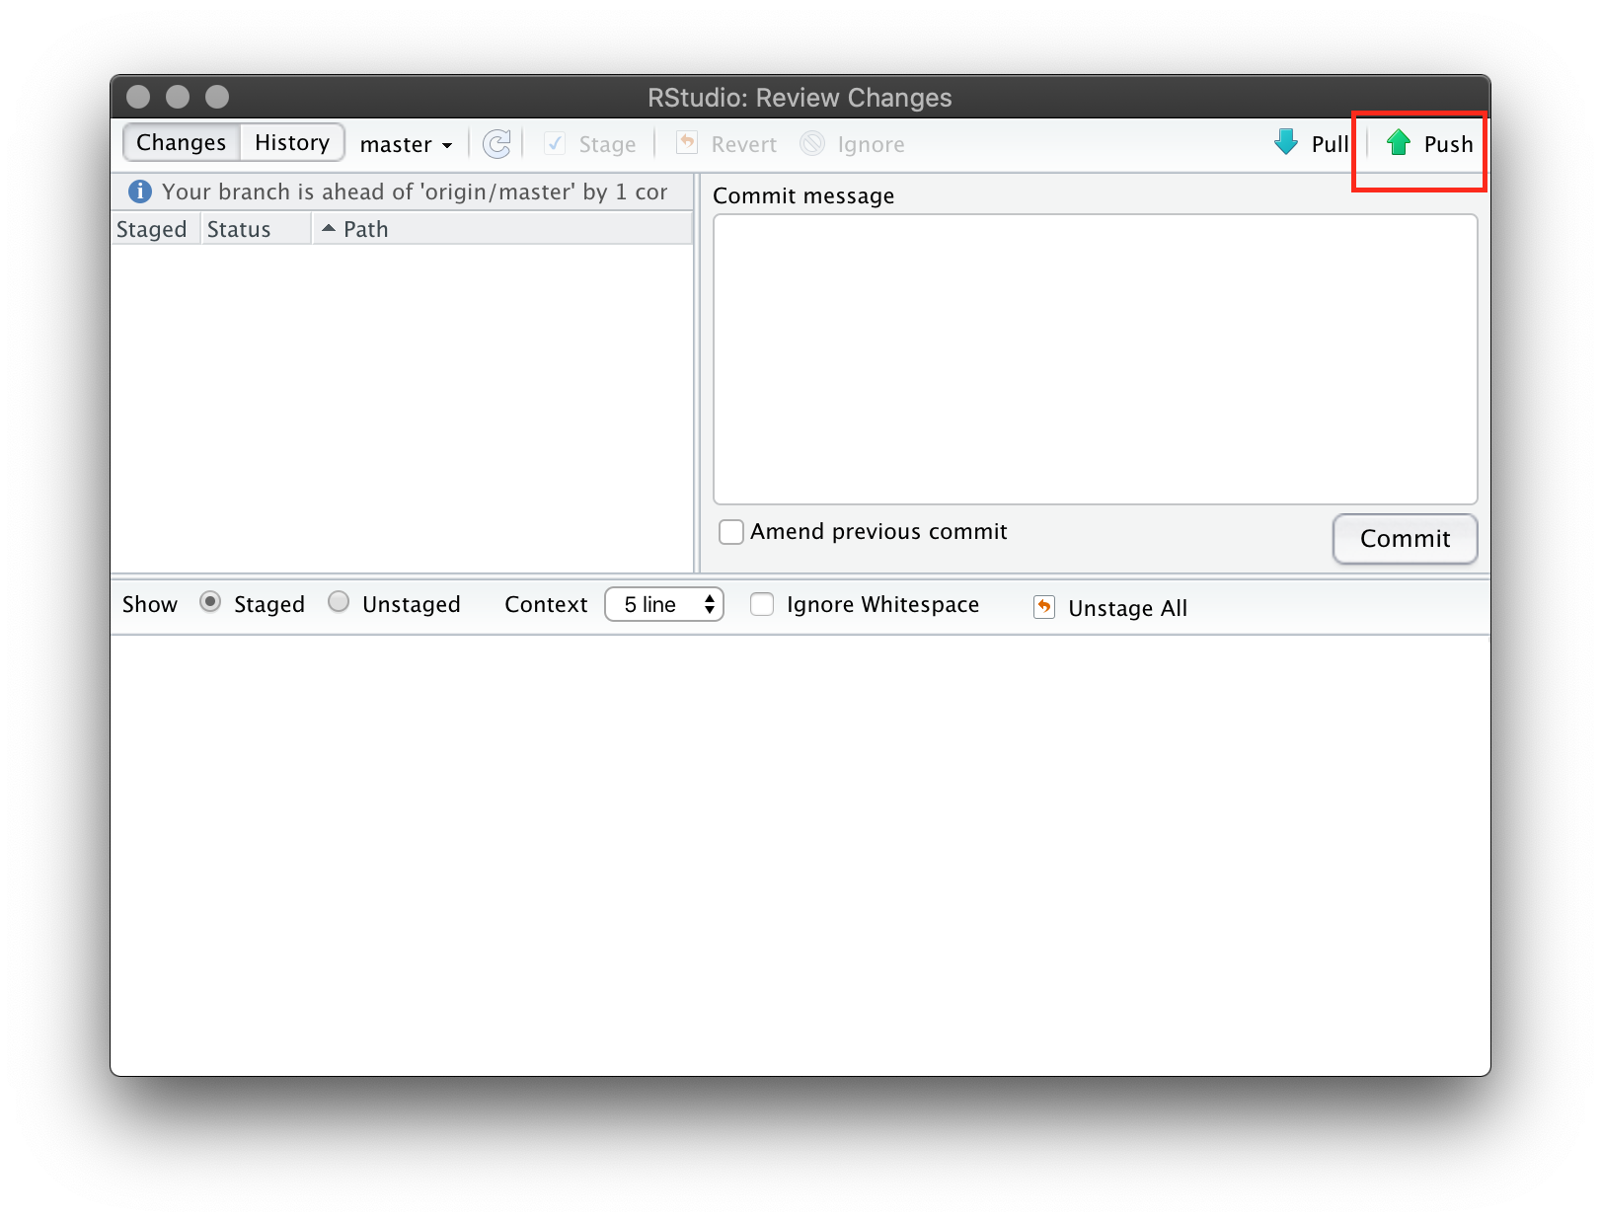
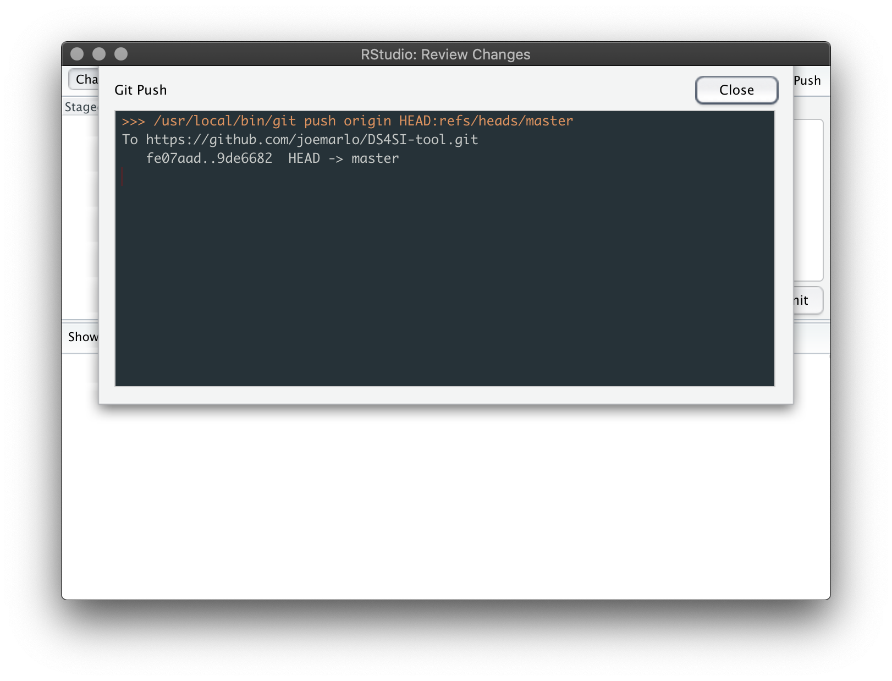
1
3
2
4
5
6

Slide 7
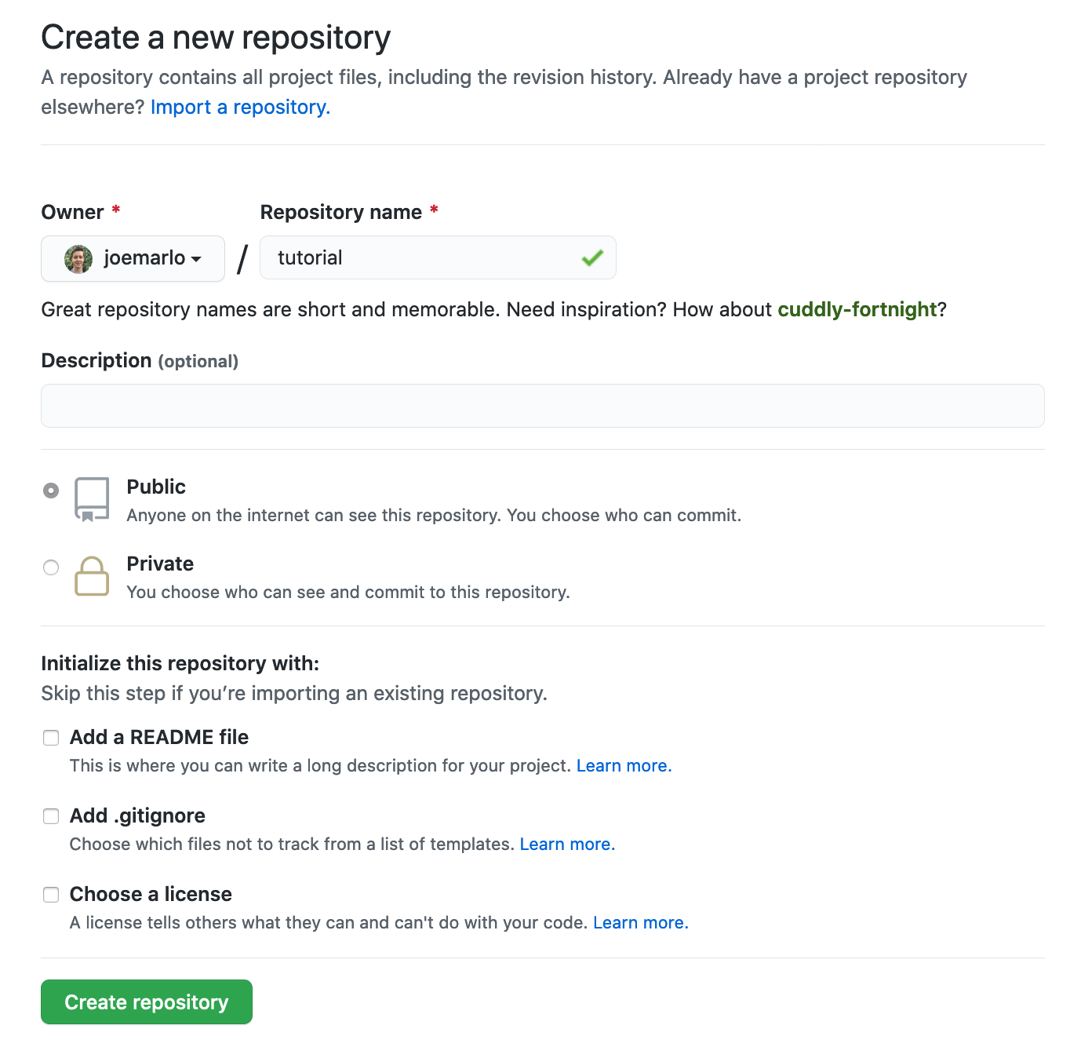
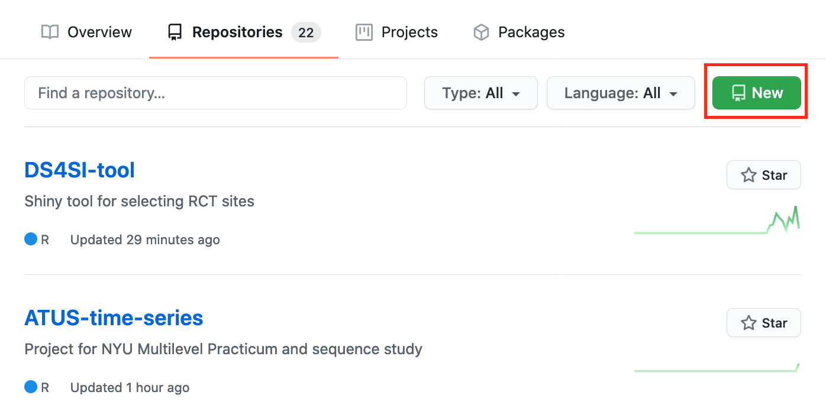
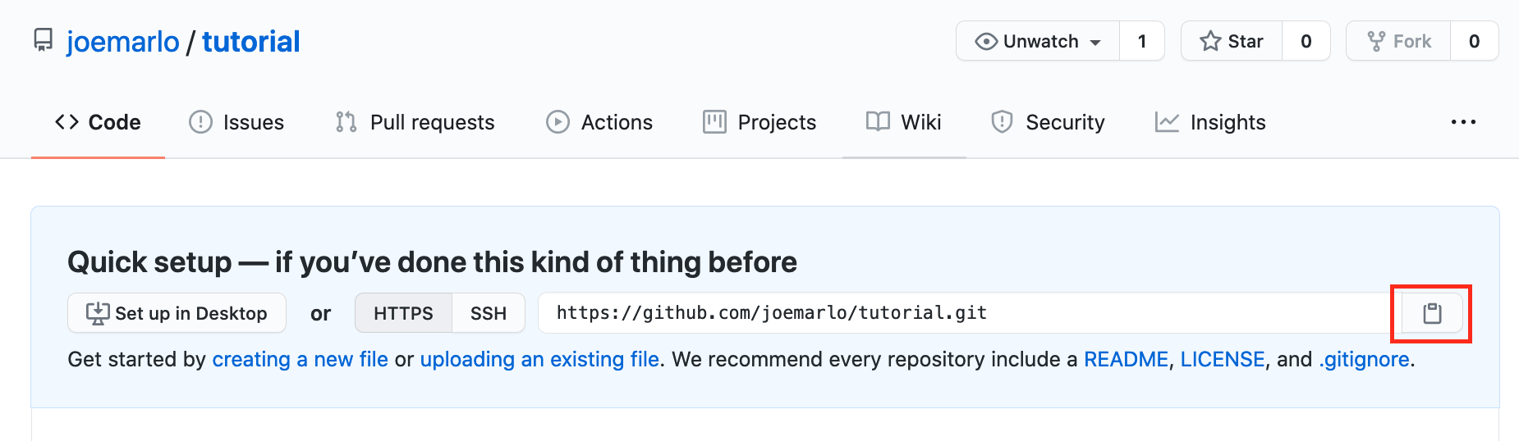
1
2
3

Slide 8
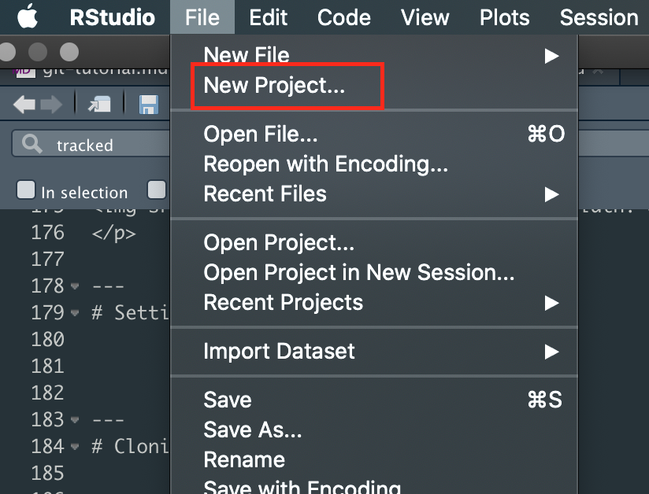
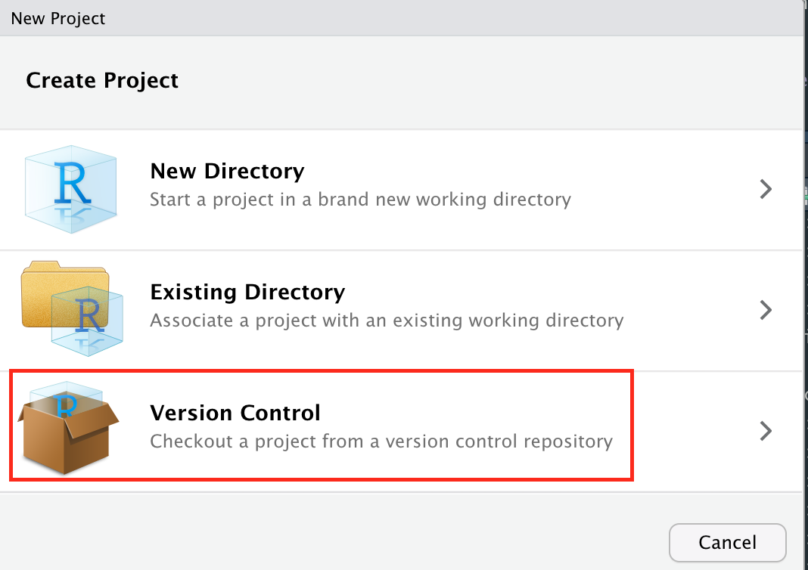
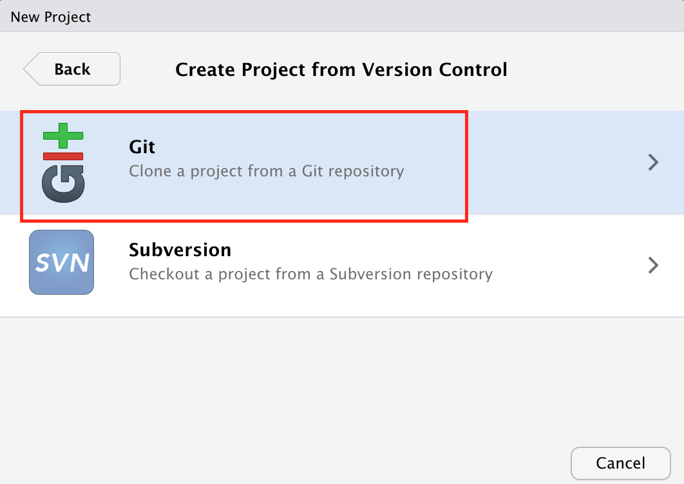
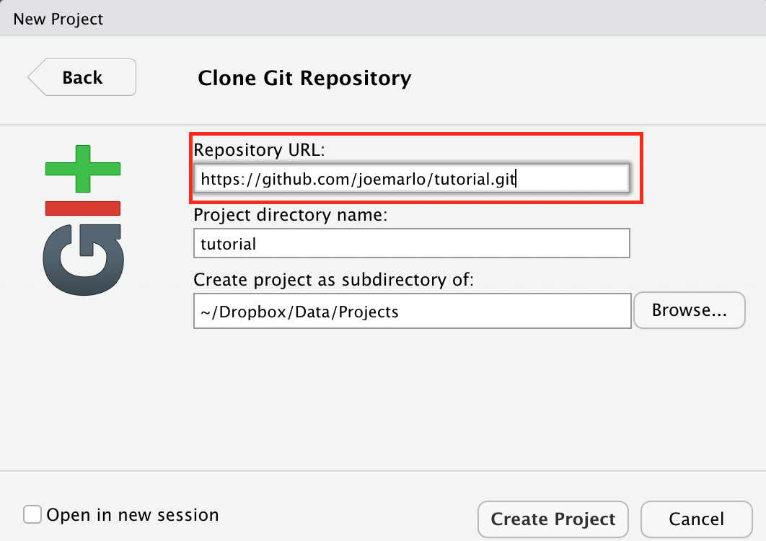
4
5
6
7

