Slide 1


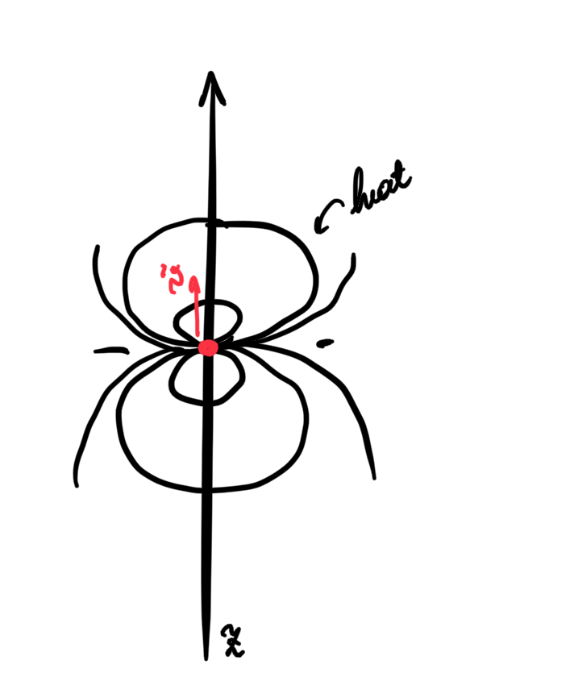
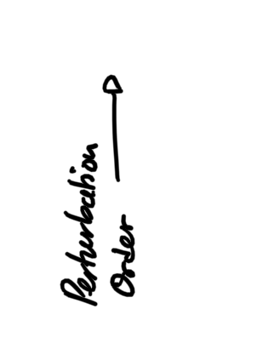
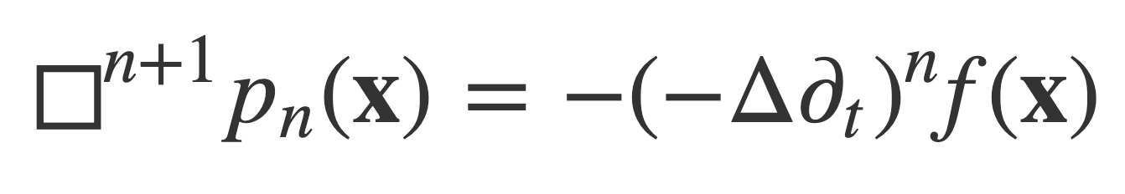
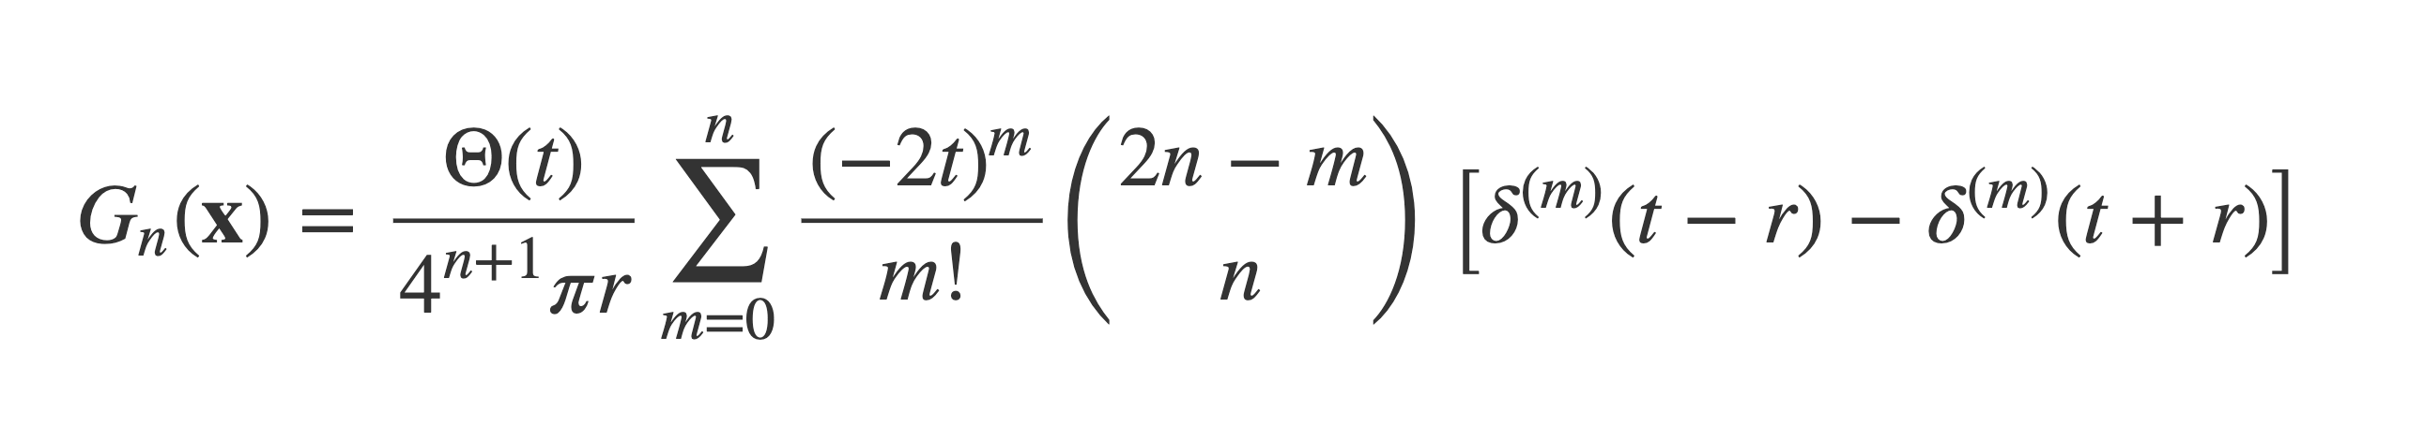
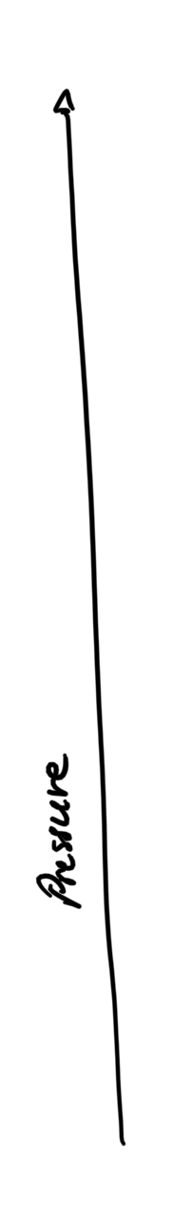
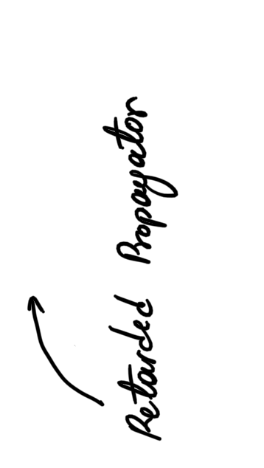
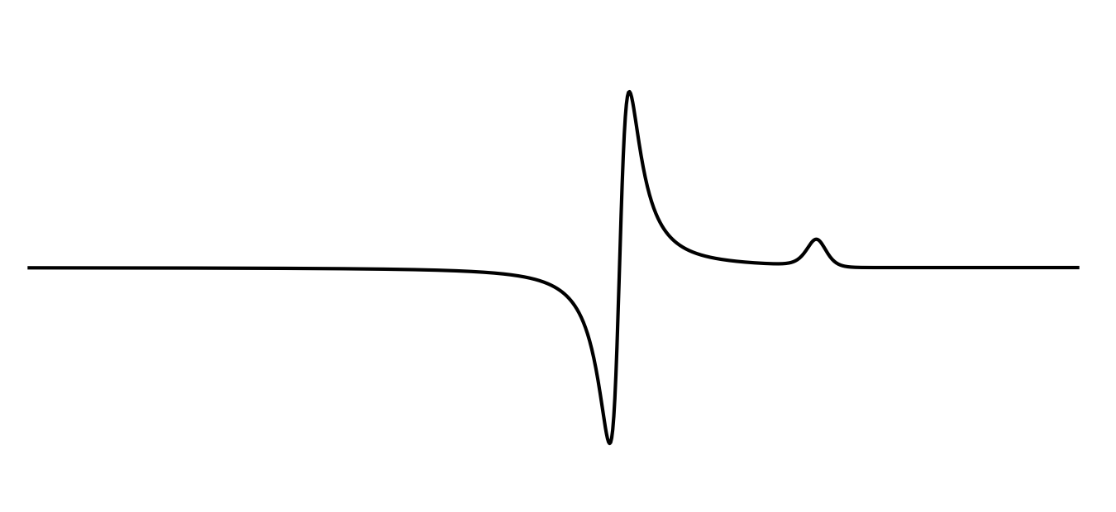
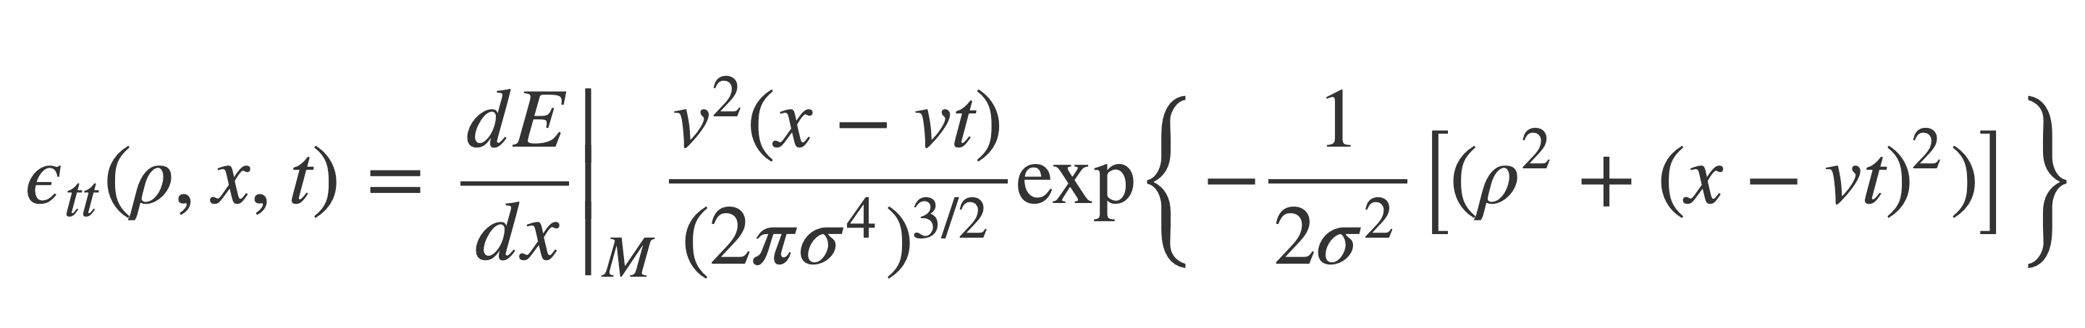
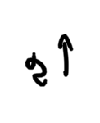
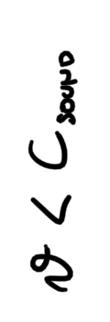
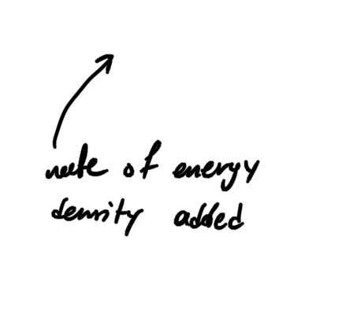
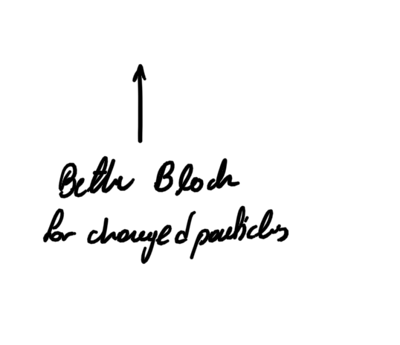

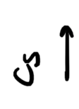
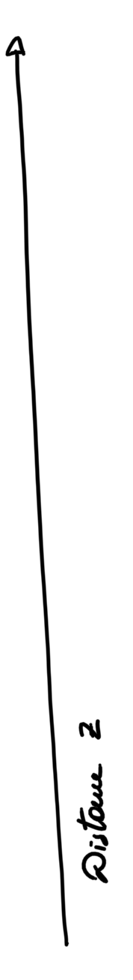
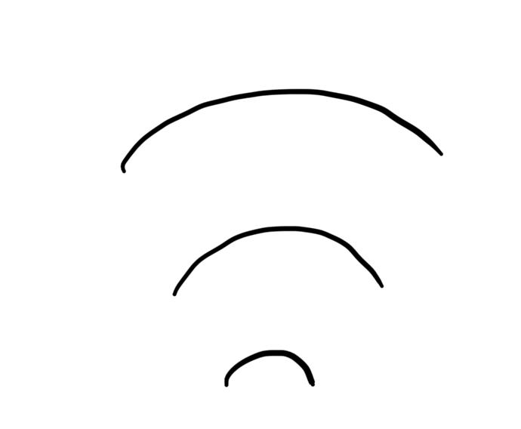
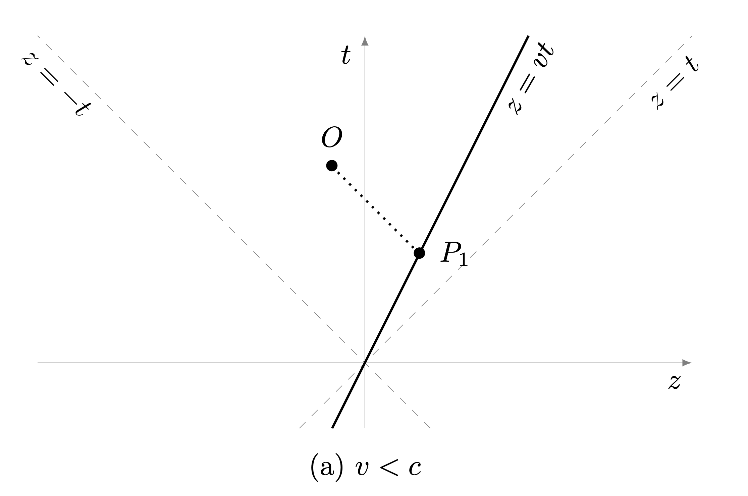
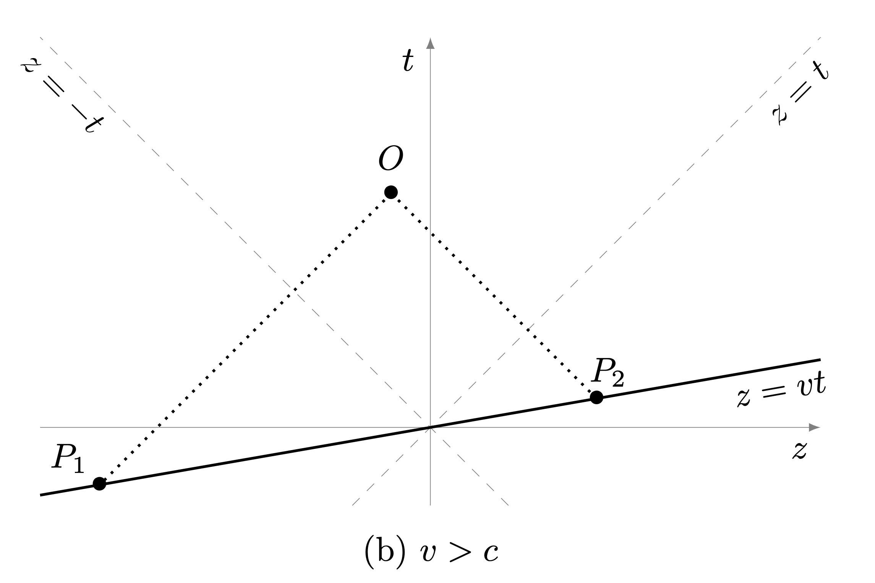
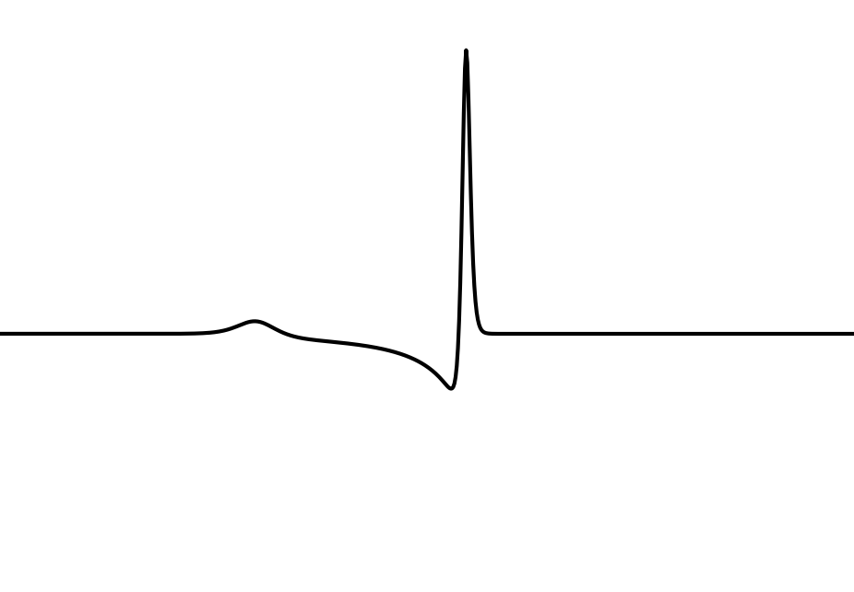
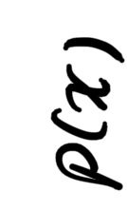
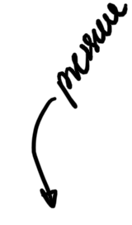
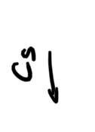
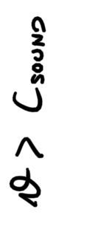
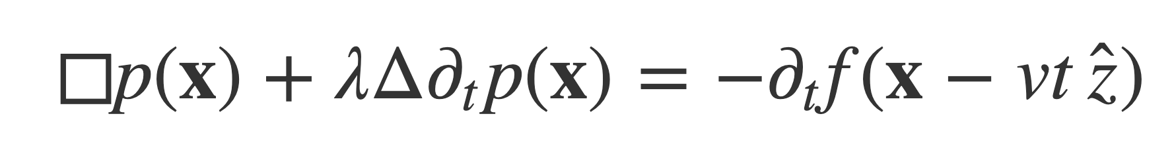

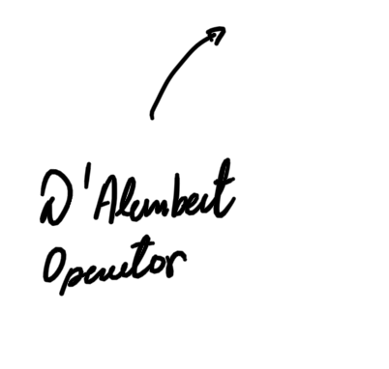
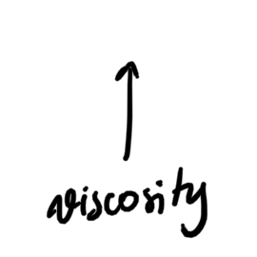
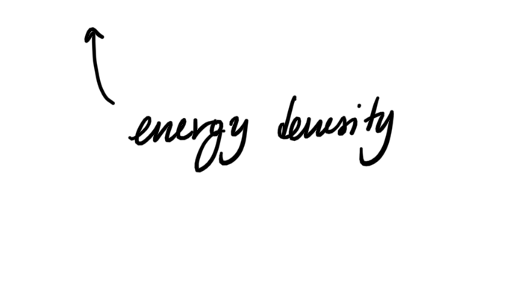
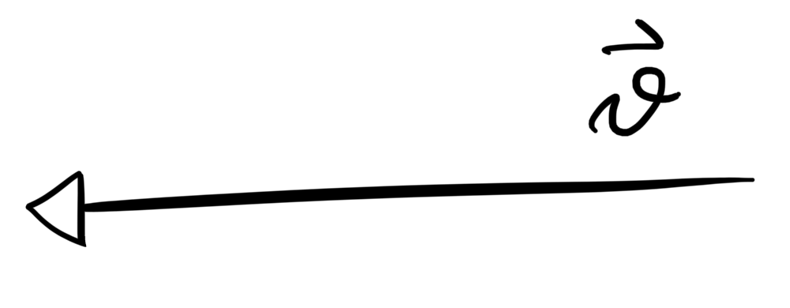
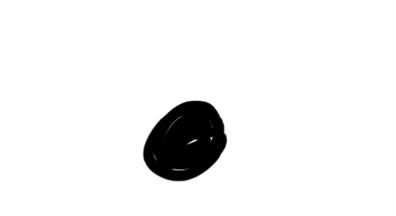
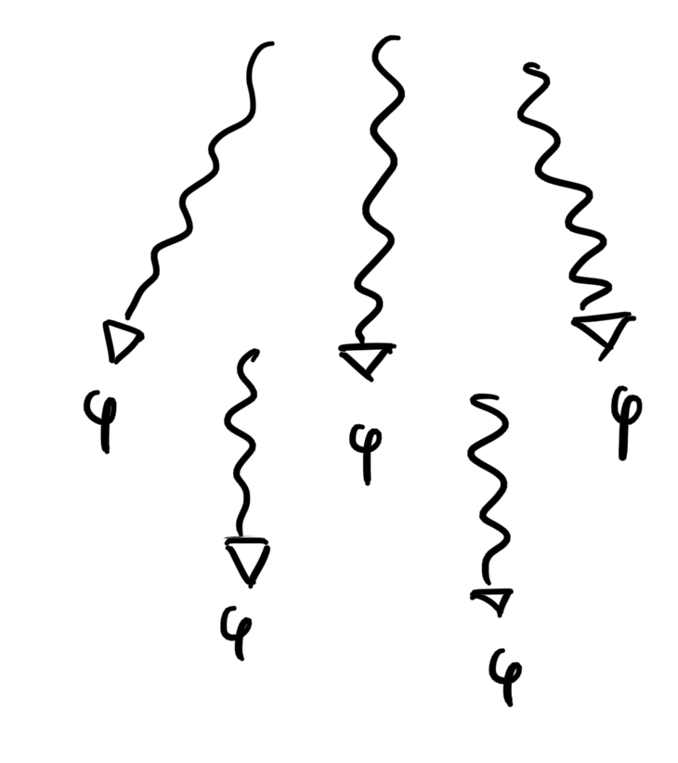
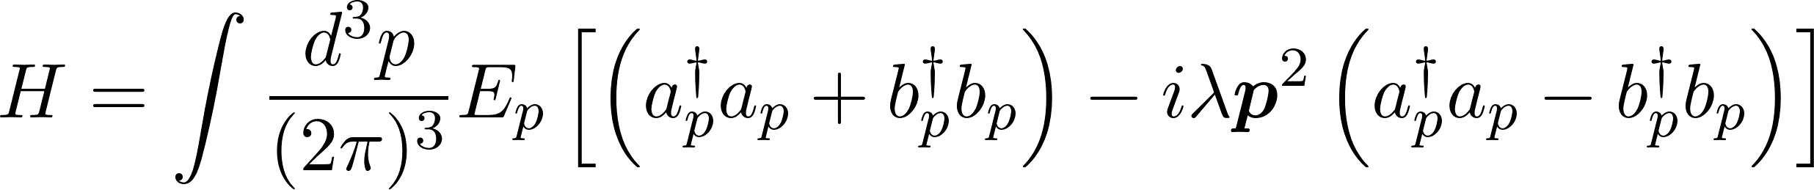
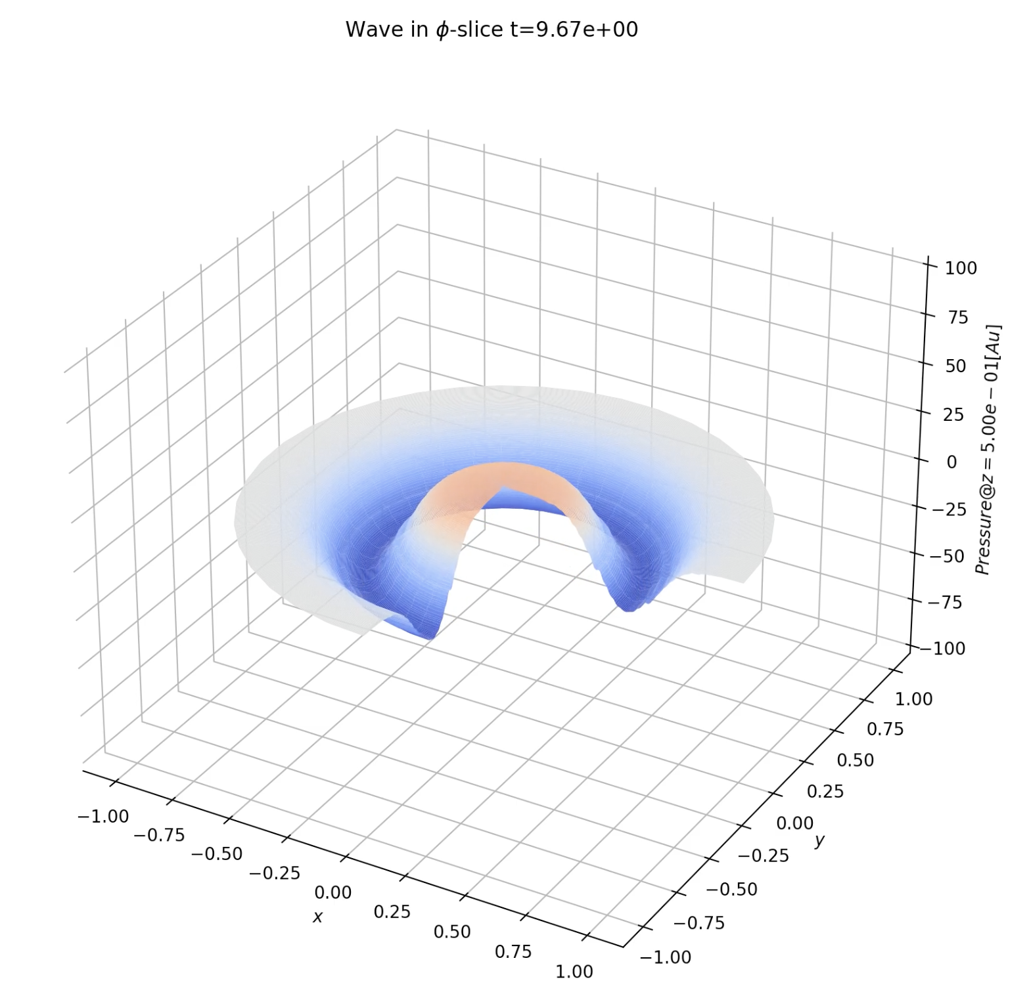
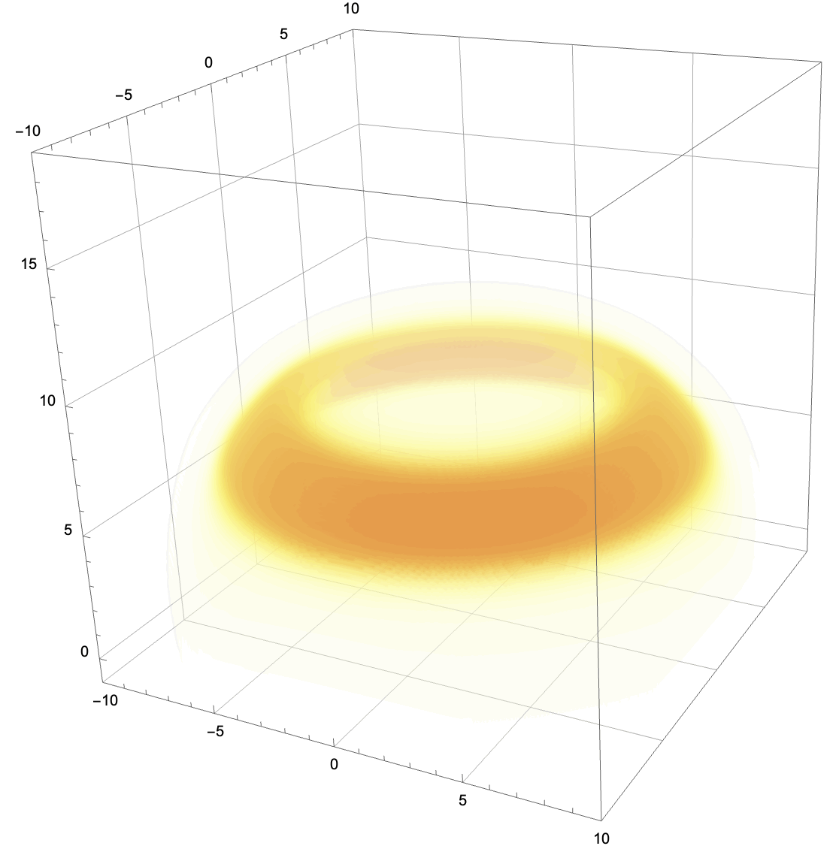

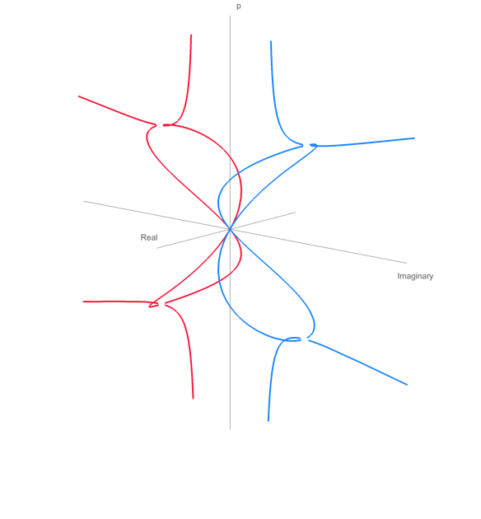
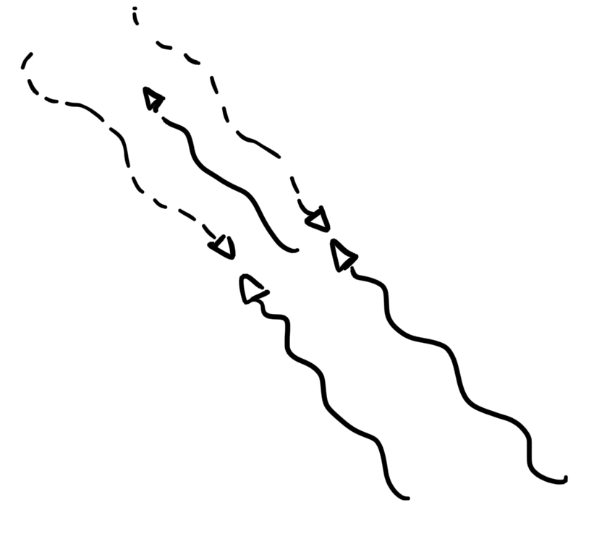


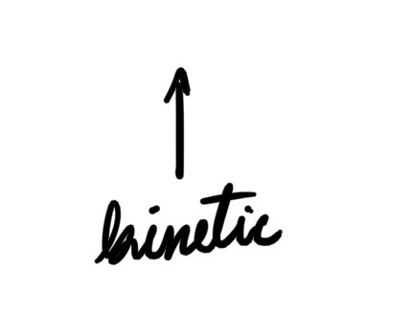

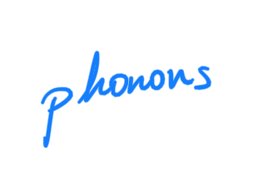
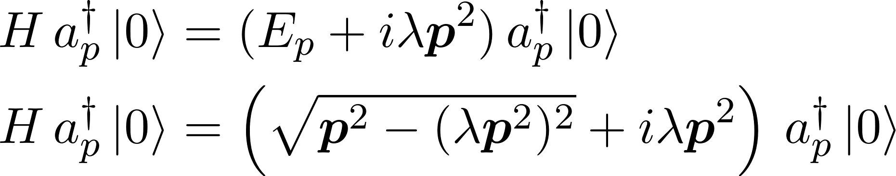
CHARACTERIZATION OF PHONONS IN VISCOUS LIQUIDS
WHAT DOES DARK MATTER SOUND LIKE?
Panos Oikonomou, Laura Manenti, Francesco Arneodo, Isaac Sarnoff
ABSTRACT In an attempt to provide an additional detection channel for direct dark matter experiments involving noble liquid scintillators, we present a theoretical framework for describing the production of sound by single particles through noble liquids. We develop a linear, classical description of the acoustic wave that accounts for viscous strong damping. We proceed with quantizing this description by introducing an effective field theory where we treat strong damping nonperurbatively through the introduction of an interaction between particles and antiparticles of sound. We use Minimum Ionizing Particles (MIPs) as a toy model to obtain quantitative results from our formalism.
INTERACTING
PARTICLE
To solve we derived a perturbation scheme on the constant viscosity $λ$, found the retarded propagator and used it to calculate solutions to arbitrary order in $λ$.
The pressure for the two different cases is shown below. The subsonic particles produce an acoustic pulse at roughly the same position as them, while supersonic particles do the
Interacting particle PASSES THROUGH A LIQUID with viscosity. Assuming that the particle does not interact nonlinearly (e.g. turbulance, direct collision with atoms, etc.) it DEPOSITS HEAT
The shape of the signal is dependent on the speed of the particles. Below are the plots for subsonic and supersonic particles. For fast particles, an observer at O hears the wave from two different points at the same time.
ACOUSTIC
WAVES
HEAT depositions PRODUCE ACOUSTIC WAVES. To model that we introduced corrections to the wave equation derived from linearized Navier Stokes.
Fig 1. Minkowski diagrams for slow and fast particles, O is an arbitrary observer and the world line of a moving particle is in bold. Dashed are worldlines of sound normalizing the speed of sound c = 1. (a) is a particle moving slower than sound, and (b) moves faster. The dotted lines are the sound waves reaching the observer. Note that for particles faster the observer hears the particle from two points at opposite phase.
Fig 2. Analytical solution for the pressure wave at constant distance perpendiccular to the particle over the z axis.
CLASSICAL TREATMENT
BALLISTIC
PHONONS
INTERACTION
PHONONS & ANTIPHONONS
NUMERICAL
SIMULATIONS
QUANTUM TREATMENT
We quantize the pressure wave to take into account factors such as thermal noise due to the ground energy state of the liquid in order to predict the decay of phonons due to viscosity at low temperatures.
Problem! The viscosity takes energy from the pressure, so a lagrangian that only describes the pressure field has no PT symmetry. We could restore that bby quantizing the lagrangian of Navier Stokes but this brings many variables that we need to keep track of that we will never use (e.g. velocity field, temperature, density, etc.). Instead we perfom a transformation on the action that keeps the minima the same, by promoting the pressure field to a complex field. In this way we have a U(1) symmetry that allows for the energy to be dissipated without modelling the fluid. The tradeoff is a harder physical interpretation of the calculations
We therefore introduce the following lagrangian
Quantizing a lagrangian with U(1) symmetry we obtain particle antiparticle pairs. There is a linear interaction between the two where one acts as a source of the other, exchanging energy. Therefore viscosity is modelled by exchanging phonons with antiphonons.
We can calculate the hamiltonian to be
To numerically make predictions of the actual signal that a single particle would create in a viscous fluid two simulations were built from scratch. One introduces an improvement on a 3D Finite Element Method scheme with cyllindrical symmetry to numerically evaluate the complete equation for a gaussian source term. The other was the symbolic calculation for the pertubative expansion solution for a delta function heat distribution using hardware accelaration (CPU clusters and GPU). We were able to successfully predict the location of a shockwave and it’s attenuation as a function of distance from the particle track.
Out of which we obtain the following dispersion relation between phonons and antiphonons. Notice that the hamiltonian is not hermitian, which is fine, because the imaginary part quantifies the damping.
As seen in Fig. 3 after some point the energy becomes imaginary which means that the phase stops oscillating and the amplitude decreases in time.
Fig 4. Outome from the two different simulations in units where (c = λ = 1). (Left) Pressure at a slice where z = 0.5, height and color represent pressure. (Right) 3D Density plot from symbolic calculation, color represents intensity. Both are simulations for a particle moving faster than the speed of sound at ($v=\frac{3}{2}c$) captured at t = 1.
Then we perform canonical quantization with minkowski metric with negative time signature.
AKNOWLEDGMENTS
PRODUCED
PHOTONS
This project was carried out under the supervision of Professor Francesco Arneodo and Dr. Laura Manenti at NYUAD. We would like to thank Professor John Learned (UHM), Dr. Mario Motta (CALTECH), and Professor Giorgio Gratta (Stanford) for insightful discussions on acoustics. Furthermore, we want to aknowledge the support of Professor Elena Beretta (NYUAD), Professor Johnathan Goodman (NYU), Professor Johnathan Weare (NYU), Professor Diogo Arsenio (NYUAD), Professor Fracesco Paparella (NYUAD) in understanding the mathematics behind the project. Finally, we would like to thank PhD Student Isaac Sarnoff (NYUAD) for his valuable contribution in classical calculations. This research was carried out on the High Performance Computing resources at New York University Abu Dhabi.
Photons can be produced using various mechanisms (Bremsstrahlung, Cherenkov etc.). This is well studied, so we don’t focus on that signal.
Fig 3. Hamiltonian Eigenvalues as a function of momentum for phonon and antiphonon states. There is a clear distinction when the eigenvalues for both types of particles become purely imaginary.

