Slide 1

CONTAINER WORKSHOP
JAYARAM RADHAKRISHNAN
BIOINFORMATICS INFRASTRUCTURE ENGINEER
CGSB

Slide 2
Table of Contents
What is a Container?
Docker
Why you need Containers?
Prerequisites
Comparison Overview - VMs vs Containers
Hands-on Session – Prechecks
Docker Image Creation - In a Nutshell
Docker commands
Docker image building process
Docker hub
Practical session

Slide 3
What is a Container?
A way to package applications with all the necessary dependencies and configurations such as libraries, frameworks and binaries within itself. This package is portable and it is easily shared and moved around.
Containers are not meant to host an operating system, they are meant to run some specific task or some processes. Examples include hosting an instance of an application, or simply to carry some kind of computation or analysis task. Once the task is complete, the container exit.
Containers are essentially a standalone mini Linux system.

Slide 4
Docker
Docker Inc is a Linux-based open-source containerization technology that is used to build, run, inspect and manage container images for developing and distributing applications.
Docker was born in 2013 as open-source software to run containers. Since then, the world of containers has evolved.
With Docker, you can treat containers like extremely lightweight, modular virtual machines (VMs) and you can create, deploy, copy and move them from environment to environment.
Podman, Buildah, RunC, Containerd are the organizations adopting containers to develop and manage stable applications.

Slide 5
Why you need Containers?
Rapid Application Development.
Ensures scalability and Flexibility.
Consistent.
Deploy Anytime, Anywhere.
OS independent apps.
Software runs in different environments.
Compatibility/Dependency of the software.

Slide 6
Prerequisites
Basic Linux command-line knowledge.
Operating System package management such as apt/yum/apk.
Application package management such as pip/R/ruby etc.
Application Service management.
Network port numbers.

Slide 7
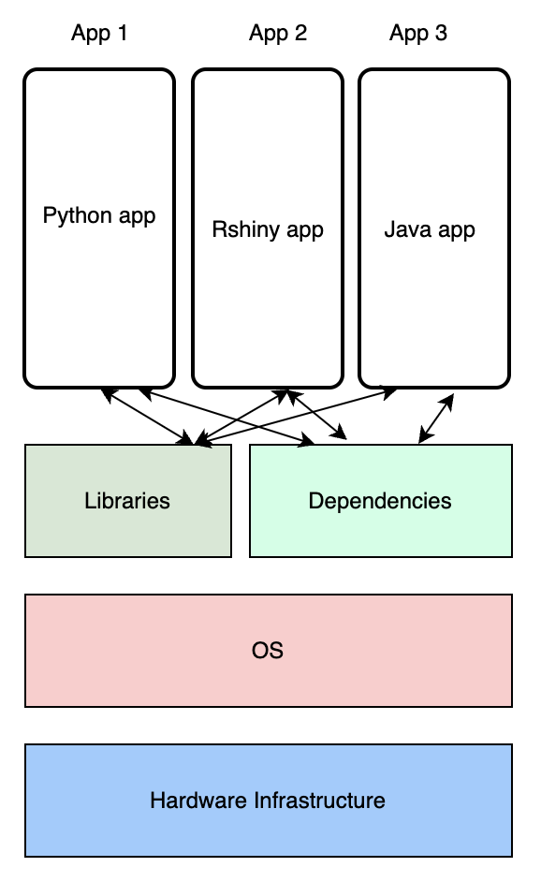
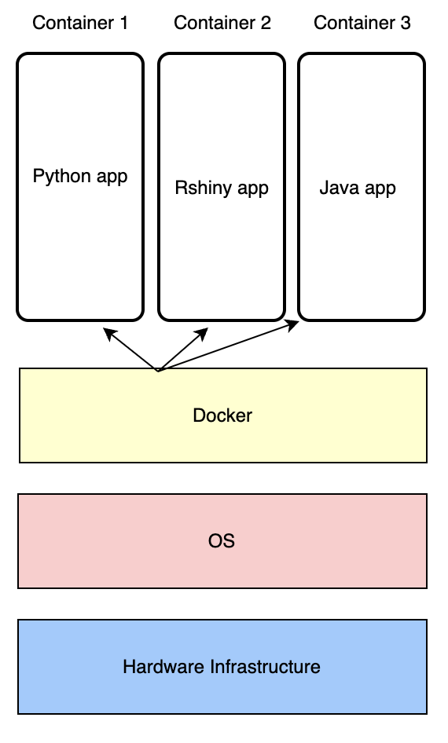
Comparison Overview - VMs vs Containers
Virtual Machines
Containers

Slide 8
DOCKER Image Creation - In a Nutshell
How docker images are built?
Choose an Operating System - eg:- Ubuntu, Centos, alpine
Install dependencies using apt/yum
Install Python dependencies using pip
Copy source code to /opt folder
Run the web server using “flask” command

Slide 9
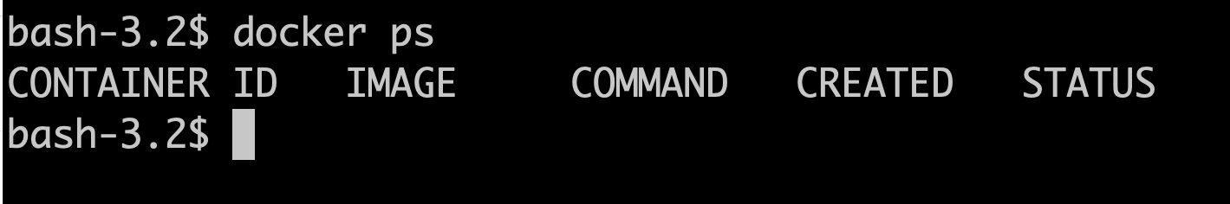
Hands-on session - Prechecks
Install Docker Desktop for Mac
Launch Docker for Desktop application
Launch Terminal app
Execute “docker ps” command

Slide 10
Docker commands
Commands | Explanation
docker pull <image-name> | To download an image
docker run <image-name> <command to excecute> | To spin a new container
docker ps | To list the active containers
docker ps -a | To list the active and inactive containers
docker stop <container-ID> | To stop a container
docker start <container-ID> | To start a container
docker exec <container-ID> <command to execute> | To execute some commands on a container
docker rm <container-ID> | To remove a container
docker images | To list the images
docker rmi <image-ID> | To remove image

Slide 11
Docker image building process
Below is an example of a Dockerfile using Ubuntu 20.04 as the starting image(FROM), execute a command while creating the image(RUN), copy the contents of the directory where the Dockerfile is into the app folder (COPY), and defines the command to be executed at the start of the container(CMD).
~~~
FROM ubuntu:20.04 Start from a base OS or another image
RUN pip install flask Install all dependencies
COPY . /app Copy source code
CMD python /app/app.py Specify Entrypoint
~~~
Execute the docker build using below command
docker build -t <tag-name> .

Slide 12
Docker Hub
Docker Hub is a cloud-based repository service where people push their Docker Container images and also pull the Docker Container images from the Docker Hub anytime or anywhere via the internet.
Your images can be pushed publicly or kept private.
URL -> https://hub.docker.com/
1. Create a repository
2. Specify the visibility as Public or Private
On the Command Line (Terminal),
docker login -u <user-id> (enter password when prompted)
docker tag <local-reponame>:<tag-version> username/<hub-reponame>:<local-reponame>
docker push username/<hub-reponame>:<local-reponame>
For eg:- Here, jr5241_testv1 – local-reponame , user
docker tag jr5241_testv1:latest user-name/hubrepo:jr5241_testv1
docker push user-name/hubrepo:jr5241_testv1

Slide 13
Practical session Python Flask addition program
We will build a docker image of a python flask based addition program.
This is a simple program that works as a basic addition calculator.
Clone the repository on your workspace (full instruction are provided in the GitHub repo below),
$ git clone https://github.com/jayramr/simple-addition.git

Slide 14
Practical session Rshiny Histogram
We will build a docker image of Rshiny application to plot a histogram graph.
Clone the repository on your workspace (full instructions are provided in the GitHub repo below)
$ git clone https://github.com/jayramr/simple-rshiny.git

Slide 15
Upcoming Coding Workshops
Python for Beginners.
Python for Intermediates.
Advanced Linux Shell Scripting.
Git, Conda Package management.
Building Rshiny Applications.

Slide 16
Thank you!
Nizar Drou – Core Bioinformatics Lead Developer
Muhammad Arshad – Bioinformatics Data Scientist
Kris Gunsalus – Director of Bioinformatics CGSB
NYUAD HPC Team
You can reach us at nyuad.cgsb.cb@nyu.edu, ERB (C1) 132.

Slide 17





FOLLOW US ON
@NYUADCGSB

