Slide 1
Lab 4: CNNs & HPC workshop
Feb 16, 2023 Tayyibah Khanam
Contact: tayyibah@nyu.edu

Slide 2
HPC
Convolutions
Stride
Padding
Pooling
Summary of Conv Layer
CNN Layers
CNN Architecture
Useful Links
Notebook go-through - Train a CNN on cifar 10 in pytorch
Agenda

Slide 3
200 GPU hours for everyone
We will be using the Greene HPC Cluster.
Getting started!
Start early, and ask questions if you have!
HPC

Slide 4
Convolutions
A convolution is the simple application of a filter to an input that results in an activation.
Repeated application of the same filter to an input results in a map of activations called a feature map, indicating the locations and strength of a detected feature in an input, such as an image.
In this visual shown, a 3*3 filter convolves over a 5*5 image & outputs a feature map of 3*3.

Slide 5
Stride
Stride is a parameter of the neural network's filter that modifies the amount of movement over the image or video
Naturally, as the stride, or movement, is increased, the resulting output will be smaller.
Stride is a component of convolutional neural networks, or neural networks tuned for the compression of images and video data.

Slide 6
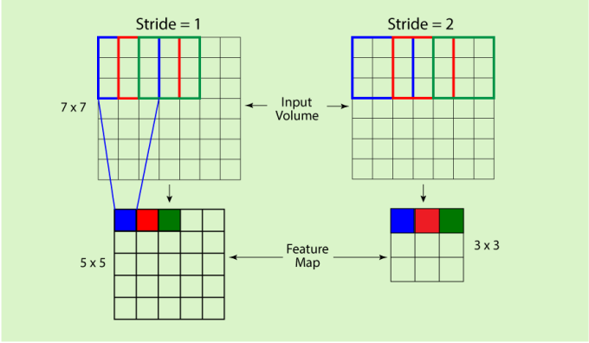
Stride

Slide 7
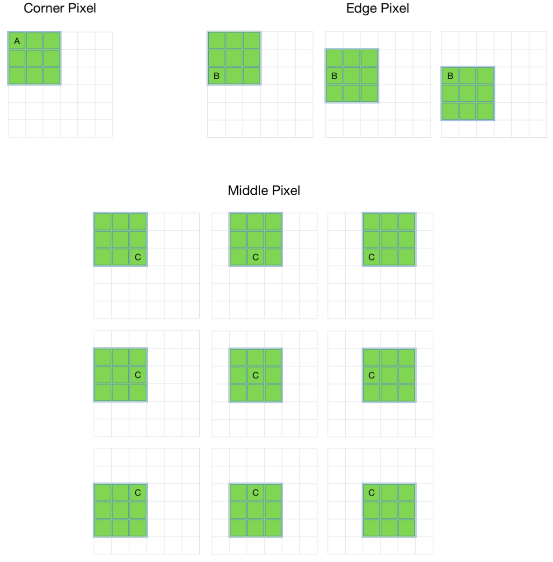
Padding
Issues with convolution -
The image shrinks every time a convolution operation is performed.
The pixels on the corners and the edges are used much less than those in the middle.

Slide 8
Padding extends the area of an image in which a convolutional neural network processes.
The kernel/filter which moves across the image scans each pixel and converts the image into a smaller image.
Types of padding:
Same padding
Valid padding
Causal padding
Padding

Slide 9
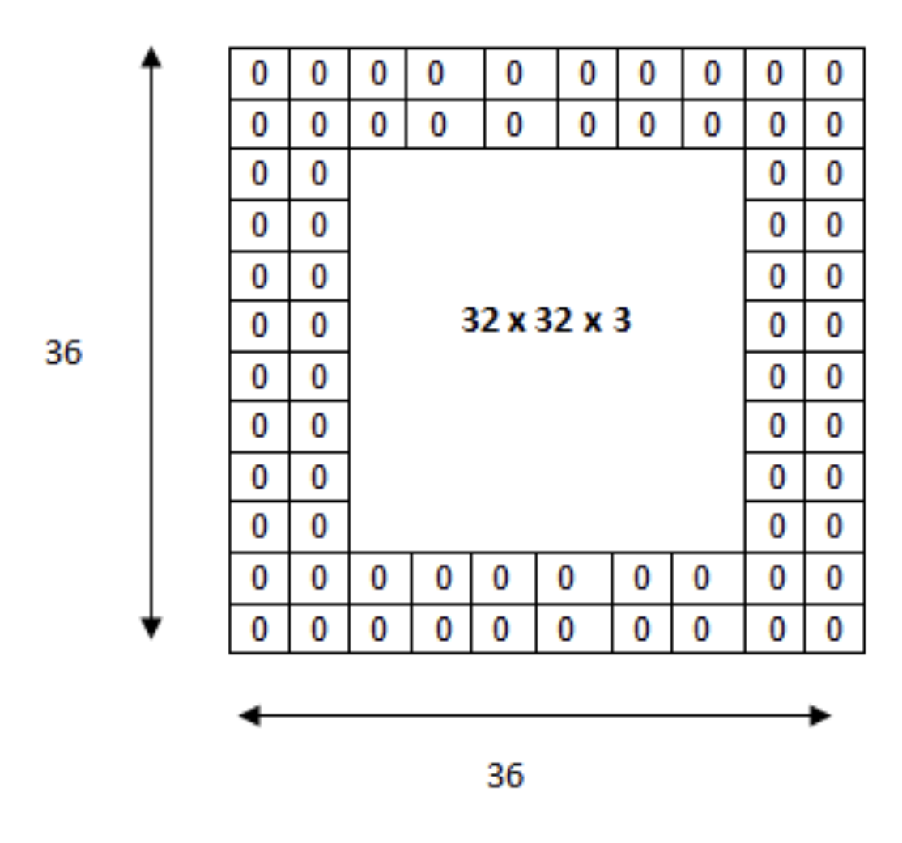
Input volume is 32*32*3
After padding, the volume is 36*36*3
Then we apply a 5*5*3 filter with a stride of 1 and get the final output of convolution as 32*32*3
Pooling layer

Slide 10
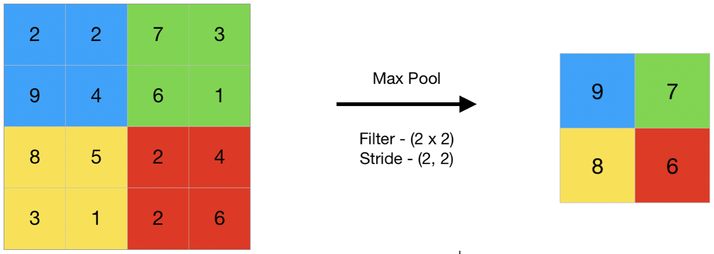
The pooling operation involves sliding a two-dimensional filter over each channel of feature map and summarising the features lying within the region covered by the filter.
Three types of spatial pooling -
Average pooling
Max pooling
Sum pooling
Pooling layer

Slide 11
Accepts a volume of size W1×H1×D1
Requires four hyperparameters:
Number of filters K,
their spatial extent F,
the stride S,
the amount of zero padding P
Produces a volume of size W2×H2×D2 where:
W2=(W1−F+2P)/S+1
H2=(H1−F+2P)/S+1 (i.e. width and height are computed equally by symmetry)
D2=K
With parameter sharing, it introduces F⋅F⋅D1 weights per filter, for a total of (F⋅F⋅D1)⋅K weights and K biases.
In the output volume, the d-th depth slice (of size W2×H2) is the result of performing a valid convolution of the d-th filter over the input volume with a stride of S, and then offset by d-th bias.
To Summarize, the conv layer -

Slide 12
Convolutional layers - they ensure the spatial relationship between the pixels is intact
Pooling layers - primary aim of this layer is to decrease the size of the convolved feature map to reduce the computational costs
Fully-connected (FC) layers - mathematical functions operations usually take place for the final prediction
CNN Layers
4. Dropout Layer - A dropout layer is utilised wherein a few neurons are dropped from the neural network during training process resulting in reduced size of the model.
5. Activation function - used to learn and approximate any kind of continuous and complex relationship between variables of the network.

Slide 13
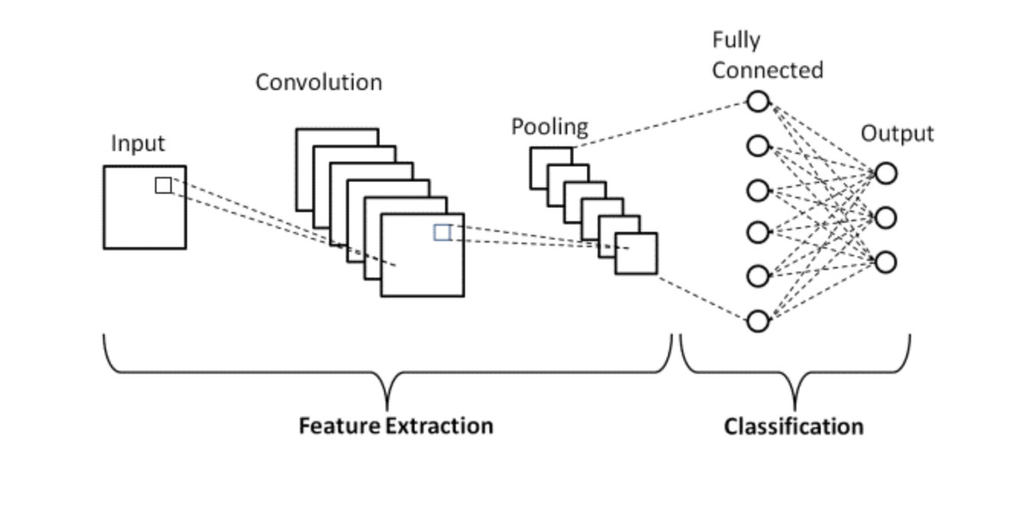
CNN architecture

Slide 14
https://cs231n.github.io/convolutional-networks/
Useful Links

