Slide 1
DL4Med (BMSC-GA 4493, BMIN-GA 3007)
- Lab 7 - Optimization
Nikolas Kalavros

Slide 2


Slide 3
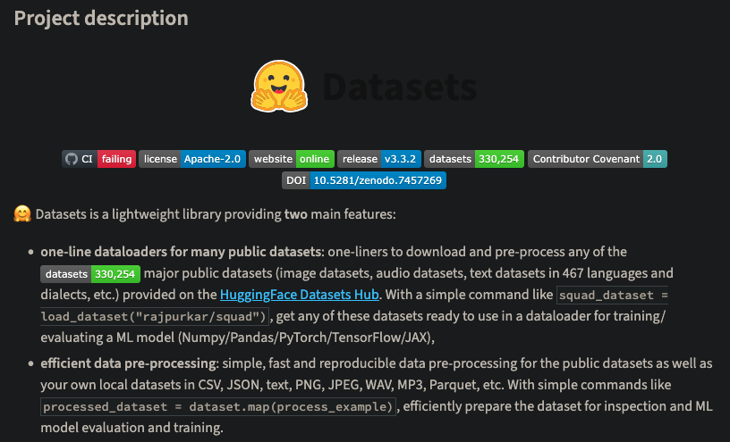

Slide 4


Slide 5
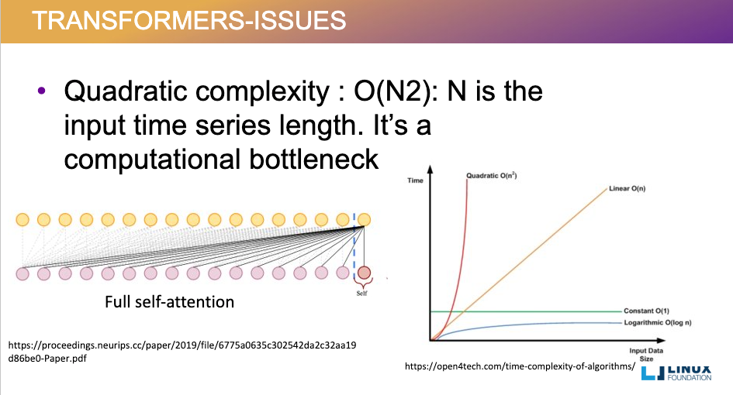
Medium

Slide 6
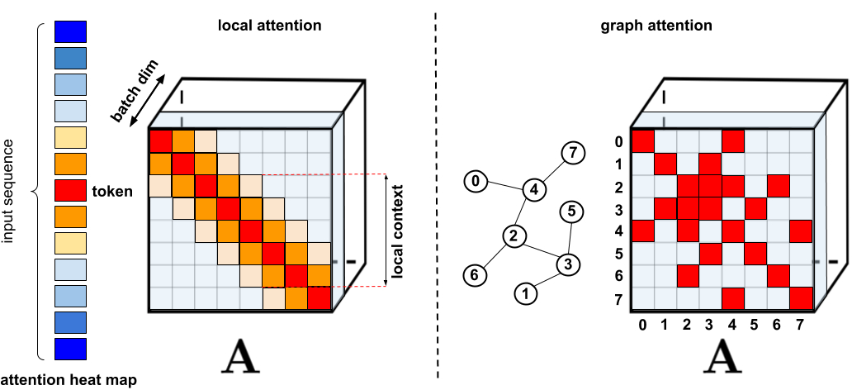
Google’s Performer Blog

Slide 7
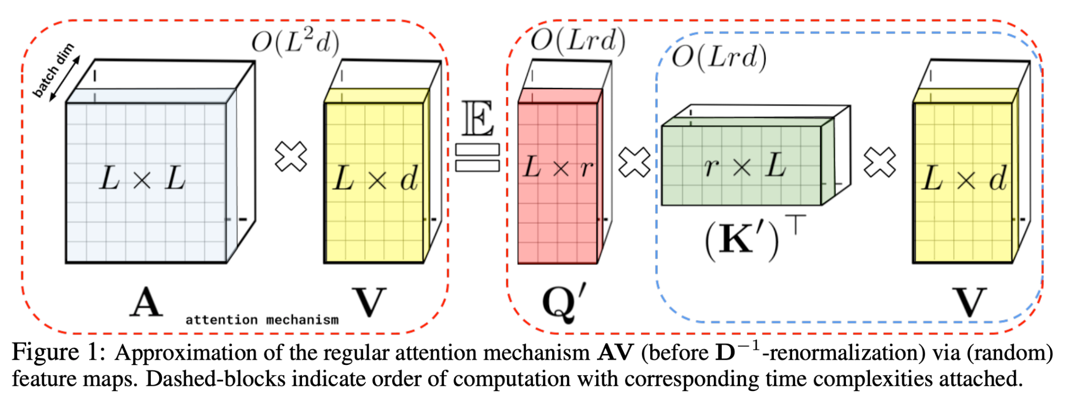

Slide 8
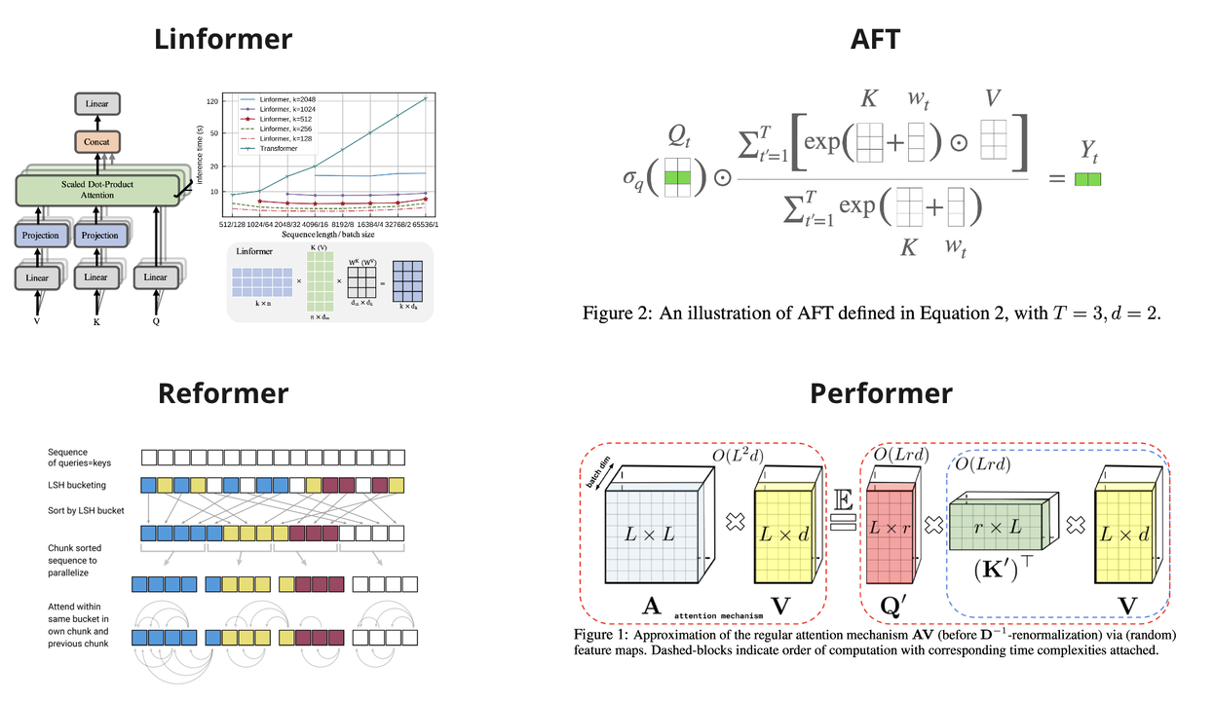

Slide 9
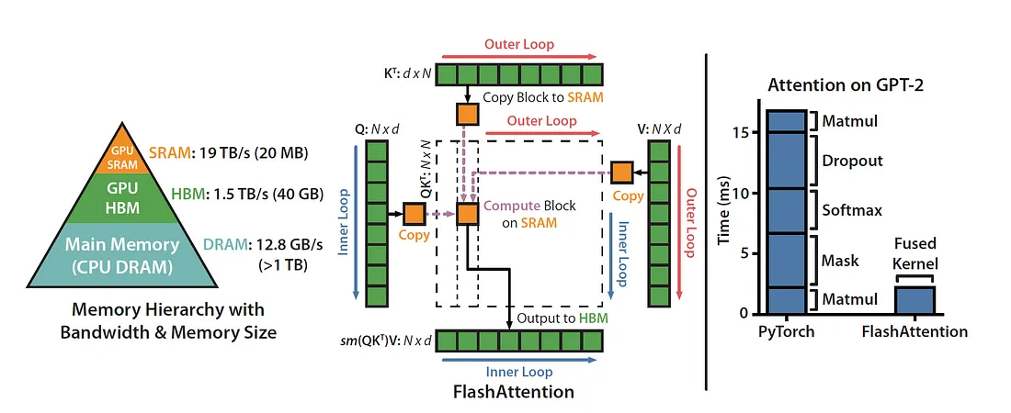

Slide 10
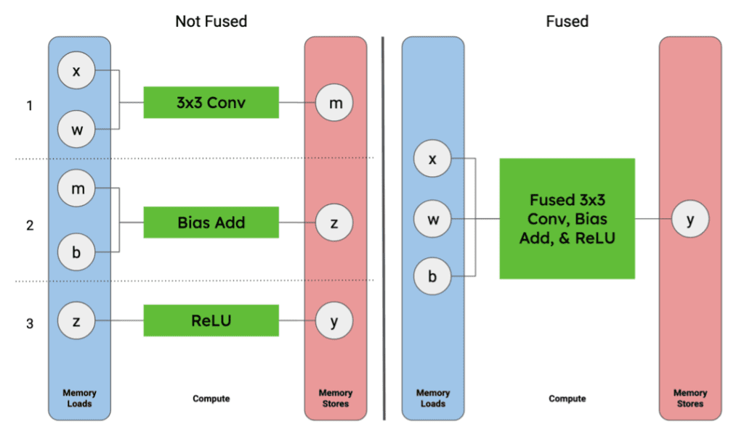
Quadric

Slide 11
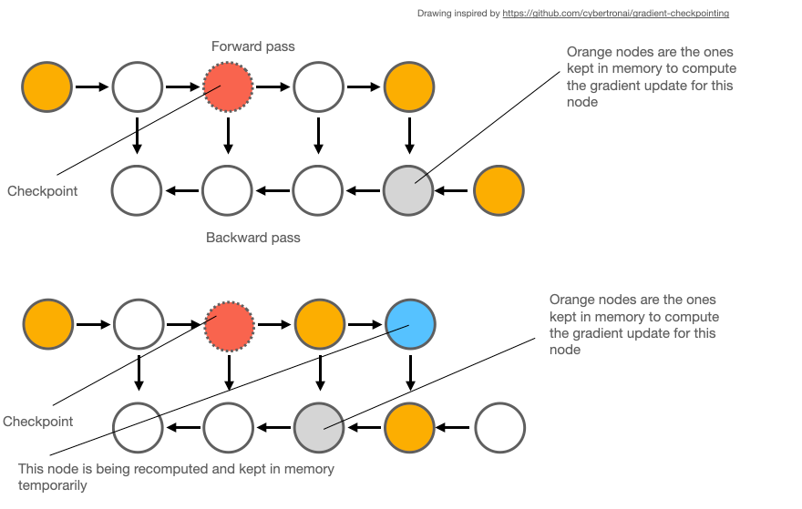

Slide 12
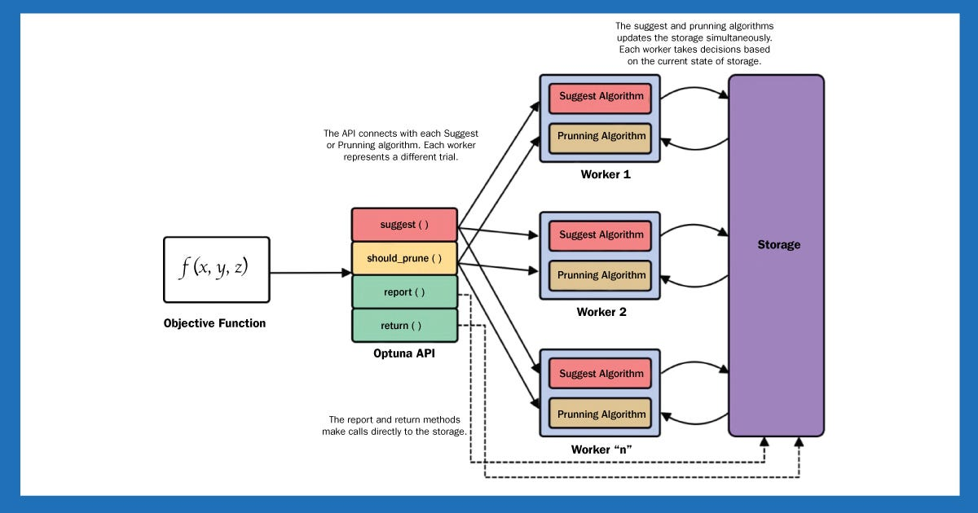
Medium

Slide 13
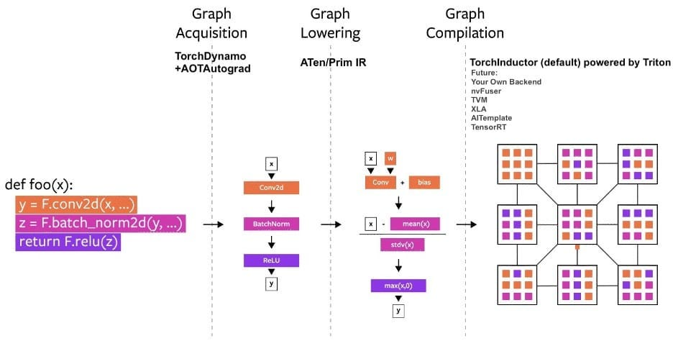
Medium

Slide 14
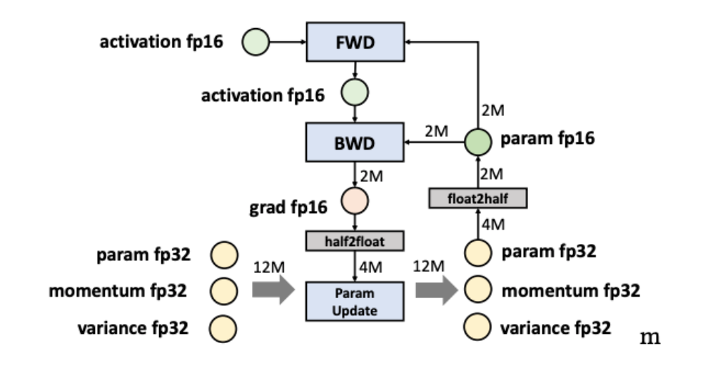
Colossal

Slide 15
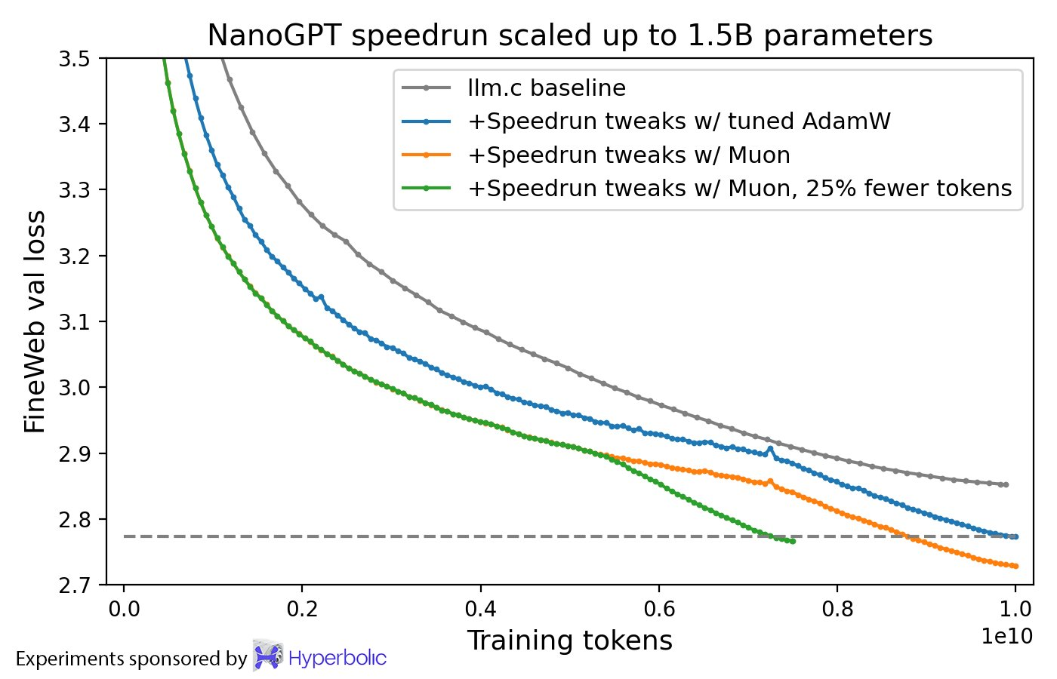
Jordan's blog
Jeremy’s blog

Slide 16
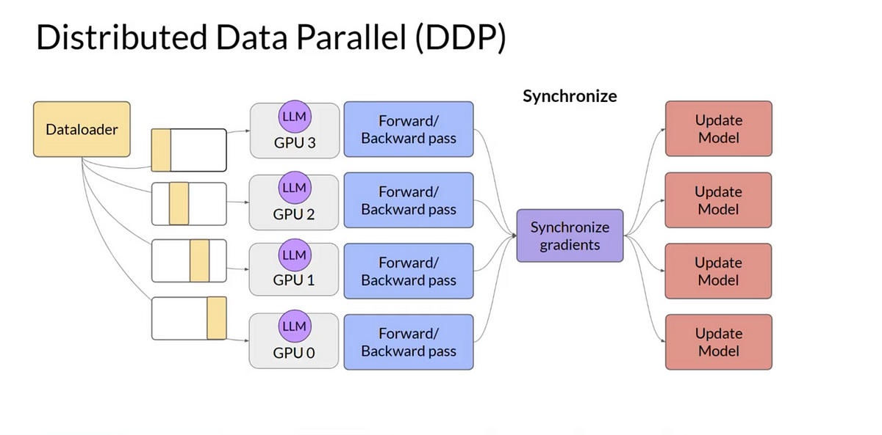

Slide 17
