Slide 1

C++ Classes and Objects II
C++ Inheritance
C++ Polymorphism
Engineering
Notes:
The main purpose of C++ programming is to add object orientation to the C programming language and classes are the central feature of C++ that supports object-oriented programming and are often called user-defined types.
A class is used to specify the form of an object and it combines data representation and methods for manipulating that data into one neat package. The data and functions within a class are called members of the class.

Slide 2
C++ Inheritance
C++ Polymorphism
Engineering
Notes:
One of the most important concepts in object-oriented programming is that of inheritance. Inheritance allows us to define a class in terms of another class, which makes it easier to create and maintain an application. This also provides an opportunity to reuse the code functionality and fast implementation time.
When creating a class, instead of writing completely new data members and member functions, the programmer can designate that the new class should inherit the members of an existing class. This existing class is called the base class, and the new class is referred to as the derived class.
The idea of inheritance implements the is a relationship. For example, mammal IS-A animal, dog IS-A mammal hence dog IS-A animal as well and so on.

Slide 3
C++ Inheritance
Classes in C++ can be extended, creating new classes
which retain characteristics of the base class. This
process, known as inheritance, involves a base class
and a derived class: The derived class inherits the
members of the base class, on top of which it can adds its own members.
Engineering
Notes:
One of the most important concepts in object-oriented programming is that of inheritance. Inheritance allows us to define a class in terms of another class, which makes it easier to create and maintain an application. This also provides an opportunity to reuse the code functionality and fast implementation time.
When creating a class, instead of writing completely new data members and member functions, the programmer can designate that the new class should inherit the members of an existing class. This existing class is called the base class, and the new class is referred to as the derived class.
The idea of inheritance implements the is a relationship. For example, mammal IS-A animal, dog IS-A mammal hence dog IS-A animal as well and so on.
C++ Inheritance:

Slide 4


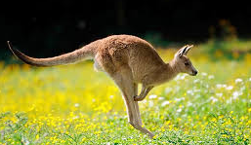
Class Animal
Animal
Class Cat
Class Dog
Class kangaroo
Engineering
Notes:
One of the most important concepts in object-oriented programming is that of inheritance. Inheritance allows us to define a class in terms of another class, which makes it easier to create and maintain an application. This also provides an opportunity to reuse the code functionality and fast implementation time.
When creating a class, instead of writing completely new data members and member functions, the programmer can designate that the new class should inherit the members of an existing class. This existing class is called the base class, and the new class is referred to as the derived class.
The idea of inheritance implements the is a relationship. For example, mammal IS-A animal, dog IS-A mammal hence dog IS-A animal as well and so on.

Slide 5
C++ Inheritance
class derived_class_name: public base_class_name
{
/*...*/
};
class Cat: public Animal
{
/*…*/
}
Engineering
Notes:
One of the most important concepts in object-oriented programming is that of inheritance. Inheritance allows us to define a class in terms of another class, which makes it easier to create and maintain an application. This also provides an opportunity to reuse the code functionality and fast implementation time.
When creating a class, instead of writing completely new data members and member functions, the programmer can designate that the new class should inherit the members of an existing class. This existing class is called the base class, and the new class is referred to as the derived class.
The idea of inheritance implements the is a relationship. For example, mammal IS-A animal, dog IS-A mammal hence dog IS-A animal as well and so on.

Slide 6
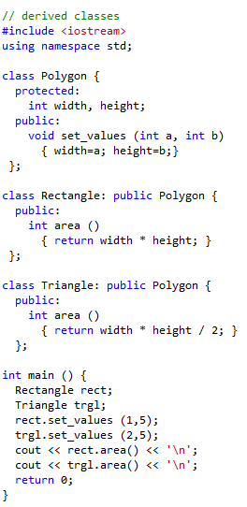
Example
Engineering
Acknowledge: http://www.cplusplus.com/doc/tutorial/polymorphism/
Notes:
One of the most important concepts in object-oriented programming is that of inheritance. Inheritance allows us to define a class in terms of another class, which makes it easier to create and maintain an application. This also provides an opportunity to reuse the code functionality and fast implementation time.
When creating a class, instead of writing completely new data members and member functions, the programmer can designate that the new class should inherit the members of an existing class. This existing class is called the base class, and the new class is referred to as the derived class.
The idea of inheritance implements the is a relationship. For example, mammal IS-A animal, dog IS-A mammal hence dog IS-A animal as well and so on.

Slide 7
What is inherited from the base class?
Its constructors and its destructor
Its assignment operator members (operator=)
Engineering
Notes:
One of the most important concepts in object-oriented programming is that of inheritance. Inheritance allows us to define a class in terms of another class, which makes it easier to create and maintain an application. This also provides an opportunity to reuse the code functionality and fast implementation time.
When creating a class, instead of writing completely new data members and member functions, the programmer can designate that the new class should inherit the members of an existing class. This existing class is called the base class, and the new class is referred to as the derived class.
The idea of inheritance implements the is a relationship. For example, mammal IS-A animal, dog IS-A mammal hence dog IS-A animal as well and so on.

Slide 8
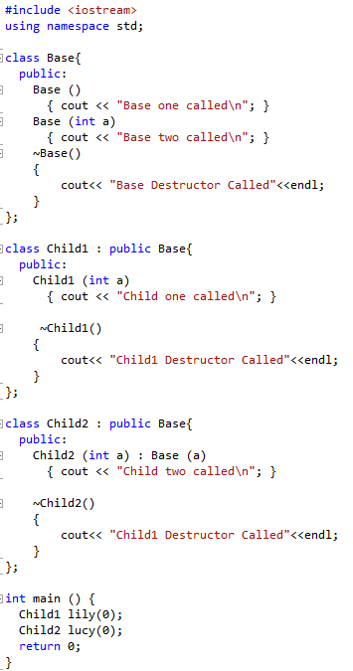
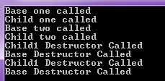
What is inherited from the base class?
Engineering
Notes:
One of the most important concepts in object-oriented programming is that of inheritance. Inheritance allows us to define a class in terms of another class, which makes it easier to create and maintain an application. This also provides an opportunity to reuse the code functionality and fast implementation time.
When creating a class, instead of writing completely new data members and member functions, the programmer can designate that the new class should inherit the members of an existing class. This existing class is called the base class, and the new class is referred to as the derived class.
The idea of inheritance implements the is a relationship. For example, mammal IS-A animal, dog IS-A mammal hence dog IS-A animal as well and so on.

Slide 9
Pointers to base class
A pointer to a derived class is type-compatible with a pointer to its base class.
Engineering
Notes:
One of the most important concepts in object-oriented programming is that of inheritance. Inheritance allows us to define a class in terms of another class, which makes it easier to create and maintain an application. This also provides an opportunity to reuse the code functionality and fast implementation time.
When creating a class, instead of writing completely new data members and member functions, the programmer can designate that the new class should inherit the members of an existing class. This existing class is called the base class, and the new class is referred to as the derived class.
The idea of inheritance implements the is a relationship. For example, mammal IS-A animal, dog IS-A mammal hence dog IS-A animal as well and so on.

Slide 10
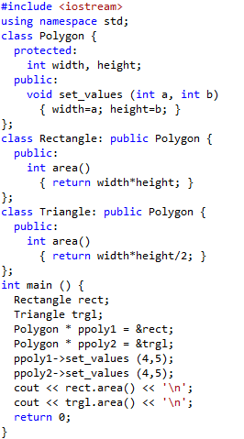
Pointer to Derived Class
What is the problem here?
Engineering
Acknowledge: http://www.cplusplus.com/doc/tutorial/polymorphism/
Notes:
One of the most important concepts in object-oriented programming is that of inheritance. Inheritance allows us to define a class in terms of another class, which makes it easier to create and maintain an application. This also provides an opportunity to reuse the code functionality and fast implementation time.
When creating a class, instead of writing completely new data members and member functions, the programmer can designate that the new class should inherit the members of an existing class. This existing class is called the base class, and the new class is referred to as the derived class.
The idea of inheritance implements the is a relationship. For example, mammal IS-A animal, dog IS-A mammal hence dog IS-A animal as well and so on.

Slide 11
C++ Polymorphism
C++ Inheritance
C++ Polymorphism
Engineering
Notes:
The word polymorphism means having many forms. Typically, polymorphism occurs when there is a hierarchy of classes and they are related by inheritance.
C++ polymorphism means that a call to a member function will cause a different function to be executed depending on the type of object that invokes the function.
C++ polymorphism means that a call to a member function will cause a different function to be executed depending on the type of object that invokes the function.
How the parent base class access the derived base.

Slide 12
C++ Polymorphism
Polymorphism means that some code or operations
or objects behave differently in different contexts.
Normally, when the term polymorphism in C++, refers
to using virtual methods
Engineering

Slide 13
Virtual member
A virtual member is a member function that can be redefined in a derived class, while preserving its calling properties through references.
Engineering

Slide 14
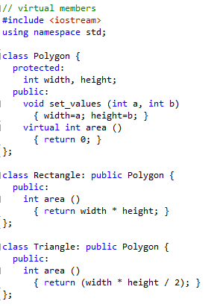
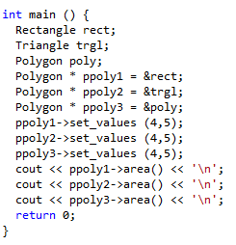
Virtual member
Engineering
Acknowledge: http://www.cplusplus.com/doc/tutorial/polymorphism/

