Slide 1

Pointers
Special case of bounded-size natural numbers
  Maximum memory limited by processor word-size
  2³² bytes = 4GB, 2⁶⁴ bytes = 16 exabytes
A pointer is just another kind of value
  A basic type in C++
int *ptr;
The variable “ptr” is a pointer to an “int”.

Slide 2
Pointer Operations in C++
Creation
  & variable Returns variable’s memory address
Dereference
  * pointer Returns contents stored at address
Indirect assignment
  * pointer = val Stores value at address
Of course, still have...
Assignment
  pointer = ptr Stores pointer in another variable

Slide 3
Using Pointers
int i1;
int i2;
int *ptr1;
int *ptr2;
i1 = 1;
i2 = 2;
ptr1 = &i1;
ptr2 = ptr1;
*ptr1 = 3;
i2 = *ptr2;
0x1014
…
0x1000
0x1010
ptr2:
0x100C
…
0x1000
0x1008
ptr1:
i2:
2
0x1004
3
i1:
3
0x1000
1

Slide 4
Using Pointers (cont.)
int int1 = 1036; /* some data to point to */
int int2 = 8;
int *int_ptr1 = &int1; /* get addresses of data */
int *int_ptr2 = &int2;
*int_ptr1 = int_ptr2;
*int_ptr1 = int2;
What happens?
Type check warning: int_ptr2 is not an int
int1 becomes 8

Slide 5
Using Pointers (cont.)
int int1 = 1036; /* some data to point to */
int int2 = 8;
int *int_ptr1 = &int1; /* get addresses of data */
int *int_ptr2 = &int2;
int_ptr1 = *int_ptr2;
int_ptr1 = int_ptr2;
What happens?
Type check warning: *int_ptr2 is not an int *
Changes int_ptr1 – doesn’t change int1

Slide 6
Example
int x = 1, y = 2, z[10];
int *ip; // ip is a pointer to an int, so it can point
// to x, y, or an element of z
ip = &x; // ip now points at the location where x is stored
y = *ip; // set y equal to the value pointed to by ip, or y = x
*ip = 0; // now change the value that ip points to to 0,
// so now x = 0 but notice that y is unchanged
ip = &z[0]; // now ip points at the first location in the array z
*ip = *ip + 1; // the value that ip points to (z[0]) is incremented
int x, *y, z, *q;
x = 3;
y = &x; // y points to x
printf("%d\n", x); // outputs 3
printf("%d\n", y); // outputs x’s address, will seem like a random number
printf("%d\n", *y); // outputs what y points to, or x (3)
printf("%d\n", *y+1); // outputs 4 (print out what y points to + 1)
printf("%d\n", *(y+1));//this outputs the item after x in memory – what is it?
z = *(&x); // z equals 3 (what &x points to, which is x)
q = &*y; // q points to x, just like y; note *& and &* cancel out

Slide 7
Pointer Arithmetic
  pointer + number pointer – number
  E.g., pointer + 1 adds something to a pointer
char *p;
char a;
char b;
p = &a;
p += 1;
int *p;
int a;
int b;
p = &a;
p += 1;
In each, p now points to b
(Assuming compiler doesn’t reorder variables in memory)
Adds 1*sizeof(char) to the memory address
Adds 1*sizeof(int) to the memory address
Pointer arithmetic should be used cautiously

Slide 8
The Simplest Pointer in C++
Special constant pointer NULL
  Points to no data
  Dereferencing illegal – causes segmentation fault

Slide 9
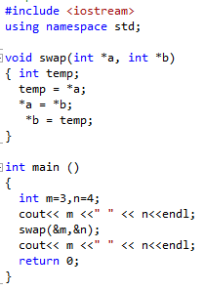
Pointer as Parameters

Slide 10
Pointer Vs Arrays
Pointers and arrays are strongly related. In fact,
pointers and arrays are interchangeable in many cases.

Slide 11
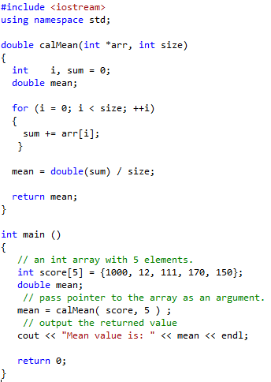
Pointer Vs Arrays

Slide 12
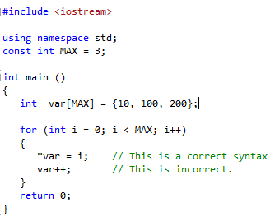
Pointer Vs Arrays
However, pointers and arrays are not completely
interchangeable.

