Slide 1

C++ Classes and Objects I
Class Definitions
C++ Class Members
C++ Objects
Pointers to C++ Classes
C++ Class Overloading
C++ Class Template
Engineering
Notes:
The main purpose of C++ programming is to add object orientation to the C programming language and classes are the central feature of C++ that supports object-oriented programming and are often called user-defined types.
A class is used to specify the form of an object and it combines data representation and methods for manipulating that data into one neat package. The data and functions within a class are called members of the class.
A class is used to specify the form of an object and it combines data representation and methods for manipulating that data into one neat package. The data and functions within a class are called members of the class.
We have the built-in type such as char, int and double. A type is called built-in if the compiler knows how to represent objects of the type and which operations can be done it without being told by declarations supplied by a programmer in a source code.
Types that are not built-in are called user-defined types (UDTs) .

Slide 2
Class Definitions
C++ Class Members
C++ Objects
Pointers to C++ Classes
C++ Class Overloading
C++ Class Template
Engineering

Slide 3
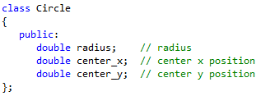
Definition
class class_name
{
access_specifier:
member;
};
Engineering

Slide 4
Class Definitions
C++ Class Members
C++ Objects
Pointers to C++ Classes
C++ Class Overloading
C++ Class Template
Engineering

Slide 5
Member
The parts used to define the class are called members
Data Member
Function Member
Engineering

Slide 6
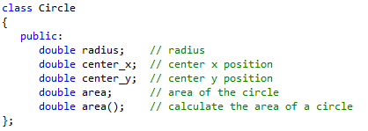
Member
Data Member
Function Member
Engineering

Slide 7
Define Member Function
Member function defined within class definition
Member function defined outside class definition
Engineering

Slide 8
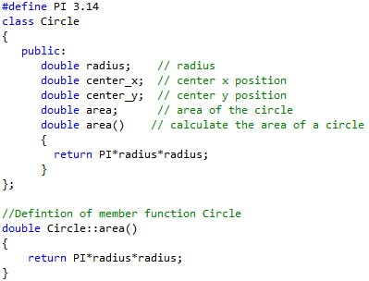
Define Member Function
Definition in class
class name :: function name
Definition outside class
Engineering

Slide 9
Special Member Function
Class Constructor:
A special member function of a class that is executed
whenever we create new objects of that class.
Class Destructor:
A special member function of a class that is called
whenever an object passes out of scope or is explicitly
deleted.
Engineering

Slide 10
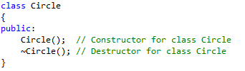
Special Member Function
A constructor is a member function with the same name as its class.
A destructor is a member function with the same name as its class
prefixed by a ~ (tilde).
The copy constructor is a constructor which creates an object by
initializing it with an object of the same class, which has been
created previously.
Will revisit this with detailed examples after introducing C++ Objects
Engineering

Slide 11
Access Specifier
Public:
public members are accessible from any function
Private:
private members are accessible only from member
functions of the same class ( or friends of the class).
Protected:
protected members are similar to private members
but they are accessible from member functions in the
derived classes.
Will revisit this with detailed examples after introducing C++ Objects
Engineering
Notes:
The keyword public determines the access attributes of the members of the class that follow it. A public member can be accessed from outside the class anywhere within the scope of the class object. You can also specify the members of a class as private or protected which we will discuss in a sub-section.
When you define a class, you define a blueprint for a data type. This doesn't actually define
any data, but it does define what the class name means, that is, what an object of the class
will consist of and what operations can be performed on such an object.
A class definition starts with the keyword class followed by the class name; and the class body,
enclosed by a pair of curly braces. A class definition must be followed either by a semicolon or a
list of declarations. For example, we defined the Box data type using the keyword class as follows:

Slide 12
Class Definitions
C++ Class Members
C++ Objects
Pointers to C++ Classes
C++ Class Overloading
C++ Class Template
Engineering
Notes:
The keyword public determines the access attributes of the members of the class that follow it. A public member can be accessed from outside the class anywhere within the scope of the class object. You can also specify the members of a class as private or protected which we will discuss in a sub-section.
When you define a class, you define a blueprint for a data type. This doesn't actually define
any data, but it does define what the class name means, that is, what an object of the class
will consist of and what operations can be performed on such an object.
A class definition starts with the keyword class followed by the class name; and the class body,
enclosed by a pair of curly braces. A class definition must be followed either by a semicolon or a
list of declarations. For example, we defined the Box data type using the keyword class as follows:

Slide 13
C++ Objects
A class provides blueprint
An object is an instance of a class
For example:
Circle C_1; // Declare C_1 of type Circle
Circle C_2; // Declare C_2 of type Circle
Engineering
Notes:
A class provides the blueprints for objects, so basically an object is created from a class. We declare objects of a class with exactly the same sort of declaration that we declare variables of basic types. Following statements declare two objects of class Box:
An object is an instance of a class.

Slide 14
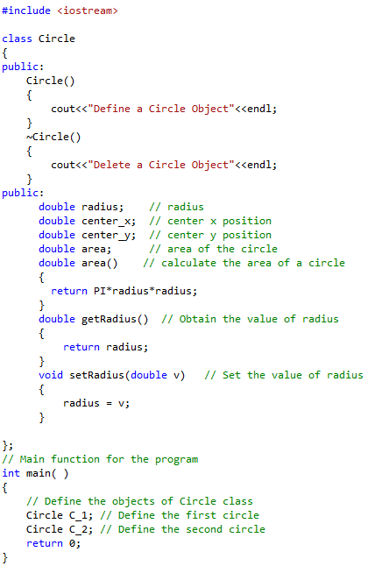

Slide 15
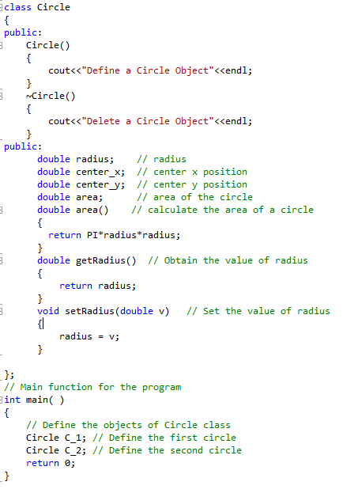
Revisit constructor and Destructor
call constructor function
call destructor function
Engineering

Slide 16
Copy constructor
classname (const classname &obj)
{
// body of copy constructor
}
Engineering

Slide 17
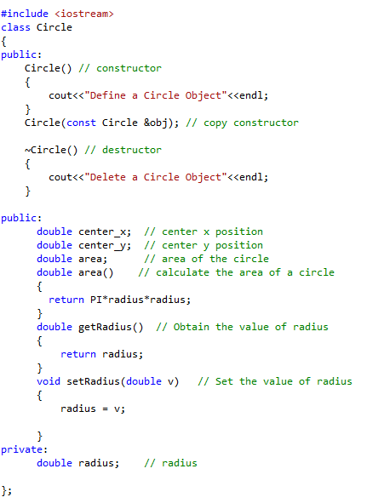
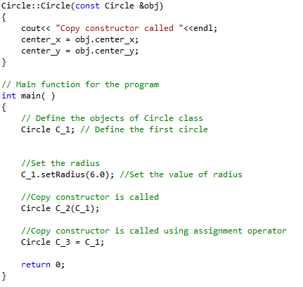
Copy constructor
Engineering

Slide 18
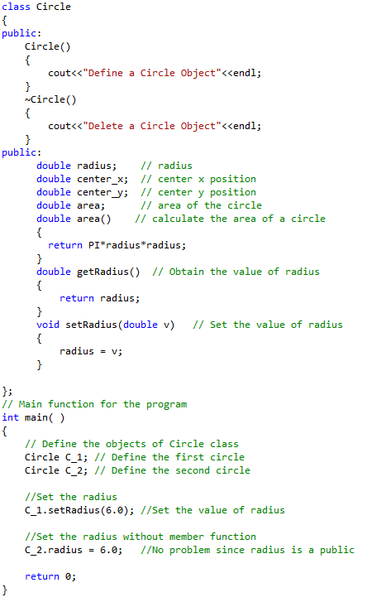
Revisit Access Specifier
Public members can
be accessible without
from a member function
Engineering

Slide 19
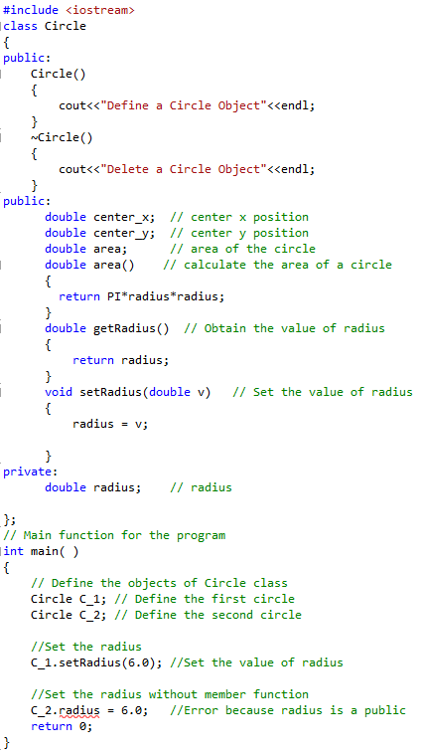
Private members can only be accessible
from a member function
Private members cannot be accessible
from other functions
Engineering

Slide 20
Class Definitions
C++ Class Members
C++ Objects
Pointers to C++ Classes
C++ Class Overloading
C++ Class Template
Engineering
Notes:
The keyword public determines the access attributes of the members of the class that follow it. A public member can be accessed from outside the class anywhere within the scope of the class object. You can also specify the members of a class as private or protected which we will discuss in a sub-section.
When you define a class, you define a blueprint for a data type. This doesn't actually define
any data, but it does define what the class name means, that is, what an object of the class
will consist of and what operations can be performed on such an object.
A class definition starts with the keyword class followed by the class name; and the class body,
enclosed by a pair of curly braces. A class definition must be followed either by a semicolon or a
list of declarations. For example, we defined the Box data type using the keyword class as follows:

Slide 21
Pointer to C++ Classes
A pointer to a C++ class is done exactly the same way as a
pointer to a structure and to access members of a pointer
to a class you use the member access operator -> operator,
just as you do with pointers to structures. Also as with all
pointers, you must initialize the pointer before using it.
Engineering

Slide 22
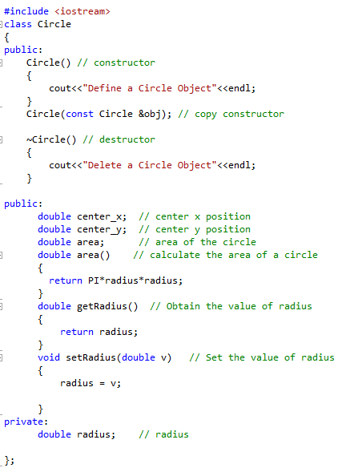
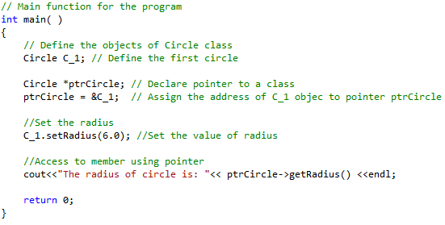
Engineering

Slide 23
“This” Pointer
This pointer: The own address of a C++ object (the memory address of every object).
This pointer is an implicit parameter to all member functions.
Engineering

Slide 24
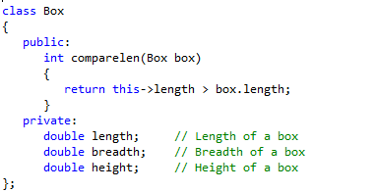
“This” Pointer
Engineering

Slide 25
Class Definitions
C++ Class Members
C++ Objects
Pointers to C++ Classes
C++ Class Overloading
C++ Class Template
Engineering
Notes:
The keyword public determines the access attributes of the members of the class that follow it. A public member can be accessed from outside the class anywhere within the scope of the class object. You can also specify the members of a class as private or protected which we will discuss in a sub-section.
When you define a class, you define a blueprint for a data type. This doesn't actually define
any data, but it does define what the class name means, that is, what an object of the class
will consist of and what operations can be performed on such an object.
A class definition starts with the keyword class followed by the class name; and the class body,
enclosed by a pair of curly braces. A class definition must be followed either by a semicolon or a
list of declarations. For example, we defined the Box data type using the keyword class as follows:

Slide 26
C++ Overloading
Function Overloading in C++
Operators Overloading in C++
Engineering

Slide 27
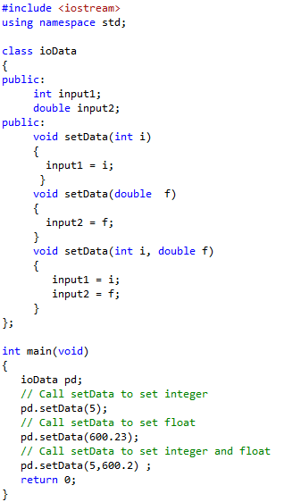
Function Overloading
Engineering

Slide 28
Operator Overloading
You can redefine or overload most of the built-in
operators available in C++. Thus a programmer can
use operators with user-defined types as well.
Overloaded operators are functions with special
names the keyword operator followed by the symbol
for the operator being defined.
Circle operator+(const Circle& other);
Engineering

Slide 29
Operator Overloading
For example, if we want to add two circle we defined
above together, how to overload the operator +?
Engineering
Notes:
Box operator+(const Box&);

Slide 30
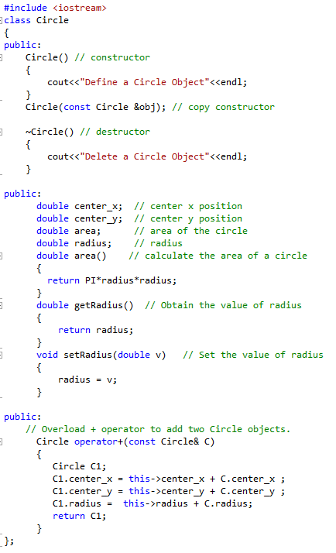
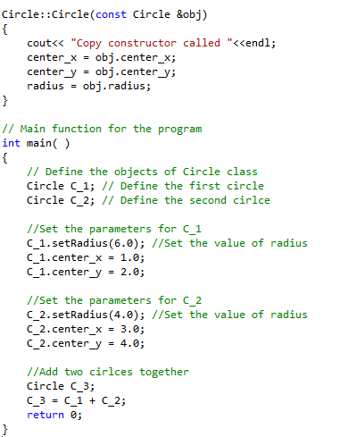
Engineering

Slide 31
How to overload the operator > for class circle?
Engineering

Slide 32
Class Definitions
C++ Class Members
C++ Objects
Pointers to C++ Classes
C++ Class Overloading
C++ Class Template
Engineering
Notes:
The keyword public determines the access attributes of the members of the class that follow it. A public member can be accessed from outside the class anywhere within the scope of the class object. You can also specify the members of a class as private or protected which we will discuss in a sub-section.
When you define a class, you define a blueprint for a data type. This doesn't actually define
any data, but it does define what the class name means, that is, what an object of the class
will consist of and what operations can be performed on such an object.
A class definition starts with the keyword class followed by the class name; and the class body,
enclosed by a pair of curly braces. A class definition must be followed either by a semicolon or a
list of declarations. For example, we defined the Box data type using the keyword class as follows:

Slide 33

C++ Class Template
we can also define class templates. The general form of a
generic class declaration is shown here:
Engineering

Slide 34
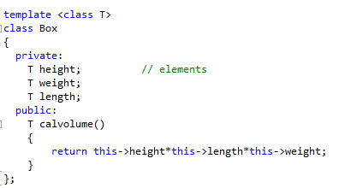
Example:
Engineering

Slide 35
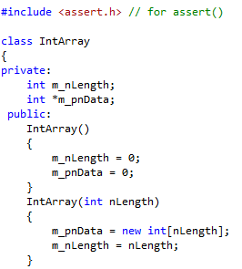
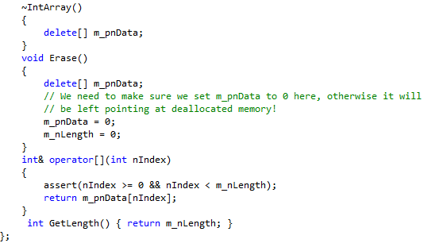
Example:
IntArray
Engineering

Slide 36
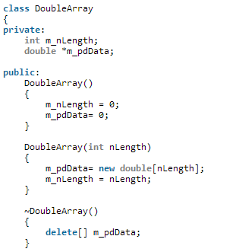
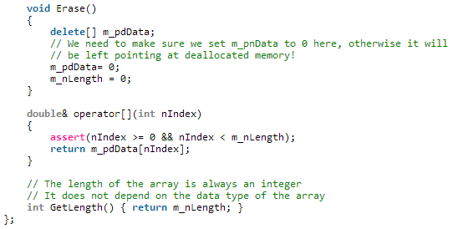
DoubleArray
Engineering

Slide 37
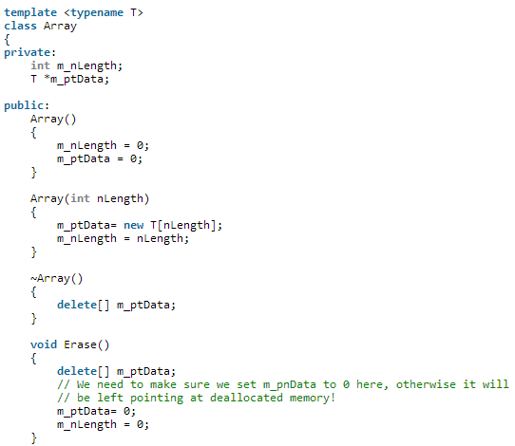
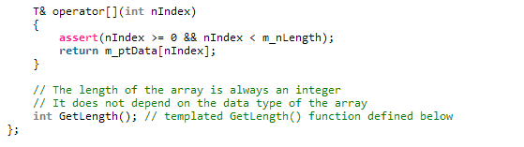
Template Array
Engineering

