Slide 1
Machine Learning, Spring 2019
Main Challenges of Machine Learning
Reading Assignment: Chapter 1 & 2
Python tutorial: http://learnpython.org/
TensorFlow tutorial: https://www.tensorflow.org/tutorials/
PyTorch tutorial: https://pytorch.org/tutorials/

Slide 2
Main Challenges of Machine Learning: Data

Slide 3
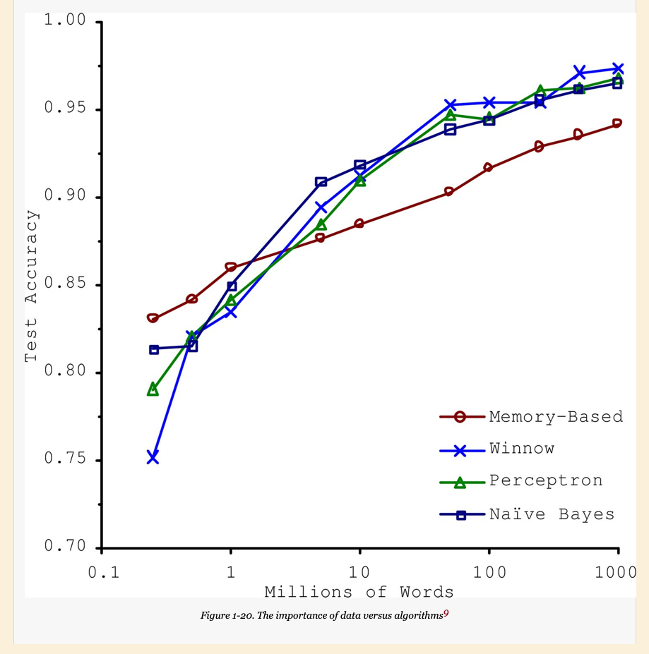
Insufficient Quantity of Training Data

Slide 4
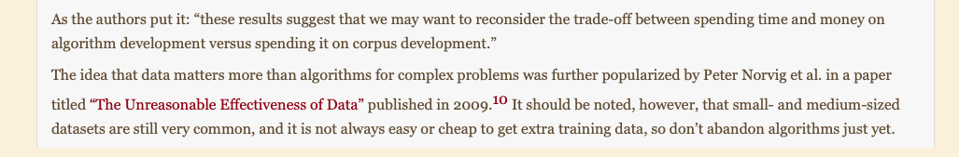
Michele & Eric, 2001, Microsoft Research:

Slide 5
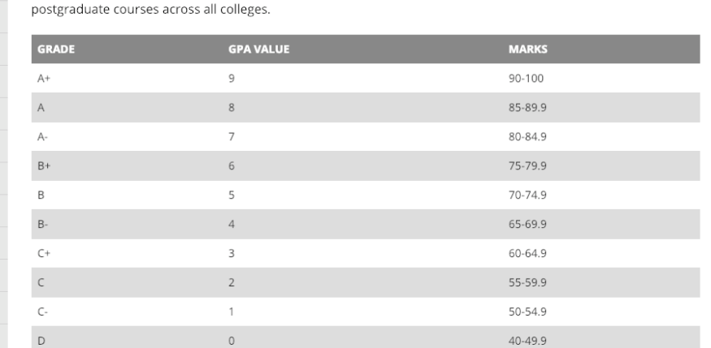
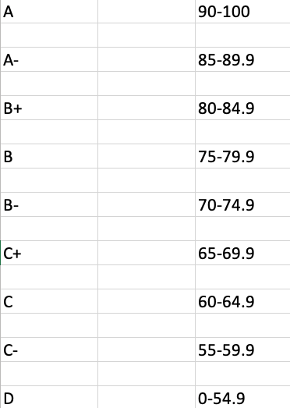
Announcements
Final grading:
YOLO Session (Feb. 13)
First mini project release today

Slide 6
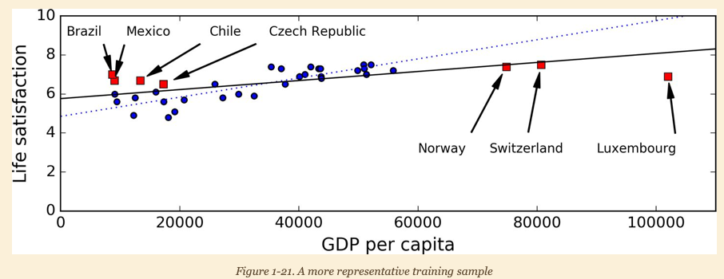
Non-representative Training Data
Notes:
﻿In order to generalize well, it is crucial that your training data be representative of the new cases you want to generalize to. This is true whether you use instance-based learning or model-based learning. For example, the set of countries we used earlier for training the linear model was not perfectly representative; a few countries were missing. Figure 1-21 shows what the data looks like when you add the missing countries.
﻿If you train a linear model on this data, you get the solid line, while the old model is represented by the dotted line. As you can see, not only does adding a few missing countries significantly alter the model, but it makes it clear that such a simple linear model is probably never going to work well. It seems that very rich countries are not happier than moderately rich countries (in fact they seem unhappier), and conversely some poor countries seem happier than many rich countries. By using a nonrepresentative training set, we trained a model that is unlikely to make accurate predictions, especially for very poor and very rich countries. It is crucial to use a training set that is representative of the cases you want to generalize to. This is often harder than it sounds: if the sample is too small, you will have sampling noise (i.e., nonrepresentative data as a result of chance), but even very large samples can be nonrepresentative if the sampling method is flawed. This is called sampling bias .

Slide 7
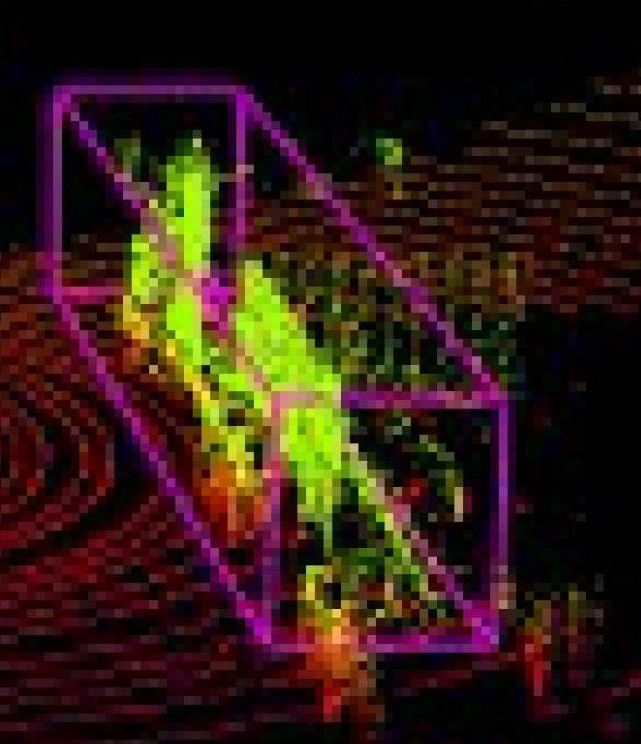
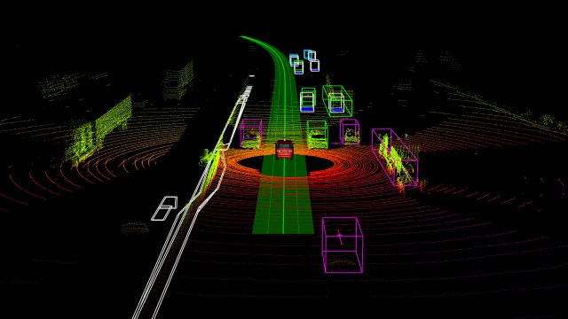
Poor-Quality Data
Image from: https://www.extremetech.com/extreme/213517-a-laser-and-a-raspberry-pi-can-disable-a-self-driving-car
Notes:
﻿Obviously, if your training data is full of errors, outliers, and noise (e.g., due to poor-quality measurements), it will make it harder for the system to detect the underlying patterns, so your system is less likely to perform well. It is often well worth the effort to spend time cleaning up your training data. The truth is, most data scientists spend a significant part of their time doing just that. For example: If some instances are clearly outliers, it may help to simply discard them or try to fix the errors manually.If some instances are missing a few features (e.g., 5% of your customers did not specify their age), you must decide whether you want to ignore this attribute altogether, ignore these instances, fill in the missing values (e.g., with the median age), or train one model with the feature and one model without it, and so on.Géron, Aurélien. Hands-On Machine Learning with Scikit-Learn and TensorFlow (p. 25). O'Reilly Media. Kindle Edition.

Slide 8
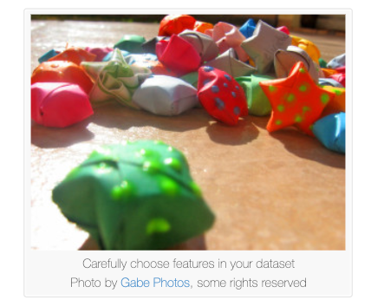
Irrelevant Features
Image cited from: https://machinelearningmastery.com/feature-selection-to-improve-accuracy-and-decrease-training-time/
Notes:
﻿As the saying goes: garbage in, garbage out. Your system will only be capable of learning if the training data contains enough relevant features and not too many irrelevant ones. A critical part of the success of a Machine Learning project is coming up with a good set of features to train on. This process, called feature engineering , involves: Feature selection : selecting the most useful features to train on among existing features.Feature extraction : combining existing features to produce a more useful one (as we saw earlier, dimensionality reduction algorithms can help).Creating new features by gathering new data.Now that we have looked at many examples of bad data, let’s look at a couple of examples of bad algorithms. Géron, Aurélien. Hands-On Machine Learning with Scikit-Learn and TensorFlow (pp. 25-26). O'Reilly Media. Kindle Edition.

Slide 9
Main Challenges of Machine Learning: Algorithms

Slide 10
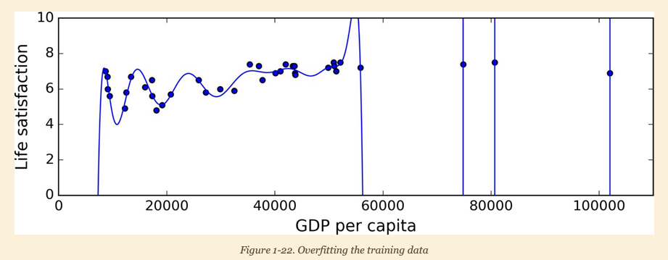
Overfitting the Training Data
Notes:
﻿Say you are visiting a foreign country and the taxi driver rips you off. You might be tempted to say that all taxi drivers in that country are thieves. Overgeneralizing is something that we humans do all too often, and unfortunately machines can fall into the same trap if we are not careful. In Machine Learning this is called overfitting : it means that the model performs well on the training data, but it does not generalize well. Géron, Aurélien. Hands-On Machine Learning with Scikit-Learn and TensorFlow (p. 26). O'Reilly Media. Kindle Edition.
﻿Figure 1-22 shows an example of a high-degree polynomial life satisfaction model that strongly overfits the training data. Géron, Aurélien. Hands-On Machine Learning with Scikit-Learn and TensorFlow (p. 26). O'Reilly Media. Kindle Edition.
﻿Complex models such as deep neural networks can detect subtle patterns in the data, but if the training set is noisy, or if it is too small (which introduces sampling noise), then the model is likely to detect patterns in the noise itself. Obviously these patterns will not generalize to new instances. For example, say you feed your life satisfaction model many more attributes, including uninformative ones such as the country’s name. In that case, a complex model may detect patterns like the fact that all countries in the training data with a w in their name have a life satisfaction greater than 7: New Zealand (7.3), Norway (7.4), Sweden (7.2), and Switzerland (7.5). How confident are you that the W-satisfaction rule generalizes to Rwanda or Zimbabwe? Obviously this pattern occurred in the training data by pure chance, but the model has no way to tell whether a pattern is real or simply the result of noise in the data. Géron, Aurélien. Hands-On Machine Learning with Scikit-Learn and TensorFlow (pp. 26-27). O'Reilly Media. Kindle Edition.

Slide 11
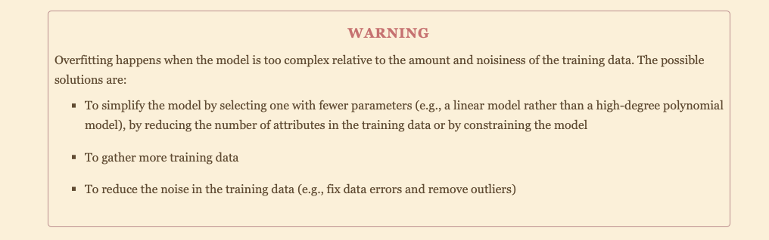

Slide 12
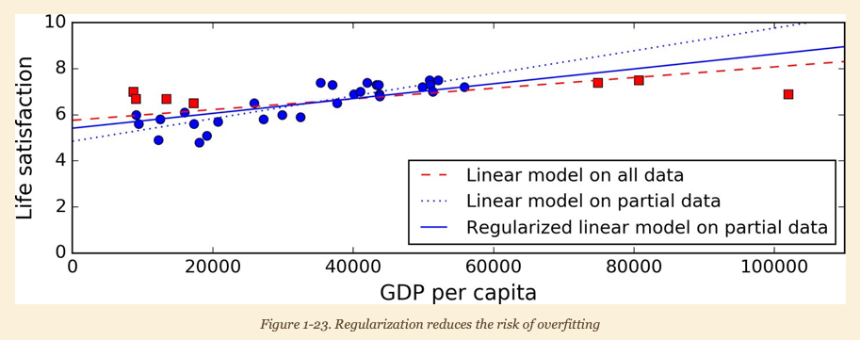
Regularization Strategy
Notes:
﻿Constraining a model to make it simpler and reduce the risk of overfitting is called regularization . For example, the linear model we defined earlier has two parameters, θ 0 and θ 1 . This gives the learning algorithm two degrees of freedom to adapt the model to the training data: it can tweak both the height ( θ 0 ) and the slope ( θ 1 ) of the line. If we forced θ 1 = 0, the algorithm would have only one degree of freedom and would have a much harder time fitting the data properly: all it Géron, Aurélien. Hands-On Machine Learning with Scikit-Learn and TensorFlow (p. 27). O'Reilly Media. Kindle Edition.

Slide 13
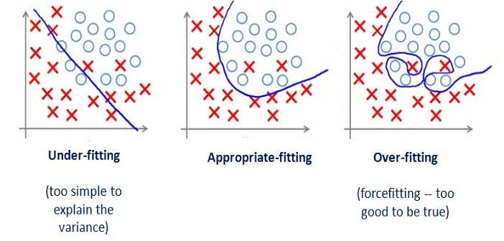
Under-fitting the Training Data
Image cited from: https://medium.com/greyatom/what-is-underfitting-and-overfitting-in-machine-learning-and-how-to-deal-with-it-6803a989c76
Notes:
﻿As you might guess, underfitting is the opposite of overfitting: it occurs when your model is too simple to learn the underlying structure of the data. For example, a linear model of life satisfaction is prone to underfit; reality is just more complex than the model, so its predictions are bound to be inaccurate, even on the training examples. Géron, Aurélien. Hands-On Machine Learning with Scikit-Learn and TensorFlow (p. 28). O'Reilly Media. Kindle Edition.

Slide 14
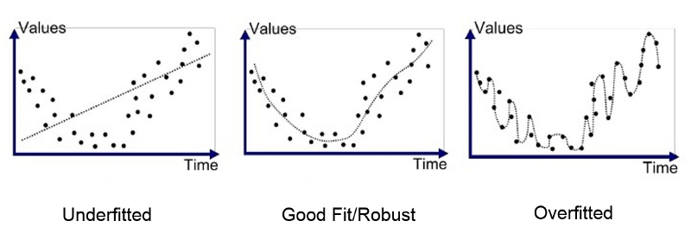
Fitting the Data
Image cited from: https://medium.com/greyatom/what-is-underfitting-and-overfitting-in-machine-learning-and-how-to-deal-with-it-6803a989c76

Slide 15
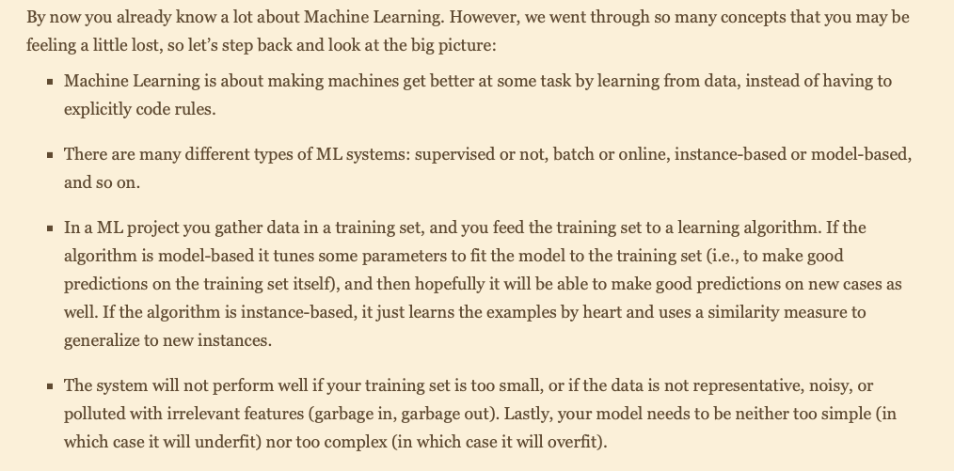
Summary:

Slide 16
Main Challenges of Machine Learning: Testing and Validating
Notes:
﻿The only way to know how well a model will generalize to new cases is to actually try it out on new cases. One way to do that is to put your model in production and monitor how well it performs. This works well, but if your model is horribly bad, your users will complain not the best idea. A better option is to split your data into two sets: the training set and the test set . As these names imply, you train your model using the training set, and you test it using the test set. The error rate on new cases is called the generalization error (or out-of-sample error ), and by evaluating your model on the test set, you get an estimation of this error. This value tells you how well your model will perform on instances it has never seen before. If the training error is low (i.e., your model makes few mistakes on the training set) but the generalization error is high, it means that your model is overfitting the training data. Géron, Aurélien. Hands-On Machine Learning with Scikit-Learn and TensorFlow (p. 29). O'Reilly Media. Kindle Edition.

Slide 17
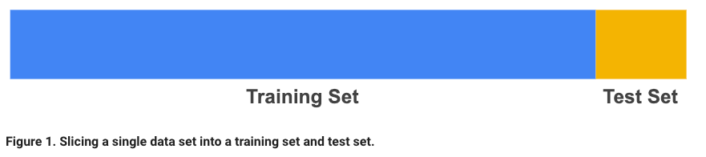
Split the Observed Data

Slide 18
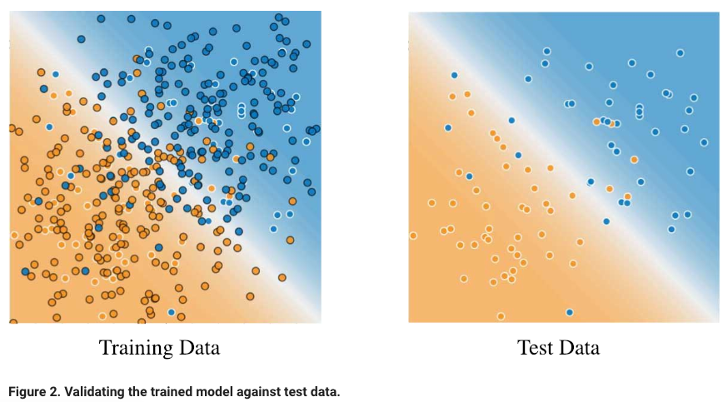
Split the Observed Data
Image cited: https://developers.google.com/machine-learning/crash-course/training-and-test-sets/splitting-data

Slide 19
