Slide 1
3D Computer Vision: Techniques and Applications
Prof. Yi Fang
yfang@nyu.edu
Fall, 2015

Slide 2
Who am I?
MMVC Lab: https://wp.nyu.edu/mmvc/
Research interests:
  3D computer vision
  Large-scale visual computing
  Deep visual computing
  Deep cross-domain model
  Deep cross-modality model
  3D Computational Structural Biology

Slide 3
Who are you?
Introduce yourself to the class

Slide 4
Syllabus

Slide 5
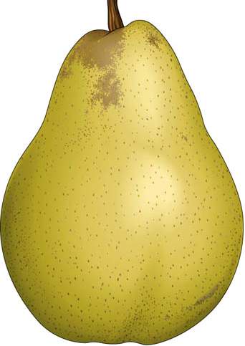
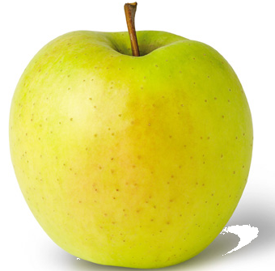

What is 3D Computer Vision?

Slide 6
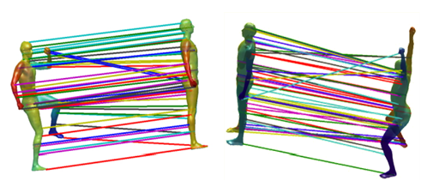
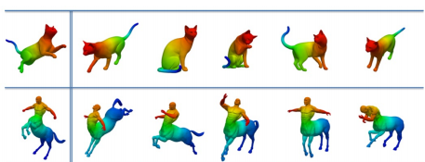
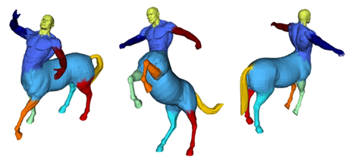
3D Shape Registration
3D Shape Retrieval
3D Shape Segmentation

Slide 7
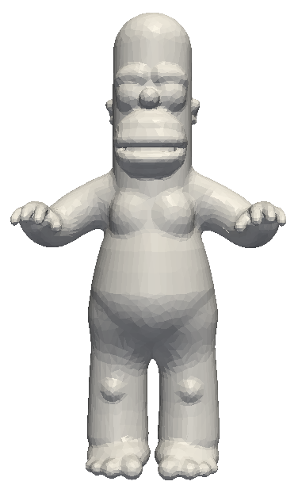
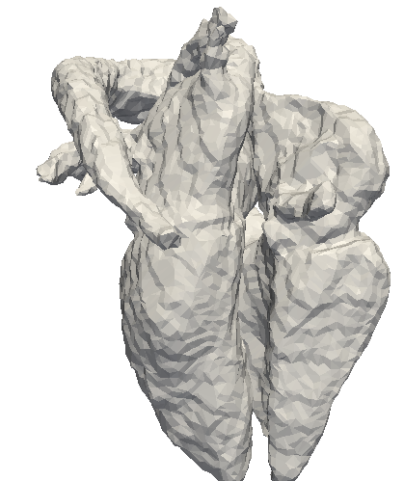
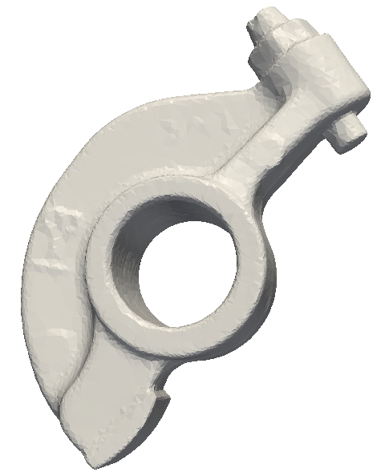
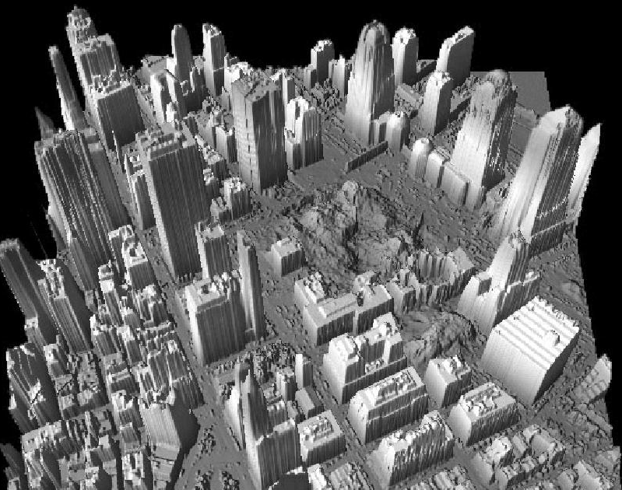
Why 3D Computer Vision?
Recent development in technology for digital acquisition of 3D models has led to a rapid growth of the number of available three dimensional (3D) objects
2. 3D shape analysis is important in multiple fields as diverse as engineering, medicine and biology.
Rockarm
Homer
Heart
3D LIDAR

Slide 8


This course will answer “How to develop
3D Computer Vision Algorithms”?
But wait… Math first!

Slide 9
Linear Algebra Review
Function and Transformation
Linear Transformation
Matrix vector products

Slide 10
Function
Co-domain
Domain
Y
X
f:X Y
Range is some subset of co-domain
Example: f(x) = x^3
f: R R
Notes:
Function, domain, co-domain, range,. 1) function

Slide 11
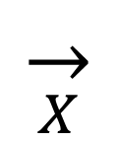
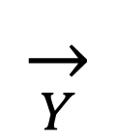
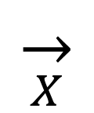
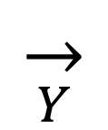
Transformation
R^{m}
R^{n}
f:
Notes:
vector valued function (vector transformations). Transformation is really just a function operating on vectors

Slide 12

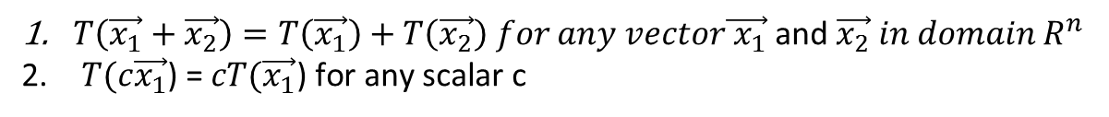
Linear Transformation
Linear transformation is a special transformation the defined as follows:

Slide 13
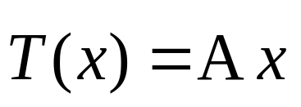
Matrix Vector Products
Matrix vector products:
Verify if matrix vector products is a Linear transformation
Also, linear transformation as matrix vector products

Slide 14
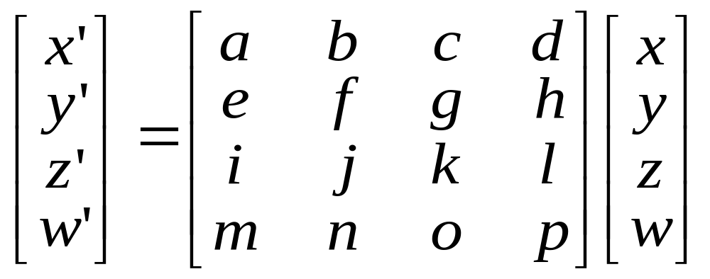
3D Geometric Transformation
  Given homogeneous coordinates: (x,y,z,w)
Transformation Matrix

Slide 15
3D Geometric Transformation
Translation
Scale
Rotation
Affine transformation

Slide 16
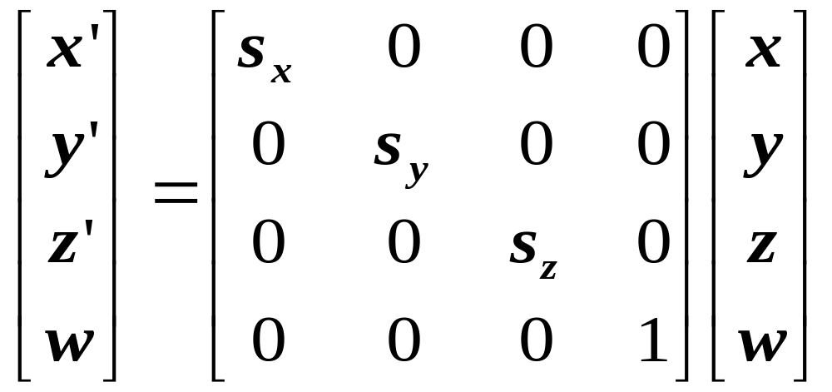
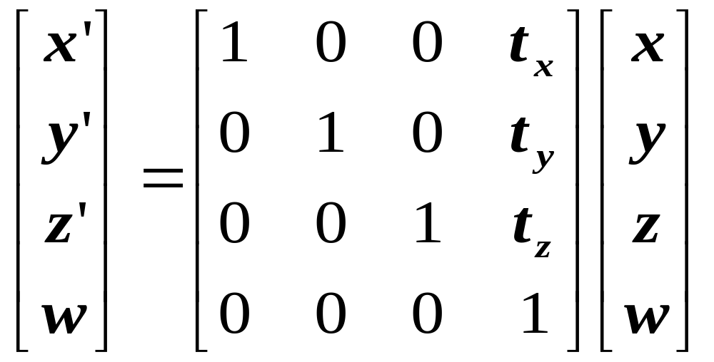
Scale
Translation

Slide 17
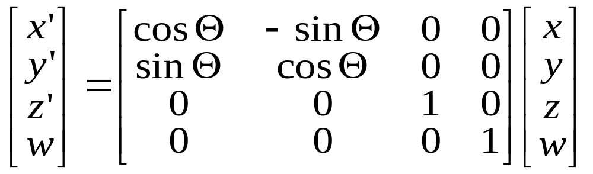

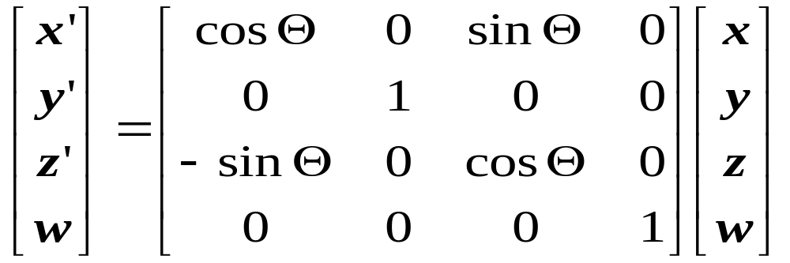
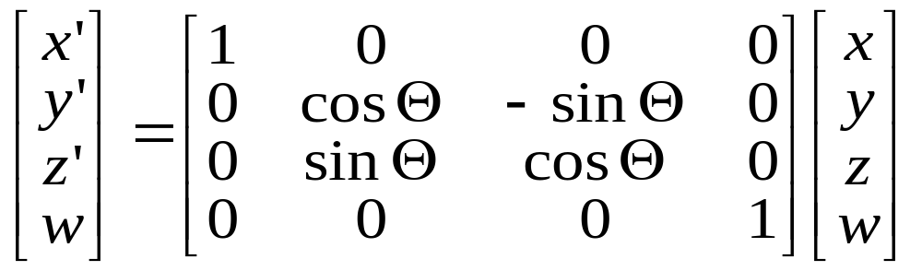
Rotate by about Z axis :
Rotate by about Y axis :
Rotate by about X axis :

Slide 18
Composition of Linear Transformations
Matrix multiplication
If P = T1*Q, Q = T2*S
  Then
  P = M*S where M=T1T2

Slide 19
Geometric Transformation Estimation
Point cloud data set
Geometric transformation estimation
  Point cloud data sets registration
  Iterative closest point algorithm

Slide 20
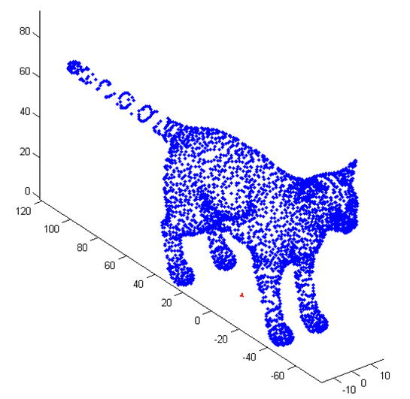
3D Point Cloud

Slide 21
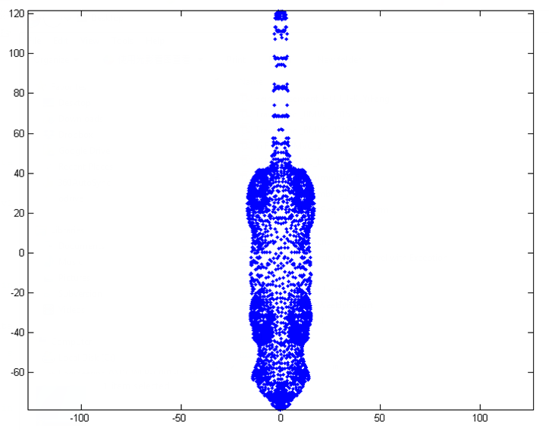
2D Point cloud

Slide 22
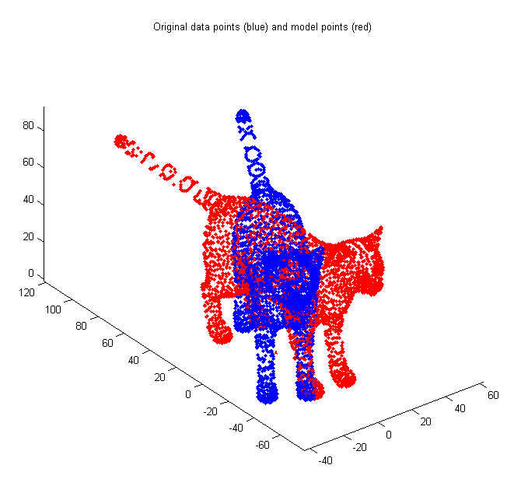
Registration between two sets of point clouds

Slide 23

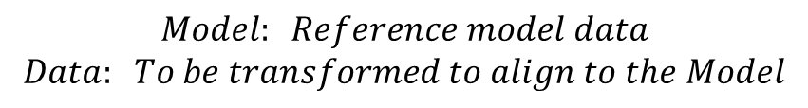
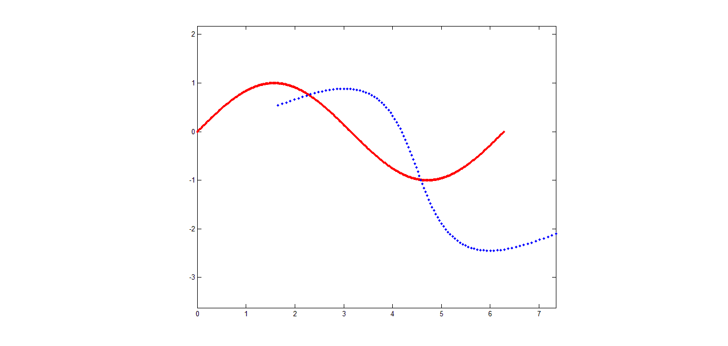
Iterative Closest Point
The MSE objective function :
Model
Data

Slide 24
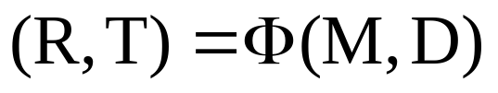
Kabsch Algorithm
If we have prior knowledge about correspondences , we can find the rotation/translation based on Kabsch algorithm
We denote

Slide 25
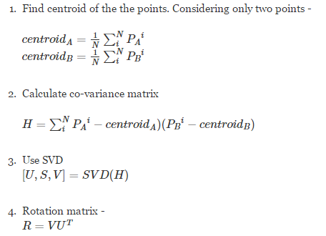
5. Translation vector
T = -R*centroidA' + centroidB'
*Acknowledge an online summary of steps of Kabsch algorithm,
http://www.quora.com/How-can-I-find-the-rotation-and-translation-between-two-sets-of-points

Slide 26
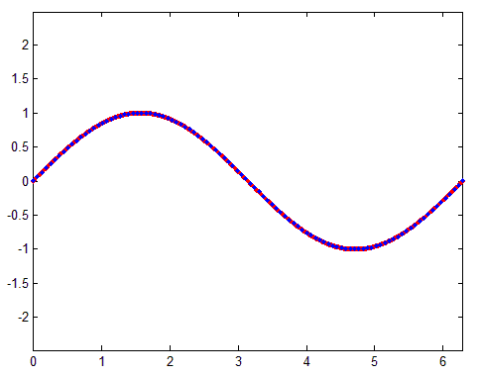
Transform

Slide 27
What if we do not have prior correspondence?
Solution: Assume closest points correspond

Slide 28
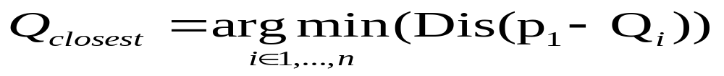
Closest Point
Given two points p₁ and p₂ , the Euclidean distance is:
Given a point p₁ and set of points Q , the closest point is defined:

Slide 29
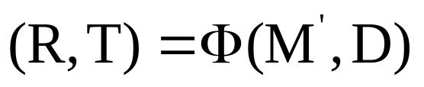

Iterative process
Given the correspondence determined by closest point algorithm, we could update the transformation step by step using Kabsche Algorithm
  Where is subset of M which is the set of the closest points to D

Slide 30
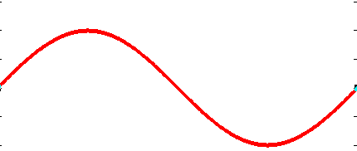
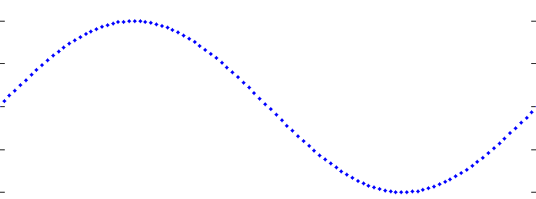
After One Iteration

Slide 31
Re-search Closest Point

Slide 32
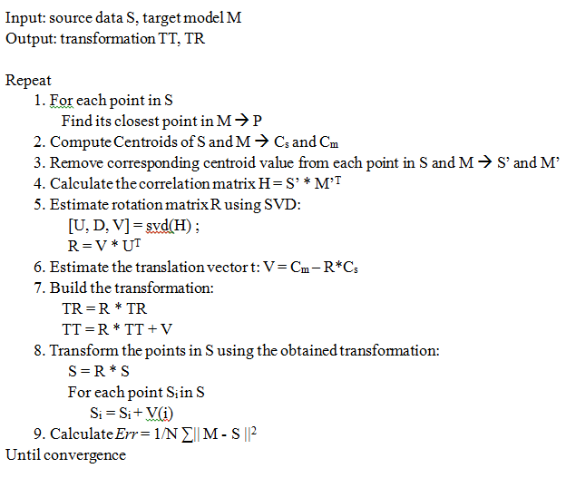
ICP Algorithm
Step 2

Slide 33
Demo Process
Step 1

Slide 34
Step 2

Slide 35
Step 3

Slide 36
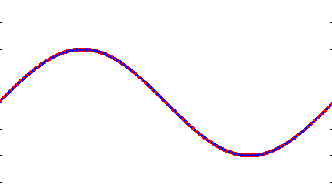
Step n

