Slide 1
3D Object Segmentation
Prof. Yi Fang
yfang@nyu.edu
Fall, 2015

Slide 2
Announcement
Project 3 will be due on Friday this week.
You are required to attend project group discussion session,
Project 4 will be release on Friday this week.

Slide 3
Today’s Content
What is 3D object segmentation?
Geometric attributes and constraints for segmentation
Segmentation algorithms
Project 4 brief introduction

Slide 4


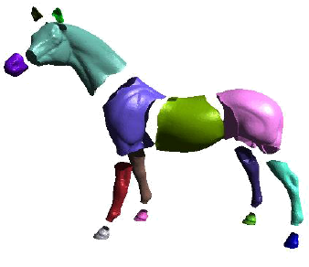
3D object segmentation
M be a 3D mesh,
S the set of mesh elements, which is either V, E or F,
A segmentation of M is the set of sub-meshes = {M₀, M₁... ,M_{k−1}} induced by a partition of S into k disjoint sub-sets.
Florent, INRIA

Slide 5
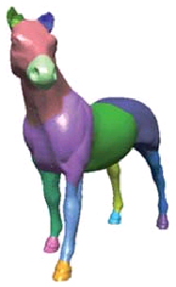
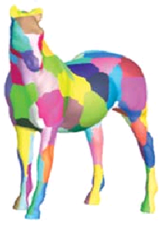
Part-Based Segmentation
Surface-Based Segmentation
Shu, 2008

Slide 6
Formulate Mesh Segmentation
A criteria function that measures the quality of a partition under a set of constraints
A algorithm for finding the optimal criteria function.
    Given a mesh M and the set of elements S ∈ {V, E, F}, find a disjoint partitioning of S into S₀, ..., S_{k−1} such that the criterion function J = J(S₀, ... , S_{k−1}) be minimized (or maximized) under a set of constraints C.

Slide 7
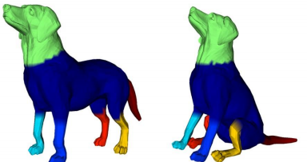
How to define a criteria function?
Depending on different applications
Two key elements for the function definition
  Attributes
  constraints
How well a 3D model
is segmented?

Slide 8
Attributes
Planarity of various forms
Higher degree geometric proxies (spheres, cylinders, cones, quadrics developable surfaces).
Difference in normals of vertices or dihedral angles between faces.
Curvature.
Geodesic distances on the mesh.
Medial axis and shape diameter.
Texture
Ariel, 2007

Slide 9
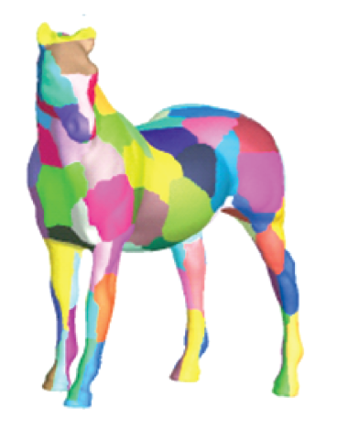
Planarity of various forms
Planarity of a segment patch

Slide 10
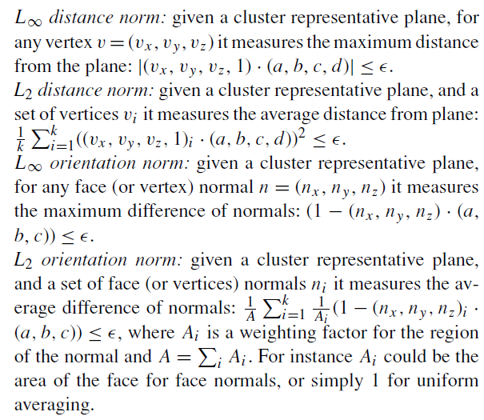
Assuming each segment is a cluster of elements best represented by a plane ax + by + cz + d = 0
Ariel, 2007

Slide 11
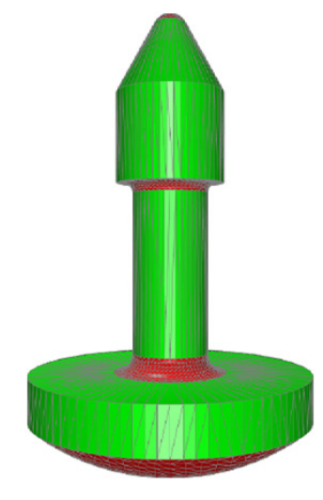
Higher degree geometric proxies
How well a segment approximates a cylinders
Dong, 2011

Slide 12
To cluster non-planar regions, other cluster representatives must be used and other criteria must be defined. We could use primitives such as spheres, cylinders and cones, and try to find the best fitting primitive in least squares sense. Other types of regions include rolling ball blends, triangle strips and cones as quasi-developable surfaces

Slide 13
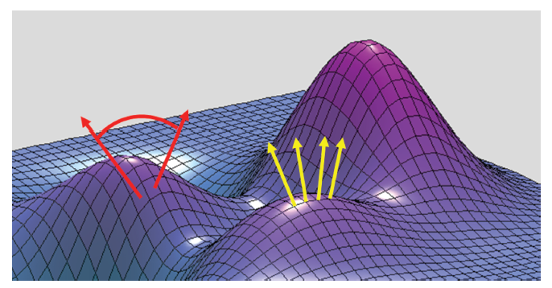
Difference in normals of vertices or dihedral angles between faces
Dihedral angle
Normal
Ariel, 2007

Slide 14
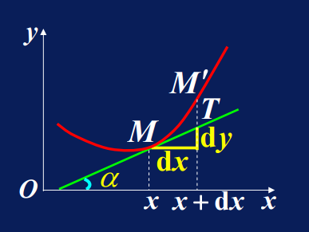
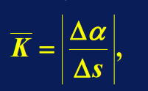
Curvature
  How “curved” a surface is at any given point.
s: Arc length

Slide 15
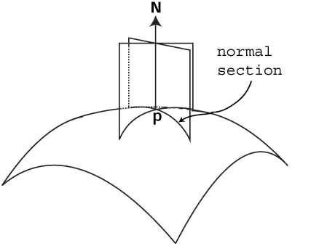
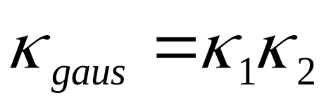
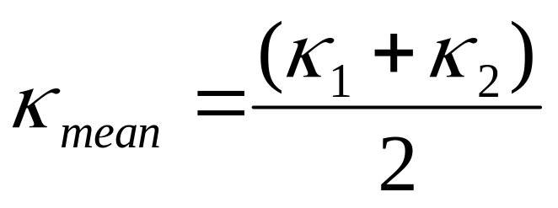
Curvature Calculation
1.
2.
The Principle Curvatures (k₁ and k₂) at a given point represent the maximum and minimum values of the normal curvature.
Matthew, Arizona State University

Slide 16
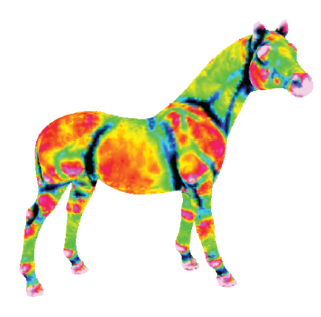
Minimum Curvature Map
Ramanathan, 2011

Slide 17
Geodesic Distance
Geodesic Distance: the geodesic distance between two points is defined as the length of a shortest path between the two points on the surface.

Slide 18
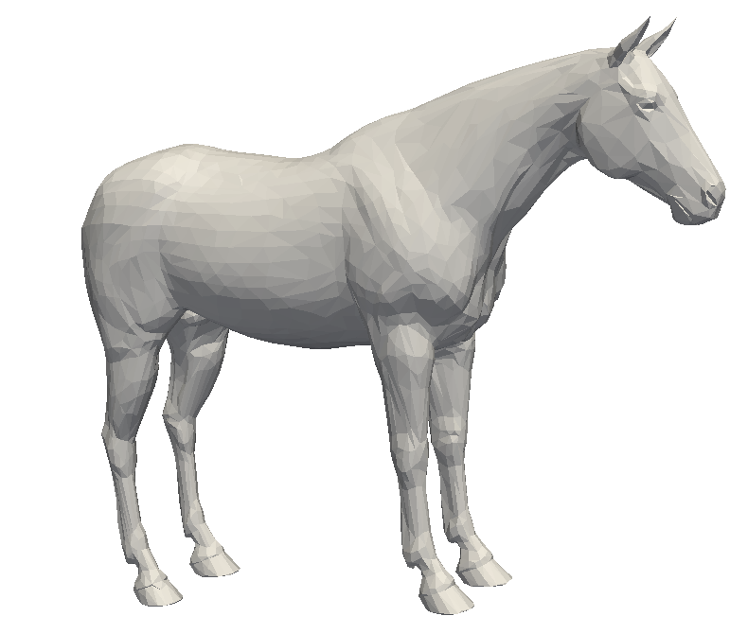
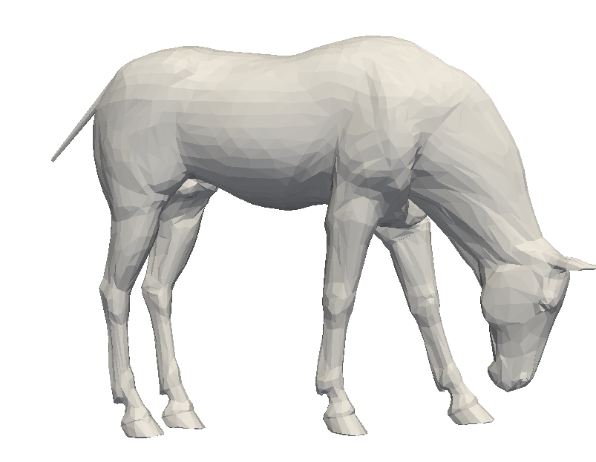

Slide 19
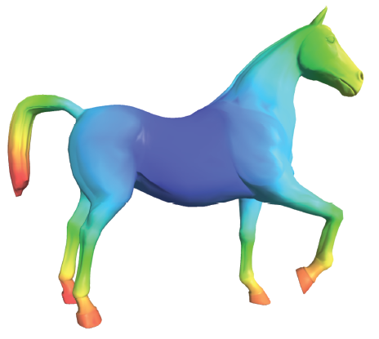
Average Geodesic Distance Map
Ramanathan, 2011

Slide 20
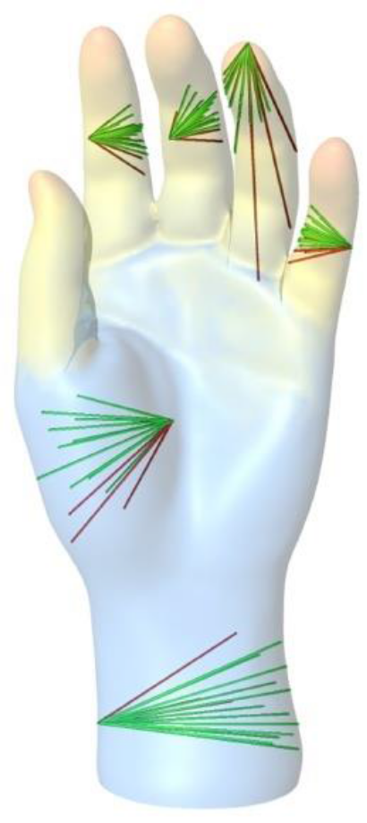
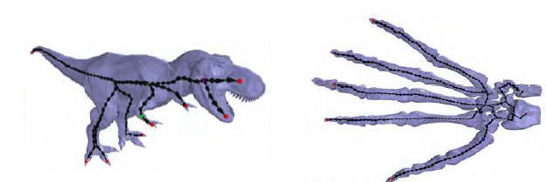
Medial axis and shape diameter
The medial axis and medial axis transform (MAT) is an important topological attribute of the object They carry information on the structure and size of the object and can often be used as guidelines for segmentation.
Florent, INRIA

Slide 21
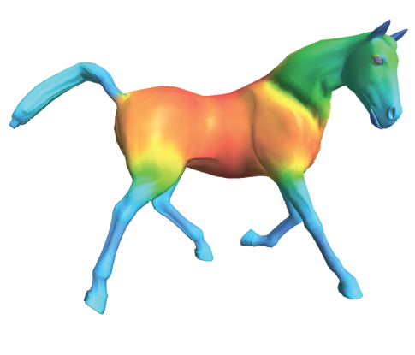
Shape Diameter Map
Florent, INRIA

Slide 22
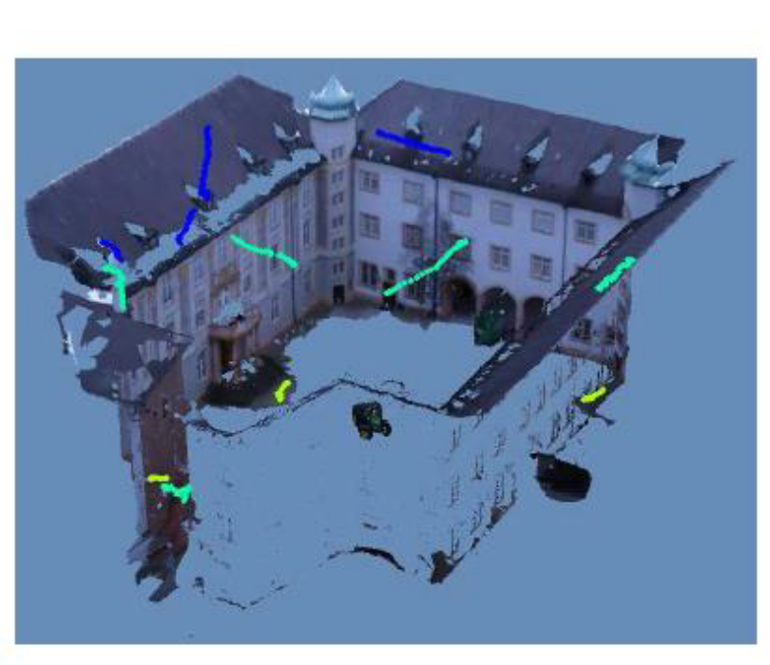
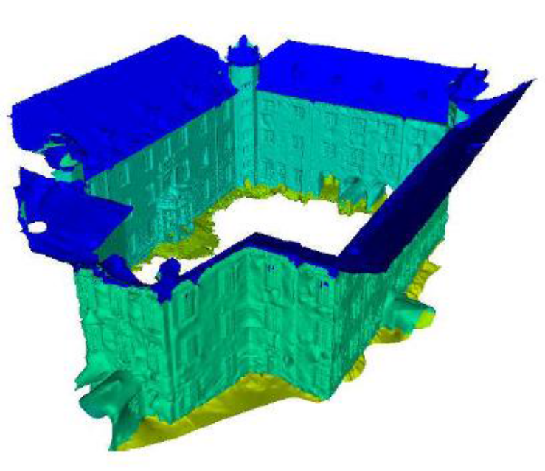
Surface Texture
Surface texture is often a bitmap or raster image that provide rich information for a 3D surface
Florent, INRIA

Slide 23
Constraints
Cardinality
Geometry
Topology
Ariel, 2008

Slide 24
Cardinality
Cardinality
  Not too small/large or a given number of clusters Overall balanced partition

Slide 25
Geometry
Geometry
  Size: area, diameter, radius Convexity, Roundness Boundary smoothness
  Maximum/minimum area of sub-mesh.
  Maximum/minimum length of diameter or perimeter of sub-mesh.
  More complex constraints such as convexity of either 2D patch or volumetric 3D part.
  Soft constraints in the form of a bias towards specific shapes.

Slide 26
Topology
Topology
  Restriction of each segment to be topologically equivalent to a disk.
  Restriction of each segment to be a single connected component.

Slide 27
Segmentation Criteria Function
Function is always defined based on the attributes and constraints.
  For example: Criteria Function sum of pair wise distances among all vertices within one segment under the constraints of a given number of segments of the entire 3D shape
  A better way to define the criteria function?

Slide 28
Segmentation Algorithms
K-Center clustering
K-Mean clustering
Center-shift algorithm
Hierarchical clustering
Data-driven segmentation

Slide 29
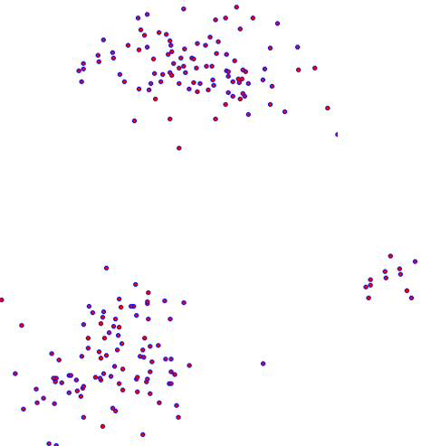


K-Center clustering
k centers which minimizes the maximum distances from points to their center point
Minimize:
Across clusters
Within a cluster

Slide 30
Farthest-first traversal
Approximation of the solution of K-center NP hard problem

Slide 31

Step 1:
Randomly pick up the point center

Slide 32
Step 2:
Find the point with largest distance to
the first center

Slide 33


Step 3:
Temporarily set this point as the second
center

Slide 34
Step 4:
Clustering the points based on the distances
Two centers

Slide 35

Step 5:
Find the point close to the mean in the
second clusters, set it as the second
center

Slide 36

Step 6:
Find the point with largest distance to both identified center and Temporarily set this point as the third center

Slide 37



Step 7:
Clustering the points based on the distances and three centers

Slide 38

Step 8:
Find the point close to the mean in the
Third clusters, set it as the third
center

Slide 39
Step 9:
Clustering based on the three identified centers and distances

Slide 40
Conclusion
Geodesic distance
Other Distance measurements
Other Similarity measurements

Slide 41

K-means
Given a set of observations (x₁, x₂, …, x_{n}), where each observation is a d-dimensional real vector, k-means clustering aims to partition the n observations into k (≤ n) sets S = {S₁, S₂, …, S_{k}} so as to minimize the within-cluster sum of squares (WCSS). In other words, its objective is to find:
wikipedia

Slide 42
K-Mean clustering
Directly clustering vertexes give the features
Vertexes coordinates
Geometric high-dimensional feature
Weighted combination (spatial constrained K-means)

Slide 43
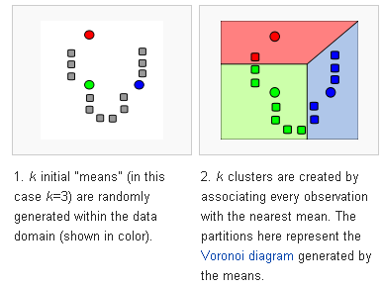
wikipedia

Slide 44
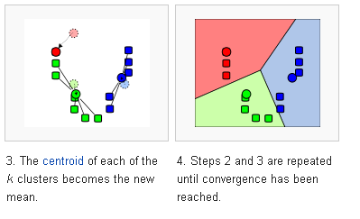

Slide 45
Adapt to 3D Segmentation
Initialization of centers
Distance metric and update rule
Always on the surface
Combine with different features

Slide 46




Seed selection for

Slide 47
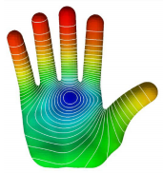
Center Shift
Center-shift algorithm: A segmentation algorithm that moves point on 3D surface with
weights by feature function defined on surface.
Construct a feature space where every vertex on the mesh surface is associated
with the corresponding feature function value.
Center-Shift algorithm for initial segmentation.
Initial segmentation result is refined through an efficient iterative process
which leads to visually salient segmentation of the shape
Yi Fang, etc, Center-Shift: An Approach Towards Automatic Robust Mesh Segmentation (ARMS), CVRP 2012

Slide 48
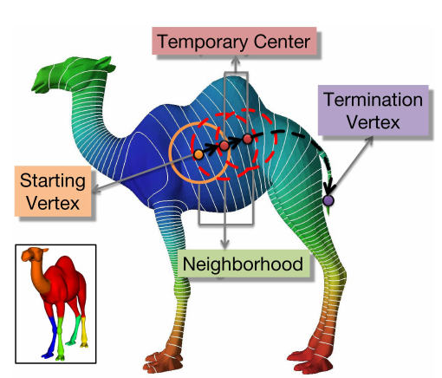

Slide 49
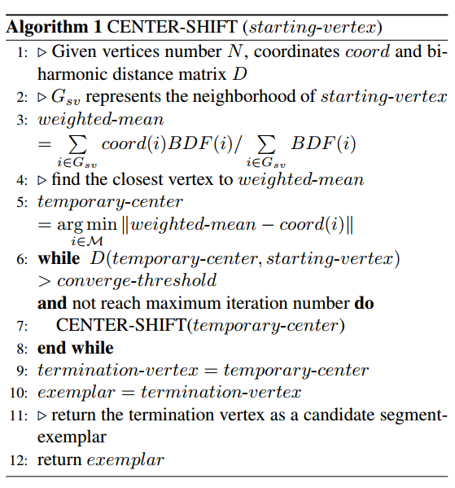

Slide 50
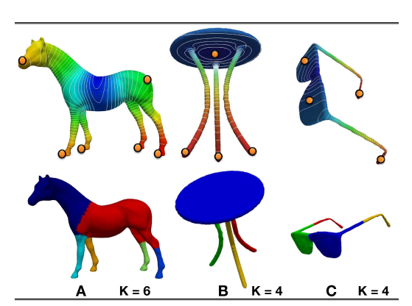

Slide 51
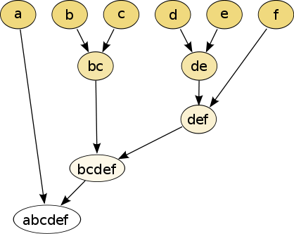
Hierarchical clustering
Hierarchical clustering (also called hierarchical cluster analysis or HCA) is a method of cluster analysis which seeks to build a hierarchy of clusters.
Stephen, University of South Carolina

Slide 52
Given a set of N vertices on the surface to be clustered, and an NxN distance (or similarity) matrix, the basic process of Johnson's (1967) hierarchical clustering is this:
  Start by assigning each item to its own cluster, so that if you have N items, you now have N clusters, each containing just one item. Let the distances (similarities) between the clusters equal the distances (similarities) between the items they contain.
  Find the closest (most similar) pair of clusters and merge them into a single cluster, so that now you have one less cluster.
  Compute distances (similarities) between the new cluster and each of the old clusters.
  Repeat steps 2 and 3 until all items are clustered into a single cluster of size N.

Slide 53
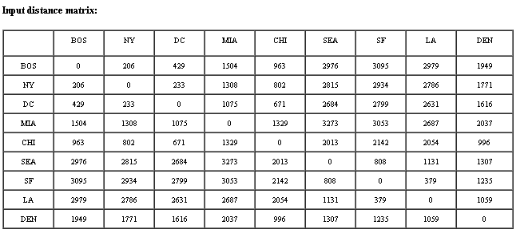
Example
The nearest pair of cities is BOS and NY, at distance 206. These are merged into a single cluster called "BOS/NY".

Slide 54
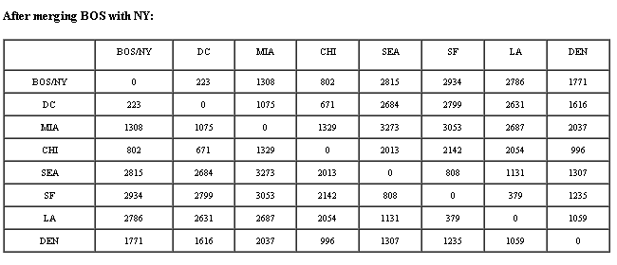
Then we compute the distance from this new compound object to all other objects. In single link clustering the rule is that the distance from the compound object to another object is equal to the shortest distance from any member of the cluster to the outside object. So the distance from "BOS/NY" to DC is chosen to be 233, which is the distance from NY to DC. Similarly, the distance from "BOS/NY" to DEN is chosen to be 1771.

Slide 55
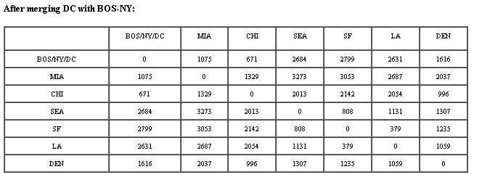
The nearest pair of objects is BOS/NY and DC, at distance 223. These are merged into a single cluster called "BOS/NY/DC". Then we compute the distance from this new cluster to all other clusters, to get a new distance matrix:

Slide 56
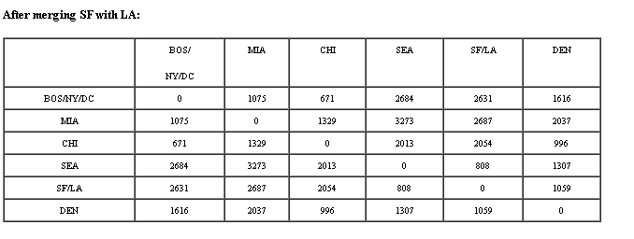
Now, the nearest pair of objects is SF and LA, at distance 379. These are merged into a single cluster called "SF/LA". Then we compute the distance from this new cluster to all other objects, to get a new distance matrix:

Slide 57
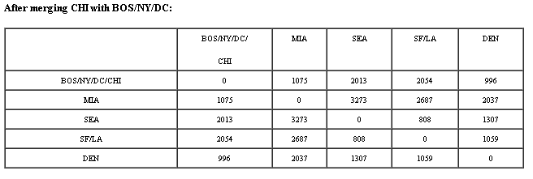
Now, the nearest pair of objects is CHI and BOS/NY/DC, at distance 671. These are merged into a single cluster called "BOS/NY/DC/CHI". Then we compute the distance from this new cluster to all other clusters, to get a new distance matrix:

Slide 58
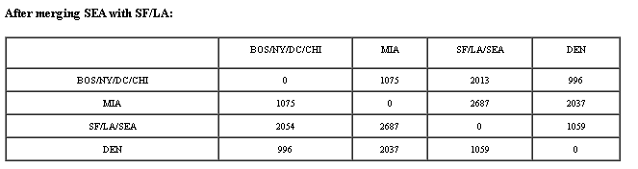
Now, the nearest pair of objects is SEA and SF/LA, at distance 808. These are merged into a single cluster called "SF/LA/SEA". Then we compute the distance from this new cluster to all other clusters, to get a new distance matrix:

Slide 59
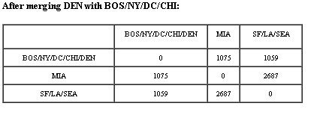
Now, the nearest pair of objects is DEN and BOS/NY/DC/CHI, at distance 996. These are merged into a single cluster called "BOS/NY/DC/CHI/DEN". Then we compute the distance from this new cluster to all other clusters, to get a new distance matrix:

Slide 60
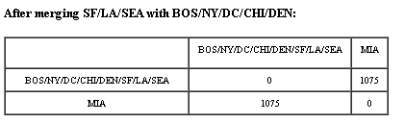
Now, the nearest pair of objects is BOS/NY/DC/CHI/DEN and SF/LA/SEA, at distance 1059. These are merged into a single cluster called "BOS/NY/DC/CHI/DEN/SF/LA/SEA". Then we compute the distance from this new compound object to all other objects, to get a new distance matrix:

Slide 61
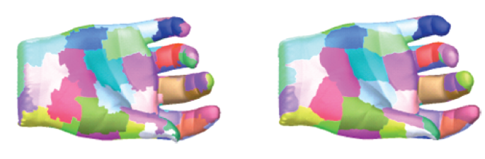
Ariel, 2007

Slide 62
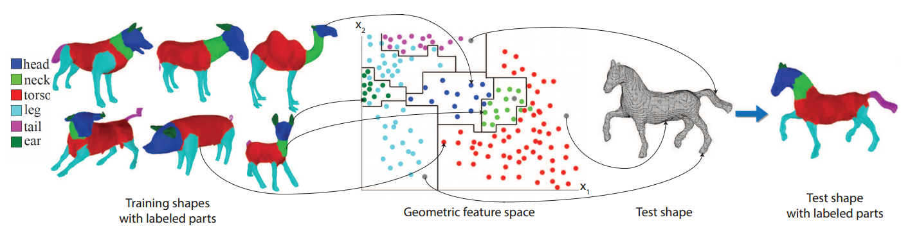
Data Driven Shape segmentation
Kai, Qixing, etc, 2015

Slide 63
Project 4: 3D Shape Segmentation
Three 3D models at different poses will be provided
Implement a Geodesic distance and HKS feature with K-Center clustering algorithm for 3D model segmentation
Implement a weighted combination of HKS feature and coordinate position with K-mean algorithm for 3D model segmentation
Bonus 100 points will be given a segmentation using center-shift algorithm
Color the segment using VTK file

Slide 64
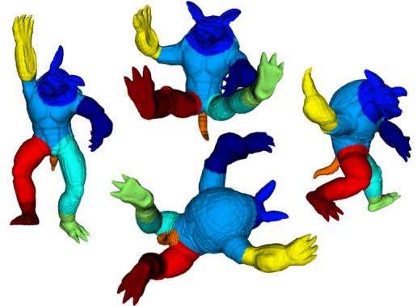
Example Result

