Slide 1
Data-Driven 3D Shape Processing Shape Registration
Prof. Yi Fang
yfang@nyu.edu
Spring, 2016

Slide 2
Announcement
Reading Assignments for low-rank optimization
Multi-Image Matching via Fast Alternating Minimization
Reweighted Random Walks for Graph Matching
Project 2 will be assigned for data-driven shape registration
Provide the bi-harmonic features for all of 3D shape to be registered
Provide the graph matching for all pairwise shape matching
Provide the low-rank optimization package
Move class on Mar. 24 to Mar. 25
Speaker: Dr. Hui Wu, IBM
Topic: Manifold learning in image and shape processing
Room: 2MTC, 10.099
Date and Time: 3:00PM to 5:30PM, Mar. 25

Slide 3
Today’s content
Pairwise shape matching
Low rank matrix for multi-shape registration
Learning better registration from multi-shape correspondence

Slide 4
Pairwise shape matching
Low rank matrix for multi-shape registration
Learning better registration from multi-shape correspondence

Slide 5
Review of 3D Point Signature
GPS Shape Signature
Heat Kernel Signature

Slide 6

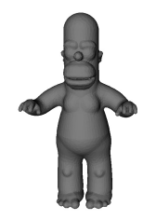
GPS Shape Signature
1. Raif, Laplace-Beltrami Eigenfunctions for Deformation Invariant
Shape Representation, 2007
Note, GPS is a point shape signature

Slide 7

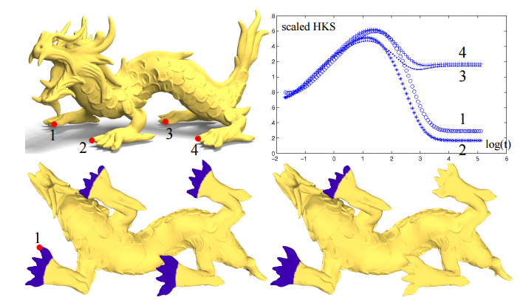
Heat Kernel Signature
1. Jian, A Concise and Provably Informative Multi-Scale Signature Based on Heat Diffusion, 2009

Slide 8
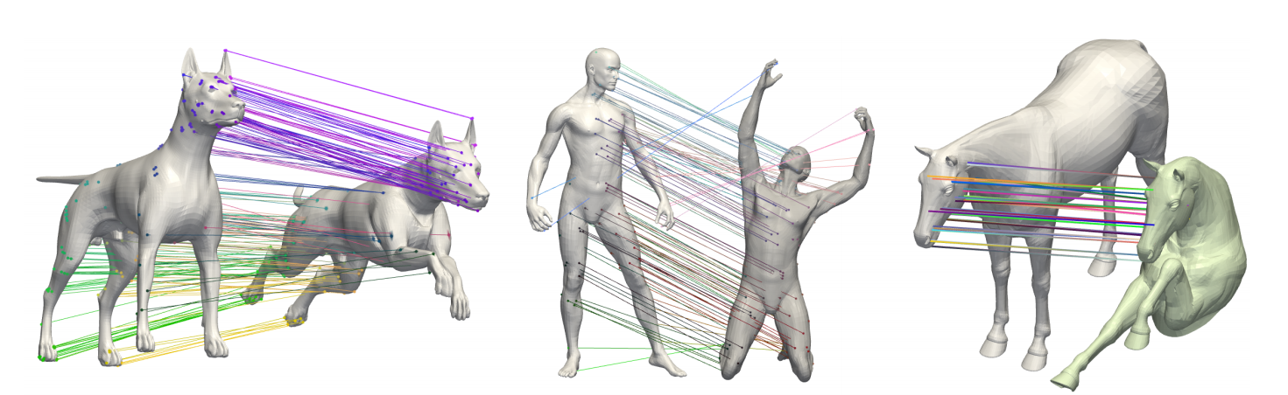
Assignment algorithm
How to define the cost of correspondence assignment?
1. A Game-Theoretic Approach to Deformable Shape Matching, 2015

Slide 9
Assignment algorithm
Three Workers
Three jobs
How to assign three jobs to three workers obtain the minimum time?
 | Job 1 | Job 2 | Job 3
A | 53 | 96 | 37
B | 47 | 87 | 41
C | 60 | 92 | 36
Some of materials here are modified based on online video and online lecture notes for example:
Math 20, Linear Algebra and Multivariable Calculus, 2014, Harvard University
Youtube: https://www.youtube.com/watch?v=dQDZNHwuuOY

Slide 10
Pairwise shape matching
Low rank matrix for multi-shape registration
Learning better registration from multi-shape correspondence

Slide 11
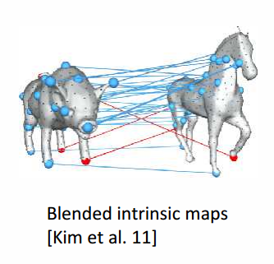
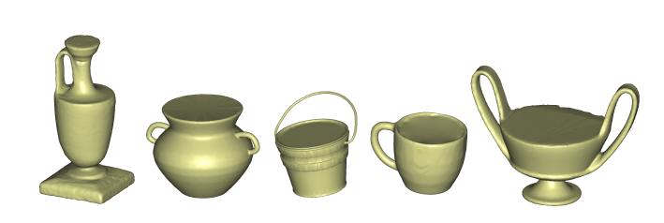
Registration among them?

Slide 12
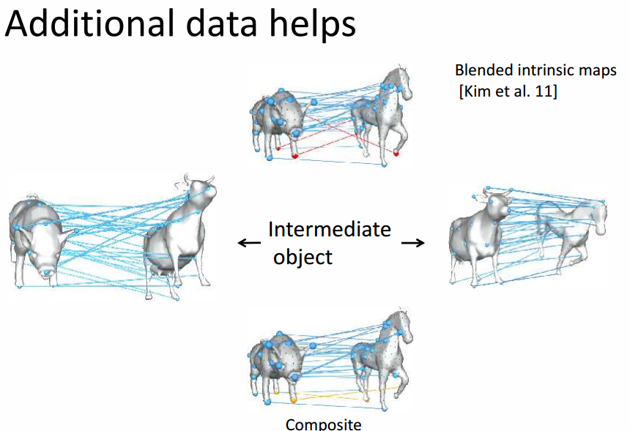

Slide 13
Background
Pairwise shape matching techniques we introduced before are limited to shapes that similar to each other.
These methods tend to be insufficient for shapes that undergo large geometric and topological variations.

Slide 14
Data-driven shape registration
Pairwise shape matching techniques we introduced before are limited to shapes that similar to each other.
These methods tend to be insufficient for shapes that undergo large geometric and topological variations.

Slide 15
Intuition
The availability of large shape collections offers opportunities to address this issue.
When matching two dissimilar shapes, we may utilize intermediate shapes to transfer maps.
Build maps between similar shapes
Obtain maps between less similar shapes

Slide 16
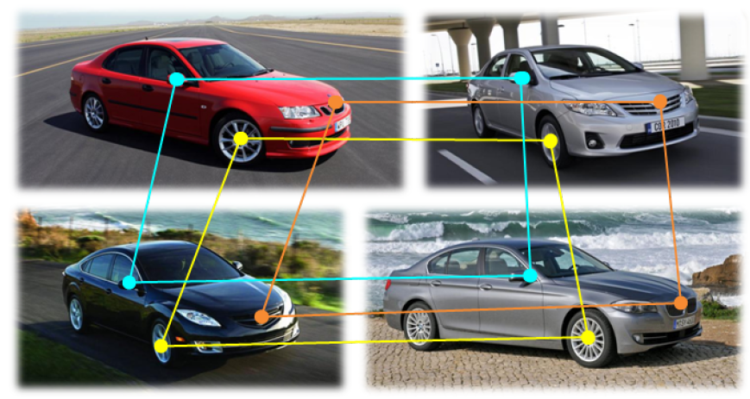
Model as cycle consistency
This intuition can be generalized to enforcing a cycle-consistency constraint, namely composite maps along cycles should be identity map.

Slide 17
How does cycle consistency work
We do not know which maps or correspondences are incorrect, but we can detect inconsistent cycles.
An inconsistent cycle indicates that at least one of the participating maps or correspondences is incorrect.

Slide 18
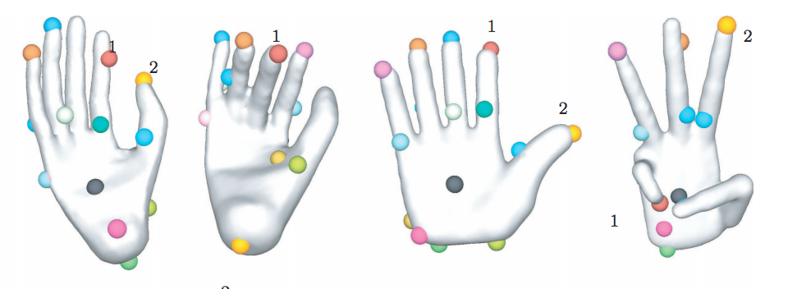
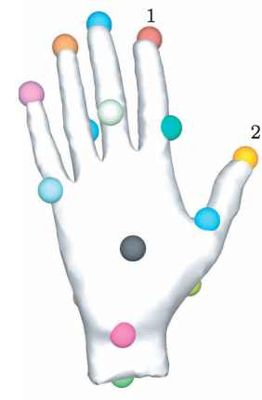
Pi
k

Slide 19
How to formulate the cost function?
Pairwise matching
Find a virtual universe where the potential correspondence candidates
Cycle consistency condition
Minimizing the number of the potential correspondence via low rank optimization

Slide 20



Pairwise Matching
1. Suppose we have n 3D shapes and p_{i} features from each 3D shape i. The objective is to
find feature correspondences between pairs of 3D shapes.
2. Match a 3D shape pair (i, j), one can compute similarities for all pairs of feature
points from two shapes and store them in a matrix
3. Represent the feature correspondence for 3D shape pair (i, j) by a partial permutation
matrix
4. The doubly stochastic constraints satisfies:
5. To find X_{ij}, we can maximize the inner product between resulting in a linear assignment problem, which can efficiently solved by Hungarian algorithm.

Slide 21


Cycle consistency
The cycle consistency as a constraint to match a bunch of 3D shapes. The cycle consistency can be described by:
For any three shapes and can be extended to multi-shapes. We can introduce virtual “universe” that is defined as the set of virtual unique features.

Slide 22
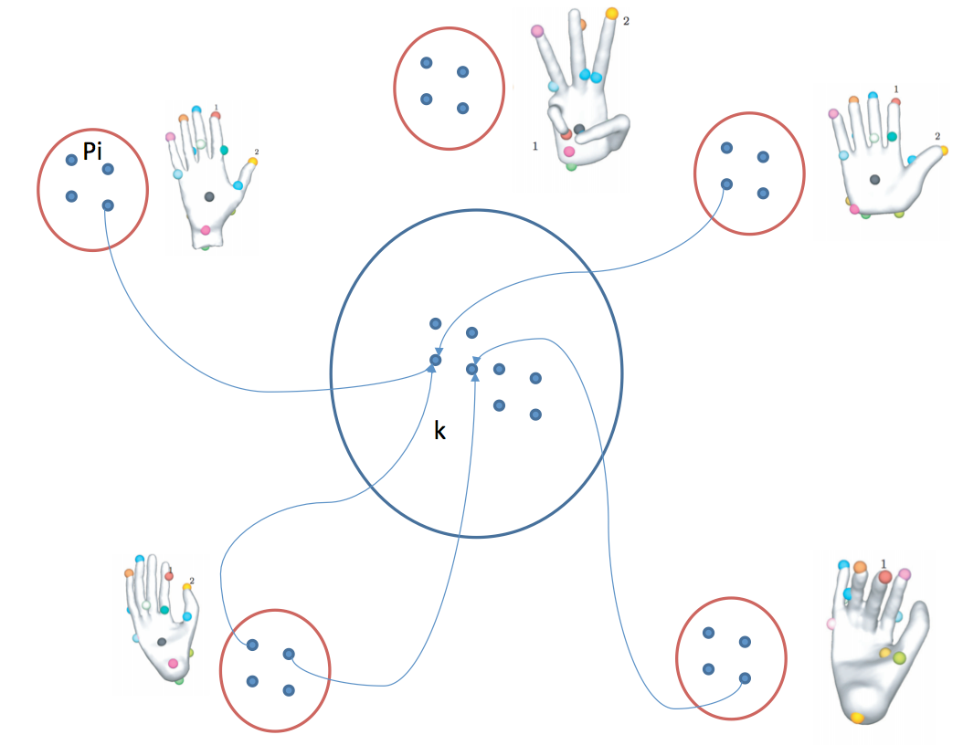
Virtual Universe
Virtual universe

Slide 23
Low rank optimization

Slide 24




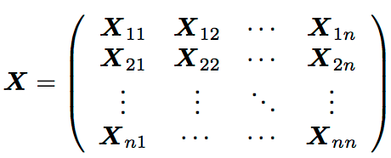

Let’s define a map from shape i to the universe, k is the number of points in the universe,
and for all i , the map can be written:
Suppose the correspondence for all features in the shape is denoted by
And all are concatenated as rows in a matrix

Slide 25



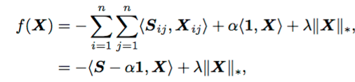
Then, we can write as
It is clear to see that X should be both positive semi-definite and low-rank:
Then the final cost function is:

Slide 26
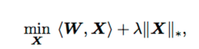

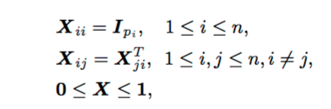
Then:
Where:
Subject to:

Slide 27
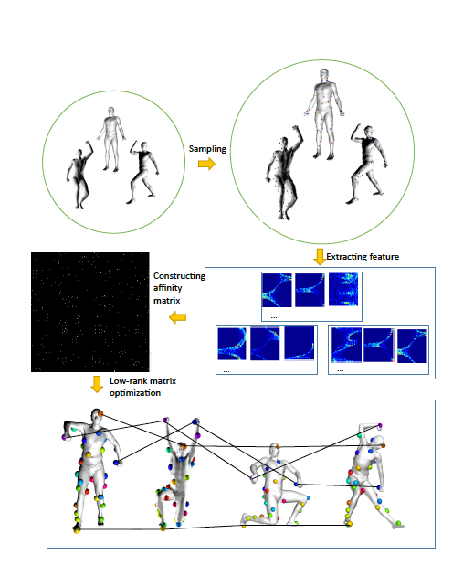
Pipeline of Multiple Shape Matching

Slide 28
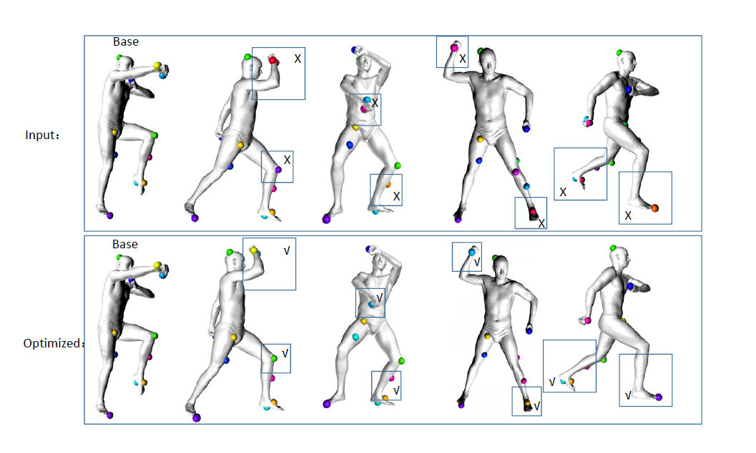

Slide 29
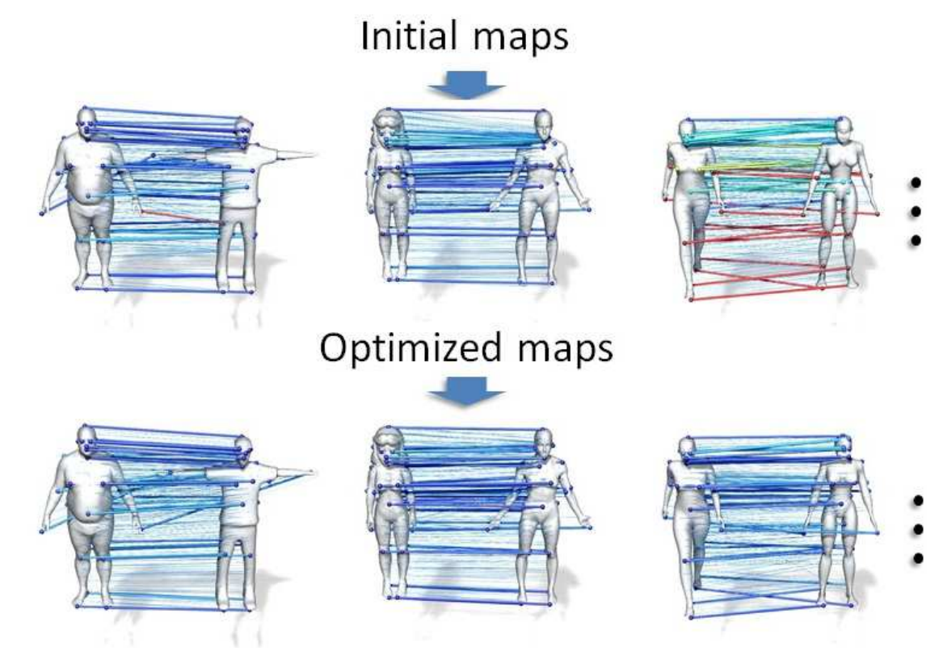

Slide 30
Pairwise shape matching
Low rank matrix for multi-shape registration
Learning better registration from multi-shape correspondence

Slide 31
Deep Learning in Shape Registration

Slide 32
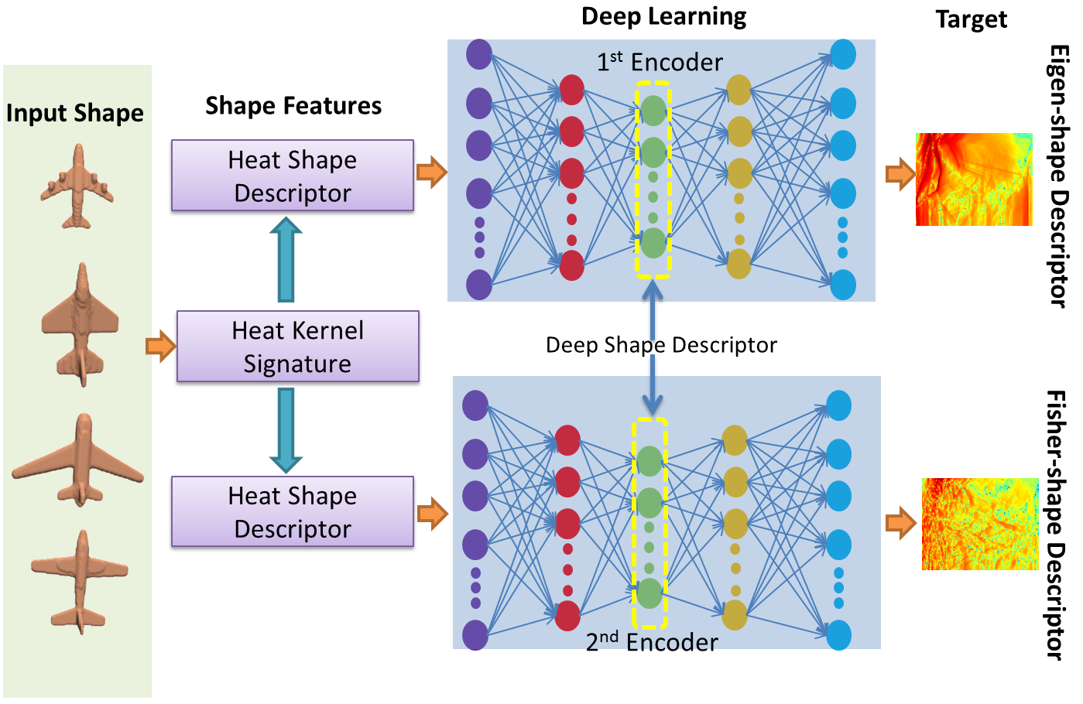
Many-to-one encoder: Deep Neural Network
Unique Shape
Deep Shape Feature
Fang, etc, CVPR 2015
Notes:
Let’s recall the Many-to-One We talk before for the shape retreival.

Slide 33
How to model our shape registration as a many-to-one?

Slide 34
Unique
Label

Slide 35
Discussion on Final Projects

Slide 36
Deep random shape Descriptor for shape retrieval
Learning Shape correspondence via Many-To-One encoder
Deep learning in consistent shape correspondence map
Robust active shape modeling via multi-shape registration
Robust 3D statistical shape model via consistent shape correspondence
Learning Correspondence Manifold for multi-shape registration (With IBM)
Learning Correspondence Manifold for multi-image matching (With IBM)
Learning Joint Sketch-Image Retrieval Using CNN
Learning Joint DepthImage-3D Shape Retrieval Using CNN
Learning Joint Sketch-3D Shape Retrieval Using CNN
Reconstruction of 3D Shape from a single view of image using CNN
3D Street Navigator
Deep Learning on 3D shape analysis via conformal mapped images
3D object recognition using depth image, deep learning and mobile devices
Implement and Present: Qixing Huang and Leonidas Guibas. Consistent Shape Maps via Semi-definite Programming. Computer Graphics Forum, Volume 32(5)
Implement and Present: Qixing Huang, Vladlen Koltun, and Leonidas Guibas. Joint-Shape Segmentation with Linear Programming. ACM Transactions on Graphics 30(5)
Implement and Present: Qixing Huang, Hai Wang, and Vladlen Koltun. Single-View Reconstruction via Joint Analysis of Image and Shape Collections. ACM Transaction on Graphics 34(4) (Proc. Siggraph 2015).

