Slide 1

Engineering Analysis: Complex Variables
Fall II 2013
Engineering

Slide 2
Why study complex variables?
Differentiable functions of complex variables are pretty:
Represented as convergent power series
Derivatives of any order
…
A broad range of applications:
Fluid Flow
Heat Transfer
Elasticity
Geometry
…
Engineering

Slide 3
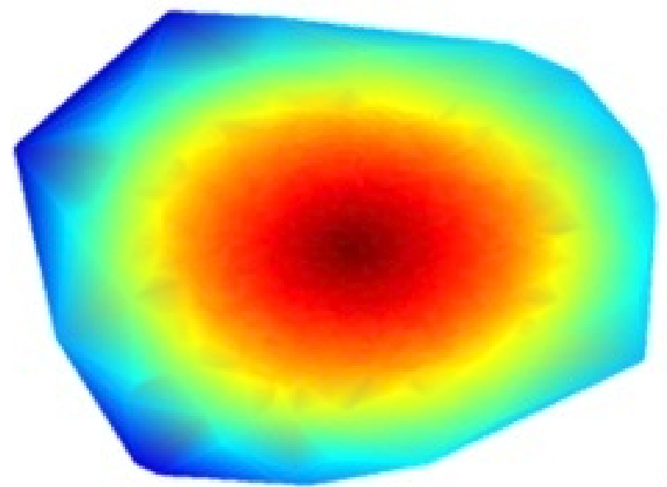
Heat Transfer in a plane
Heat Source
Engineering

Slide 4
Simulation of Heat Flow on 3D surface
Heat Source
Engineering

Slide 5
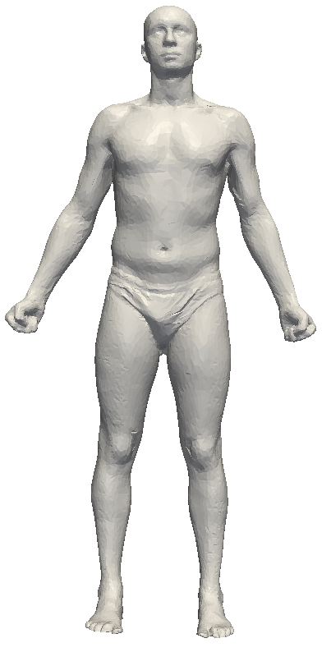
Symmetry Detection
Mobius Transformations For Global Intrinsic Symmetry Analysis, Computer Graphics Forum (Symposium on Geometry Processing), July 2010

Slide 6
What will be covered in this course?
Complex Number
Function of a complex variable
Complex Integrals and Integral Theorems
Series Expansion
Residue Theorem
Engineering
Notes:
Complex Number:
Analytic Function:
Integrals:
Series Expansion:
Residue Theorem
Conformal Mapping

Slide 7
How to succeed in the class?
Think of the difference and relationship between real value function and complex variable function.
Analyze the geometric nature of functions with graphical assistance
Practice and practice more example problems.
…
Engineering

