Slide 1

Integrals
Engineering

Slide 2
Integrals
Introduction of Integrals of complex valued functions
Contour Integrals
Cauchy-Coursat Integral theorem
Cauchy Integral Formula
More properties
Engineering

Slide 3
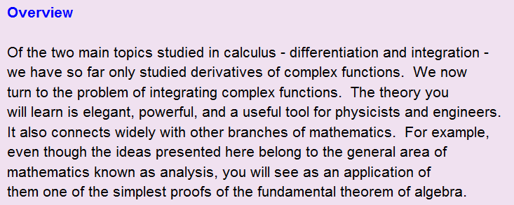
Introduction
Engineering

Slide 4


Engineering

Slide 5
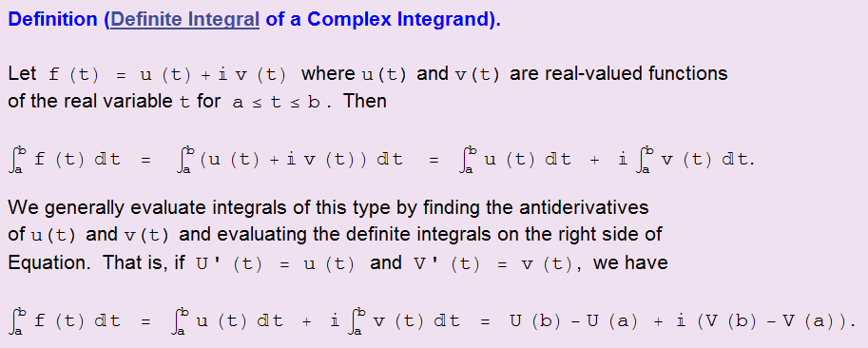
Engineering

Slide 6
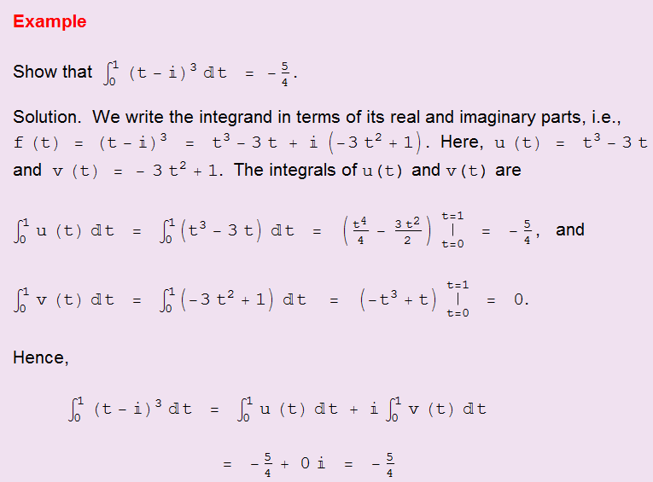
Engineering

Slide 7



Contour Integrals
Engineering

Slide 8

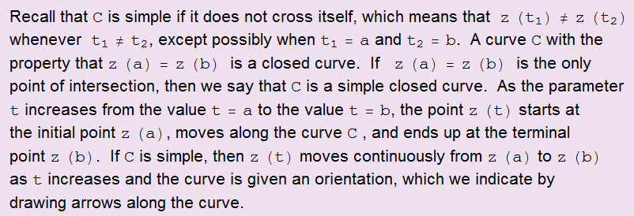
Engineering

Slide 9
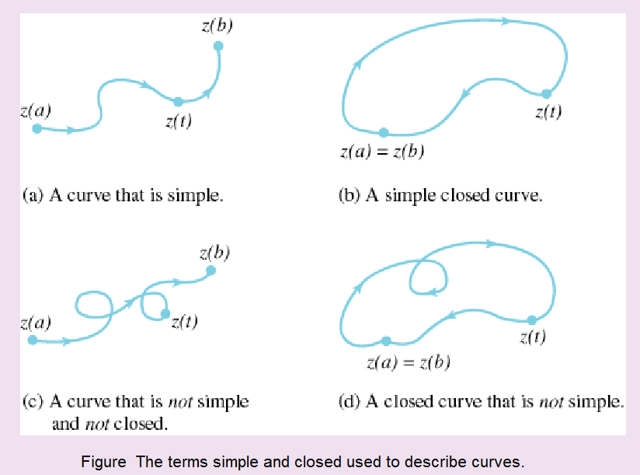
Engineering

Slide 10

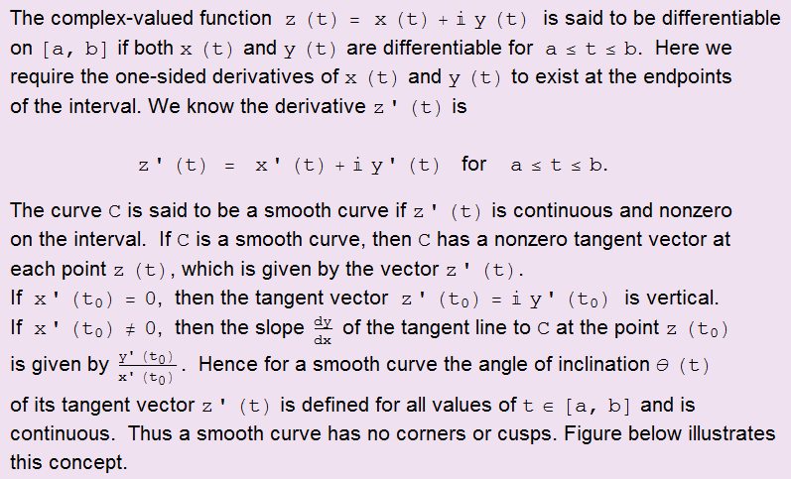
Engineering

Slide 11
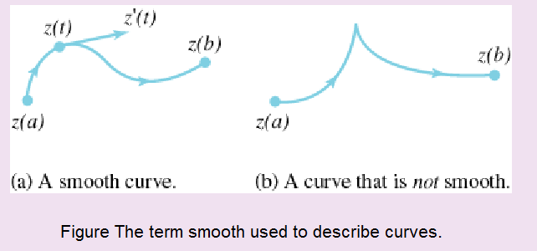
Engineering

Slide 12
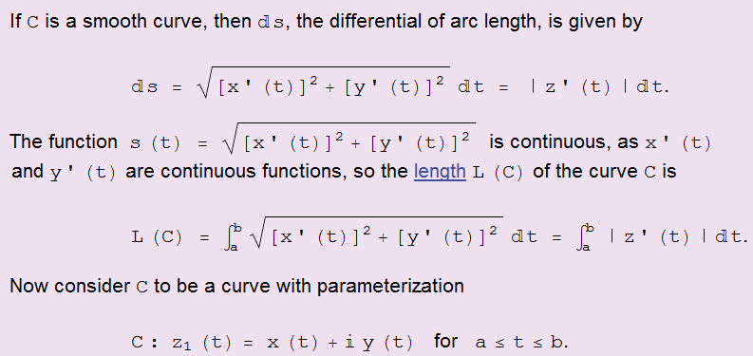
Engineering

Slide 13
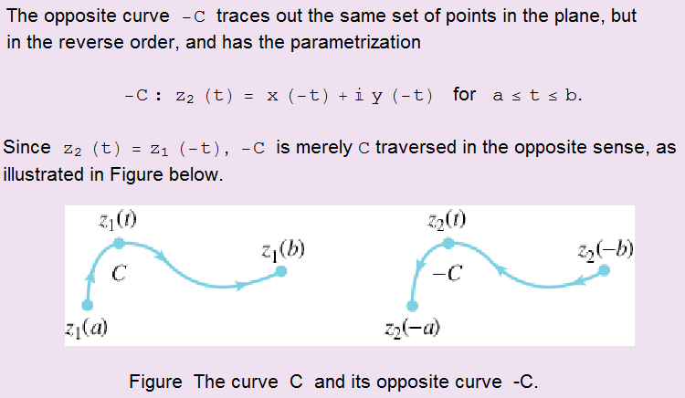
Engineering

Slide 14

Engineering

Slide 15
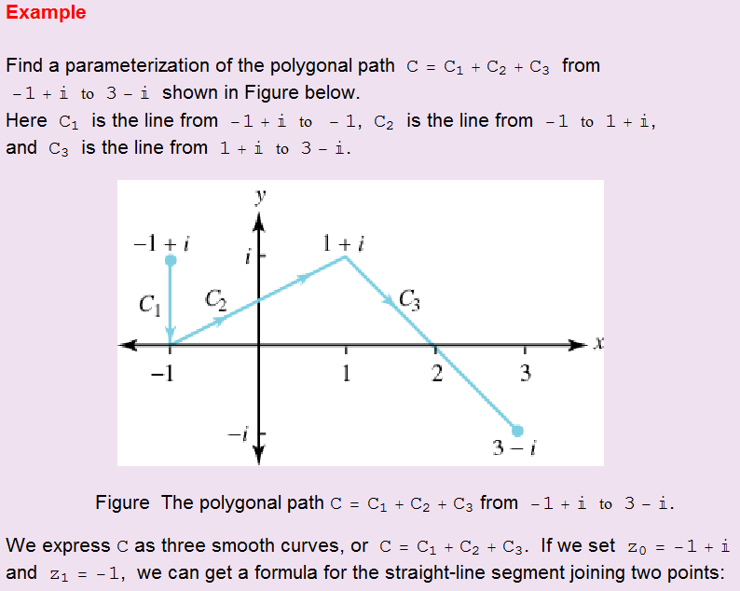
Engineering

Slide 16
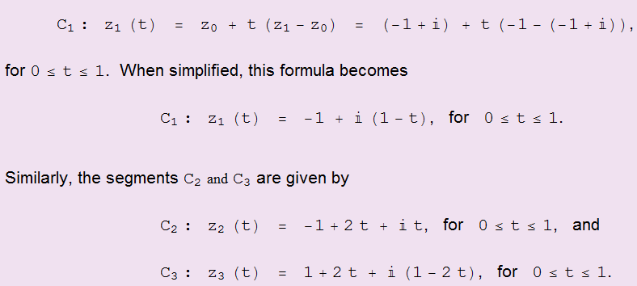
Engineering

Slide 17
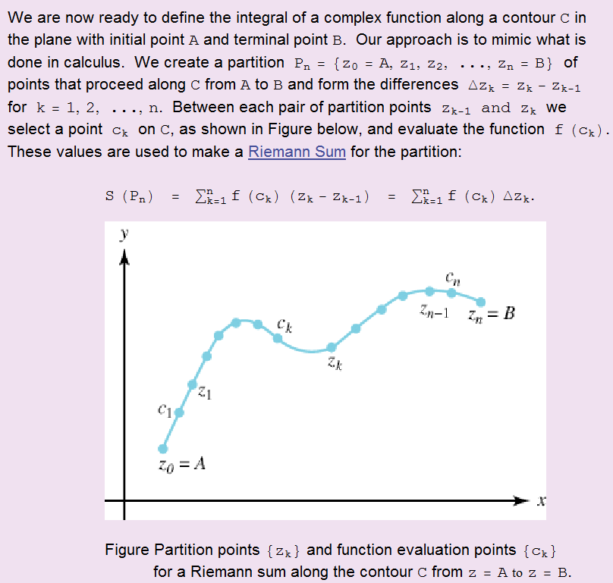
Engineering

Slide 18


Engineering

Slide 19
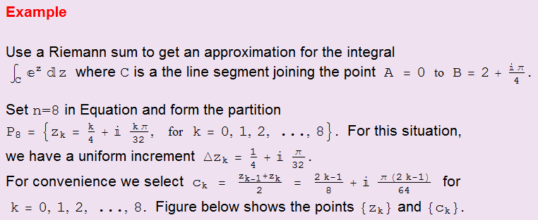
Engineering

Slide 20
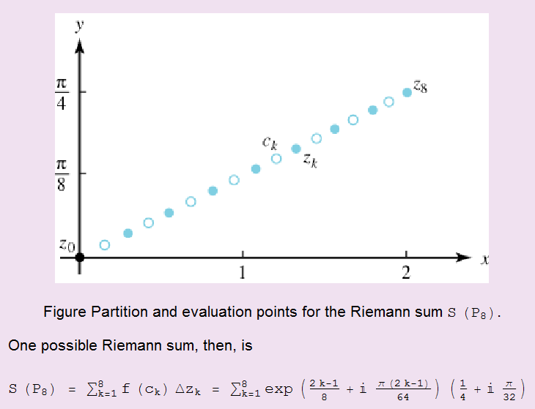
Engineering

Slide 21
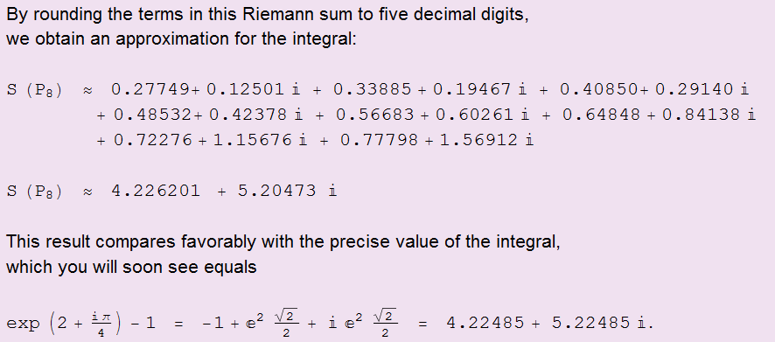
Engineering

Slide 22
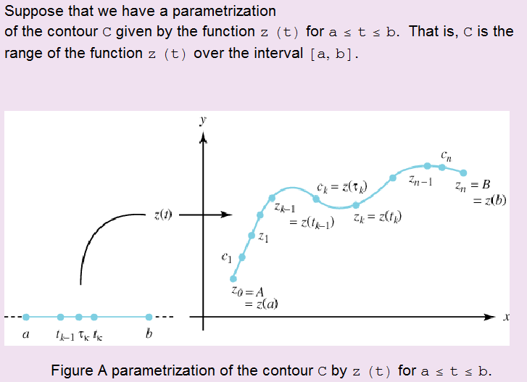
Engineering

Slide 23
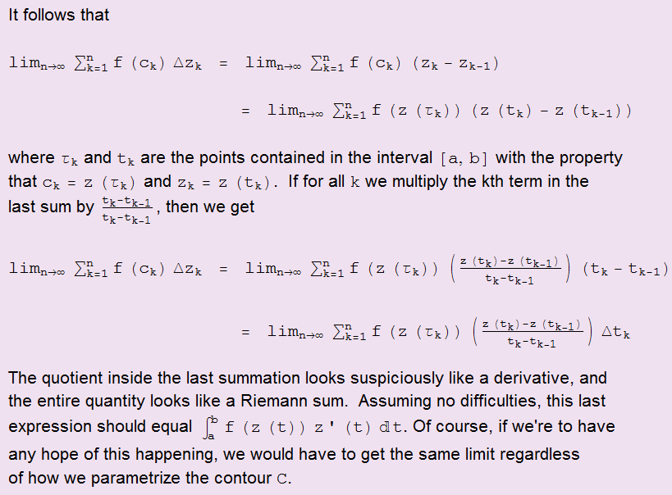
Engineering

Slide 24

Engineering

Slide 25
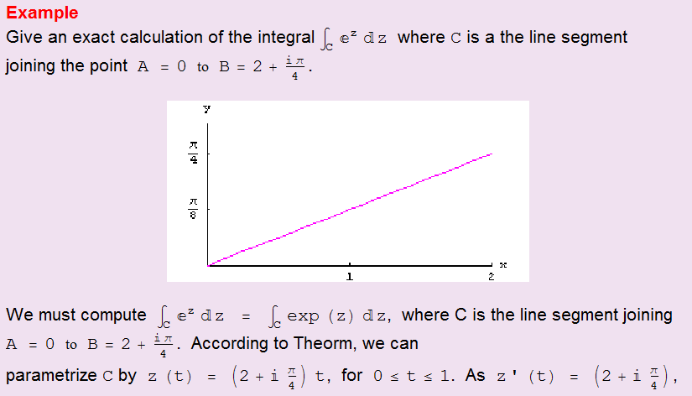
Engineering

Slide 26
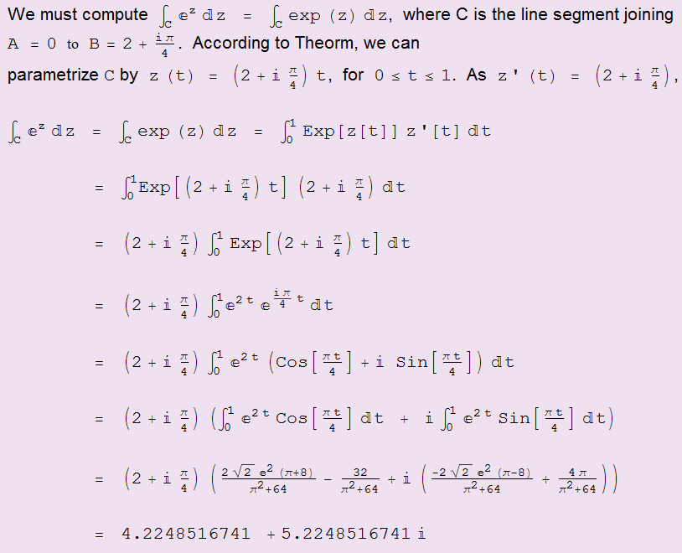
Engineering

Slide 27
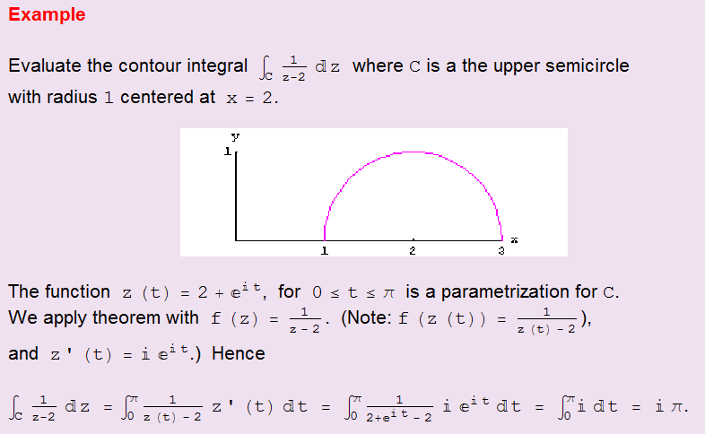
Engineering

Slide 28
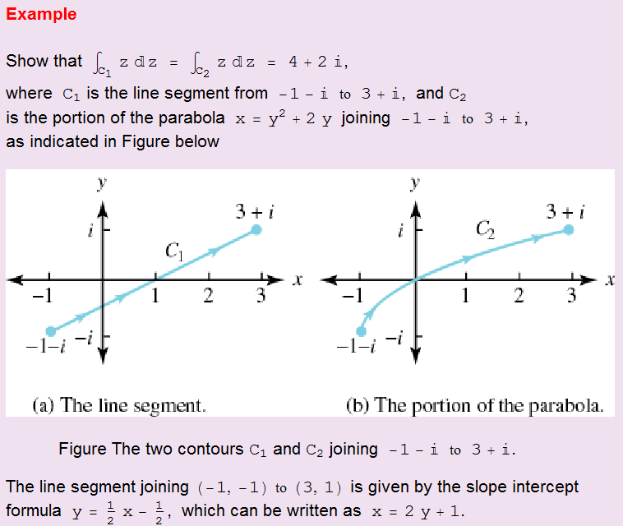
Engineering

Slide 29
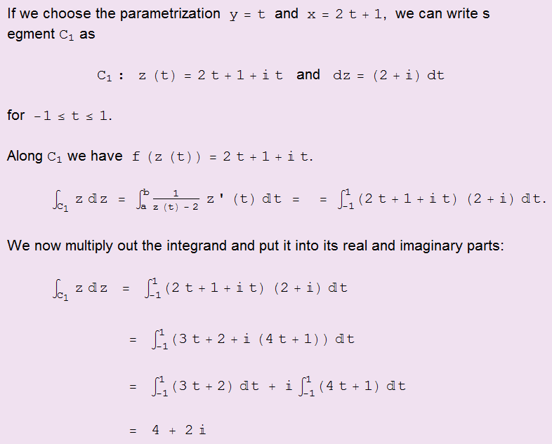
Engineering

Slide 30
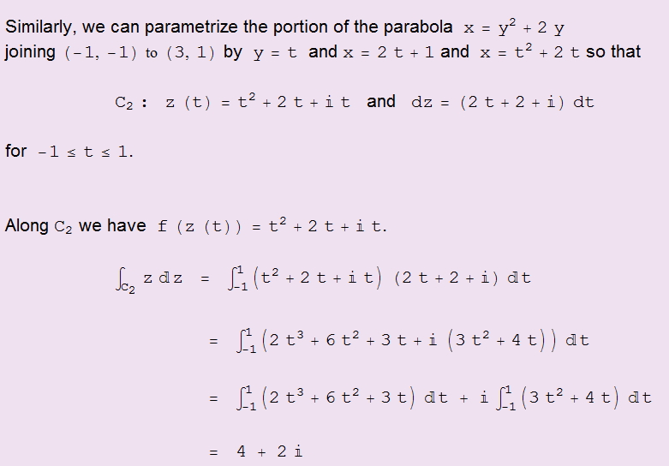
Engineering

Slide 31
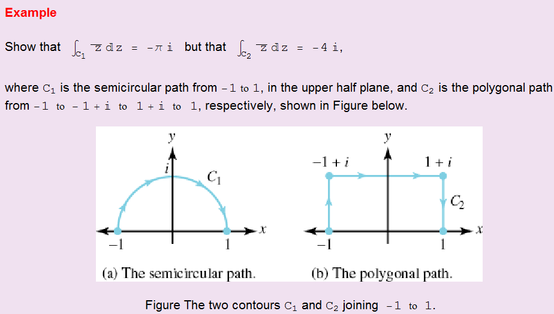
Engineering

Slide 32
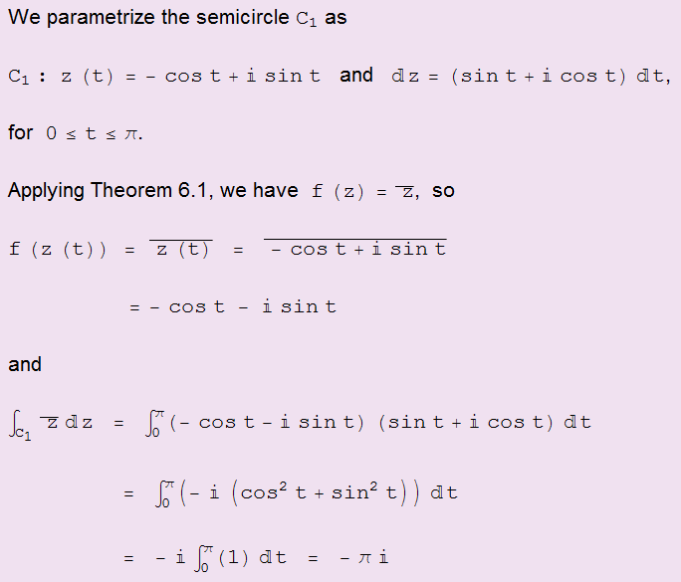
Engineering

Slide 33
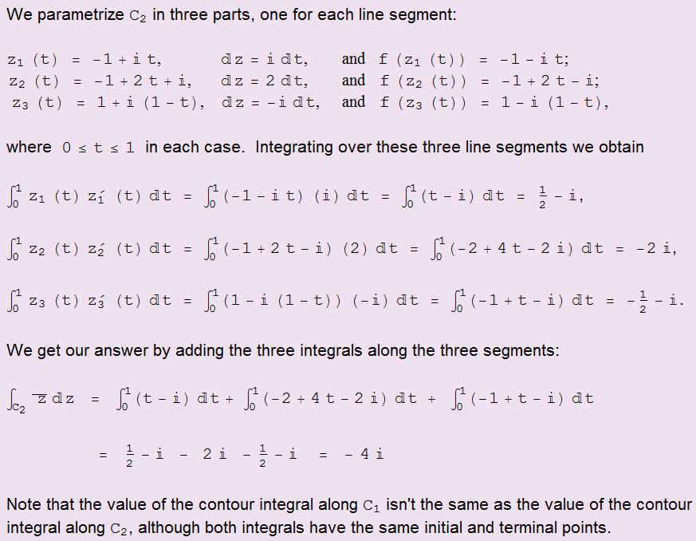
Engineering

Slide 34



Slide 35


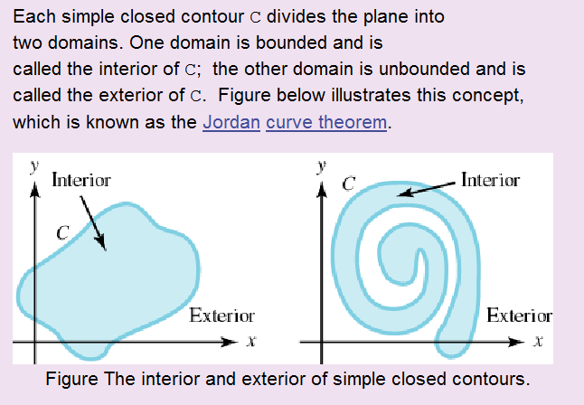
Cauchy-Coursat Integral theorem
Engineering

Slide 36

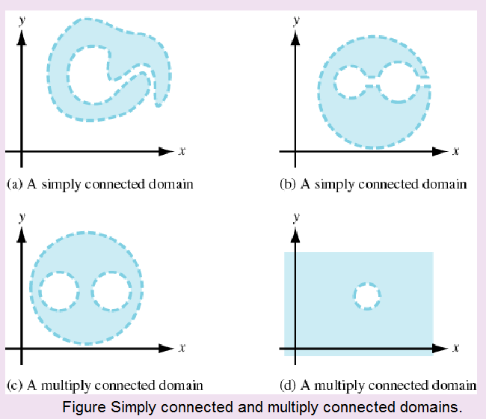
Engineering

Slide 37

Engineering

Slide 38
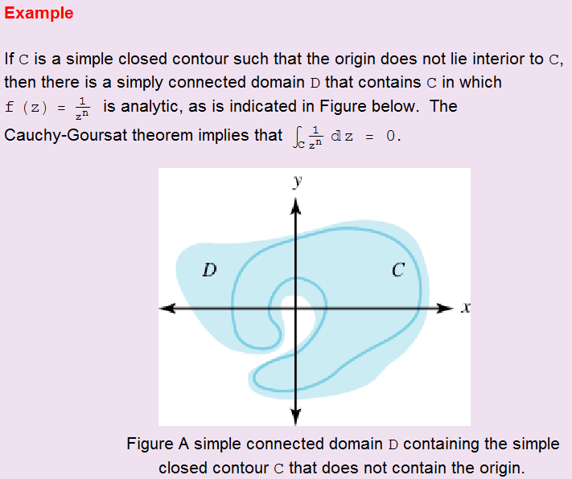
Engineering

Slide 39
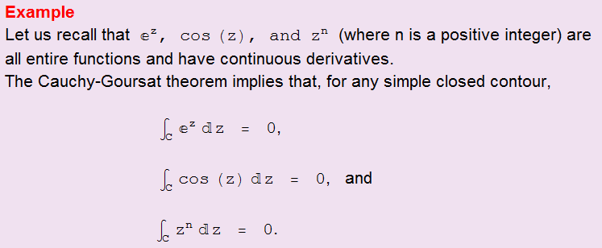
Engineering

Slide 40
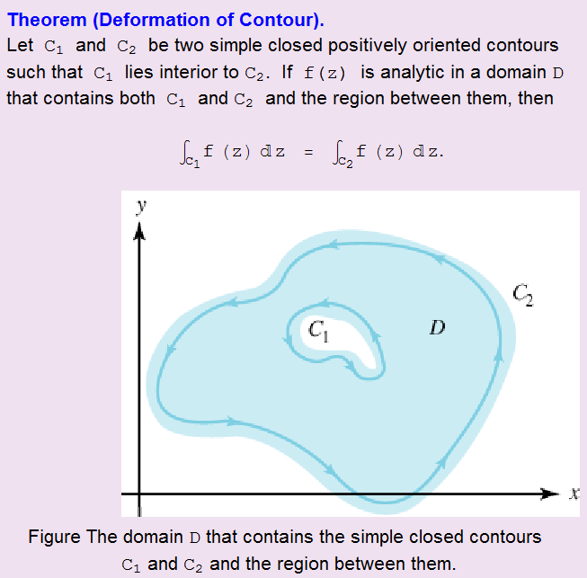
Engineering

Slide 41
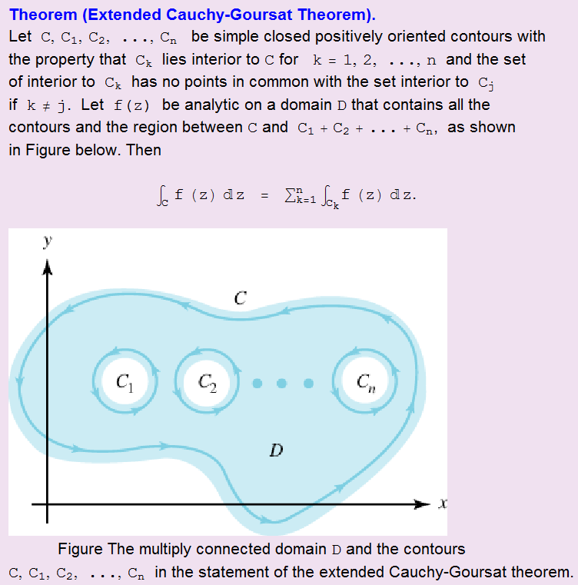
Engineering

Slide 42


Cauchy Integral Formula
Engineering

Slide 43
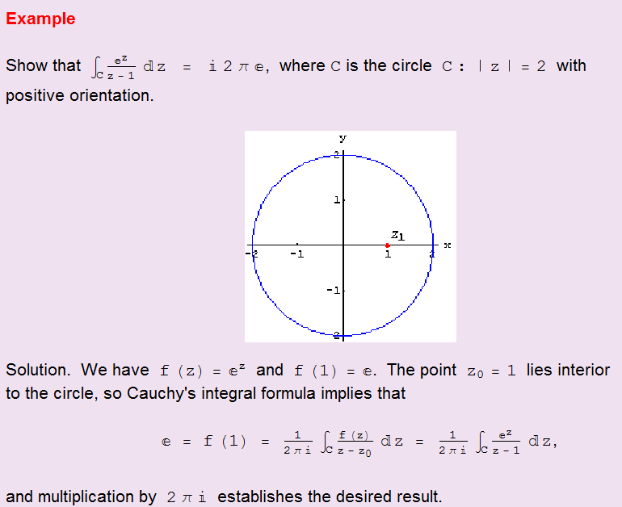
Engineering

Slide 44
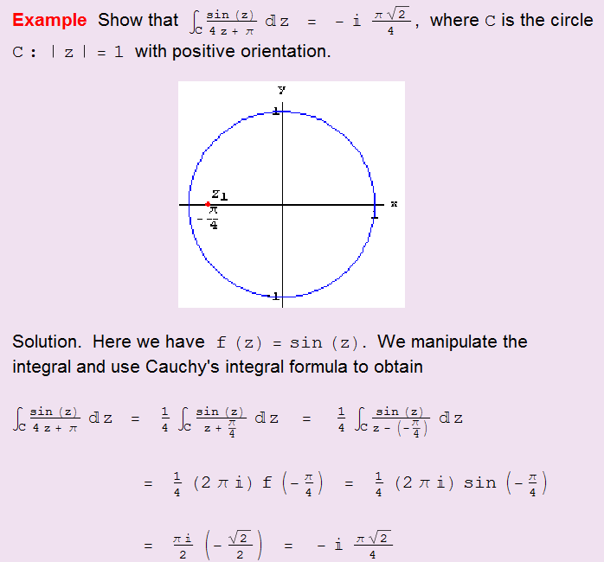
Engineering

Slide 45
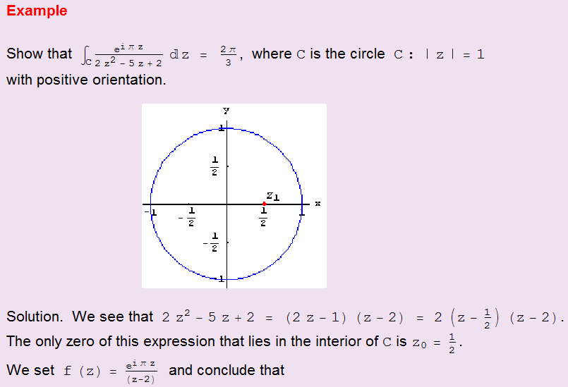
Engineering

Slide 46
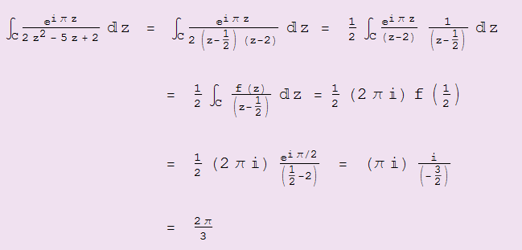
Engineering

Slide 47

Engineering

Slide 48
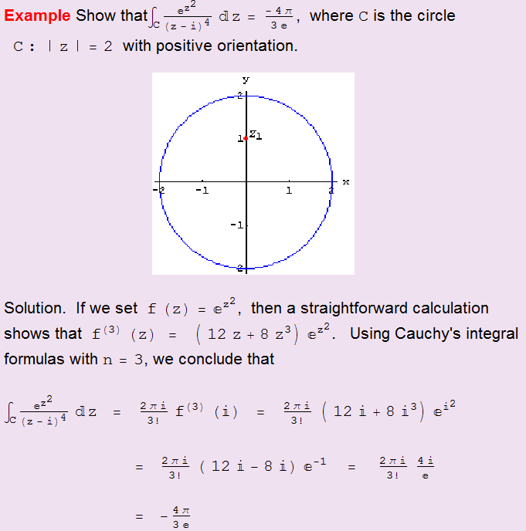
Engineering

Slide 49


More properties
Engineering

