Slide 1
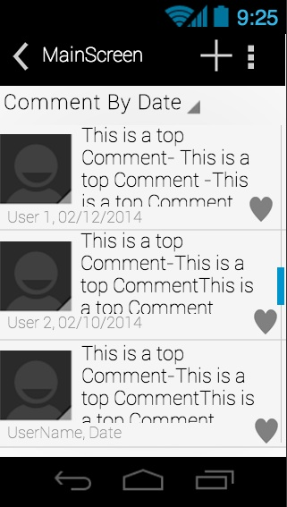
After the user has installed the application, he can make a top level comment (provided he is logged in). To make a reply on a comment, the user must press on the comment he wishes to make a reply on.

Slide 2
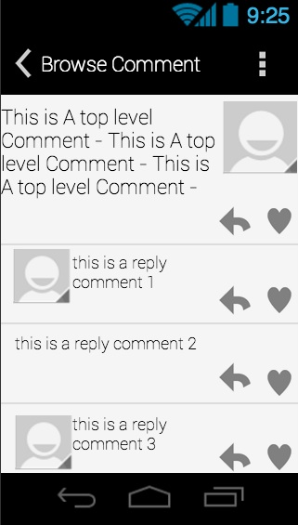
When the user clicks on the top-level comment, this screen comes up. The user can now see the full top-level comment and all the replies that were made about it. To reply to the top-level comment, the user must press on the reply button (arrow button) just beneath the comment.

Slide 3
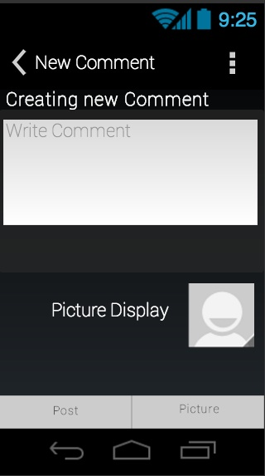
When the user clicks on the reply button, they are taken to this new screen. The user can then type in their comment in the text box. If the user wants to add a picture, they will click on the Picture button on the bottom of the screen.

Slide 4
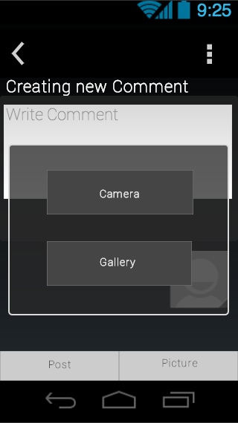
When the user clicks on the Picture button, they are taken to this screen. The user must then choose if the picture they want to add to the comment comes from their gallery, or if they want to use the camera and take a picture.

Slide 5
After the user has added a picture (or decided to not add a picture), the user should press the Post button at the bottom of the screen.

Slide 6
After the user has decided to publish the reply, that comment will appear underneath the top-level comment, at the very top of all of the replies (if it is the most recent).

