Slide 1
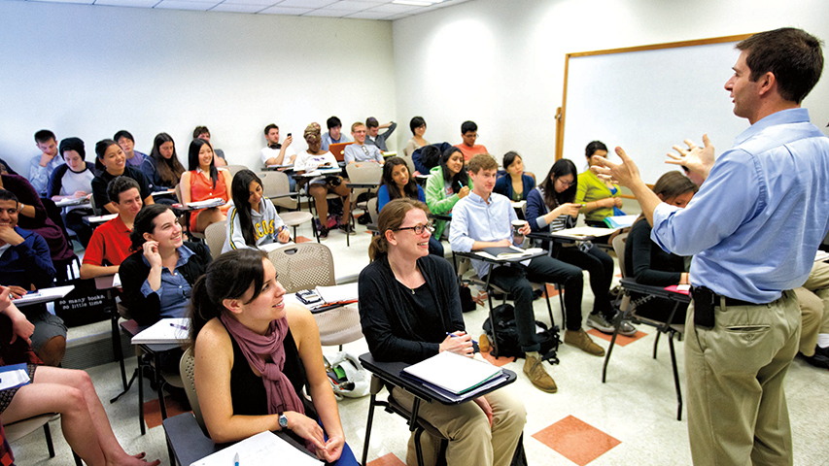

Setting up your computers for R
SURP R Workshop #1
Yen-Chung Chen & Cassandra Buzby
June 22 2021

Slide 2
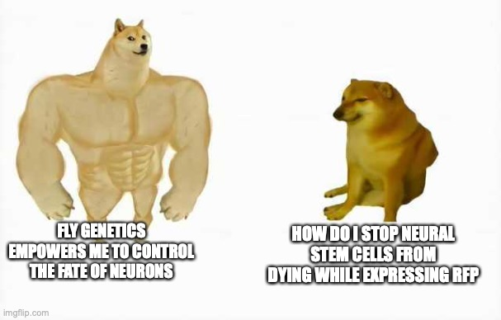
Who am I
Yen-Chung Chen
4th-year PhD student, Desplan lab (Brown 10th floor)
Work with flies, R, and a bit of Python
Live in a virtual different time zone since the pandemic
Email: yenchung.chen at nyu.edu

Slide 3
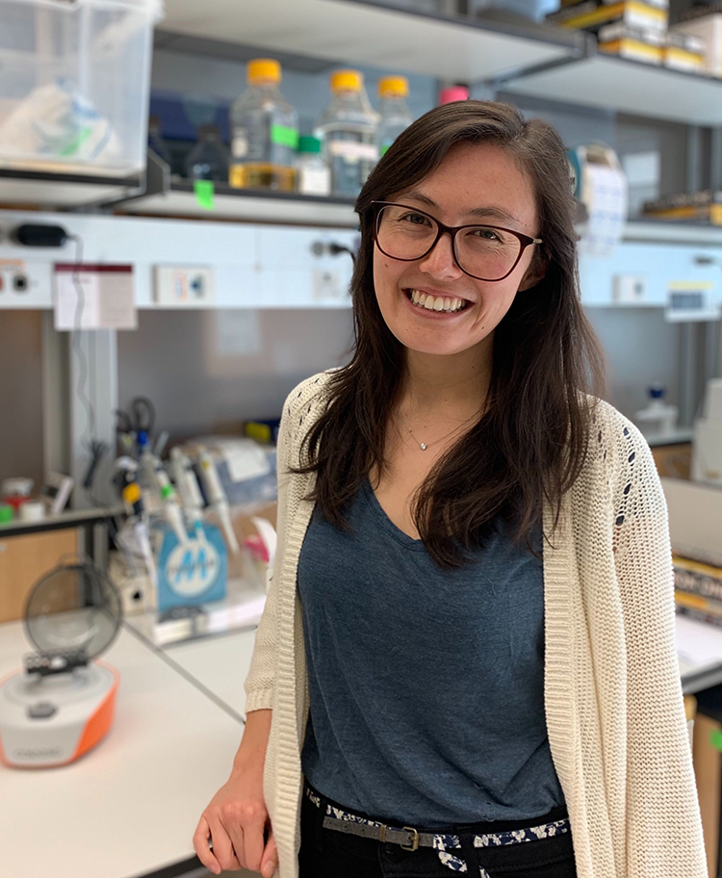
Who am I
Cassandra Buzby
4th-year PhD student, Siegal lab (CGSB 3rd floor)
Studies yeast genetics (how much do gene interactions contribute to phenotypic variation?)
Email: cassandra.buzby at nyu.edu

Slide 4
Outline
What we are going to do today (Handout)
A glimpse of what R is usually used for
Set up your laptop for R
Simple arithmetic

Slide 5
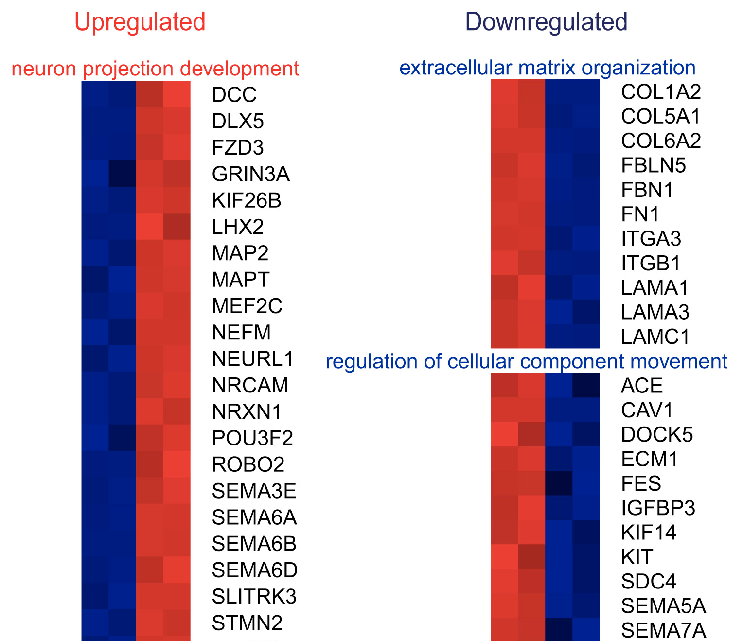
Using R
What is R usually used for?
In place of Excel or Google sheets
To automate repetitive things
A gateway to larger datasets
Abernathy et al. (2017). Cell stem cell, 21(3), 332–348.e9. https://doi.org/10.1016/j.stem.2017.08.002

