Slide 1
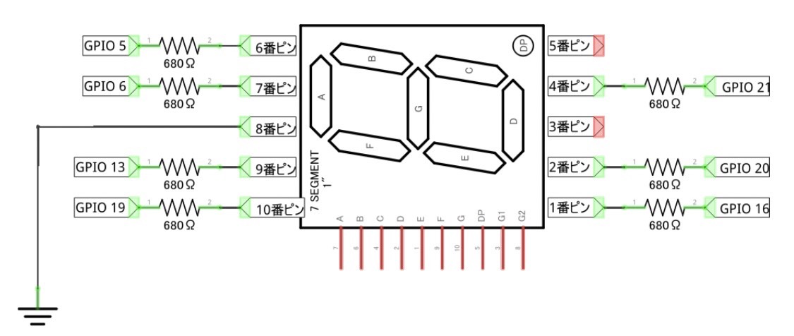
GPIO26
680Ω

Slide 2
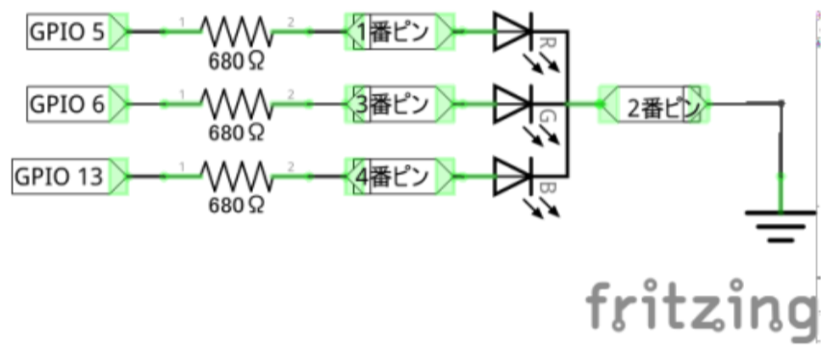
LED_1
2
3
4

Slide 3
LED_2
17
27
22

Slide 4
LED_3
10
9
11

Slide 5
判定用LED
25
8
26

Slide 6
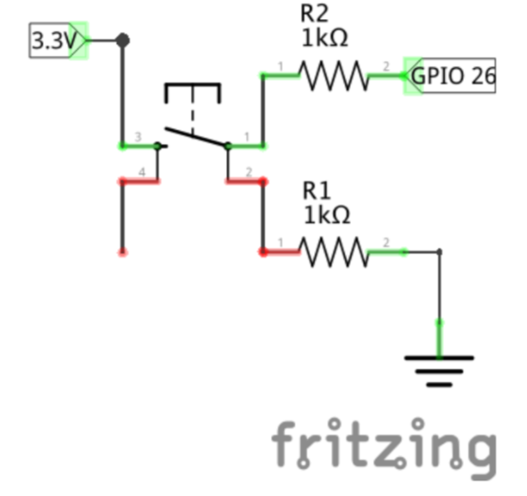
switch_1
Switch_2
7
12

