Slide 1
Designing an Object Detection System Phase 1
Group 4

Slide 2
Implementation
Key Setup Module
Computes initial internal state
Cipher Module
Generates cipher stream
Trivium Module
Overall module
Output stream = input stream XOR cipher stream

Slide 3
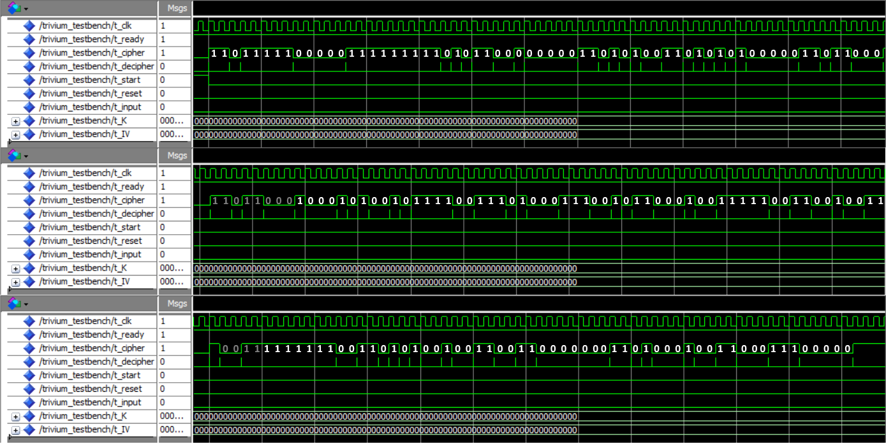
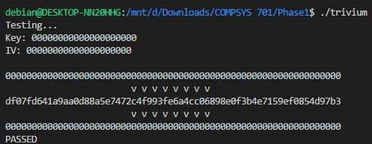
Simulation Results

Slide 4
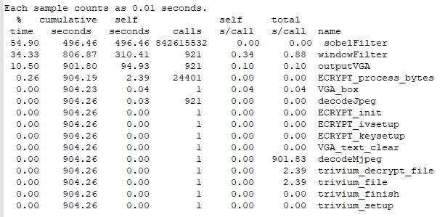
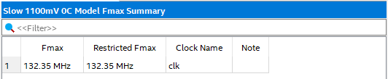
Performance Comparison

Slide 5
Hardware/Software Integration
HPS Bridge which maps ARM memory to Cyclone V PIO
Allows us to write to FPGA registers from C code on Linux system
20 bit data bus, 4 bit control signals
FPGA output can be mapped back to ARM

Slide 6
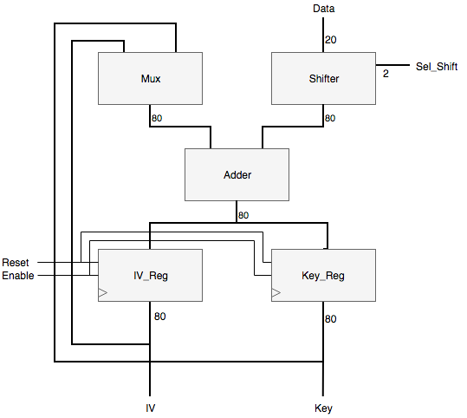
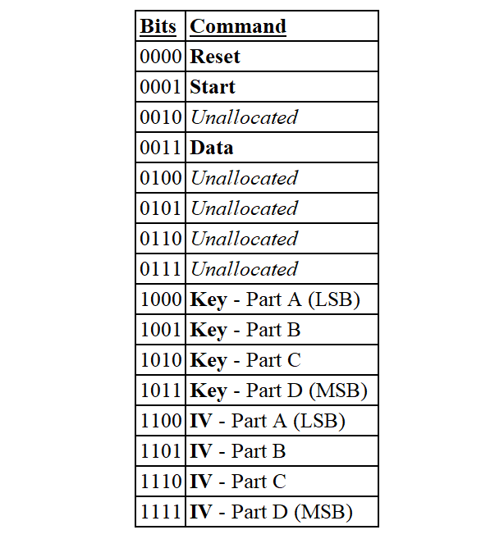
HPS Interface and Signals

Slide 7
Any Questions?

