Slide 1
Designing an Object Detection System on Chip
Group 4

Slide 2
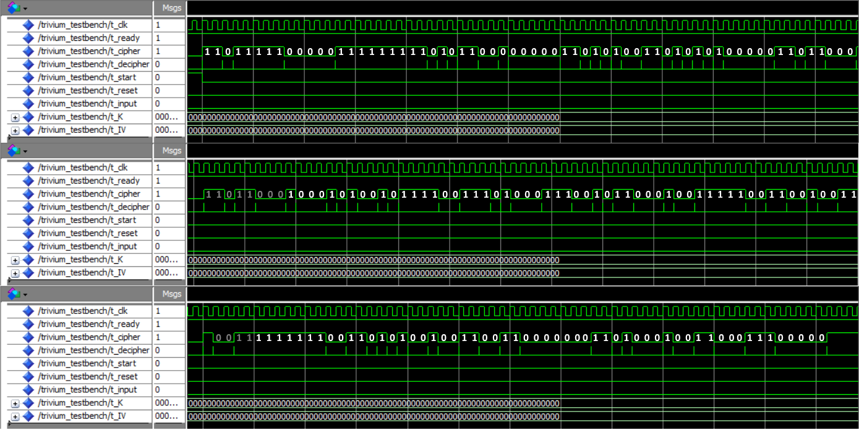
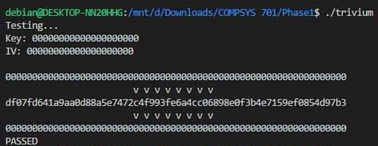
Simulation Results

Slide 3
Performance comparison
Sak, I hope you got our bak
Performance comparison (with or without the communication overhead, this could include theoretical calculations based on operating frequency and required number of cycles)

Slide 4
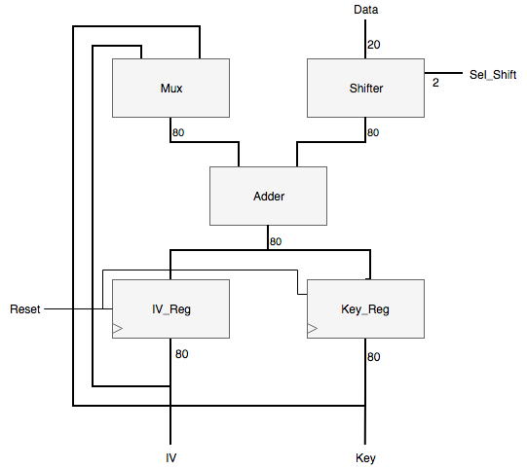
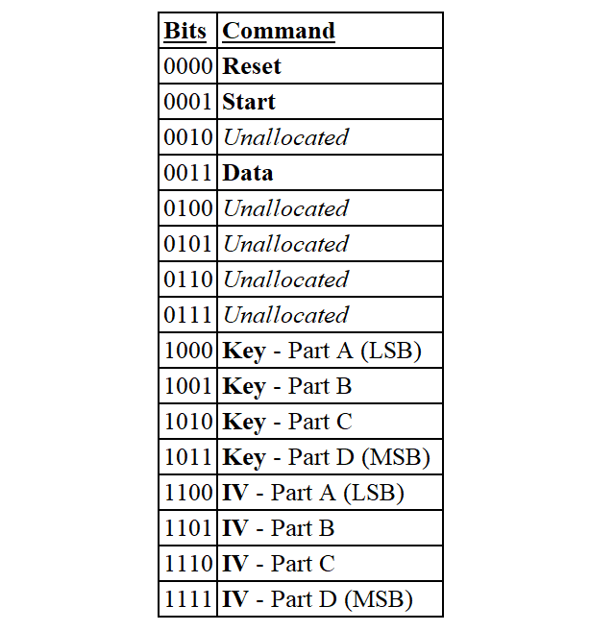
Datapath/control unit diagrams

Slide 5
Outlining your approach for integration with the ARM core
Outlining your approach for integration with the ARM core

