Slide 1
Checklist of points to consider
If we need to support both a single stage filter and a double stage filter, can we reuse the hardware from the second stage when you only need a single stage filter?
How much control does the HPS have over the operations performed?
Can we share data between adjacent windows to reduce the amount of loading required?
How separable are our filters?
Can we break down our input to operate on multiple independent parts at once?
What about multiple adjacent parts at once?
How can the image data be used for the required processing?
Can we use less than the full data width of all three (RGB) channels?
Do we only need greyscale data?
Can we pack the data to use the communication available more efficiently?
How can we make sure that the hardware is used efficiently?
What if we include an additional hardware component?
Our filtered result must be available for the HPS to use later for object detection.
o How do we manage loading image data onto the FPGA as well as the pre-processed data back off?

Slide 2
Checklist of expectations
A plan for our implemented co-processor, detailing the interfaces used and some example use cases.
This includes diagrams of our control unit FSM as well as the datapath, potentially shown as multiple datapaths where muxes have been configured according to a specified filter setup.
We will also need to produce a “data sheet” which explains the memory-mapped registers we make available to software, their functions (i.e. control or status registers, and the “meaning” of each bit), as well as an outline of the steps that need to be performed in order to set up our IP block.
Demonstration of correct setup functionality, shown through simulation.
This means being able to provide the necessary commands to our co-processor to allow for setup of various filters.

Slide 3
Designing an Object Detection System Phase 2
Group 4

Slide 4
Implementation
Filters implemented in hardware:
Sobel filter
Convolution filter
Median filter
Bi-directional HPS – FPGA interface
C code in full control of filtering hardware
No FSM required

Slide 5
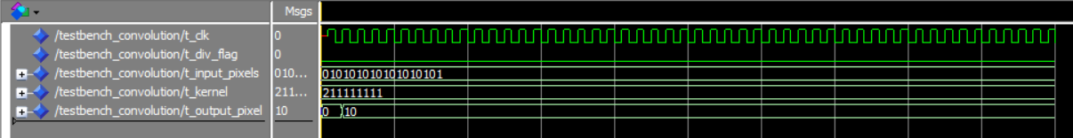
Simulation
Median Filter:
Convolution Filter:
Sobel Filter:

Slide 6
Integration
Windowing functionality remains the responsibility of the ARM core
Series of 3x3 pixels sent to FPGA
FPGA responds with a single pixel value
16-bit ID tags used to identify messages

Slide 7
Interface
ARM Core
Avalon AXI Bus
24
24
24
16
24
filter_interface
PIO_0
PIO_1
PIO_2
PIO_3
PIO_4
Convolution Filter
clk_50
8 bits | 8 bits | 8 bits
8 bits | 8 bits | 8 bits
8 bits | 8 bits | 8 bits
All loaded on PIO_0
All loaded on PIO_1
All loaded on PIO_2

Slide 8
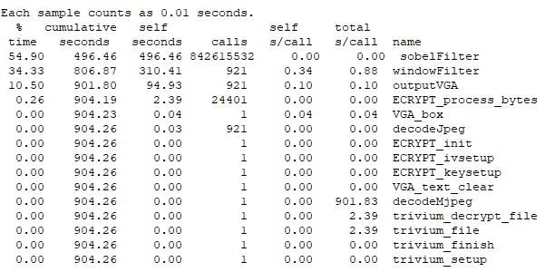
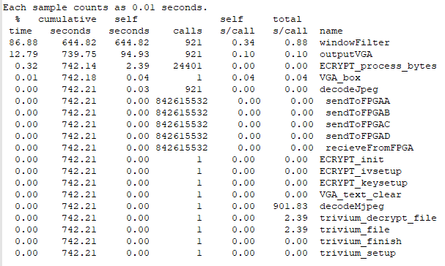
Performance Comparison
21% Improvement

Slide 9
Future Work
Filter type/s will be selectable using ID
Pipelined approach
Multiple filter components
Windows will be filtered concurrently as they are received by interface
Optimising packet creation
Implementing object detection

