Slide 1
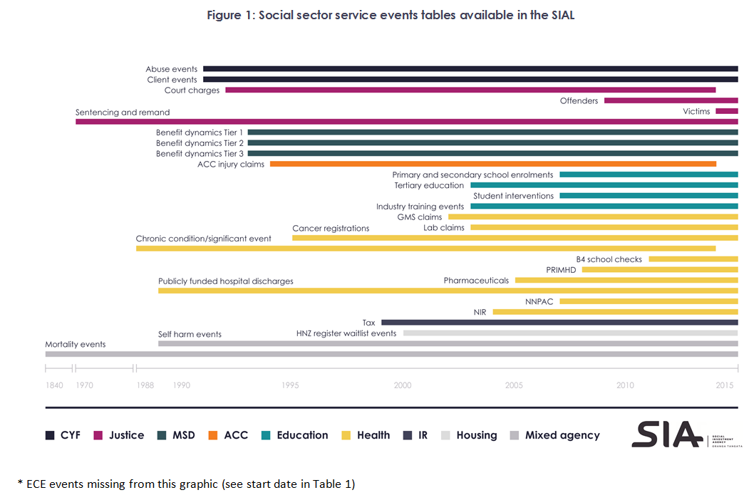
Notes:
To prompt discussion -

