Slide 1
Presentation of Dissertation
Nicolas Zachariou

Slide 2
Dynamic Programming: An experimental analysis and comparison of the Bottom-Up and Top-Down approaches
January 2021

Slide 3
Introduction to Dynamic Programming
An algorithmic approach that solves problems which can be described by an optimal function efficiently by storing and reusing data. Problems are divided using the optimal function, and solved in such an order so that data is used efficiently and excess calculations are avoided.
Dynamic Programming algorithms typically make use of arrays to represent the value of sub-problems. The array values can generally be computed in two ways, these are the two Dynamic Programming approaches, commonly known as the Top-Down and Bottom-Up approaches.

Slide 4
The Top-Down approach
Is a direct representation of the recursive description. It is a recursive approach that uses the recursive function of a problem to recursively divide and solve the problem. To speed up the process of recursion we use an array to store every calculated values to all sub-problems that occur during the recursive process. This way we can detect problems that are declared more than once and avoid computing them again.
The process of storing the solved Sub-Problems and using this information to stop duplicate recursion branches is known as Memorization or Memoization
This process was name the Top-Down approach because of its ability to start from a problem and divide it recursively to smaller problems, thus moving from the “top” of an array to its “Bottom”

Slide 5
The Bottom-Up approach
This approach is an iterative approach, it uses the optimal description of a problem to gradually build up from small Sub-Problems to bigger ones. This approach generally starts from the smallest possible Sub-Problems or end cases and it solves every possible Sub-Problem until the solution to the original problem is found.
This process is also called as tabulation, since the array (or table) is used to store all possible Sub-Problems and solve bigger problems with each iteration.
Since this approach begins from small problems and builds into bigger and more complex problems, it was named the Bottom-Up approach.

Slide 6
My Goal
It is well known that recursive implementations cause an overhead to the stack usage, and the execution time. However, I wanted to test how much this overhead was, to find out which of the two approaches was more efficient.
After realising the results varied depending on the input of a problem, I wanted to test enough problems to be able to categorize their performance in regards to their input type, to devise a rule of thumb that could possibly give us an idea of what to expect from each algorithm for any given problem.

Slide 7
Project Timeline: Preliminary Research
Research on alternative data structures for dynamic programming algorithms
Research on memory usage, CPU utilization, optimizations and taking their measurements.
Hands on practise with the first problem, taking the data measurements, and making a reusable template used to develop all other problems
Development of a variety of scripts to automate data collection

Slide 8
Project Timeline: Problem Analysis
Implementation of basic problems using arrays. After implementing and analysing the results of the “Dijkstra” problem and the “Independent Sets” problem i realised the effect of the input to the performance of the approach
Therefore, the implementation of more tree based problems and the “LISS” problem followed
I realised there were limitations with the Valgrind tool so I rerun all problems with new memory measuring tools

Slide 9
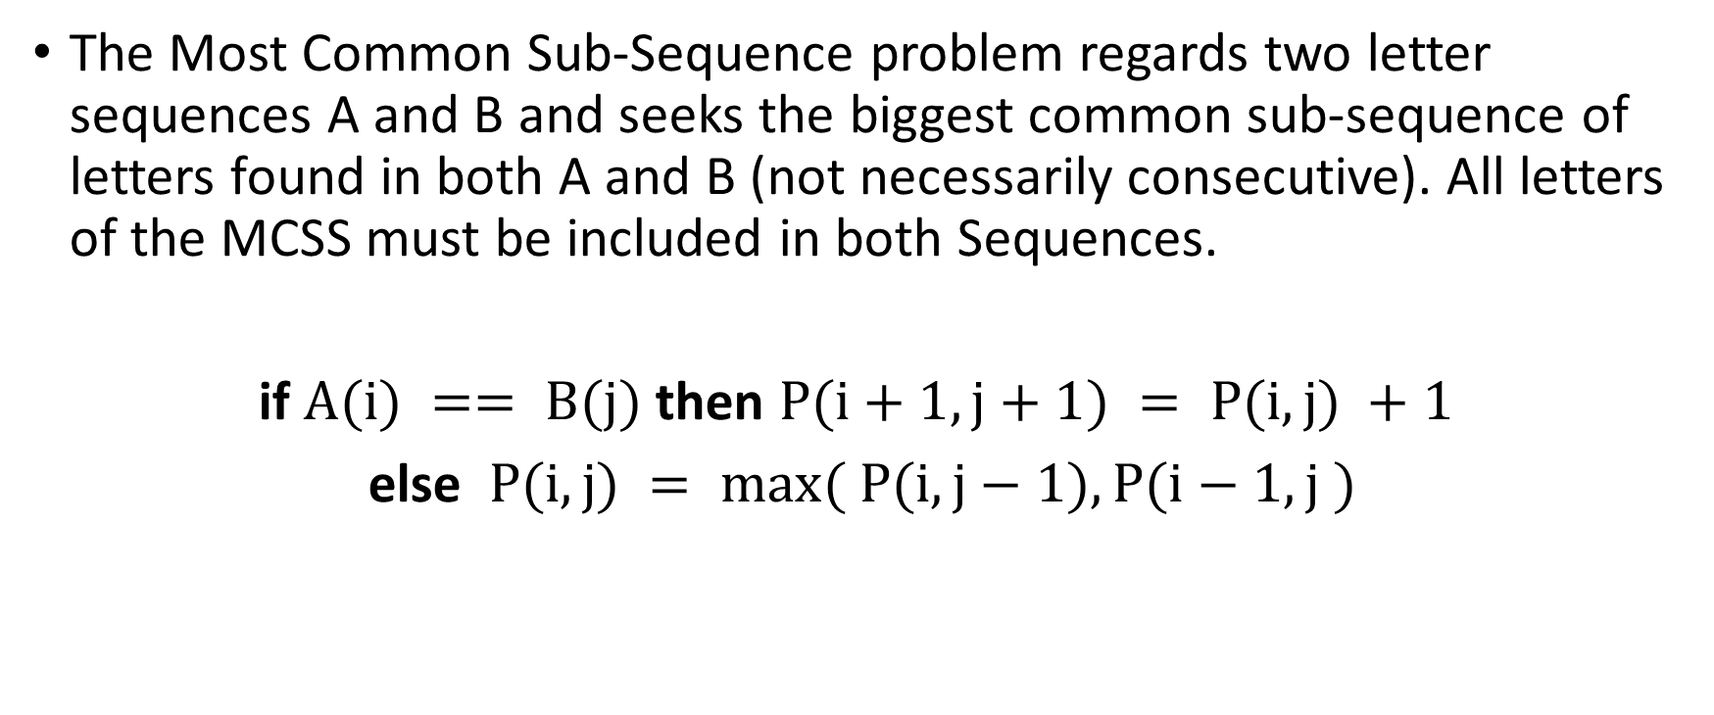
Most Common Sub-Sequence
The Most Common Sub-Sequence problem regards two letter sequences A and B and seeks the biggest common sub-sequence of letters found in both A and B (not necessarily consecutive). All letters of the MCSS must be included in both Sequences.
if $A(i) == B(j)$ then $P(i+1, j+1) = P(i,j) +1$
else $P(i,j) = max( P(i,j−1), P(i−1,j )$

Slide 10
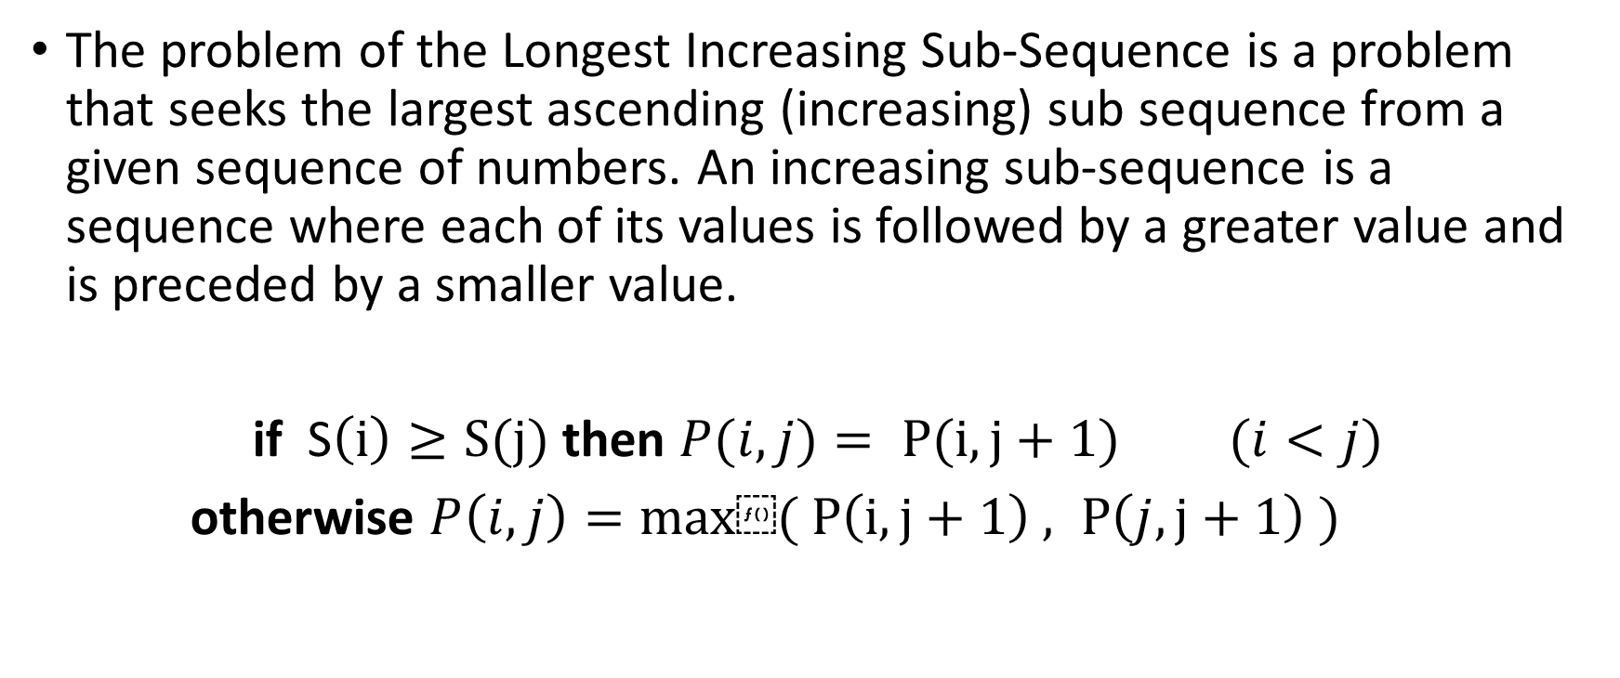
Longest Increasing Sub-Sequence (1D & 2D)
The problem of the Longest Increasing Sub-Sequence is a problem that seeks the largest ascending (increasing) sub sequence from a given sequence of numbers. An increasing sub-sequence is a sequence where each of its values is followed by a greater value and is preceded by a smaller value.
if S$\left(i\right)≥S(j)$ then $P(i,j)= P(i,j+1)$ $(i<j)$
otherwise $P\left(i,j\right)=max⁡( P\left(i,j+1\right) , P\left(j,j+1\right) )$

Slide 11
Chain Matrix Multiplication
Let 2 matrices A and B of size NxI and JxM respectively. The multiplication (dot-product) of these 2 matrices requires that I is equal to J and results in a new matrix of size NxM. This process requires NxIxM operations, this is also set to be the cost of the multiplication. When multiple matrices have to be multiplied in a sequence, the order in which these matrices are multiplied has an effect in the resulting cost. The aim is to minimize this cost by choosing the optimal order in which these matrices should be multiplied.

Slide 12
0-1 Knapsack
The problem is to find the selection of items within a certain weight limit C, with the most value. For the ‘0-1’ version of the problem we assume an item can either be completely inside the sack or completely out. We also assume that weights are natural numbers. The idea is that we create C sacks, and then we choose an item arbitrarily and attempt to place the item in these sacks to maximize the value. The choice is to either place the item in the sack or not. When all items have been processed for all C sacks the solution will be found.

Slide 13
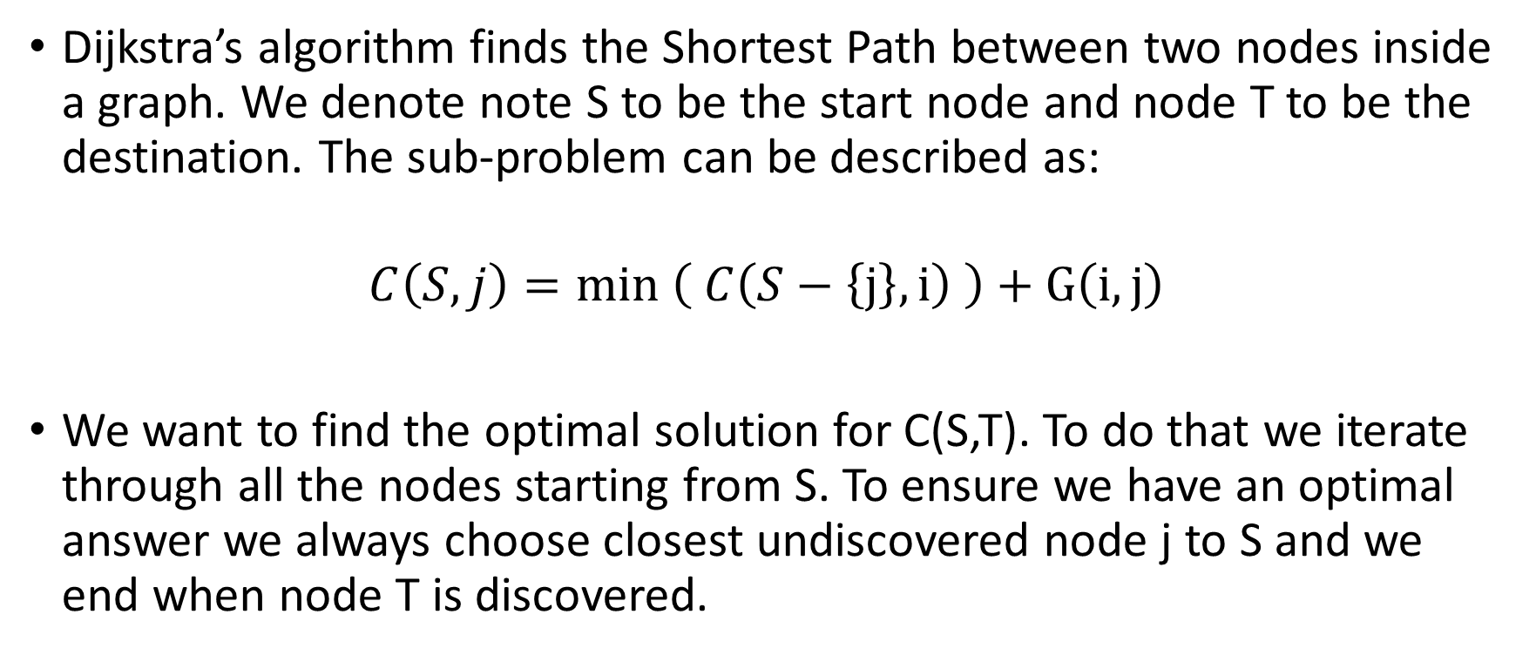
Dijkstra
Dijkstra’s algorithm finds the Shortest Path between two nodes inside a graph. We denote note S to be the start node and node T to be the destination. The sub-problem can be described as:
$$C\left(S,j\right)=min \left( C\left(S−\left\{j\right\}, i\right) \right)+G\left(i,j\right)$$
We want to find the optimal solution for C(S,T). To do that we iterate through all the nodes starting from S. To ensure we have an optimal answer we always choose closest undiscovered node j to S and we end when node T is discovered.

Slide 14
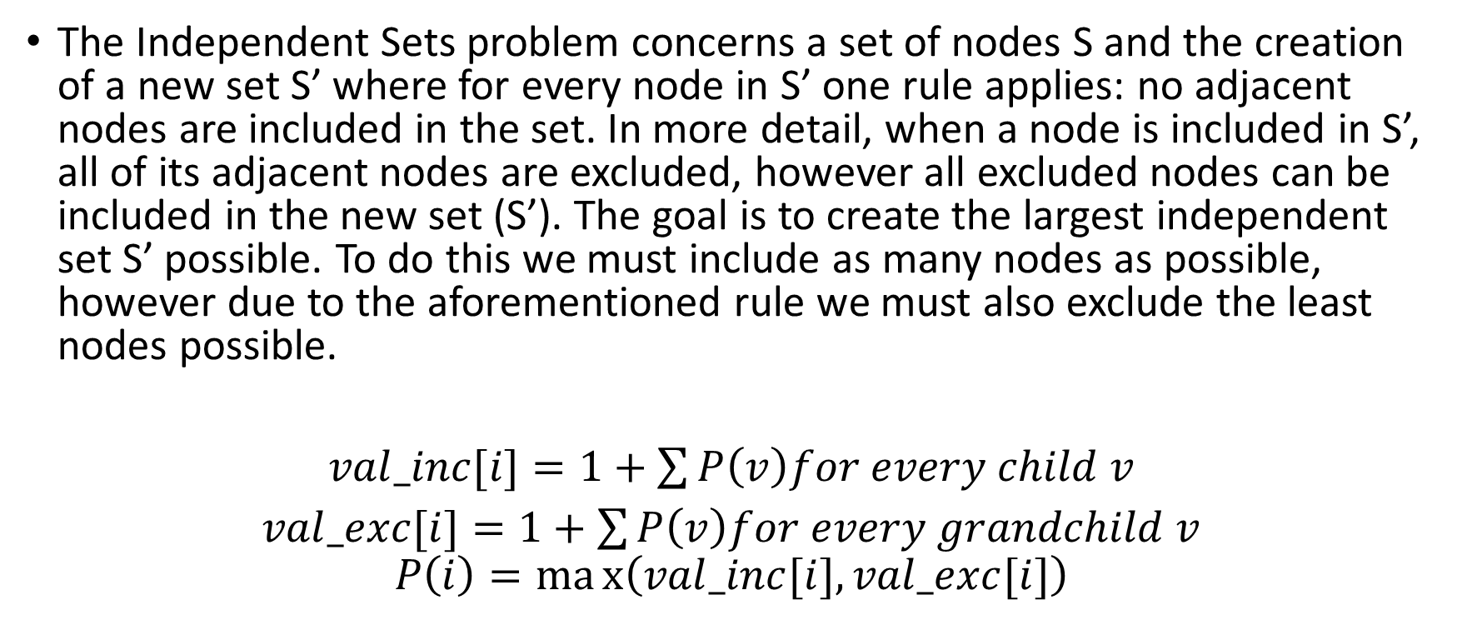
Independent Sets
The Independent Sets problem concerns a set of nodes S and the creation of a new set S’ where for every node in S’ one rule applies: no adjacent nodes are included in the set. In more detail, when a node is included in S’, all of its adjacent nodes are excluded, however all excluded nodes can be included in the new set (S’). The goal is to create the largest independent set S’ possible. To do this we must include as many nodes as possible, however due to the aforementioned rule we must also exclude the least nodes possible.
$val_inc[i]=1+\sum{P\left(v\right)for every child v}$
$val_exc[i]=1+\sum{P\left(v\right)for every grandchild v}$
$$P\left(i\right)=max\left(val_inc[i],val_exc[i]\right)$$

Slide 15
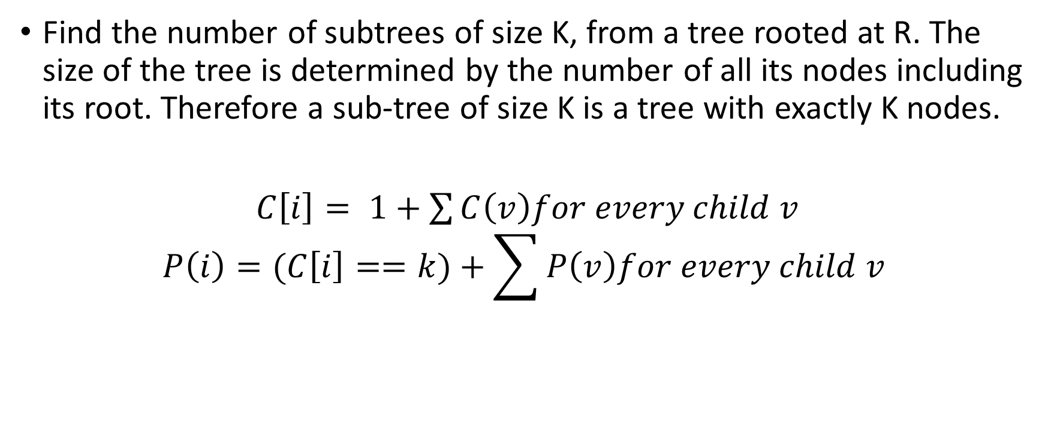
K-Trees
Find the number of subtrees of size K, from a tree rooted at R. The size of the tree is determined by the number of all its nodes including its root. Therefore a sub-tree of size K is a tree with exactly K nodes.
$C\left[i\right]= 1+\sum{C\left(v\right)for every child v}$
$$P\left(i\right)=(C\left[i\right]==k)+\sum{P\left(v\right)for every child v}$$

Slide 16
Tree Diameter
Find the diameter of a tree rooted at R. The diameter is the maximum distance between 2 nodes inside the tree.

Slide 17
Digging Further - MCSS

Slide 18
Example - MCSS
Iterative - Bottom-Up approach
Recursive – Top-Down Approach
Sequences |  | A | P | P | L | E | S
 | 0 | 0 | 0 | 0 | 0 | 0 | 0
P | 0 | 0 | 1 | 1 | 1 | 1 | 1
I | 0 | 0 | 1 | 1 | 1 | 1 | 1
N | 0 | 0 | 1 | 1 | 1 | 1 | 1
E | 0 | 0 | 1 | 1 | 1 | 2 | 2
A | 0 | 1 | 1 | 1 | 1 | 2 | 2
P | 0 | 1 | 2 | 2 | 2 | 2 | 2
P | 0 | 1 | 2 | 3 | 3 | 3 | 3
L | 0 | 1 | 2 | 3 | 4 | 4 | 4
E | 0 | 1 | 2 | 3 | 4 | 5 | 5
Sequence |  | A | P | P | L | E | S
 | -1 | -1 | -1 | -1 | -1 | -1 | -1
P | -1 | 0 | 1 | 1 | 1 | 1 | 1
I | -1 | 0 | 1 | 1 | 1 | 1 | 1
N | -1 | 0 | 1 | 1 | 1 | 1 | 1
E | -1 | 0 | 1 | 1 | 1 | 2 | 2
A | -1 | 1 | 1 | 1 | 1 | 2 | 2
P | -1 | -1 | 2 | 2 | 2 | 2 | 2
P | -1 | -1 | -1 | 3 | 3 | 3 | 3
L | -1 | -1 | -1 | -1 | 4 | 4 | 4
E | -1 | -1 | -1 | -1 | -1 | 5 | 5

Slide 19
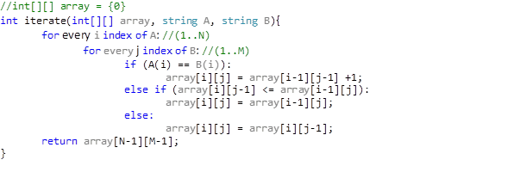
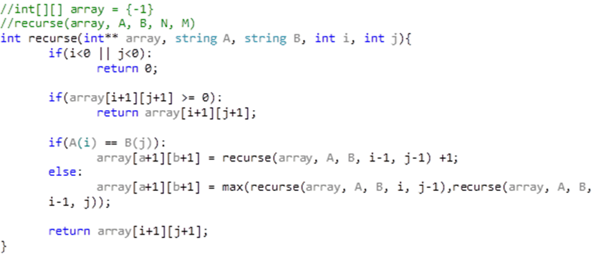
Implementation - MCSS
Iterative - Bottom-Up approach
Recursive – Top-Down Approach

Slide 20
Comparing Results - MCSS

Slide 21
Digging Further - Knapsack

Slide 22
Example - Knapsack
Sack capacity C: 5
Items: 8 (weight: 1-3, value: 1-30)
Iterative – Bottom-Up Approach
Item | Weight | Value
1 | 3 | 4
2 | 3 | 13
3 | 2 | 15
4 | 1 | 26
5 | 3 | 2
6 | 2 | 5
7 | 3 | 12
8 | 1 | 12
Item \ Sack |  | 1 | 2 | 3 | 4 | 5
 | 0 | 0 | 0 | 0 | 0 | 0
1 | 0 | 0 | 0 | 4 | 4 | 4
2 | 0 | 0 | 0 | 13 | 13 | 13
3 | 0 | 0 | 15 | 15 | 15 | 28
4 | 0 | 26 | 26 | 41 | 41 | 41
5 | 0 | 26 | 26 | 41 | 41 | 41
6 | 0 | 26 | 26 | 41 | 41 | 46
7 | 0 | 26 | 26 | 41 | 41 | 46
8 | 0 | 26 | 26 | 41 | 53 | 53

Slide 23
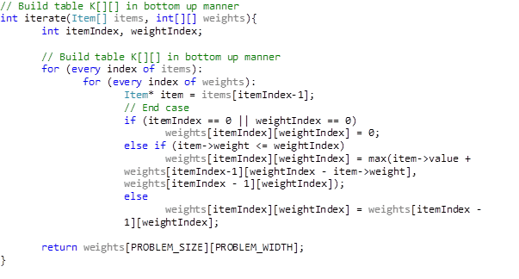
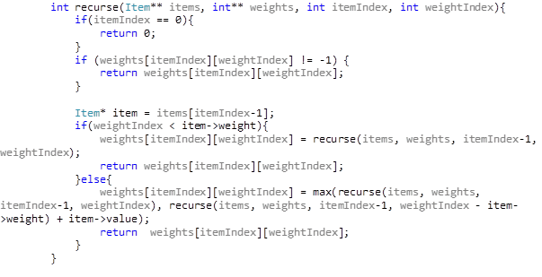
Implementation - Knapsack
Iterative - Bottom-Up approach
Recursive – Top-Down Approach

Slide 24
Comparing Results - Knapsack

Slide 25
Digging Further – Dijkstra

Slide 26
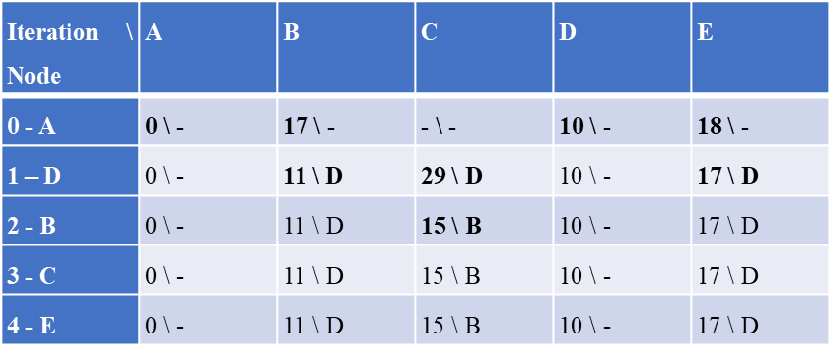
Example - Dijkstra
Example Graph
Node | A | B | C | D | E
0 | -1 | 17 | -1 | 10 | 18
1 | 17 | -1 | 4 | 1 | 8
2 | -1 | 4 | -1 | 19 | 1
3 | 10 | 1 | 19 | -1 | 7
4 | 18 | 8 | 1 | 7 | -1

Slide 27
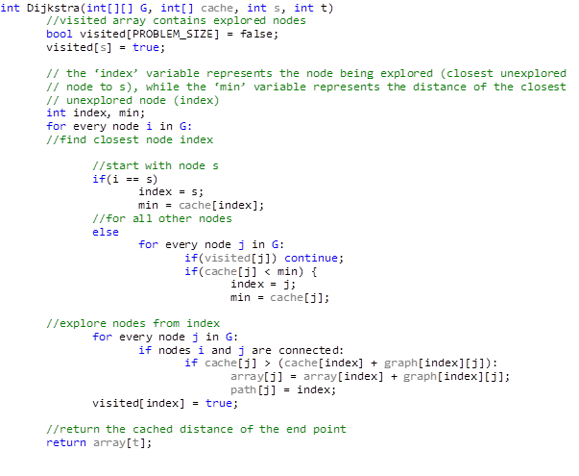
Implementation - Dijkstra

Slide 28
Comparing Results - Dijkstra

Slide 29
Digging Further – Independent Sets

Slide 30
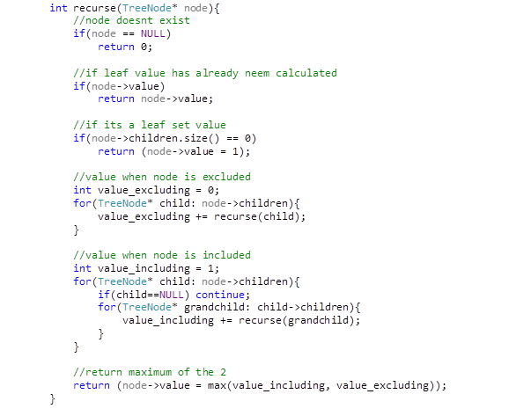
Implementation - Independent Sets
Iterative - Bottom-Up approach
Recursive – Top-Down Approach

Slide 31
Comparing Results – Independent Sets

Slide 32
Future Work

