Slide 1
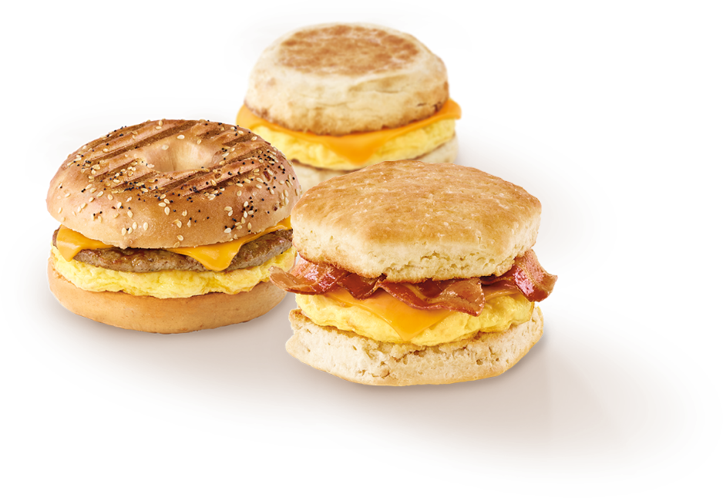



Tim Horton’s Review
Presentation: Niloofar Zarifi
DATA SCIENCE AND APPLICATION
Data Prepared: October 05, 2019

Slide 2

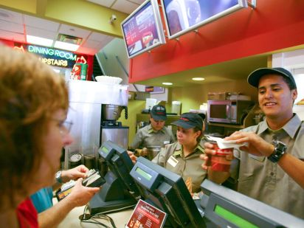
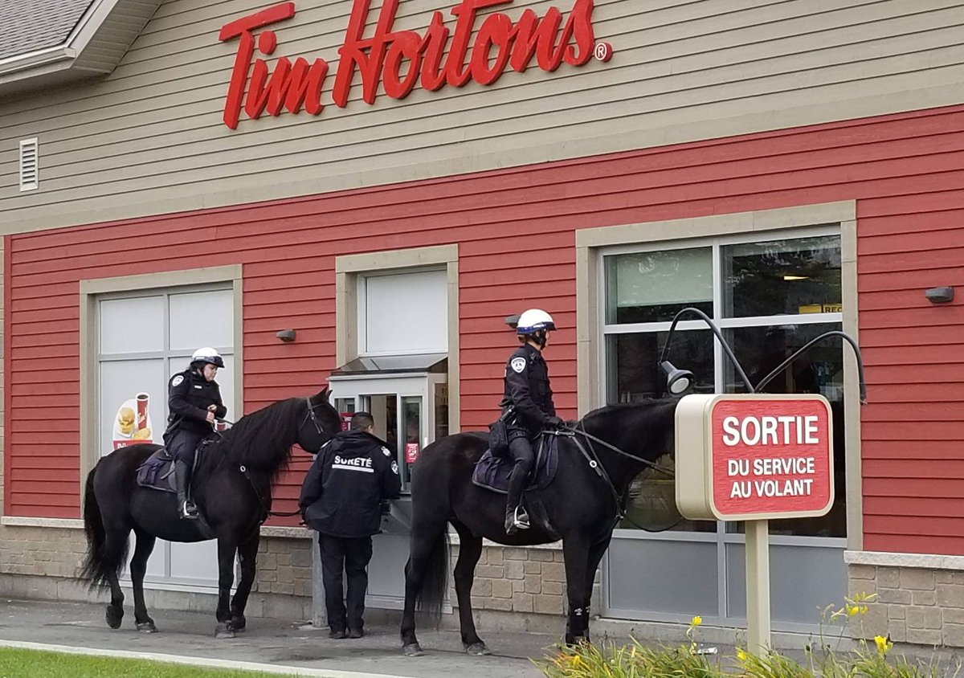
A client has come to you with a data file containing workplace reviews by current and former employees. They don’t know what value they can derive from it. It’s your job to garner business value from the given information and pose the findings to the client.
Introduction to data set
Hypothesis Generation
Exploratory Data Analysis
Input Data Relationship
LR and NLP
Conclusion

Slide 3
Introduction to Data Set
Rating | 1-5
Title | String
Body | text
Job Title | String
Location | String
Date | Day month year
Rating - Job Work/Life Balance | 1-5
Rating - Salary/Benefits Rating | 1-5
Rating - Job Security/Advancement | 1-5
Rating - Management | 1-5
Rating - Job Culture | 1-5
Employment Status | String
Original Dataset: 13020 observations
Rating * are ordinal numbers
Body contains long/short texts
Location :City and Province

Slide 4
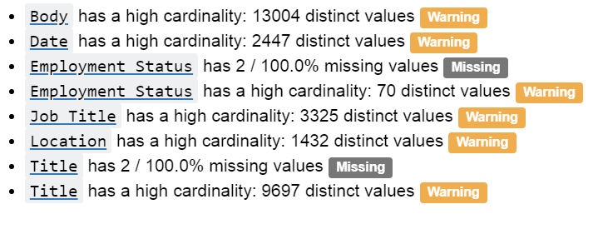

Cleaning Data
What we are looking for??? And So what!
?
?
?

Slide 5
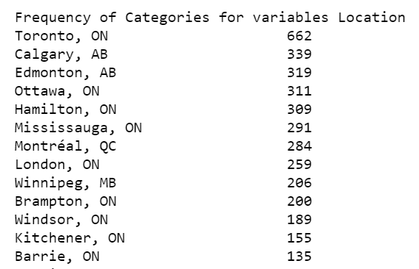
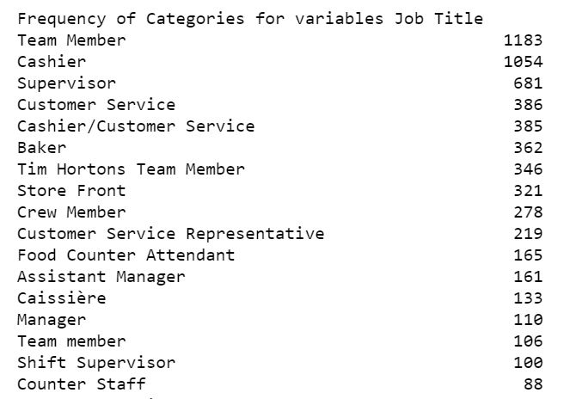
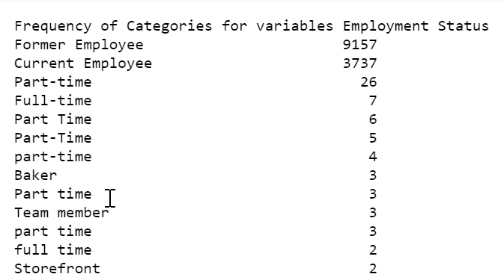
Priority of Cleaning Data

Slide 6

Hypothesis Generation
Brainstorming possible factors that can impact the outcome
Demographics Former and current employees
Product/Service how to analyse their review
Possible Outcomes why positive/ negative review
Cleaning and categorize job Title
Grouping Date
Location : grouping provinces or city
Employment Status and Rating
Niloofar is thinking
Niloofar is thinking

Slide 7
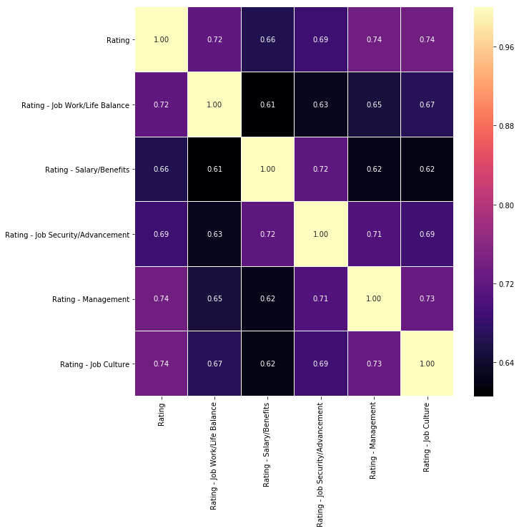
Spearman Rank-Order correlation
For all employees
Job Culture 0.74
Management 074
Initial guess is these two factors have main impact on the final rating

Slide 8
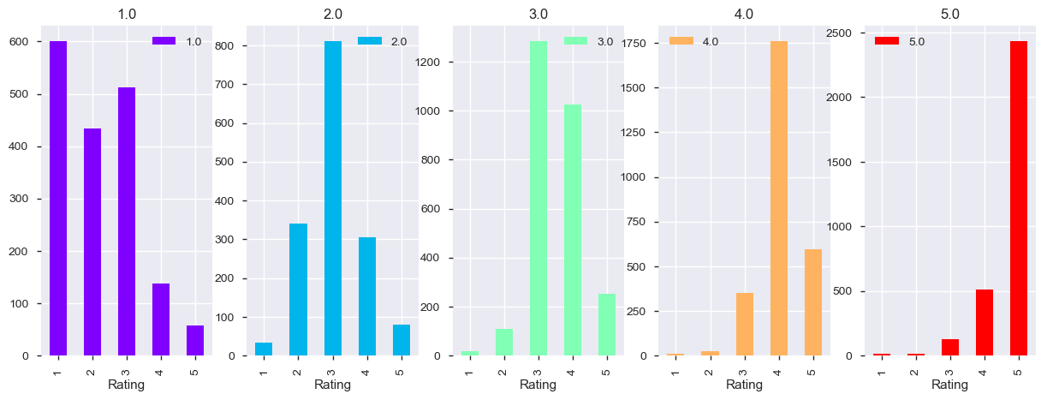
Rating vs Rating -Management

Slide 9
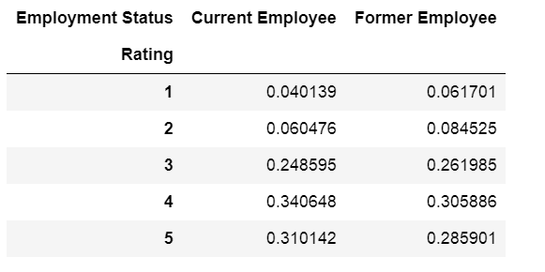
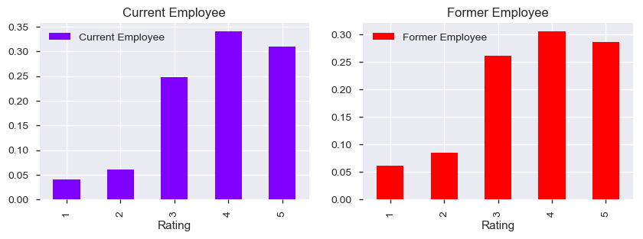
Current and Former employees
From general rating we can see that current employees are slightly happier

Slide 10
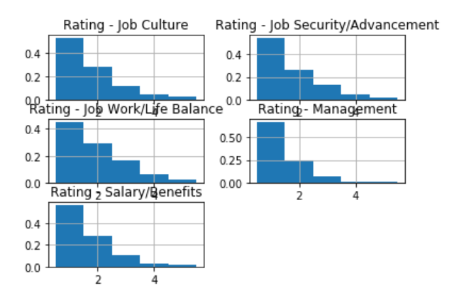
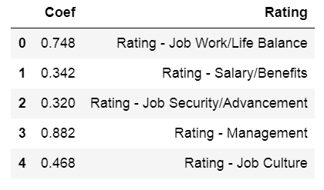
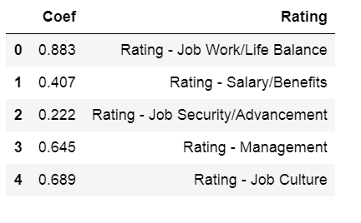
Rating explained by categorical ratings
mord: Ordinal Regression in Python
https://pythonhosted.org/mord/
All former employees
Unhappy former employees
data['Rating']<3

Slide 11
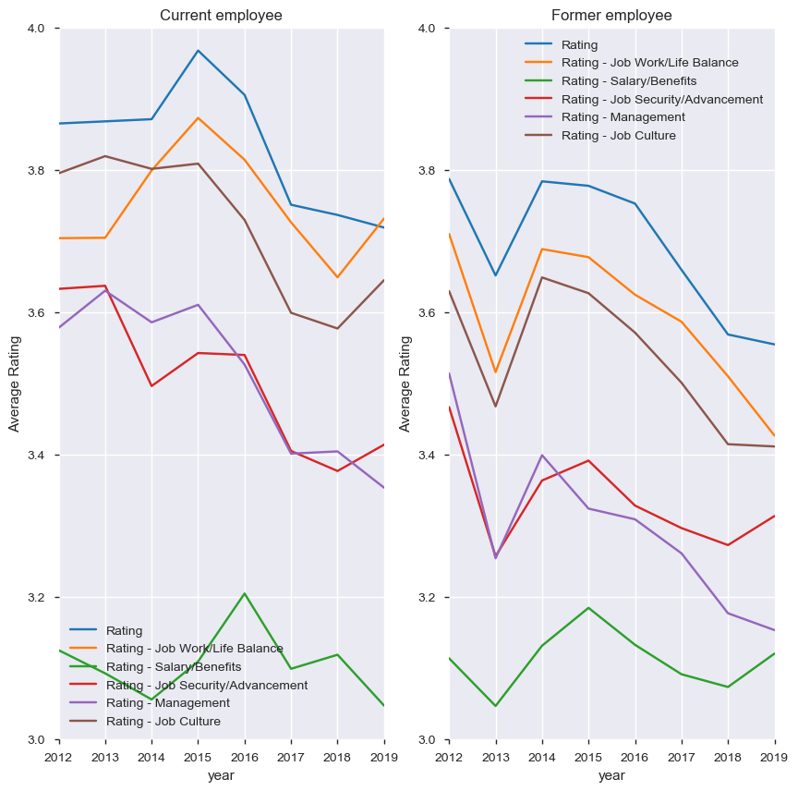
Average Rating Over Years
Former employee's review in 2013 was not great but significantly was improved in 2014 and 2015
Generally speaking, rating scores are declining over years
The rate of decline for Management and job security seems to be more than others
Both groups are unhappy with their salary and benefit and unfortunately it is declined for current employees in 2019

Slide 12
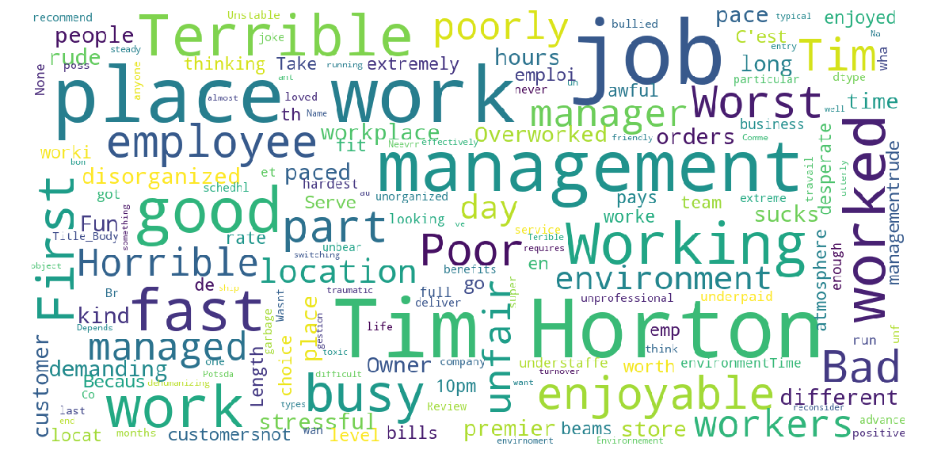
Single Word Cloud

Slide 13
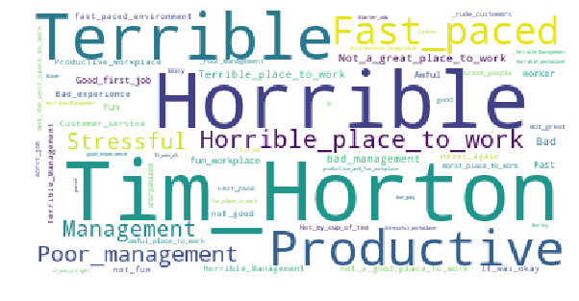
Bigram Word Cloud

Slide 14
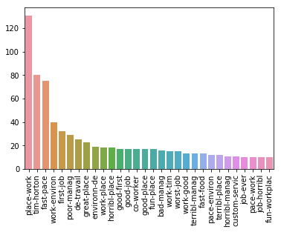
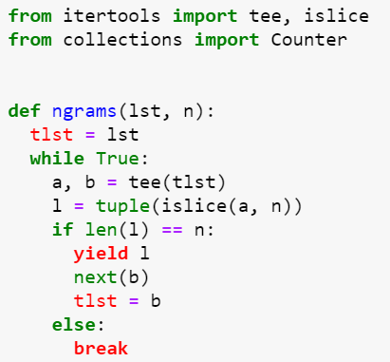
Frequency of Bigrams
Function makes ngrams
Fast-paced
poor/bad/terrible management

Slide 15
RandomForestClassifier & LogisticRegression
Split Rating to Rating <3 : 0 Rating > 3: 1
Concatenate ‘Title’ and ‘Body’ to Title_Body
RF_score: 87 %
LogR: 87 %
This prediction has value to business ???

