Slide 1

Advanced Statistical Modeling:
Regression Models
Niloofar Zarifi
DATA SCIENCE AND APPLICATION
May 22, 2019

Slide 2
Linear Regression 120 Years of Olympic History: Athletes and Results
Available at https://www.kaggle.com/
Numerical: ID, Age, Height, Weight, Year
Categorical: Name, Sex , Team, NOC , Games, City, Sport, Event, Season, Medal
Definitions:
Team: full name of country
NOC: country abbreviations
Games: year plus season
Sport: name of sports
Event: description of sports
Season: summer/winter

Slide 3

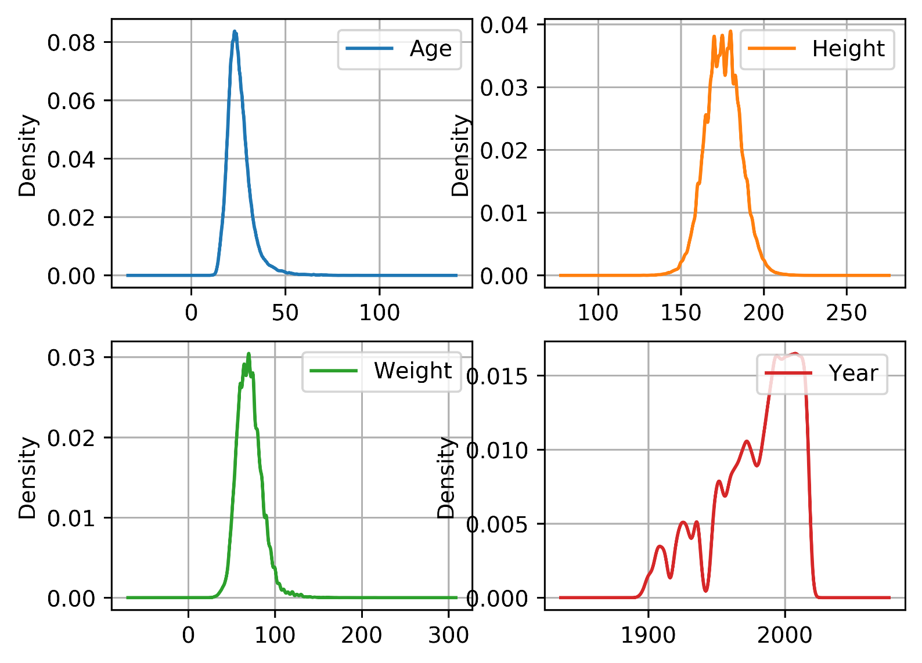
Exploratory data analysis
The peaks of a Density Plot displays where values are concentrated over the interval.
Notes:
A Density Plot visualises the distribution of data over a continuous interval or time period. This chart is a variation of a Histogram that uses kernel smoothing to plot values, allowing for smoother distributions by smoothing out the noise. The peaks of a Density Plot help display where values are concentrated over the interval.
An advantage Density Plots have over Histograms is that they're better at determining the distribution shapebecause they're not affected by the number of bins used (each bar used in a typical histogram). A Histogram comprising of only 4 bins wouldn't produce a distinguishable enough shape of distribution as a 20-bin Histogram would. However, with Density Plots, this isn't an issue.

Slide 4
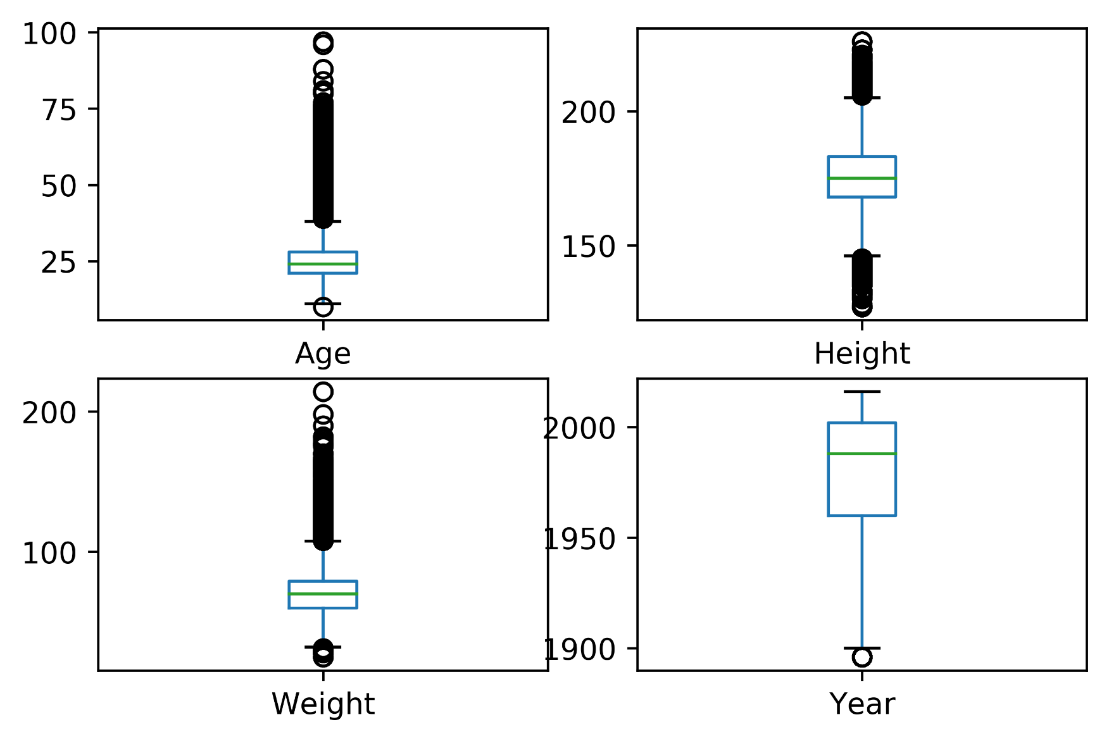
Exploratory data analysis
Oldest :97 Youngest : 10
Heaviest:214 lightest:25
Tallest: 226 shortest:127
Notes:
A Density Plot visualises the distribution of data over a continuous interval or time period. This chart is a variation of a Histogram that uses kernel smoothing to plot values, allowing for smoother distributions by smoothing out the noise. The peaks of a Density Plot help display where values are concentrated over the interval.
An advantage Density Plots have over Histograms is that they're better at determining the distribution shapebecause they're not affected by the number of bins used (each bar used in a typical histogram). A Histogram comprising of only 4 bins wouldn't produce a distinguishable enough shape of distribution as a 20-bin Histogram would. However, with Density Plots, this isn't an issue.

Slide 5
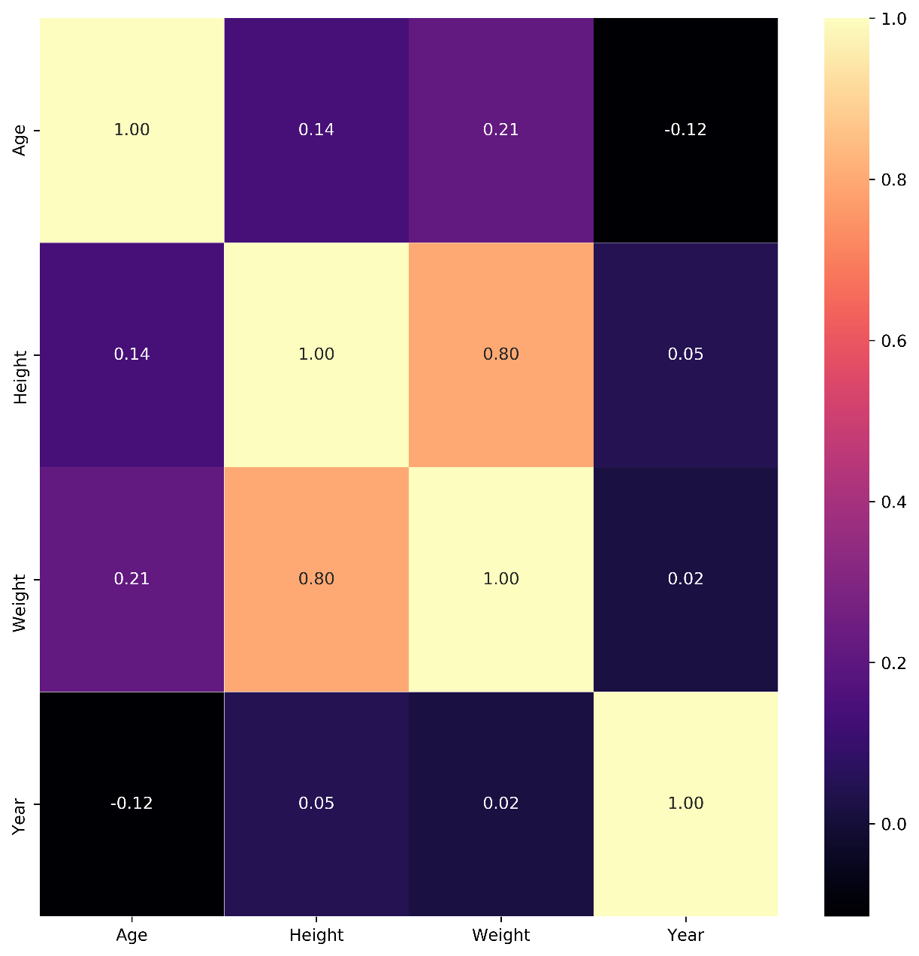
Exploratory data analysis
Weight and height are reasonably correlated
Year and age are negatively correlated

Slide 6
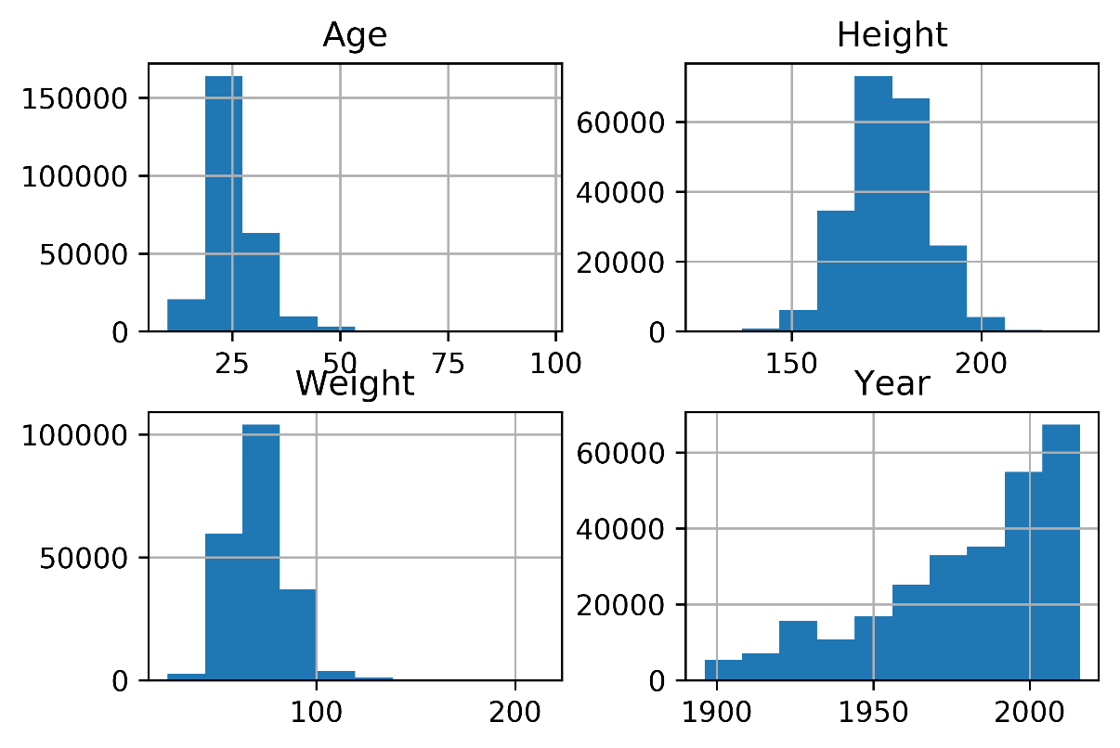
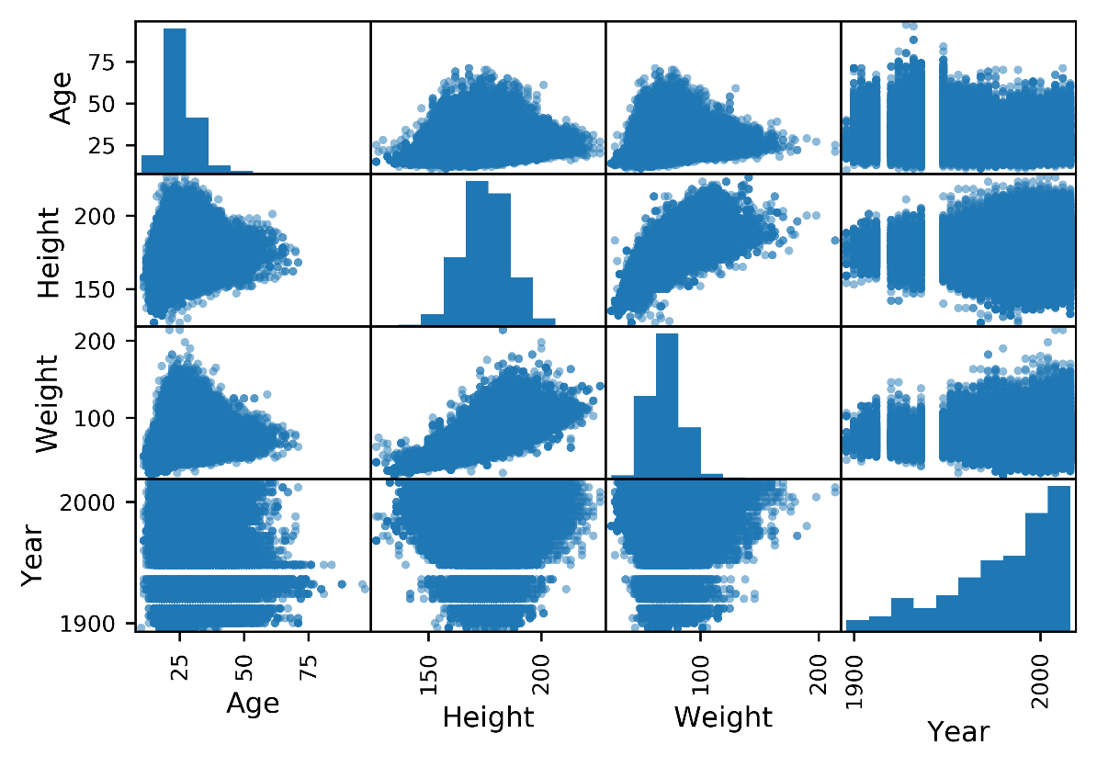
Exploratory data analysis
Histogram scatter_matrix

Slide 7
Cleaning Data
Size of data :(271116, 14)
missing missing%
Age 9474 3.4%
Height 60171 22.2%
Weight 62875 23.2%
Medal 231333 85%
Target: Height
Features: Weight, Age, Year
Replace missing data with mean value

Slide 8
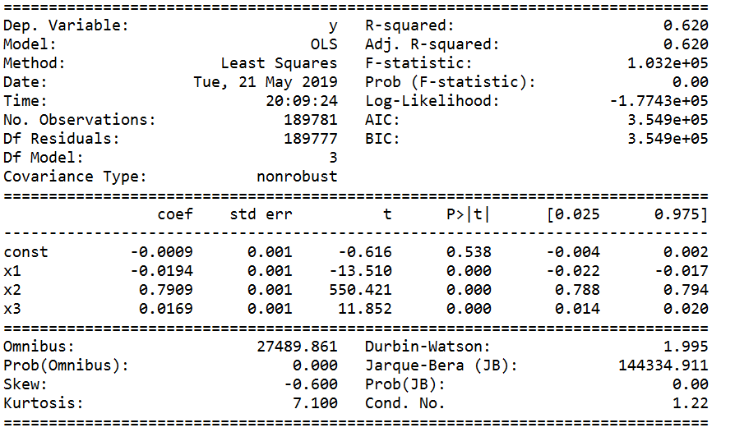
Regression Model
Training set:70%
height=-0.0009-0.0194Age+0.7909weight+0.0169year
Model.score: 0.618
RMSE: 5.734

Slide 9
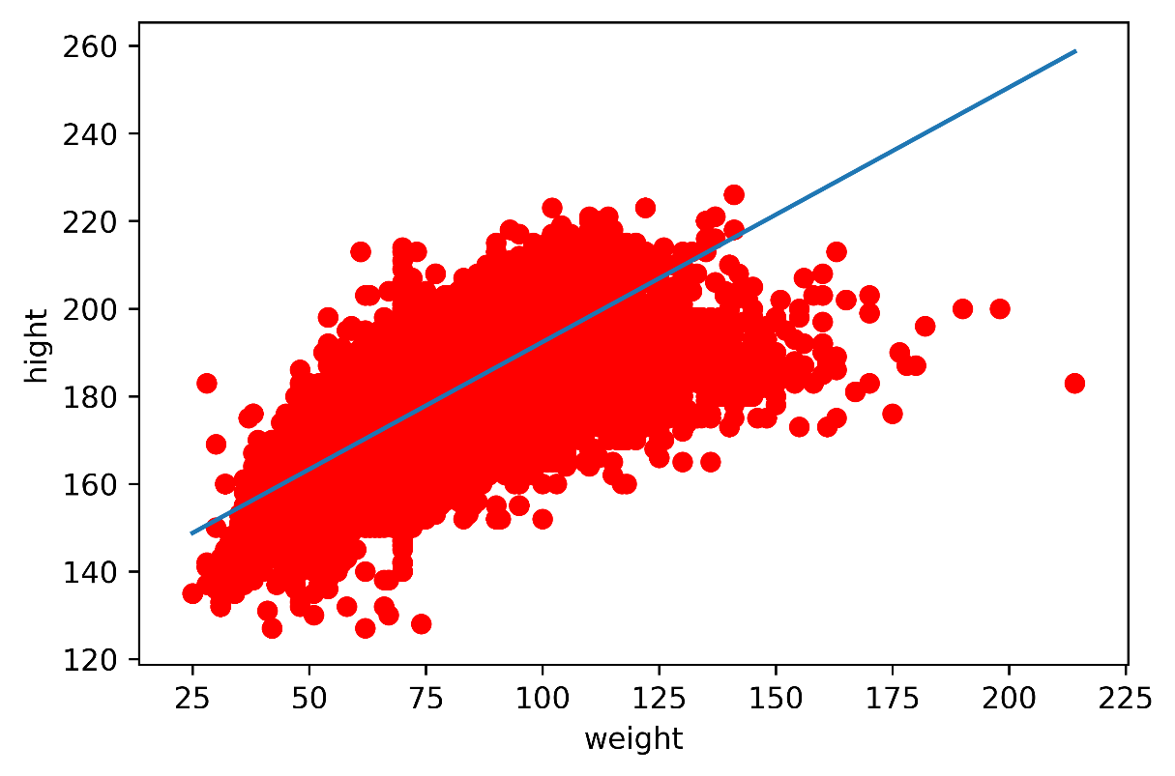
Regression Model
10-kfold:
mean score: 0.619
RFE:
adj_R2:0.619
[ True, True, True]
Final model:
height=0.58weight+134
Score:0.617

Slide 10
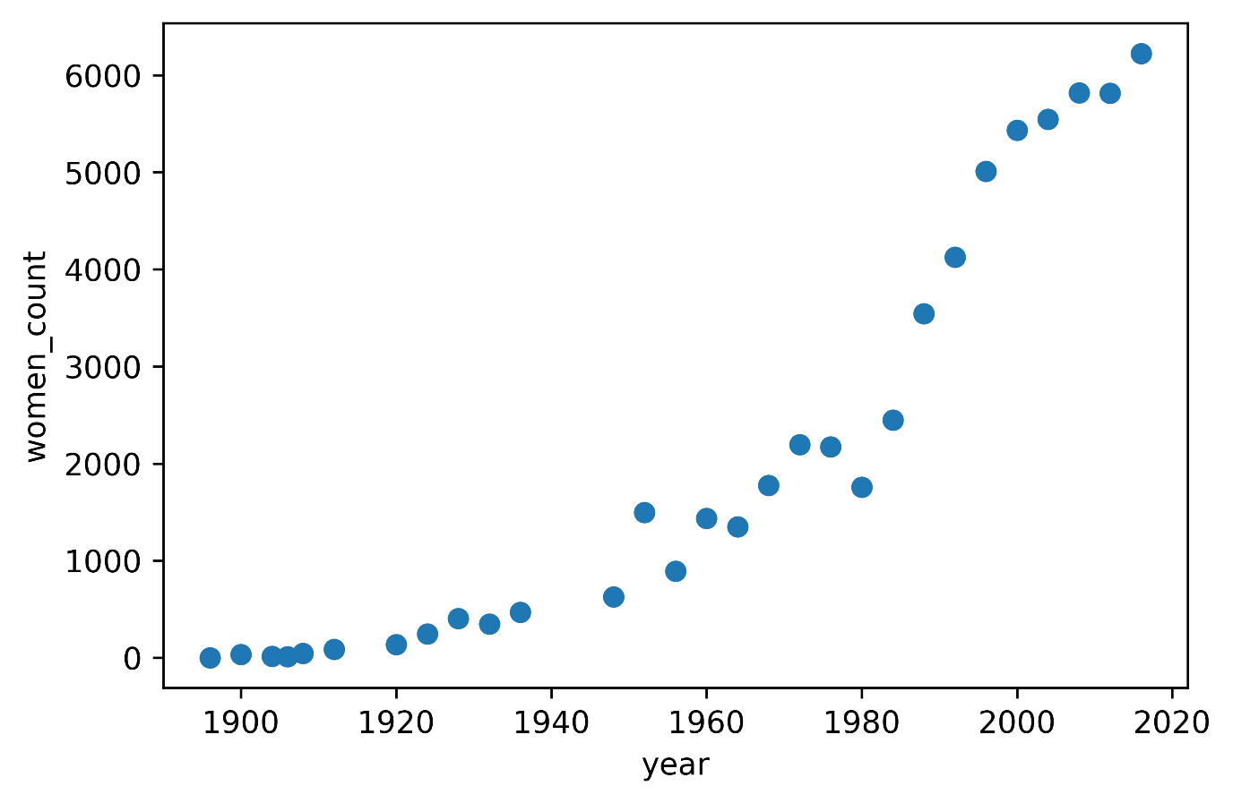
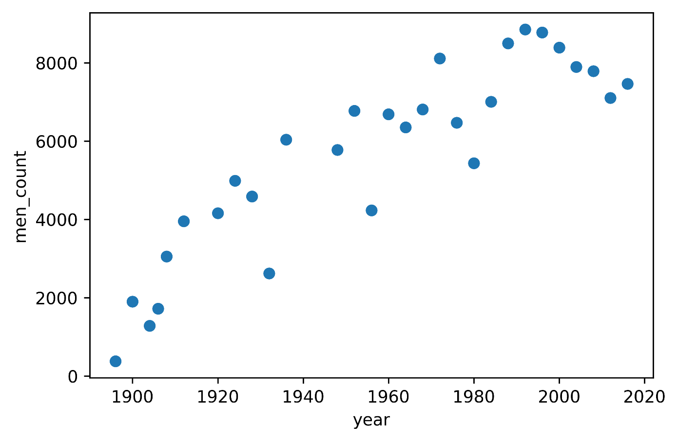
Women and Men athletes

Slide 11
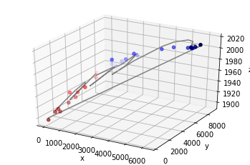
Multiple Linear Regression
Year F M
Year 1.000000 0.920937 0.88966
F 0.920937 1.000000 0.77499
M 0.889660 0.774990 1.00000
predicted_year=1897+0.01women+0.006men
Score: 0.96

