Slide 1
Property Tax Report in Vancouver
Niloofar Zarifi
DATA SCIENCE AND APPLICATION
June 20, 2019

Slide 2

Property Tax Report in 2018
Beautiful Vancouver
Available at https://data.vancouver.ca/datacatalogue/propertyTax.htm
Contains information on properties from BC Assessment (BCA) and City Sources
28 attributes and 209649 observations
Accuracy is dependent on the matching of records between multiple agencies including non-City sources.
Stanley Park

Slide 3
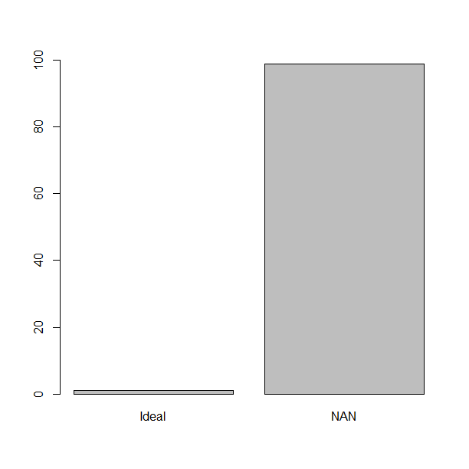
Cleaning Data
option2
Only # 2660 rows have no missing values
#dataset without missing value/Total dataset =1%
Should I ignore 99% of data!?
My answer: No, deal with it
In order to work on option 2, subset of data will be extracted
Based on type of questions
option1
?

Slide 4
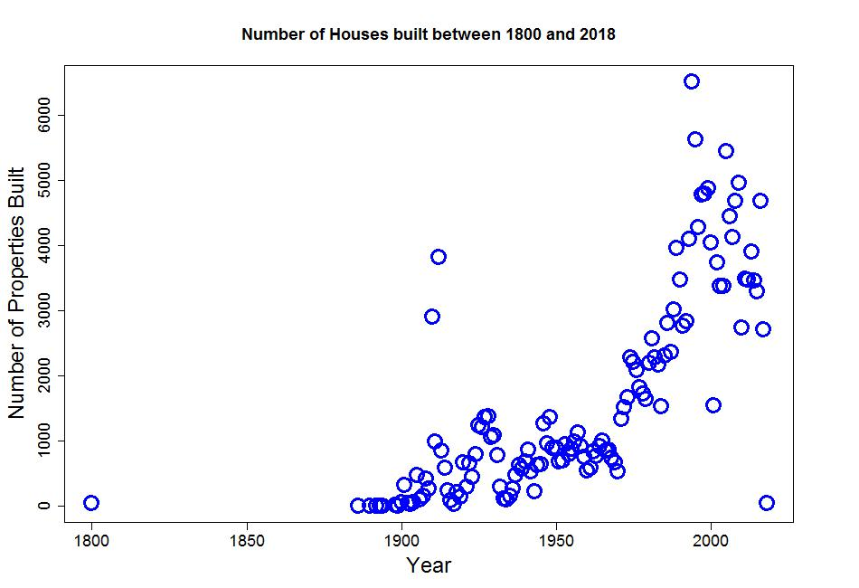
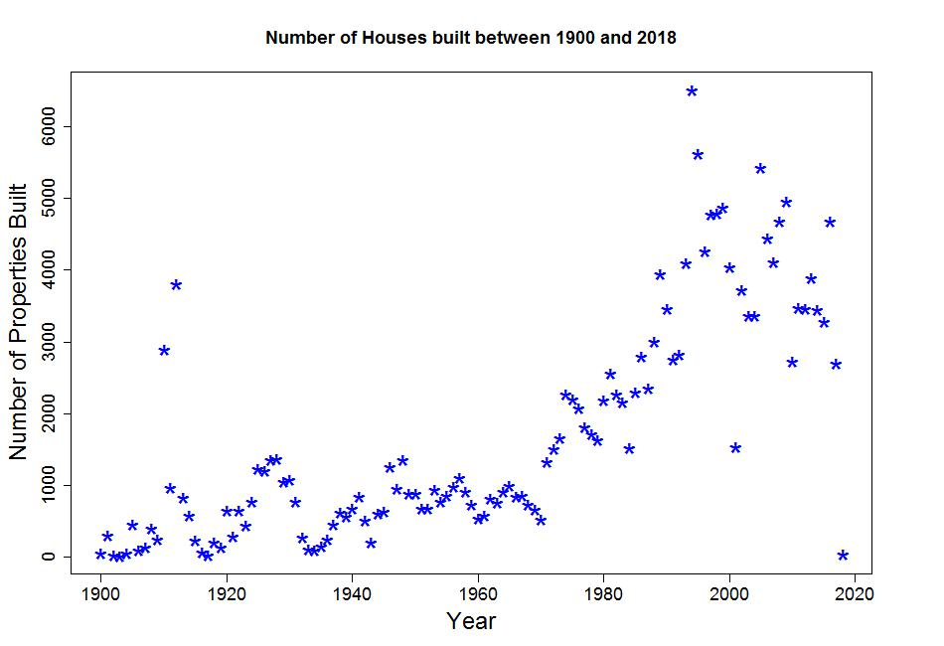
Number of properties built
Cleaning data:
PROPERTY_POSTAL_CODE
& YEAR_BUILT
Year of 2018 may not be complete (#41)
Only one data point before 1886
As expected the :
#Year #property built

Slide 5
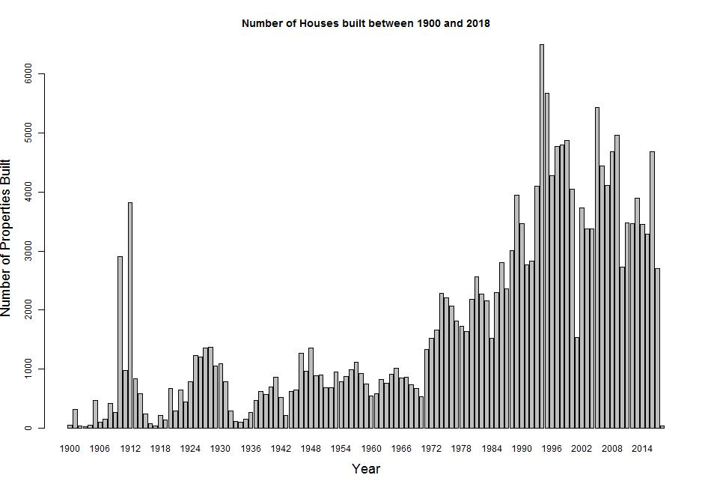
Number of properties built

Slide 6
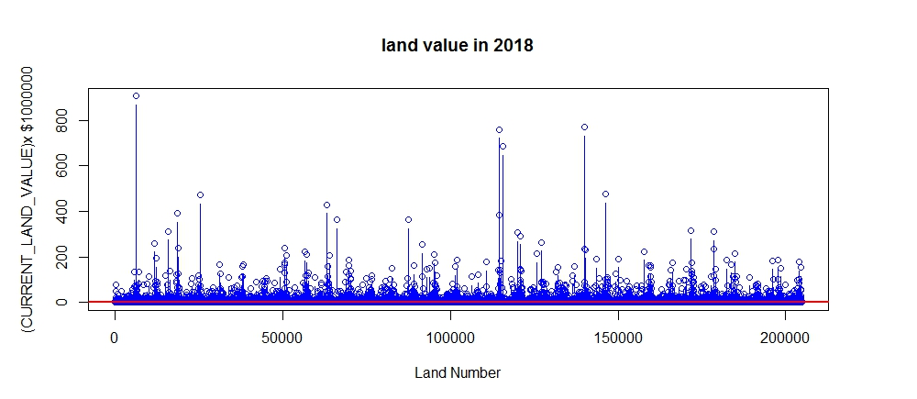
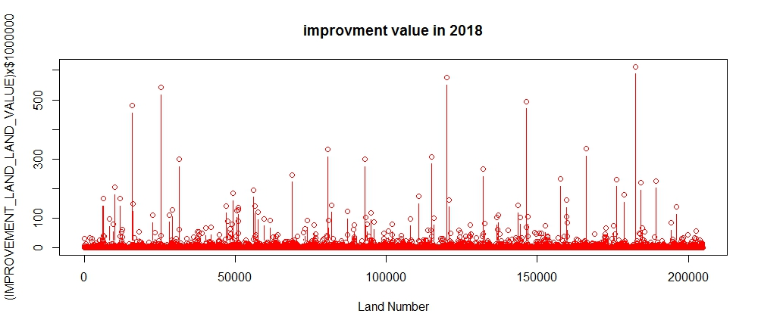
Land and Improvement Value in Current Year
Cleaning data: remove NA, 0 and 1 values
CURRENT_IMPROVEMENT_VALUE &
IMPROVMENT_IMPROVEMENT_VALUE
CURRENT_LAND_VALUE, CURRENT_IMPROVEMENT_VALUE: The market value of the fee simple interest in land and improvements (Assessment Act) provided by BCA for the Tax_Assessment_Year. The assessments are issued in the Completed Roll which is received in January and in the Revised Roll which is received mid-March. Amendments to values may be received for individual properties in Supplementary Rolls throughout the year. This is the actual value; it differs from taxable value which is net of exemptions and which may also be averaged.
Simple speaking: when improvements are made to a property which cause extra cost to owners
1.Abline is on $1 million
2. In general, land values are bigger than improvement

Slide 7
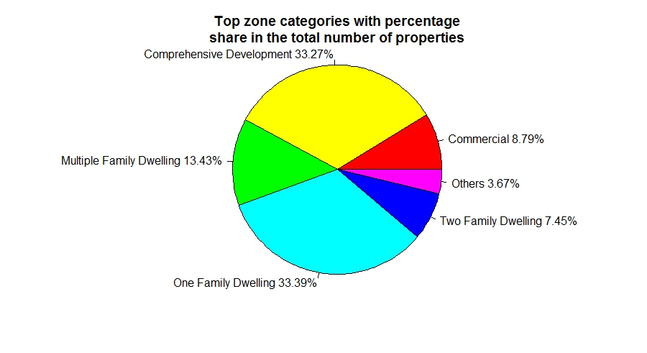
Zone Categories
Cleaning data: ZONE_CATEGORY &
PROPERTY_POSTAL_CODE
1.Four categories have contribution less than 1%
2.Merged minority groups to ‘Others’

Slide 8
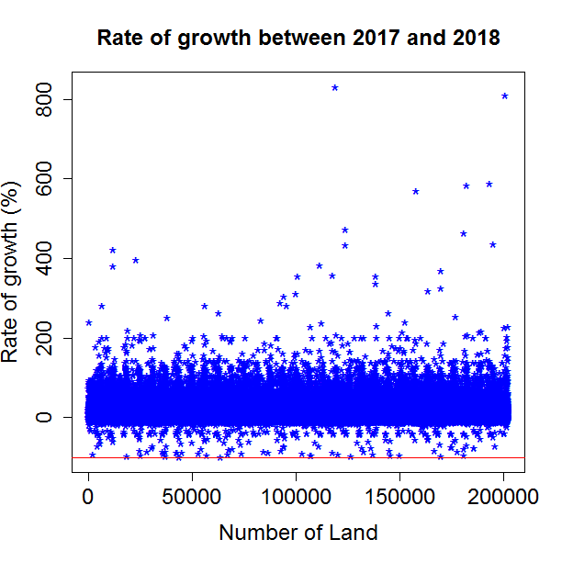
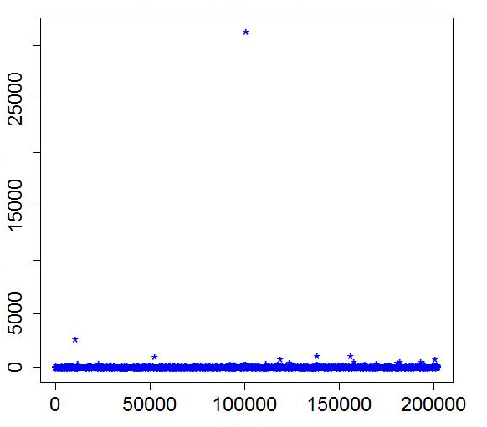
Rate of Growth
Cleaning data: remove NA and data points smaller than
1000. Can we buy a land in Vancouver less than $1000!!!??
PREVIOUS_LAND_VALUE & CURRENT_LAND_VALUE
Rate of Growth indicates that some lands have lost 99.999%
of its values and few lands raised up to 1000% profit!

Slide 9
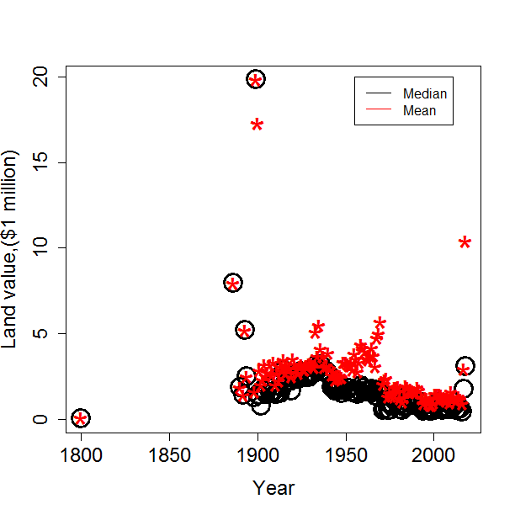
Summary of Land Values Over Years
Cleaning data: remove few outliers from rate of growth
CURRENT_LAND_VALUE & YEAR_BUILT
Land price is decreasing!
Housing in BC in recent years is cheaper than 1900!
In general, median is smaller than mean
Only “1” data point for 1886, 1893,1899

Slide 10
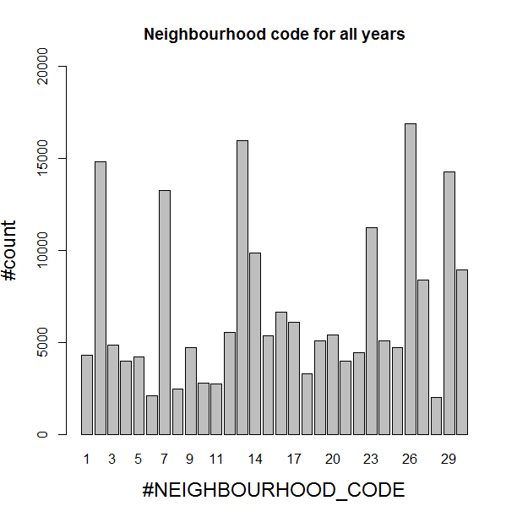
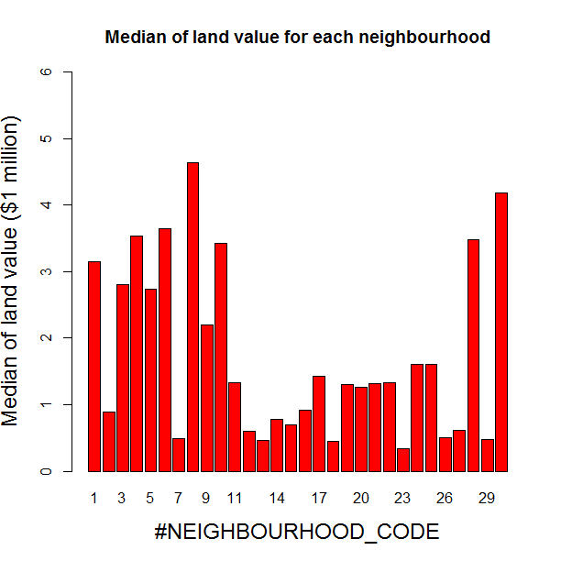
Neighbourhoods Code
Why Median value
Groupby
Year
Neighbour_code
Is different?

Slide 11
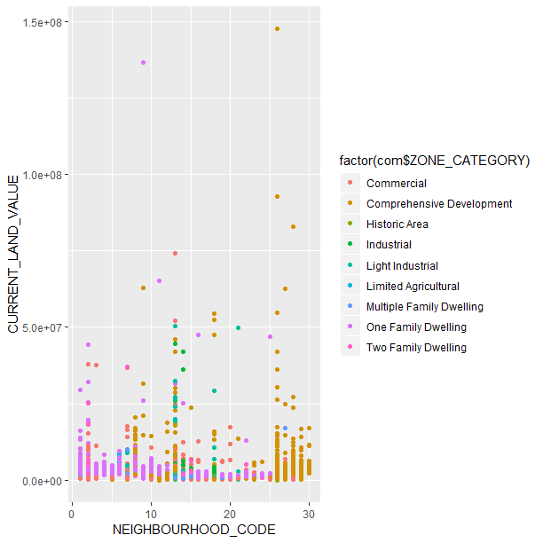
Correlation of data
YEAR_BUILT >=2010
Industrial and Comprehensive Development have more outliers
Apparently Neighbour_Code between 26 to 30 show distinctive data points belongs to Comprehensive Development
Color dots overlap problem due to the size of data ponit

Slide 12
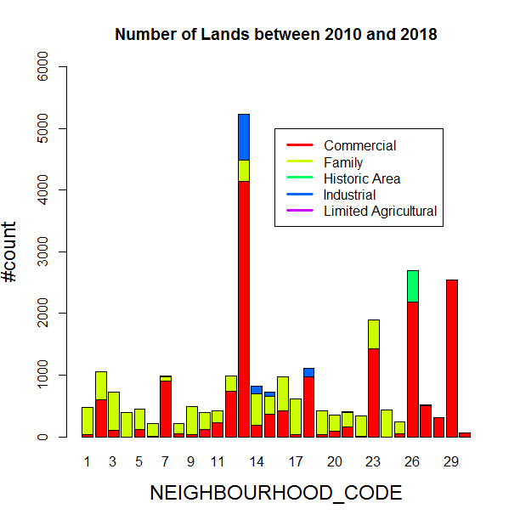
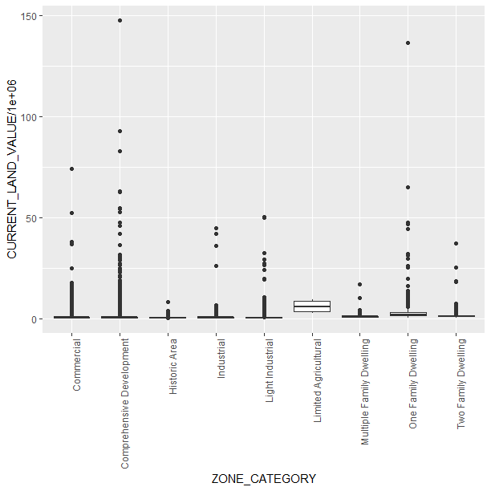
Correlation of data, YEAR_BUILT >=2010

Slide 13
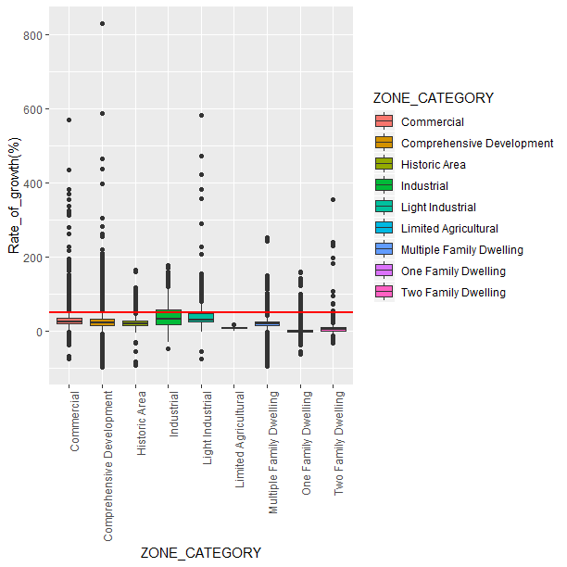
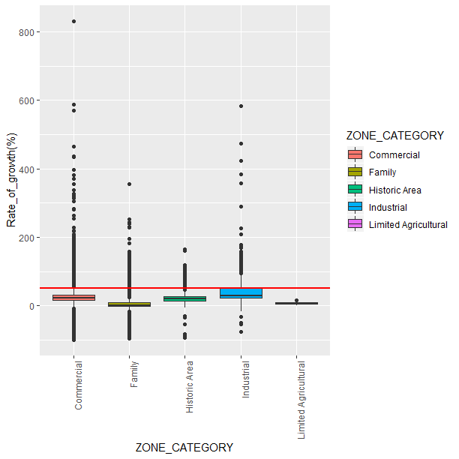
Rate of Growth vs Zone Category
Abline=50%

Slide 14
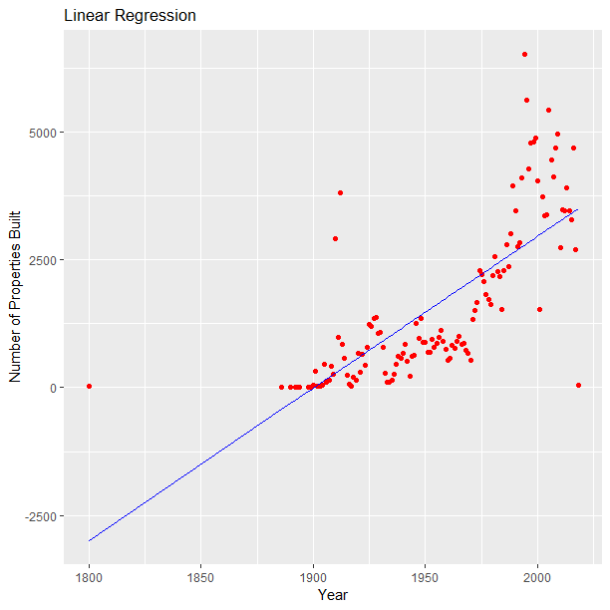

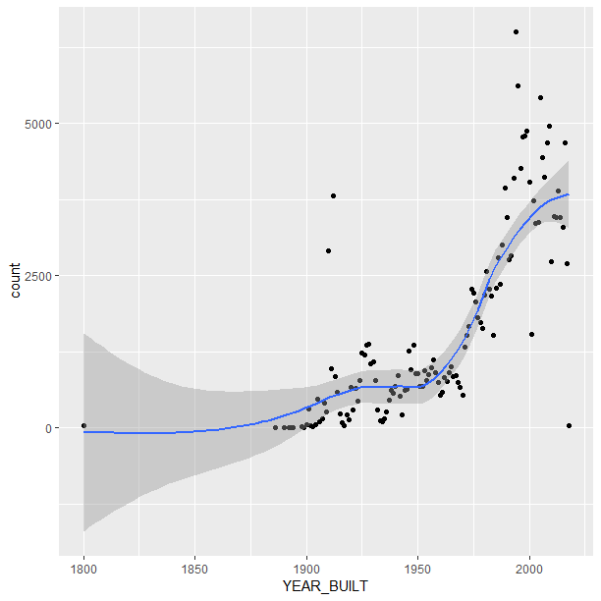
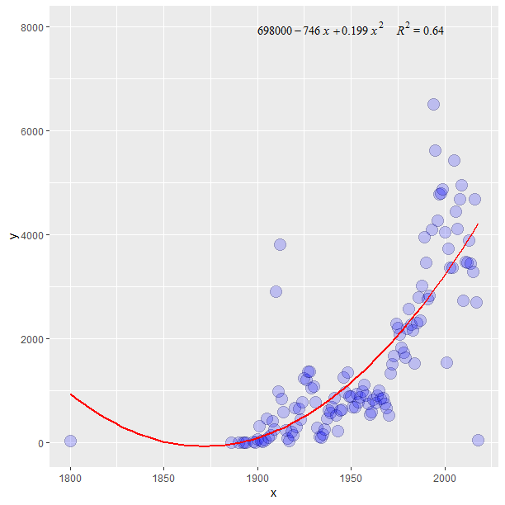
Prediction: Number of Properties vs Year
Linear Regression Smooth Polynomial2

Slide 15
Thank you

