Slide 1

PHOTOBIOREACTOR AS GENERATOR OF OXYGEN FOR FISH IN AQUARIUM
Completed by: student of 11 «А» grade of Nazarbayev Intellectual School Maratova Saya
Director:Mukasheva Kuralay Kairdinovna
Scientific director: c.b.s, docent Sadykanova Gulnaz Esembekovna

Slide 2

Despite the well-known experience of growing unicellular algae in bioreactors, the compact design of the photobioreactor remains one of the main tasks of our time. Economically and scientifically considered to be effective, since the device is considered affordable, does not require special expenses and does not require the use of electricity.

Slide 3

to design a photobioreactor with the use of algae that will enrich the aquarium with oxygen.

Slide 4
Stages of research:
Familiarization with the experience of the closed ecological systems;
Master methods of the growing chlorella;
Consideration of the method of producing carbon dioxide;
construct photobioreactor;
setup photobioreactor to the aquarium;

Slide 5

Methods
Analysis of sources on the topic under study
Getting the carbon dioxide necessary for photosynthesis
Methods for determining gases formed in a photobioreactor
The method of growing chlorella
Determination of energy efficiency using photobioreactor

Slide 6

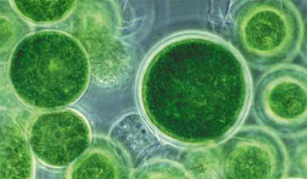
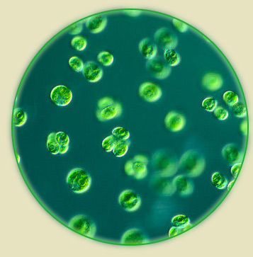
The main element that provides life in the aquarium

Slide 7
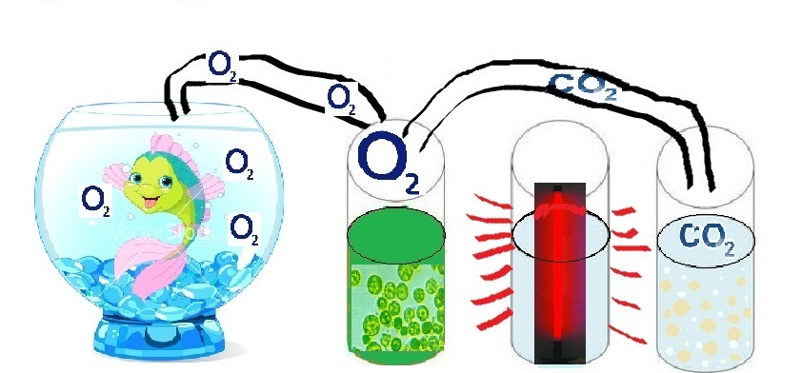
The principle of the photobioreactor is based on the process of photosynthesis.
6СО2+6Н2О=С6Н12О6+6О2

Slide 8

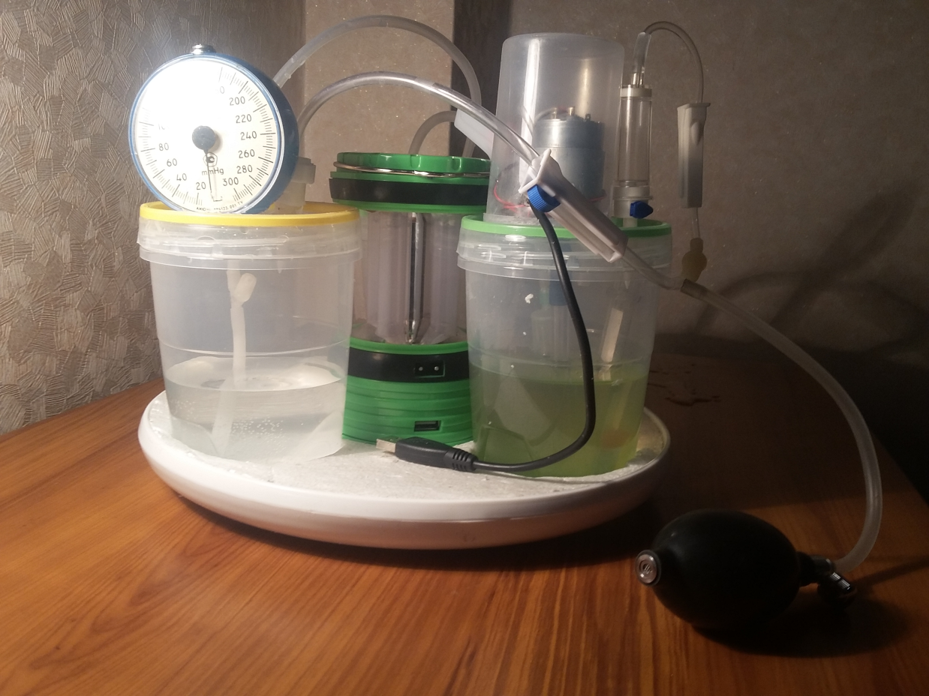
This device for growing unicellular algae
фотобиореактордың моделі

Slide 9

The temperature range is – (+20⁰) - (+36⁰) С;
pH 7-9;
Water and mineral salts;
Mixing;
Sunlight;
Carbon dioxide.

Slide 10

Carbon dioxide contaminates lime water;
When the ray is brought to the oxygen tube, a combustion process is observed;
The number of released bubbles in water for 1 minute on average 40.

Slide 11

№ | Time | Energy consumed by the aerator, Wt | Energy consumed by the photobioreactor
1 | 1 hour | 15 | Energy of the Sun
2 | 1 day | 360
3 | 1 month | 10800
4 | 6 month | 64800
5 | 1 year | 129600
Saving for one year |  | 129600

Slide 12

Enrichment of water with oxygen in the aquarium;
noiseless run;
condensation of room air;
Power saving;
Low price and simple design

Slide 13
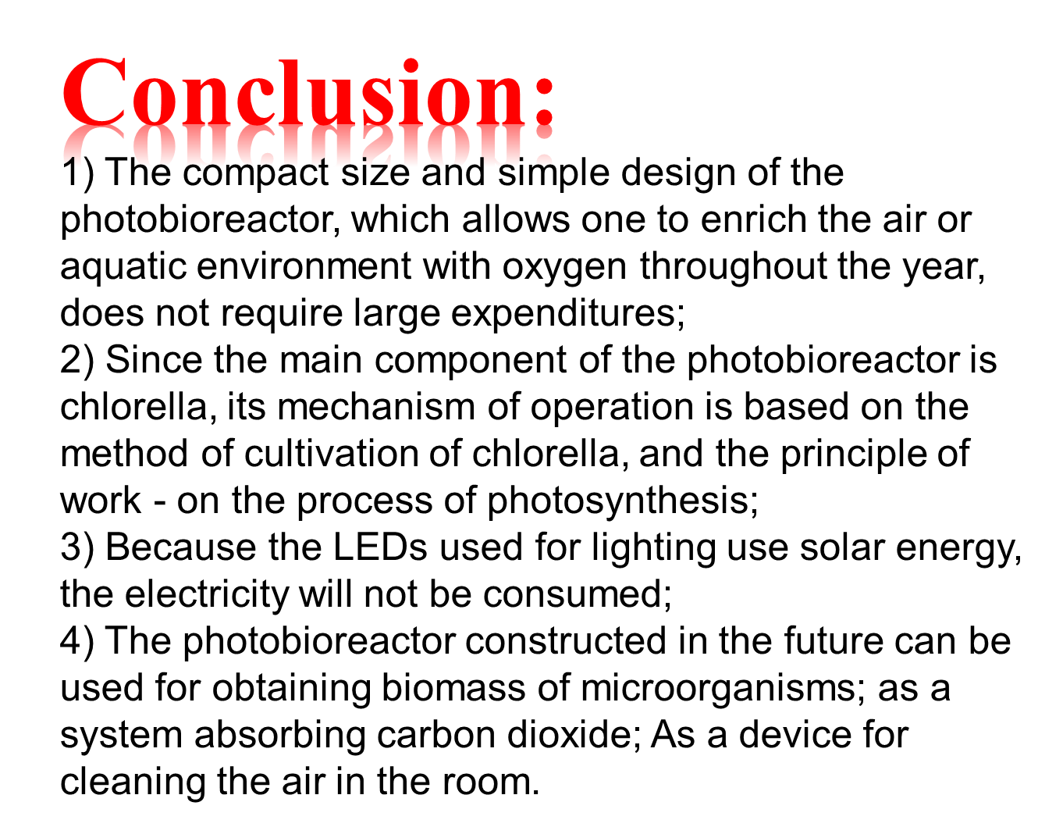

Slide 14


