Slide 1
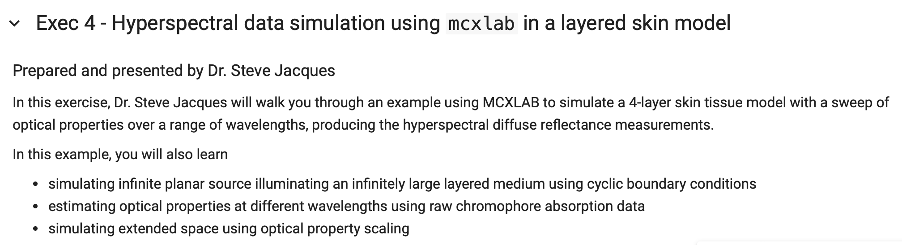
The runMCXspectrum.m program can generate a reflectance spectrum over a chosen wavelength range.
This example generates R(nm) for nm = 300:10:1000.

Slide 2
The basics of skin optical properties are summarized.
First, the absorption of a skin layer
containing different amounts of these
tissue components.
B = blood volume fraction
S = arteriovenous oxygen saturation
W = water content
M = melanosome volume fraction
C = dietary carotenoids
F = fat volume fraction
A = background absorption (constant over wavelength)
$$μ_{a}=BSμ_{a.oxy}+B(1-S)μ_{a.deoxy}+Wμ_{a.water}+Xμ_{a.X}+A$$
where X = C, M, F, …
$$μ_{a}=MU(λ,1:6)×[BSB(1-S)WCMF]^{T}+A$$
where MU(:,:) is an array
that holds the absorption spectra for the tissue components

Slide 3
The basics of skin optical properties are summarized.
Second, the scattering properties
of a skin layer is specified.
a = scattering strength [1/mm]
b = scattering power
g = anisotropy of scatter
$$=μ_{s}^{′}(500nm)$$
$$μ_{s}^{′}=a(\frac{λ}{500nm})^{-b}$$
$$μ_{s}=\frac{μ_{s}^{′}}{1-g}$$
g

Slide 4

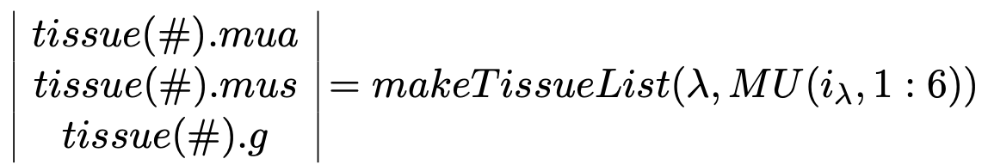
The makeTissueList.m subroutine generates a tissue structure that holds the optical properties at one wavelength.
for tissue types #:
1 = epidermis
2 = papillary dermis
3 = superficial vascular plexus
4 = reticular dermis

Slide 5
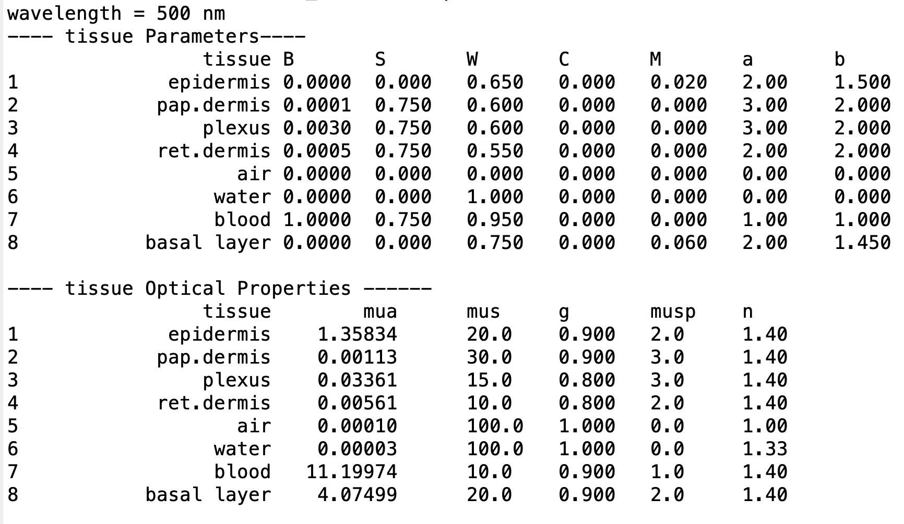
The makeTissueList.m subroutine generates a tissue structure that holds the optical properties at one wavelength.

Slide 6
MCX uses makeTissueList.m
to fill the cfg.prop array that
specifies the optical properties
of each tissue layer.
A 6th tissue type is defined as dermis
with its absorption and scattering
increased 1000-fold.
The ratio of scattering/absorption
cancels the 1000 factor, so the
reflectance of this layer is the same
as the normal dermis.
$$tissue=makeTissueList(λ,MU(λ,1:5))$$
% specify tissue layer properties
PRINTON=0;
tissue = makeTissueList_skinWorkshop(nm1, MU2(inm,:), PRINTON);
prop(1,:)=[0 0 1 1]; % outer boundary [mua mus g n]
for i=1:4 % epi pap plx ret
mua = tissue(i).mua + A;
mus = tissue(i).mus;
g = tissue(i).g;
n = tissue(i).n;
prop(i+1,:) = [mua mus g n];
end
prop(5+1,:) = [mua*1000 mus*1000 g n]; % mimic semi-infinite dermis
% 1=outer boundary
% 2=epidermis
% 3=papillary dermis
% 4=vascular plexus
% 5=reticular dermis
% 6=semi-infinite dermis
cfg.prop = prop;

Slide 7
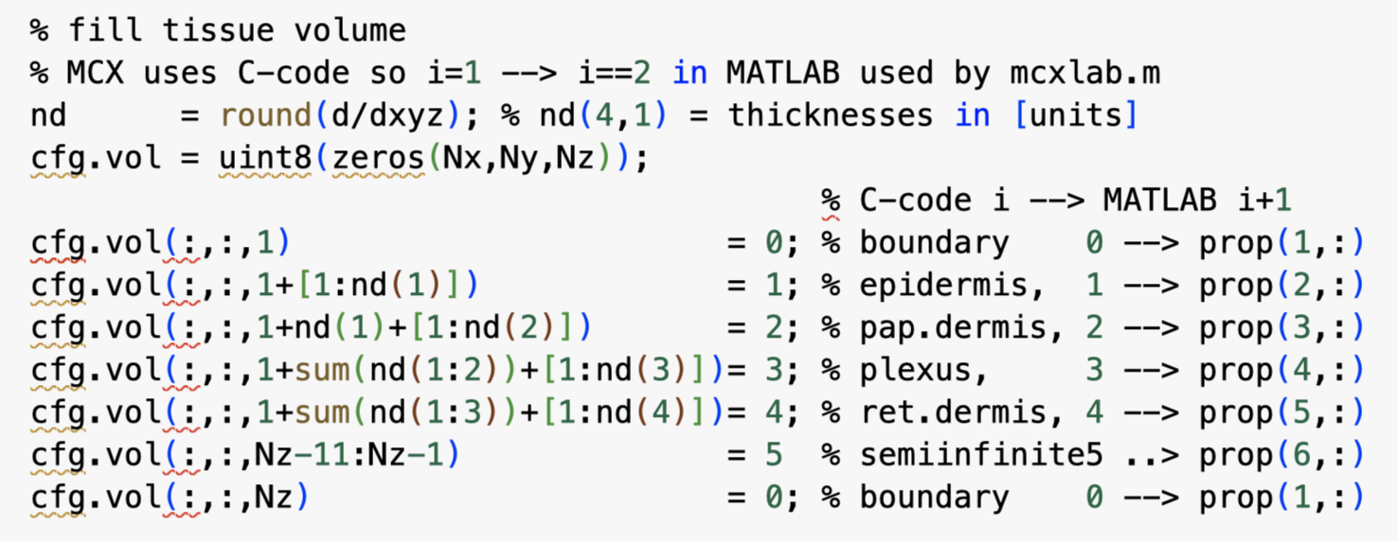
Fill the tissue volume with the skin layers, including a final layer of 11-voxel thickness
Filled with the semi-infinite dermis properties (prop(6,:)) that mimics a semi-infinite dermis.
Models a semi-infinite tissue without requiring a ridiculously thick volume.
Alternatively, you might create
finite-thickness dermis (eg., 2 mm),
a sub-cutaneous vascular plexus,
and a fat layer.
Fill the tissue volume with skin layers
Note the semi-infinite mimic

Slide 8
The lateral boundaries of the volume are set to “cyclic” so that no photons
are lost out the sides of the volume.
cfg.bc = 'ccrccr'; % cylic edges, reflective top,rear
The total reflectance is calculated by summing the Rxy array.
Rxy = flux.dref(:,:,1)*cfg.tstep*cfg.unitinmm^2;
R(inm,1) = sum( Rxy(:));
Hence, the resulting reflectance R is a 1D solution, i.e., the reflectance from an infinitely broad beam of incidence.

Slide 9
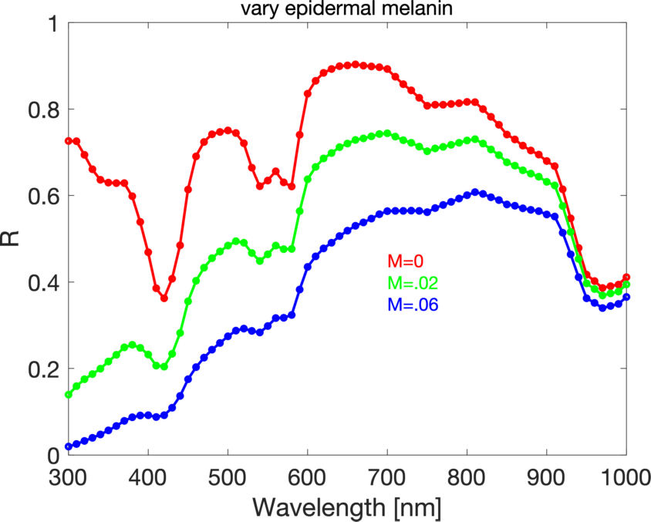
Example: Run MCX using different amounts of epidermal melanin.
The melanosome volume fraction (M) in the epidermis is varied as 0, 2%, 6%.
This is accomplished by adjusting the value of M in makeTissueList.m:
tissue(1).name = 'epidermis';
M = 0.02; % melanosome volume fraction

Slide 10
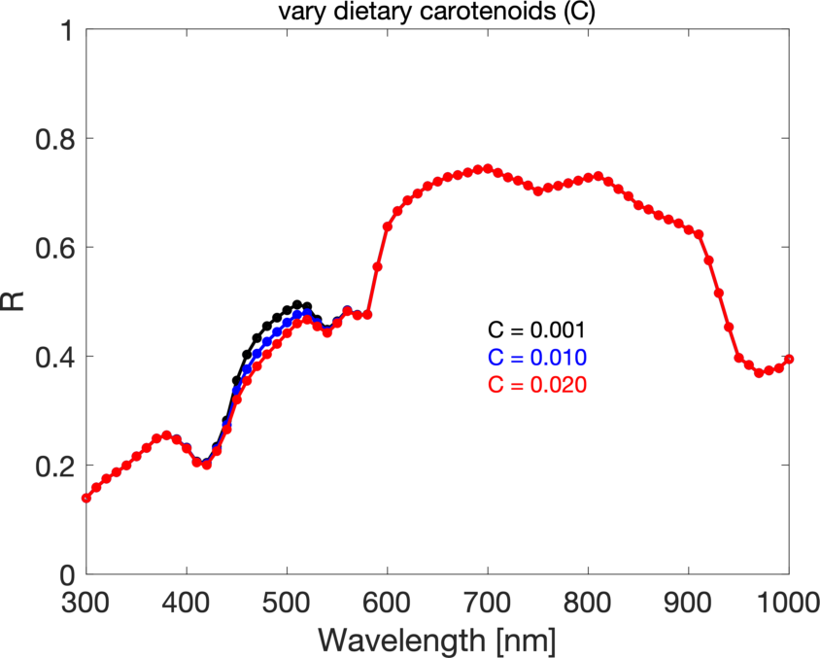
Example: Run MCX using different amounts of dietary carotenoids (C).
The factor C scales an experimental carotenoid absorption spectrum.
This is accomplished by adjusting the value CC in makeTissueList.m:
CC = 0.0; % Carotenoids (scales carotenoid absorption)
which then specifies the value tissue(#).C for all tissue types.
The carotenoids affect the 460-520 nm range.

Slide 11
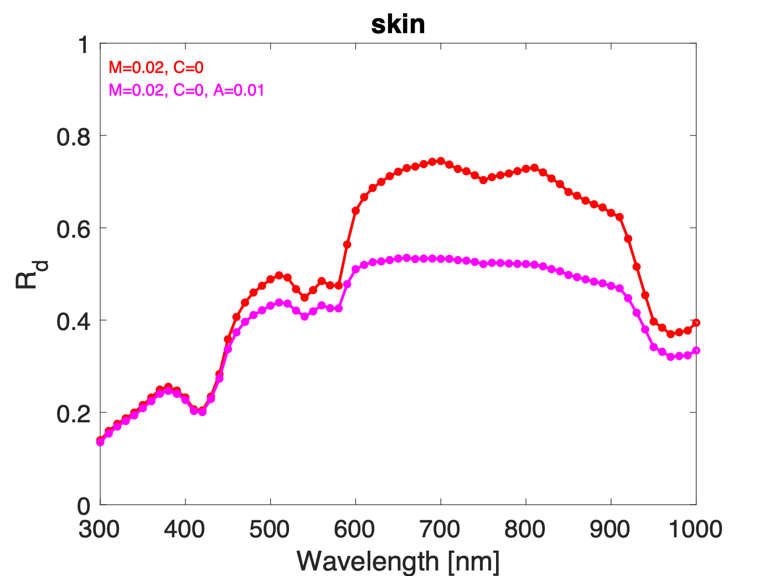
There is a background absorption (A [1/mm]) that should be included for skin.
In this example, A is a constant over all wavelengths, but primarily affects the longer wavelengths where photon pathlengths are long.
More work is needed on A, but a typical values is 0.01/mm.
Currently, the value of A is changed within the runMCXspectrum.m program, rather than within the makeTissueList.m subroutine,
because study of A is on-going. Eventually, A may be included in makeTissueList.m.

Slide 12
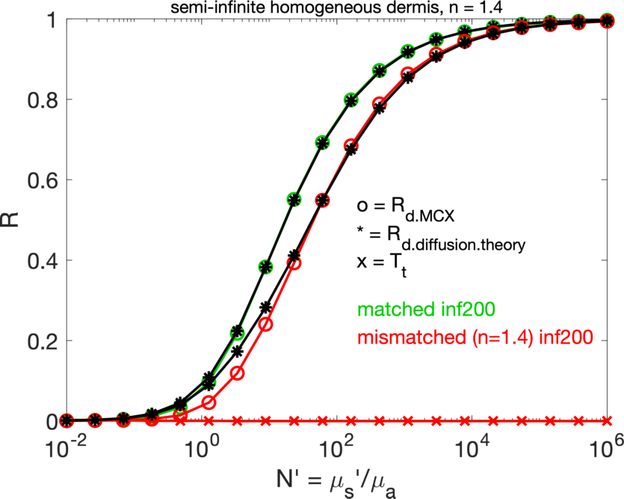
A FINAL NOTE: Simulating the reflectance of a semi-infinite tissue as the ratio of N’=mus’/mua is varied.
This simulation used the semi-infinite mimic of cfg.prop(6,:) = [mua*1000 mus*1000 g n].
Comparison of the MCX R(N’) versus the diffusion theory R(N’) is shown.
For a matched surface boundary condition, the two calculations are indistinguishable on the R vs log(N’) plot.
For a mis-matched boundary condition, the MCX result deviates from the diffusion theory result when R<0.40.
When scattering no longer dominates absorption, the photons do not have enough scattering events
to become randomized before being absorbed. Hence, diffusion theory over-estimates reflectance.
Monte Carlo simulations are needed when the ratio N’ is less than 10.
The transmission (Tt) is zero.

Slide 13
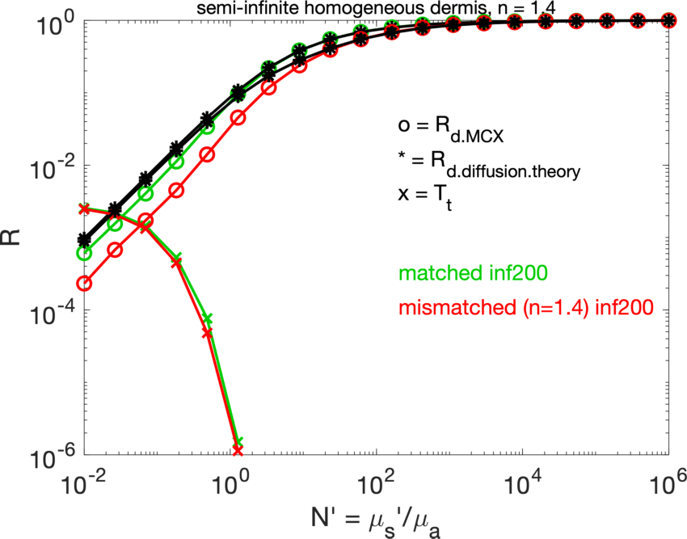
The same comparison of MCX vs Diffusion Theory on a log-log scale.
The curves illustrate that diffusion theory overestimates R(N’)
when N’<1 for a matched boundary, and
when N’<10 for a mismatched boundary.
For problems involving superficial scatter (confocal reflectance/fluorescence, OCT), Monte Carlo sims are needed.
For problems involving fluence around absorbing objects or near boundaries, Monte Carlo sims are needed.
Note: when N’ is very small,
there is still some transmission
despite the semi-infinite mimic.
Making the mimic more optically thick
could fix this transmission leakage.

