Slide 1
Assignment 1 Writeup
Name: Nan Zheng
GT Email:nzheng32@gatech.edu
GT ID:903447397

Slide 2
Two-Layer Neural Network

Slide 3
Learning Rates
Tune the learning rate of the model with all other default hyper-parameters fixed. Fill in the table below:
 | lr=1 | lr=1e-1 | lr=1e-2 | lr=5e-2
Training Accuracy | 0.9440 | 0.9215 | 0.7296 | 0.9087
Test Accuracy | 0.9514 | 0.9254 | 0.7599 | 0.9129

Slide 4
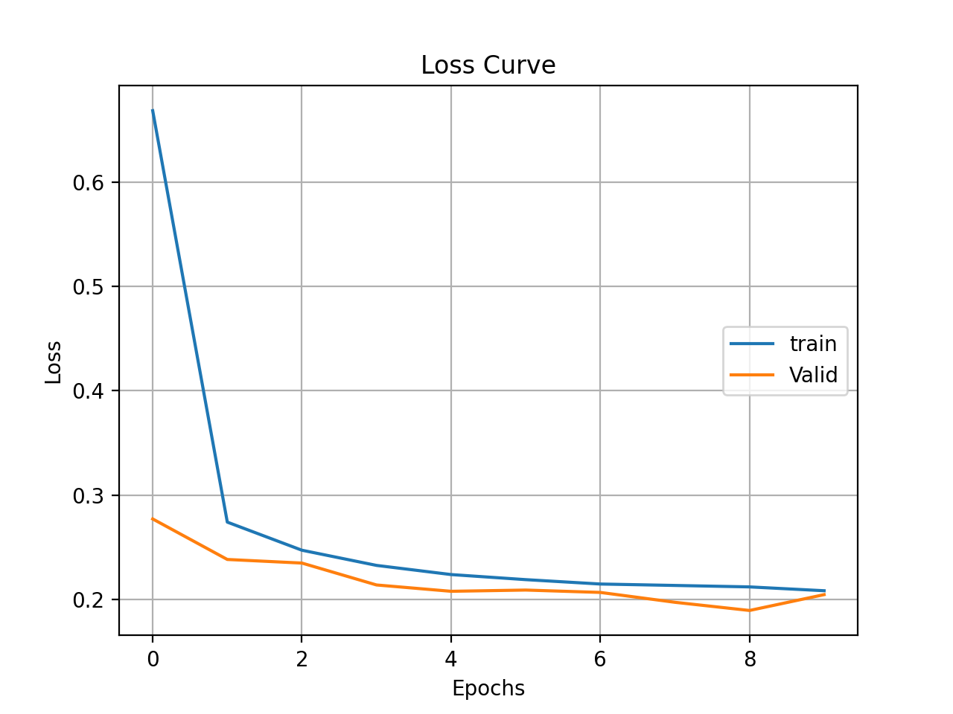
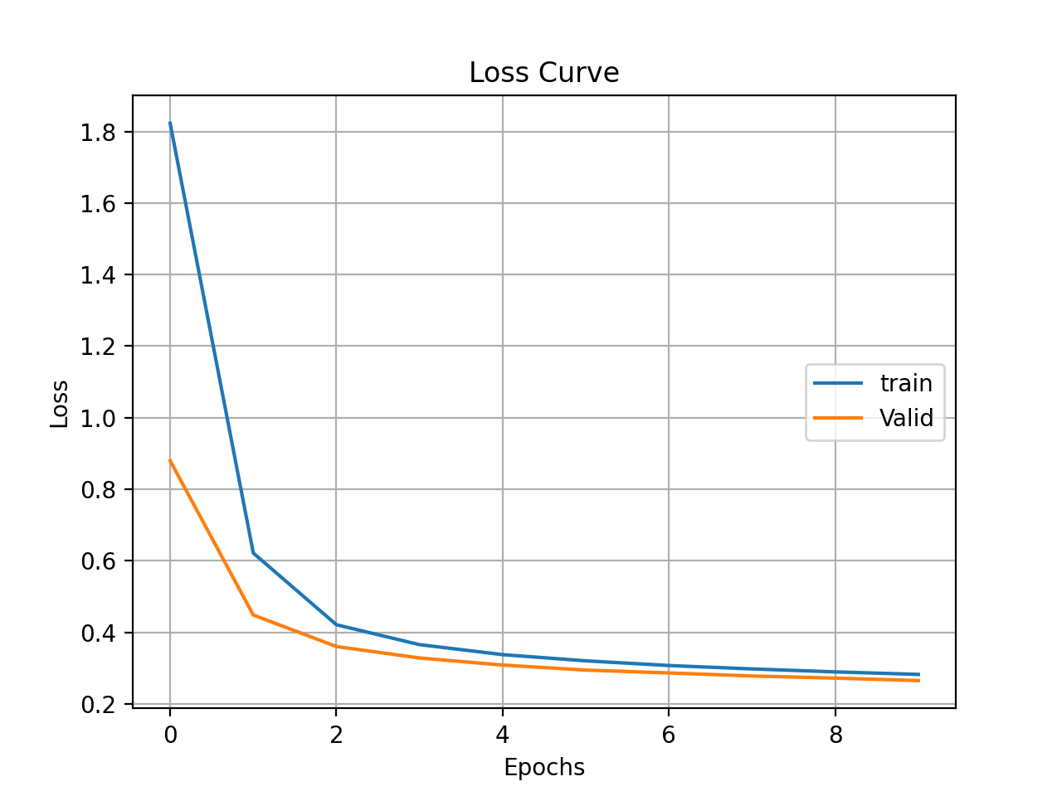
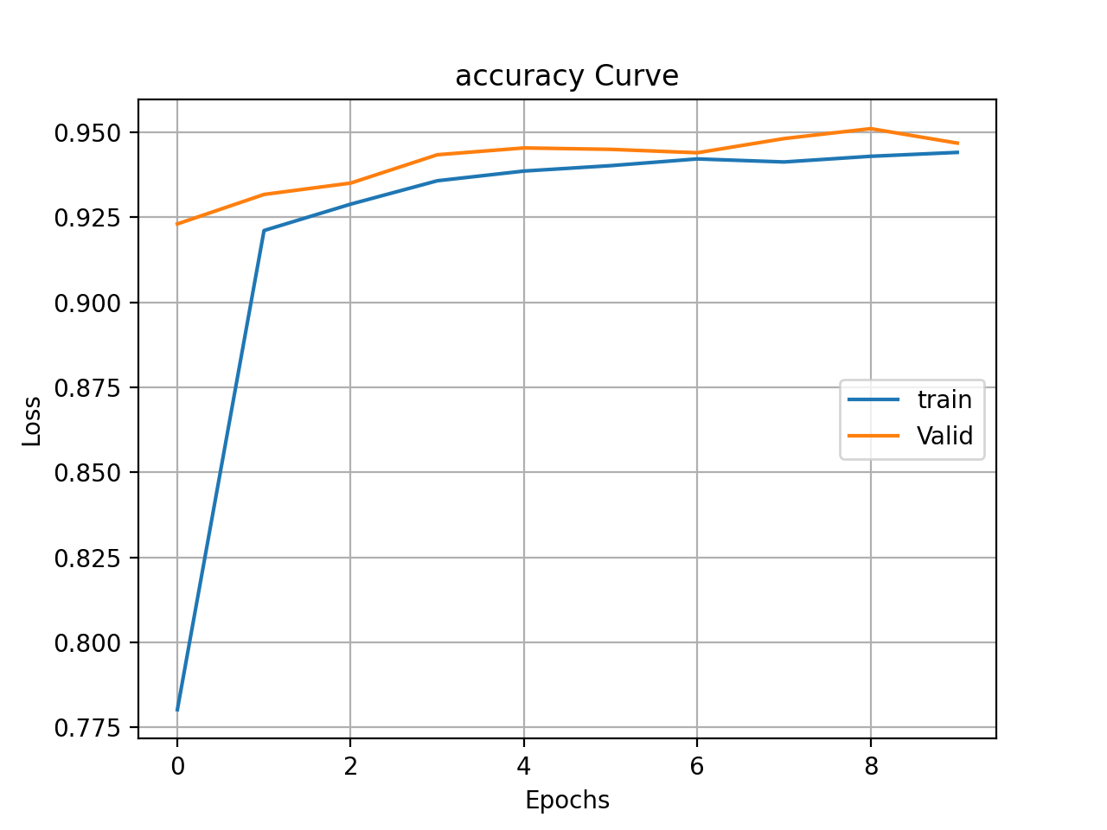
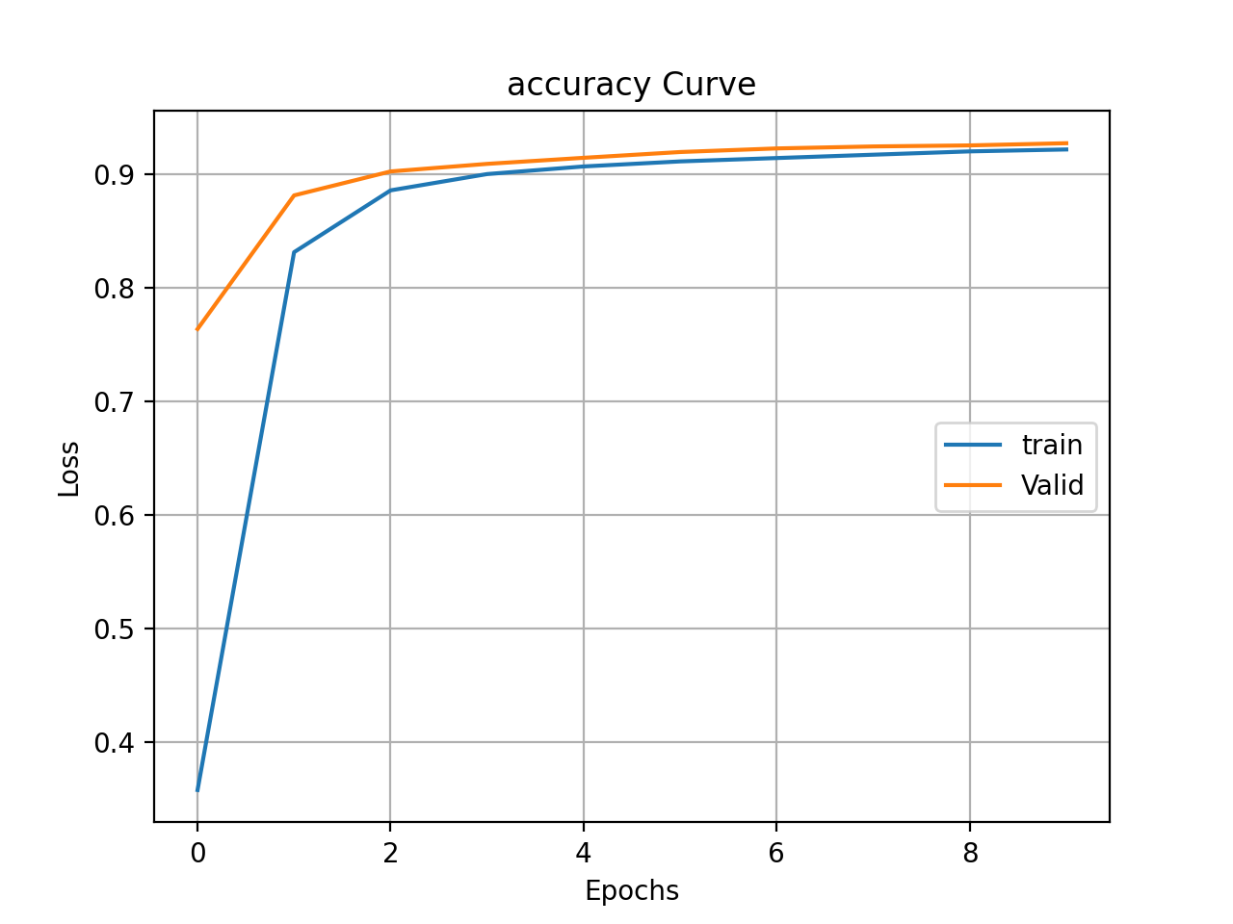
Learning Curve
Plot the learning curves [both accuracy and loss curves] and put it below:
lr = 1
lr = 1e-1

Slide 5
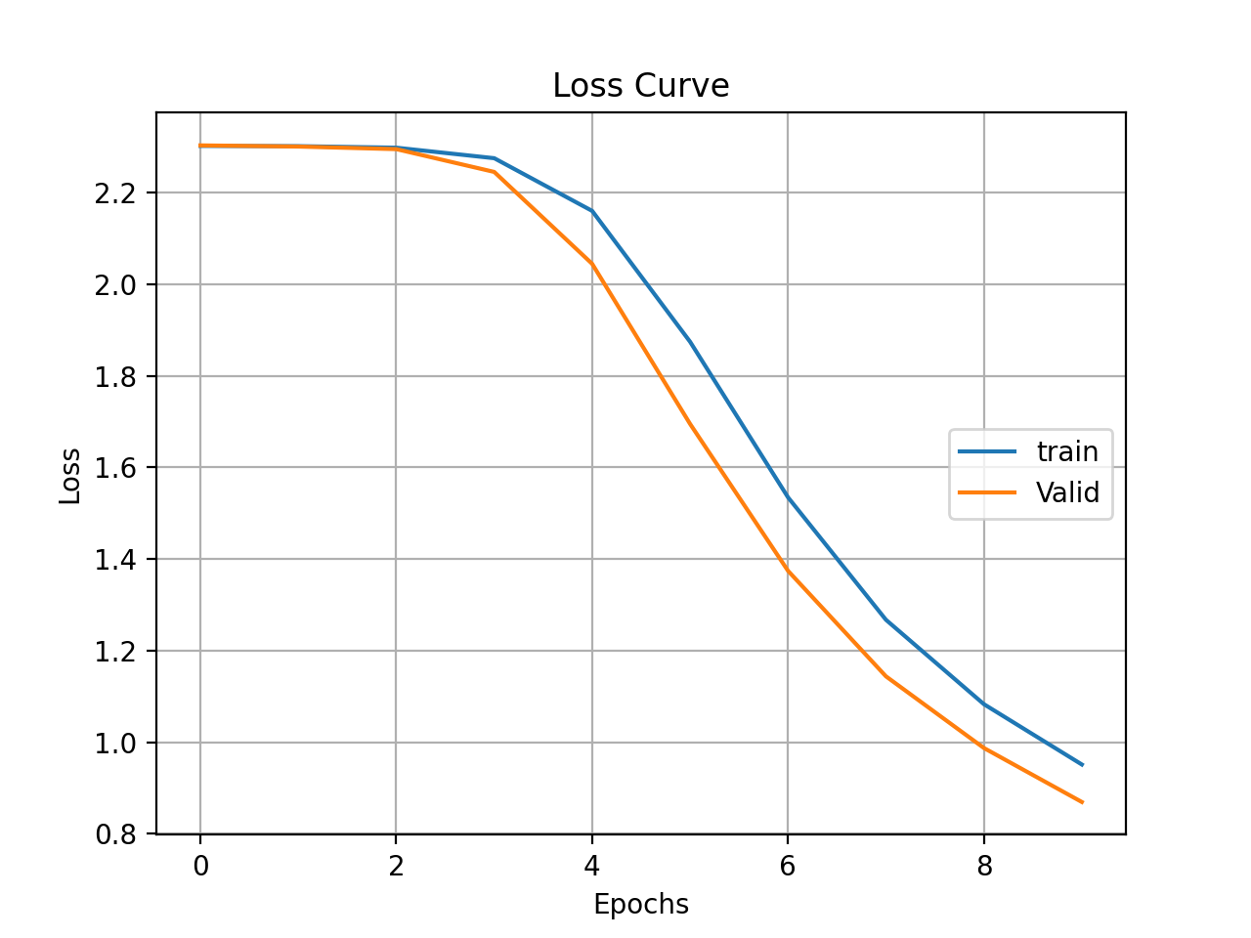
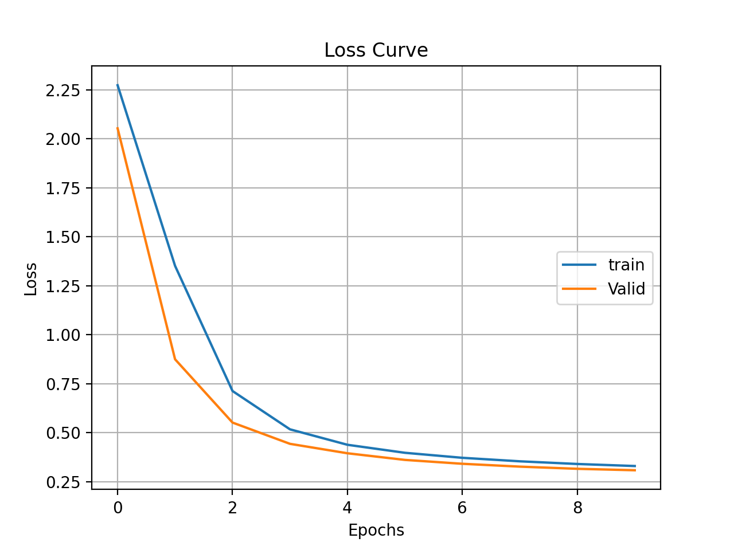
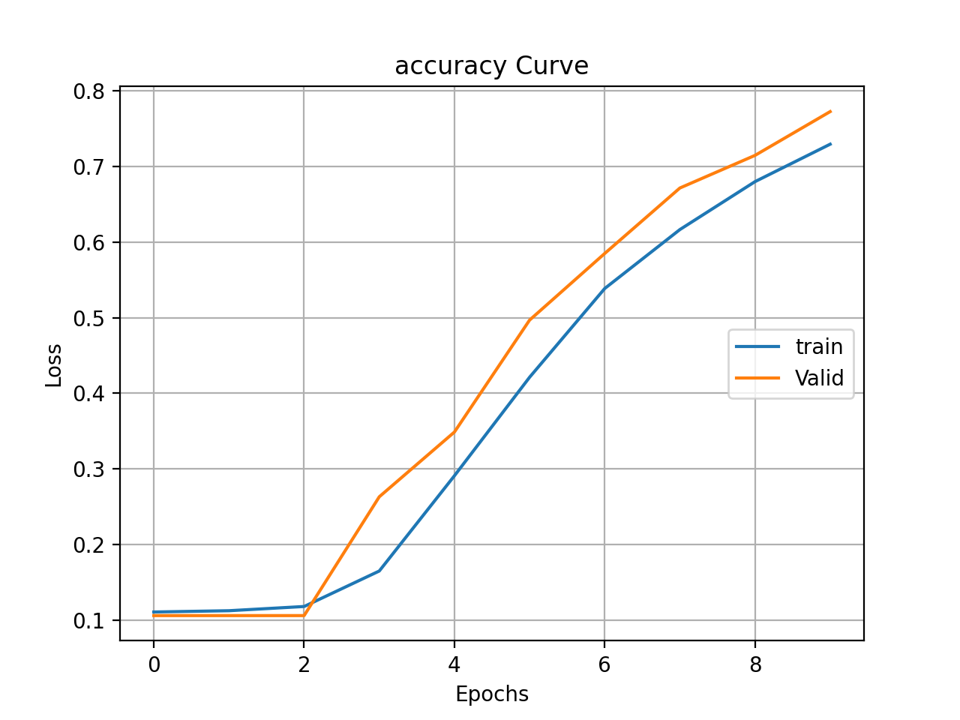
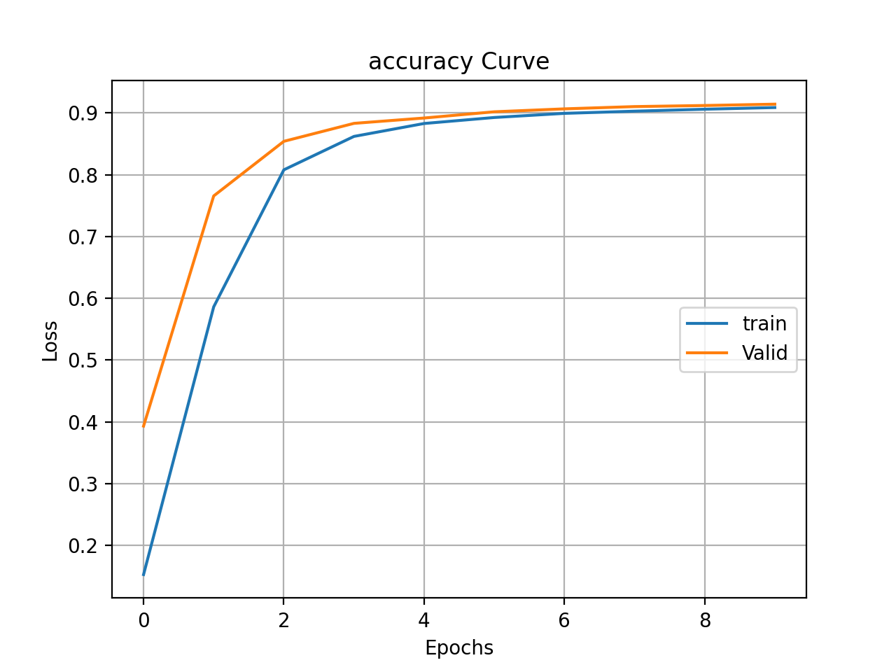
lr = 1e-2
lr = 5e-2

Slide 6
Learning Rates
Describe and Explain your findings:
The accuracy decreases an loss increases as learning rate decreases. Test accuracy tends to be higher than training accuracy. This is because that learning rate controls how quickly the model is adapted to the problem. When learning rate decreases, smaller changes are made to the model in each update round. If the number of epochs stays the same, the accuracy will decrease as well.

Slide 7
2. Regularization
Tune the regularization coefficient of the model with all other default hyper-parameters fixed. Fill in the table below:
 | alpha=1e-1 | alpha=1e-2 | alpha=1e-3 | alpha=1e-4 | alpha=1e-0
Training Accuracy | 0.3358 | 0.8847 | 0.9213 | 0.9295 | 0.1040
Validation Accuracy | 0.3423 | 0.8952 | 0.9275 | 0.9341 | 0.0956
Test Accuracy | 0.3625 | 0.8920 | 0.9263 | 0.9318 | 0.1135

Slide 8
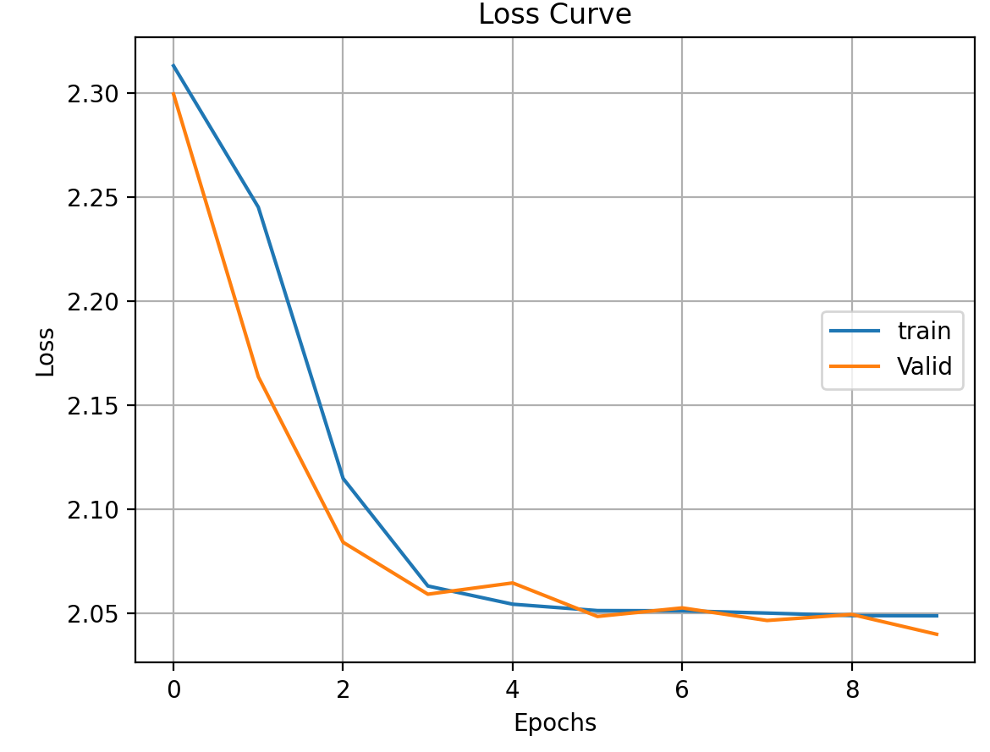
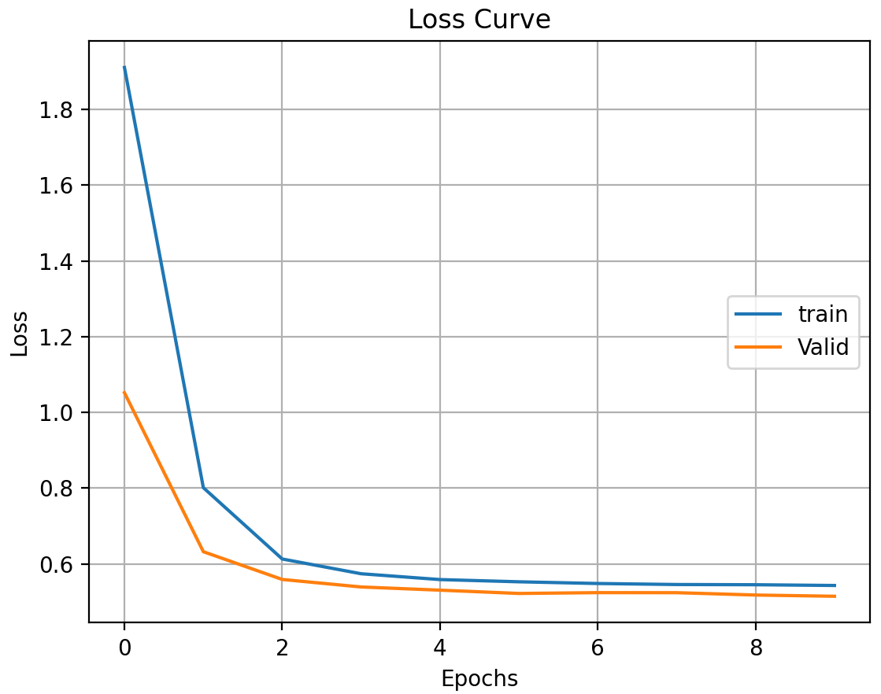

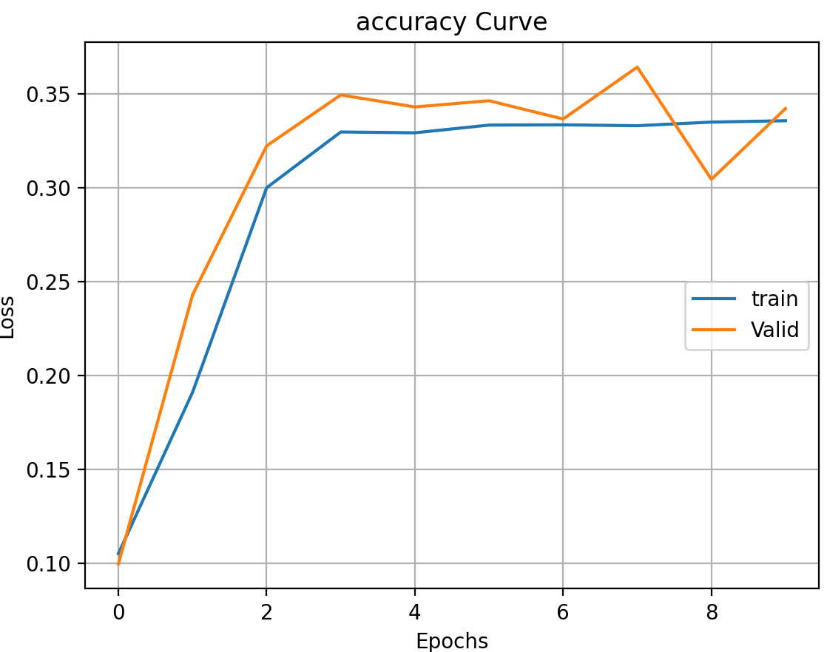
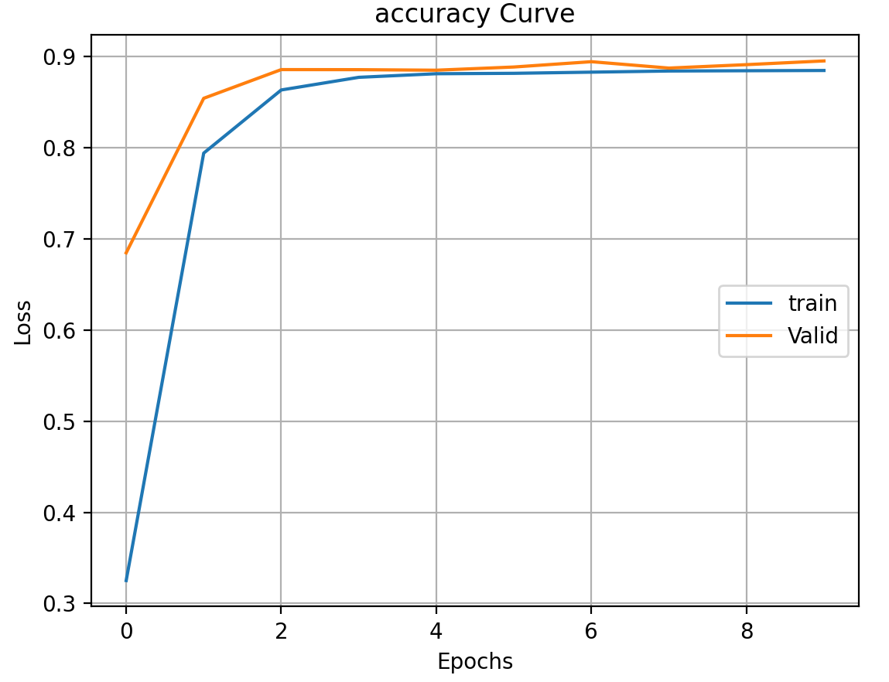

2. Regularization
Plot the learning curves [both accuracy and loss curves] and put it below:
alpha=1e-1
alpha=1e-2
alpha=1e-3

Slide 9
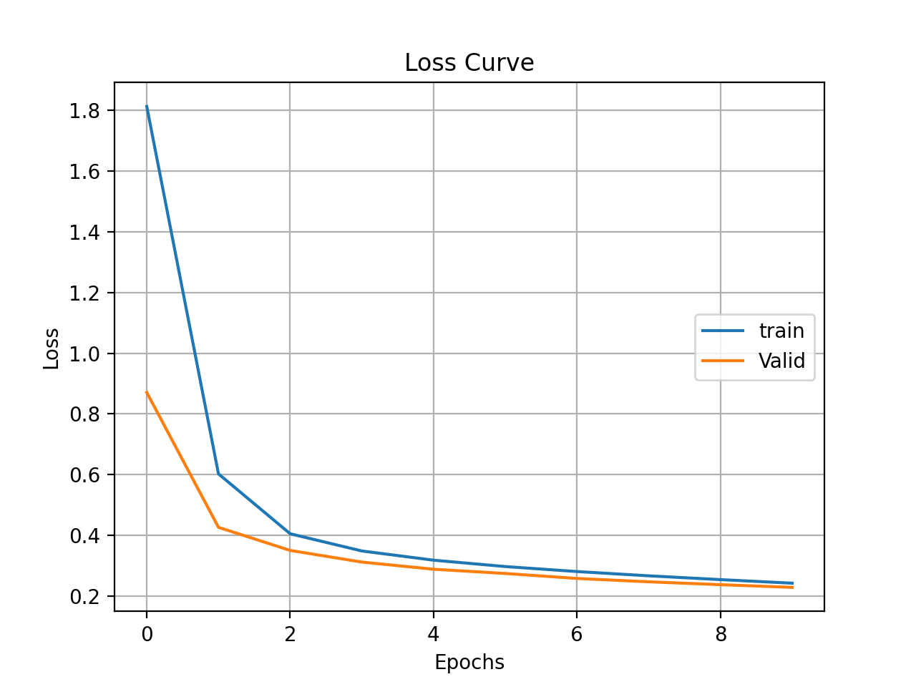
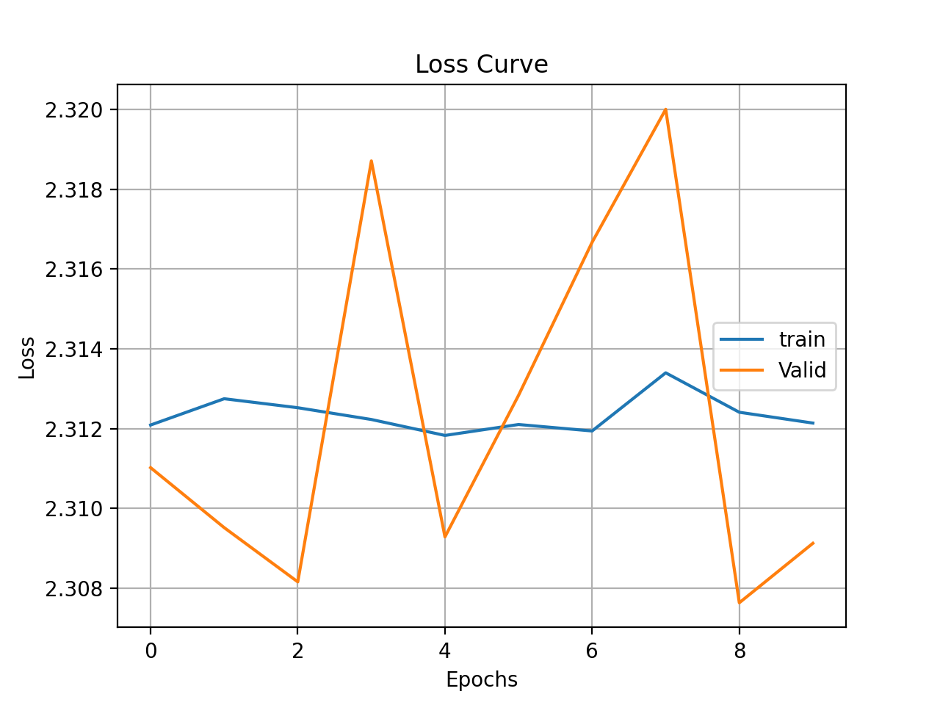
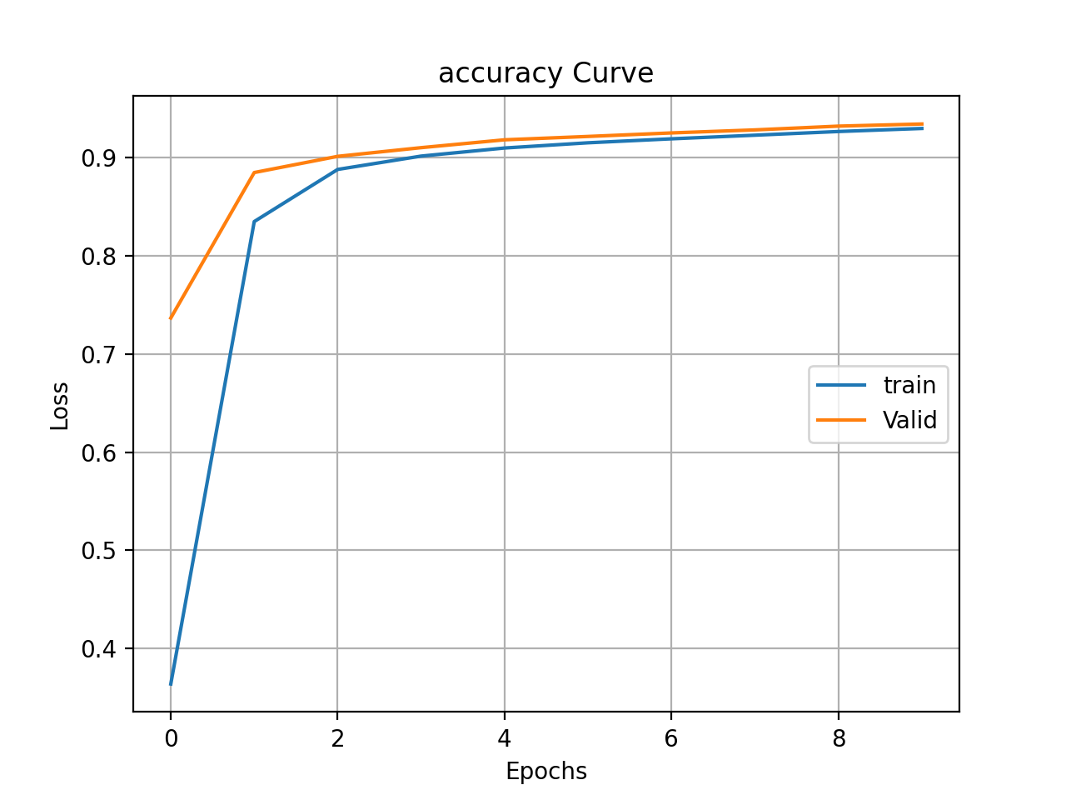
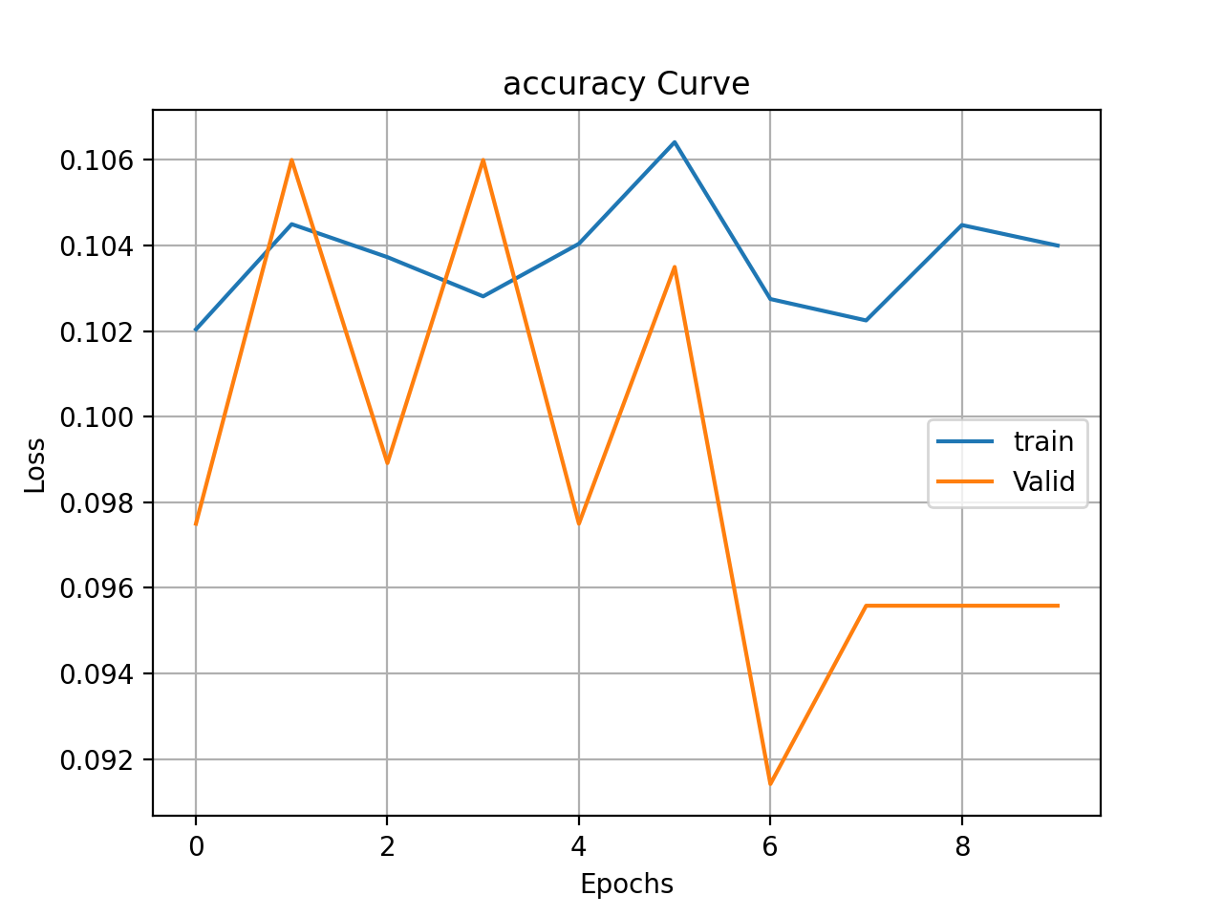
1e-4
1e-0

Slide 10
2. Regularization
Describe and Explain your findings:
When lambda increases, accuracy decreases, and loss increases. Lambda controls the impact on bias and variance. When lambda increases, the variance decreases, and the model avoids overfitting until a certain point before giving rise to bias in the model and underfitting.

Slide 11
3. Hyper-parameter Tuning
You are now free to tune any hyper-parameters for better accuracy. Create a table below and put the configuration of your best model and accuracy into the table:
Briefly explain why your choice works: both reg and learning rate are described in the previous pages. For the rest of the parameters, momentum was increased to accelerate the training of the model and to smooth the progression of the algorithm. Epochs is increased to 50 since increasing epochs gives the model more chances to update. However, number above 50 take a very long time to run and the improvement is not obvious. Batch size is increased to 3 * 32. But the difference is not obvious.
Batch size | Learning rate | reg | epochs | momentum | Testing accuracy | Training Accuracy
64 | 1 | 0.0001 | 50 | 0.99 | 0.9762 | 0.9886

