Slide 1
GraphQL | A query language for your API

Slide 2
Background
Facebook, 2012
Initial Public Release, 2015
GraphQL Foundation, 2018
Language support: javascript & the ‘rest’ (all major languages)
Major Enemy: RESTful APIs

Slide 3
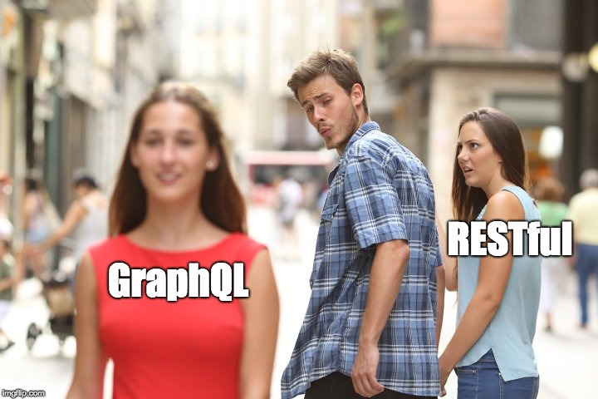

Slide 4


Slide 6
Problems with REST
Data over-fetch
(GET) /api/v1/author/1
{
"id": 1,
"firstName": "John",
"lastName": "Doe",
"displayName": "John Doe",
"blogs": [. . .],
. . .
. . .
"creationDate": 1558321600,
"createdBy": 123,
"lastUpdateDate": 1558321601,
"lastUpdatedBy": 124,
. . .
}
(GET) /api/v1/authors
[ {}, {}, {}, {}, … ]

Slide 7
Problems with REST
Data under-fetch | Multiple Trips
(GET) /api/v1/article/1
{
"id": 1,
"authorId": 1,
"title": ". . .”
. . .
}
(GET) /api/v1/author/1
{
"id": 1,
"blogs": [. . .],
}
(GET) api/v1/blog/1
(GET) api/v1/blog/3
(GET) api/v1/blog/11
(GET) api/v1/blog/3/recentArticles
. . .

Slide 8
Example Schema
Blog 1A
Article 1A.1
Article 1A.2
Article 1A.3
Author 1
Blog 1B
Article 1B.1
Author 2
Blog 2A
Author 3
Blog 3A
Article 3A.1
Article 3A.2

Slide 9
GraphQL’s Way
Query {
authors {
id
}
}
Query {
authors {
id displayName
}
}
Query {
authors {
id displayName
blogs {
id
articles {
id
}
}
}
}

Slide 10
GraphQL’s Way
Query {
authorDtl(id: 1) {
id name
}
}
query getAuthorDtl($id: Int!) {
authorDtl(id: $id) {
id name
}
}
{ “id”: 1 }

Slide 11
Some GraphQL’s Concepts
Query
Mutation
Subscription
Resolvers
Basic Types
String, Int, Float, Boolean, ID
[Int]

Slide 12


