Slide 1



Toolkit
Security related demos
SQL injection
Eavesdropping
Steganography

Slide 2
Demos
SQL injection playground
  Website to experiment with SQL injection
  Database generated at runtime
Eavesdropping/packet sniffing
  One-way messaging
Image steganography
  Encode messages into image data

Slide 3




Techs and Reqs
GUI
  Launcher
  Steganography frontend
Non-GUI
  Eavesdropping
    Wireshark (tshark)
  Steganography backend
    Python Image Library (PIL)
Web & database
  SQL injection
    CherryPy server
    SQLite3 database

Slide 4
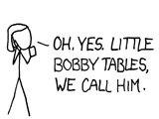
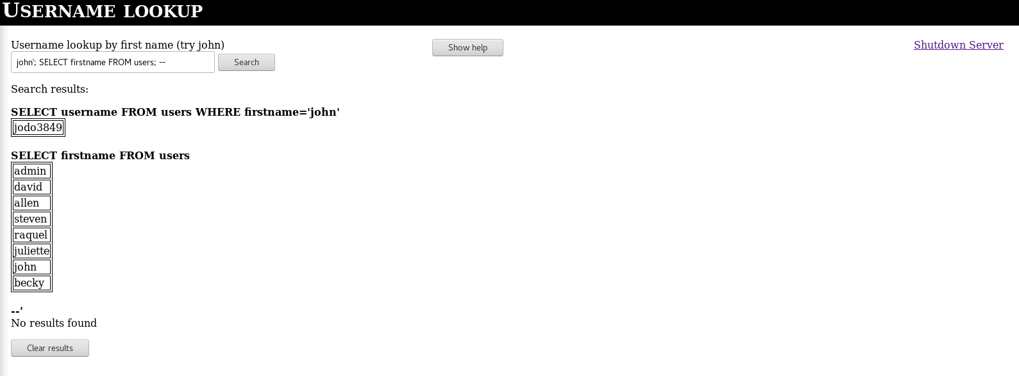
SQL injection
Tech used
  SQLite3
  CherryPy
Bobby tables proof
  Database generated at runtime – drop all the tables you like!

Slide 5
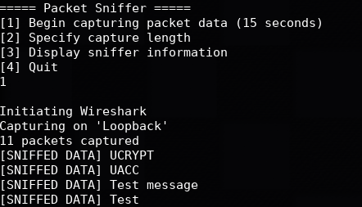
Eavesdropping
Sender-reciever relationship for simplicity
  Supports basic encryption
Sniffer displays packet data

Slide 6
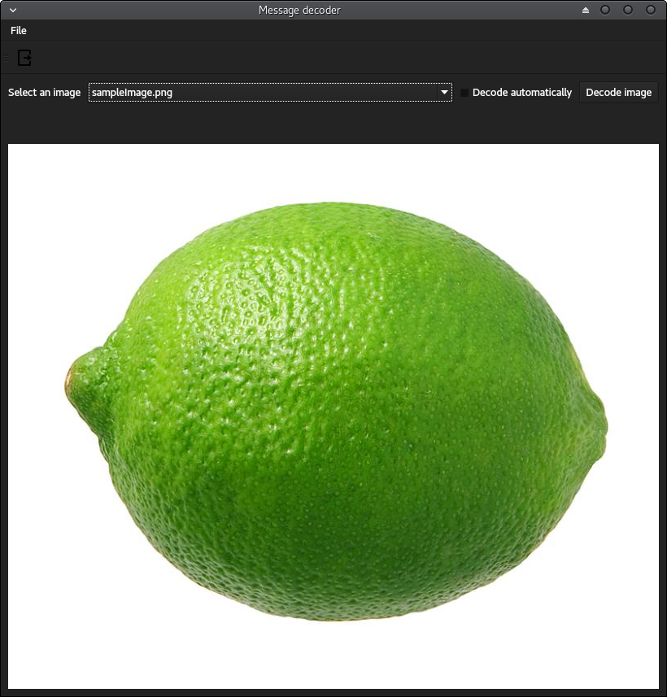
Steganography
Hides plaintext ascii message in a PNG image
Decodes and displays messages

Slide 7
Unfinished business
Places for improvement:
  Create database in memory instead of disk
    Unsure how to pass a db located in memory to javascript
  Implement RSA key generation and SSH handshake
    Using an API is a trivial solution
  Make chat flow both ways
    2-way isn’t necessary to illustrate passive eavesdropping
  Display sniffed sender/receiver data
    Requires more handling of raw packet data
  Support additional image types for Steganography
    Standard JPEG is lossy, makes encoding trickier
Bugs
  Steganography window does not resize dynamically
  Enter key doesn’t connect with button on SQL webpage
  Auto-launch for eavesdropping only loads terminal, not all three necessary
  Server gets sad when Client is killed

Slide 8
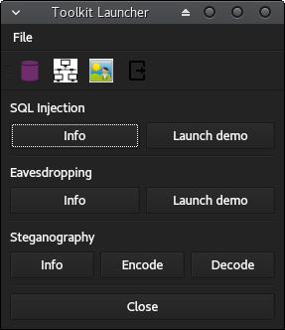
Live demo

