Slide 1



Toolkit
Python-based security oriented demonstration

Slide 2
Features
SQL injection
Eavesdropping/packet sniffing
Image steganography

Slide 3
Application requirements
GUI
  Launcher
    PyQt
  Steganography (frontend)
    PyQt
Non-GUI
  Eavesdropping
    Python
    wireshark
  Steganography (backend)
    Python
    Python Image Library (PIL)
Web & database
  SQL injection
    CherryPy server
    SQLite3 database

Slide 4
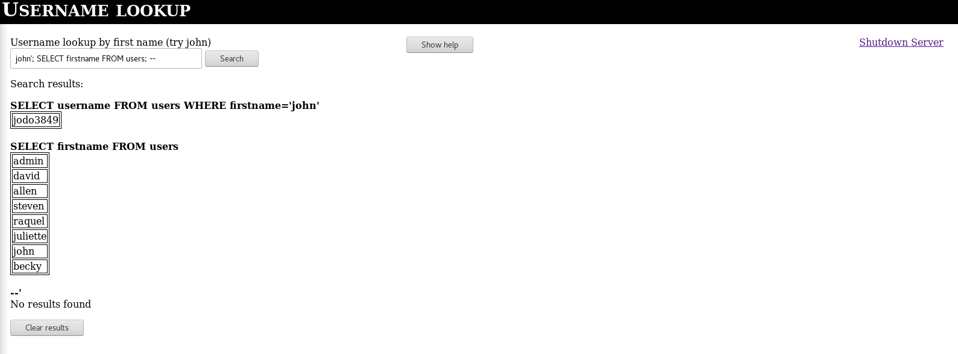
SQLi
Simple CherryPy server to demonstrate how SQL injections are preformed
Database generated at runtime to limit SQL command reprocussions – drop all the tables you like!

Slide 5
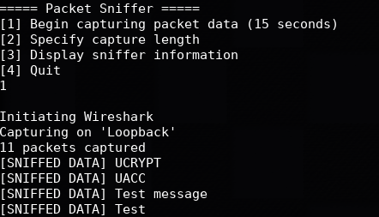
Eavesdropping
Sender-reciever relationship for simplicity
  Supports basic encryption
Sniffer displays packet data

Slide 6
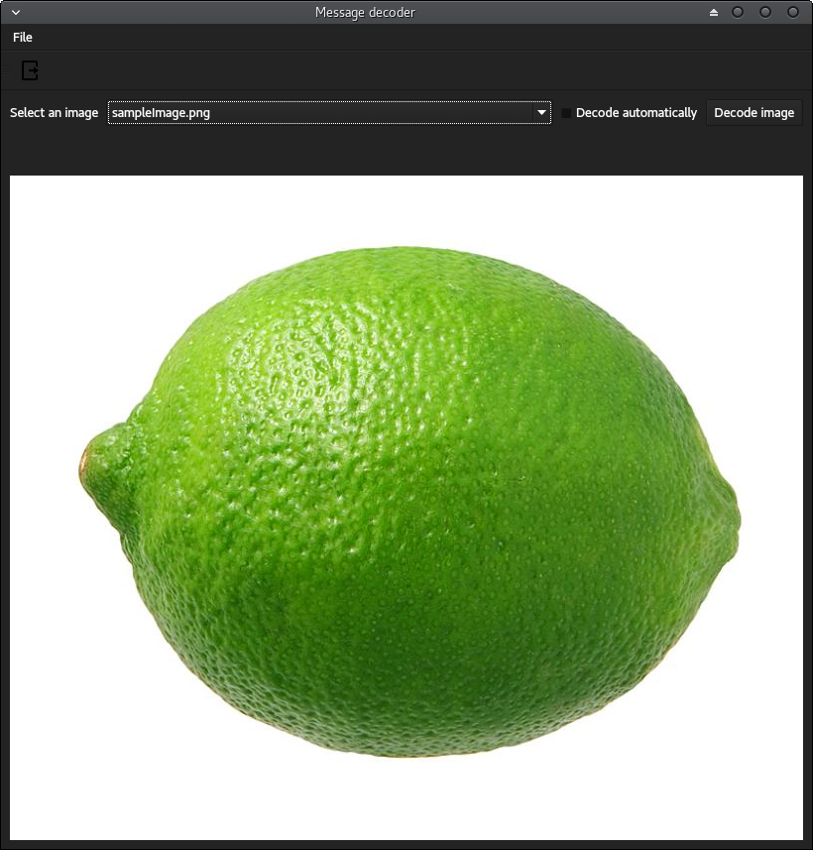
Steganography
Encodes a plaintext message into .png image
Decodes and displays messages

Slide 7
Unfinished business
Additional features:
  RSA & Diffie-Hellman for Eavesdropping demo
Bugs
  Steganography window improperly resizes
  Enter key doesn’t execute query on SQL webpage

Slide 8
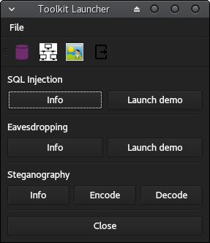
Live demo

