Slide 1
Fridge Forager
Zak Collins
Alex Cordero
Daniel Strawn
Notes:
Alex: Introduce us. Talk about what project actually is.

Slide 2

Agile
Occasional stand-up meetings
Pair Programming
Unofficial Peer Code Review
Test Driven Development
Notes:
Daniel: We did stand-up meetings whenever we needed to catch up on what everybody else has been doing.

Slide 3
GitHub
Merge conflicts
Learning curve
Makes collaboration easier
Notes:
Daniel

Slide 4

Trello
Simple and straight forward
Free
Available on Android
Very easy to communicate who needs to do what
Notes:
Zak

Slide 5

Eclipse IDE
None of us could get it to work
Emulator didn’t work
Very hard to set up
Notes:
Zak

Slide 6
Android Studio
Android Framework built in
Java and XML
Lint Static Analysis
Emulator Very Slow
Notes:
Alex

Slide 7
Javadoc
Built-in to Android Studio
Super easy
Notes:
Alex

Slide 8
Food2Fork API
Thought about creating our own database
Searches based on ingredients
Recipes returned in JSON format
Directions not included – have to link to external site
Notes:
Zak

Slide 9
Challenges
4th member of group dropped class without telling anybody
No experience with mobile development or Android framework
Notes:
Daniel:

Slide 10
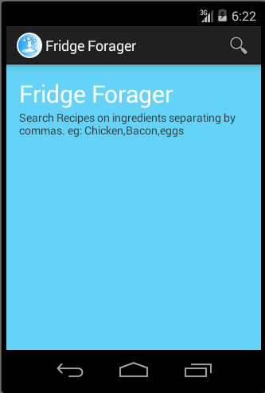
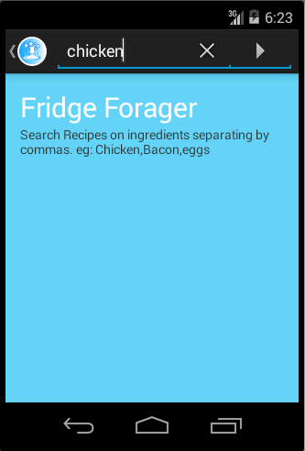
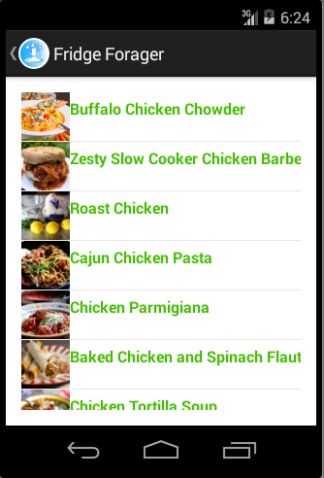
Demonstration
Notes:
Alex

