Slide 1
Nuada: Bionic Hand Movement Estimation via TinyML
Edge-AI Hand Gesture Classification via Multi-Channel sEMG and IMU Fusion
CSE 495/496 - Graduation Project Proposal Presentation
Researchers: Nuri Ziya Kırtepe & Evrim Doğa Solmaz
Advisor: Prof. Dr. Erkan Zergeroğlu
Department of Computer Engineering, Gebze Technical University
October 2026

Slide 2
Contents
1. Project Definition & Motivation (Affordable Bionic Hand Control)
2. Project Design & System Architecture (Dual-Core FreeRTOS Pipeline)
3. Hardware Selection: Microcontroller & Platform Benchmark (Why ESP32-S3?)
4. Cost Optimization: Economic Feasibility & Sensor Strategy (AD8232 vs. MyoWare)
5. Hardware Engineering: AD8232 EKG to sEMG Modification (10x Savings)
6. Circuit Layout Verification
7. Project Requirements (Hardware, Software, Subject Protocol)
8. Concrete & Testable Success Criteria (Quantitative Thresholds)
9. Work Breakdown & Team Responsibilities
10. Project Timeline & Monthly Milestones (Oct 2026 – Apr 2027)
11. References, Project Summary & Discussion

Slide 3
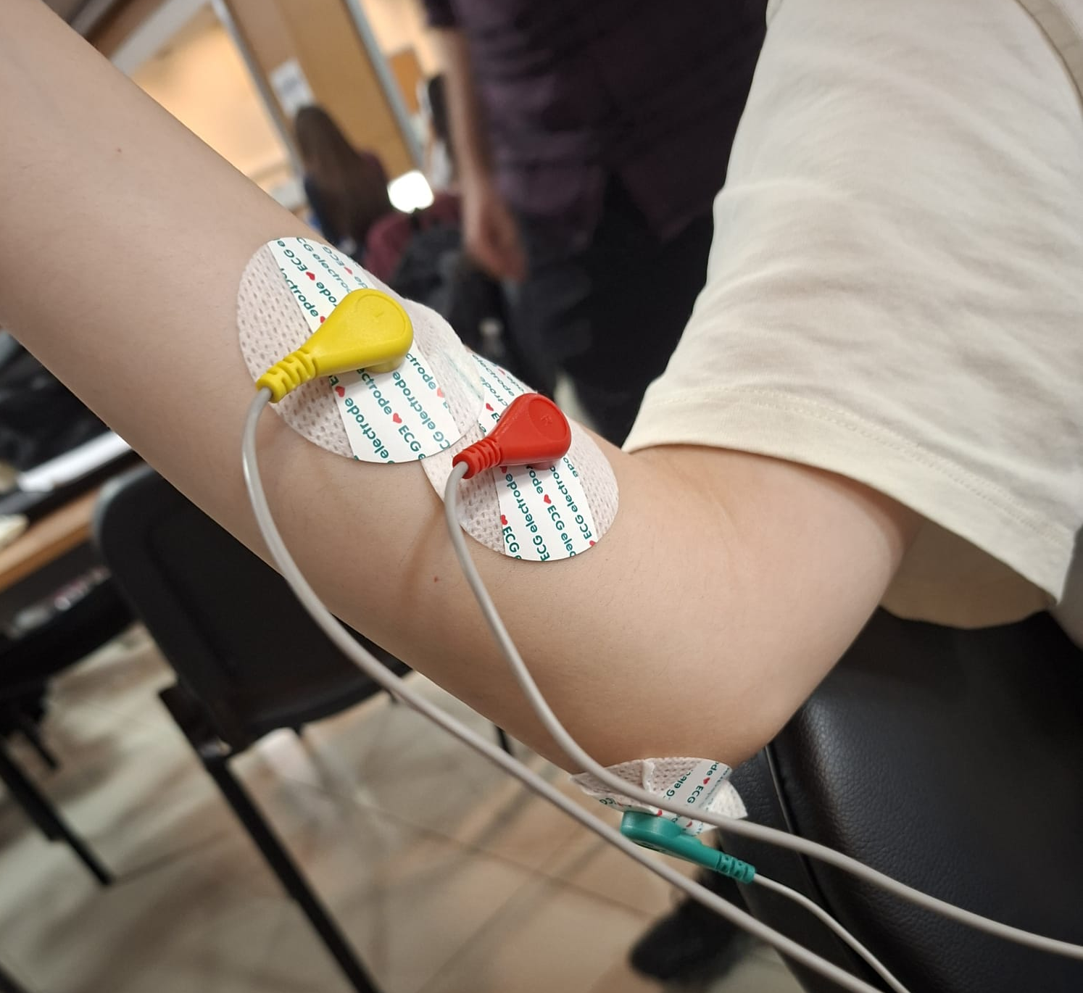
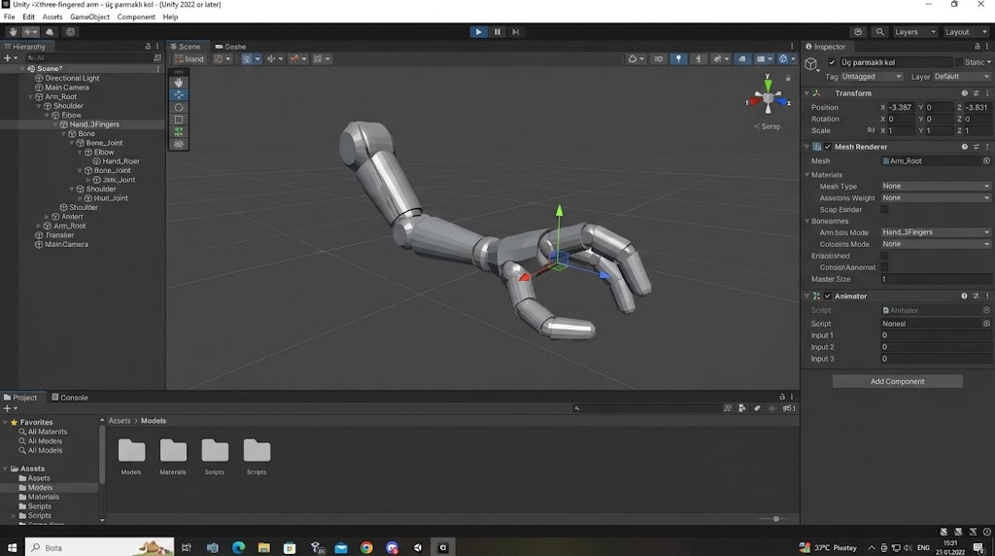
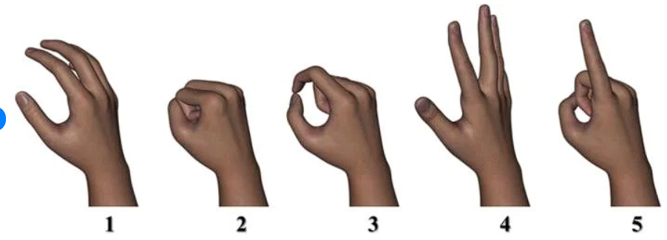
Project Definition & Motivation
Economic Problem & Need:
• Can be used for rehabilitation for amputee and paralyzed people
• > 90% Global Accessibility Barrier (Unaffordable)
Realistic VR(virtual reality) experience
Nuada Project Vision:
• Ultra-Affordable Complete Hardware Kit
• Wearable, Standalone & Real-Time Bionic Control
Dual-Sensing Modality (Anti-Drift Fusion):
• 4-Ch sEMG: Forearm Flexors/Extensors (Motor Intent)
• 6-Axis IMU: Arm Elevation (Pitch/Roll). Cancels Gravity Drift
Standalone Edge Intelligence (Zero Cloud):
• ESP32-S3 TinyML: INT8 Quantized (< 25 ms Latency)
• 5 Functional Gestures:
Rest, Fist, Pinch, Open, Point
• Actuation: Three.js 3D Digital Twin

Slide 4
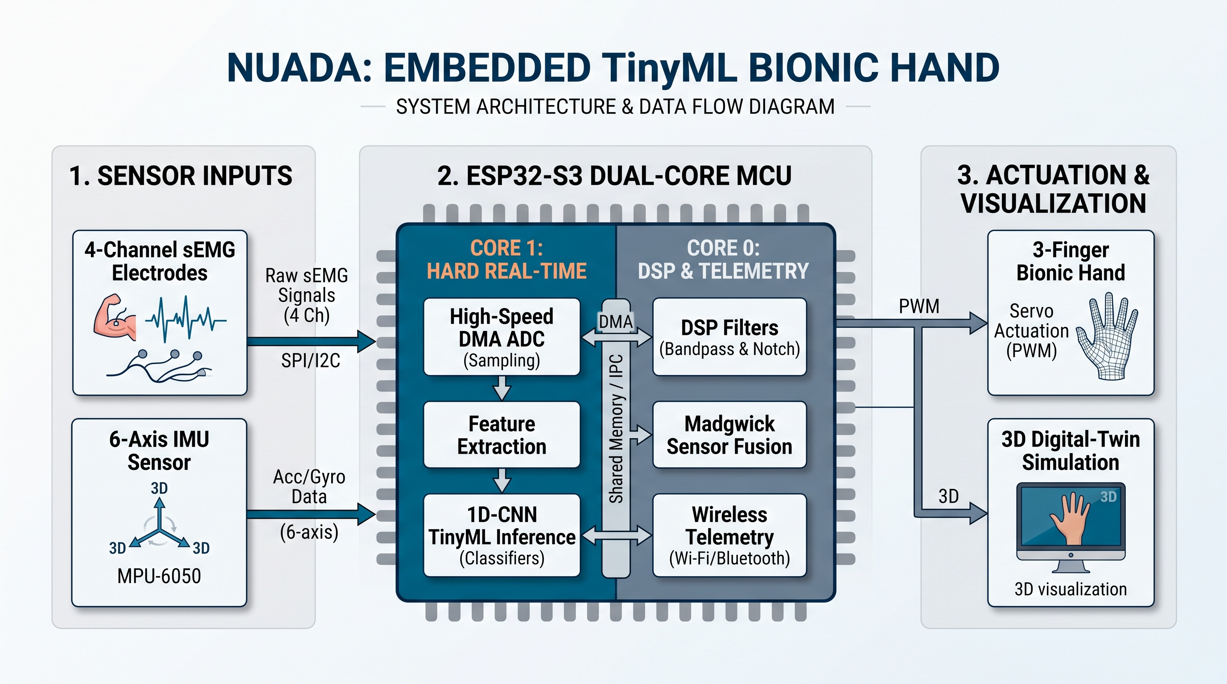
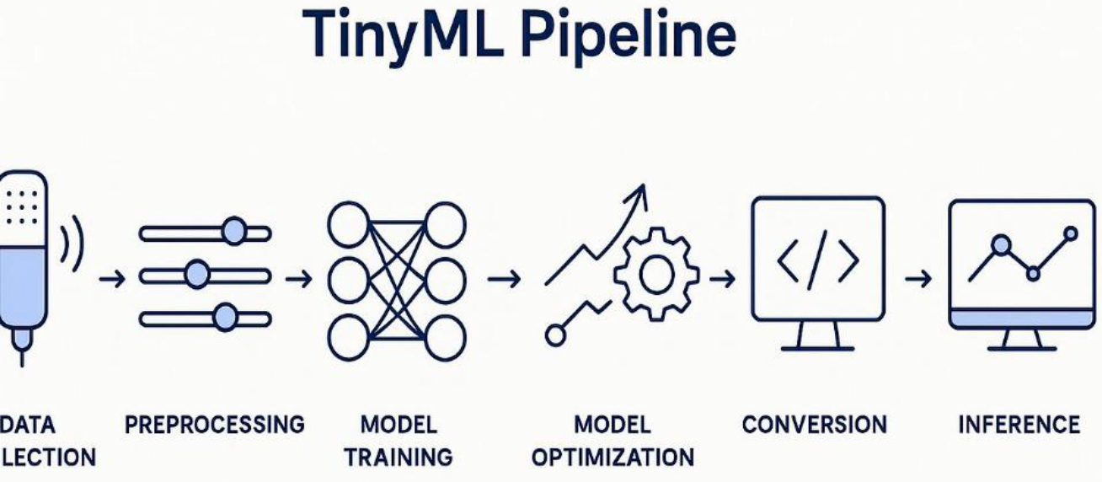
Project Design & System Architecture
End-to-End System Breakdown:
1. Front-End Sensing Layer (Forearm Acquisition):
• 4x AD8232 Modules: 1100x Gain, Modified 410.9 Hz sEMG LPF
• 1x MPU-6050 IMU: I2C Fast-Mode (400 kHz), Pitch & Roll Kinematics
• Custom Armband: Stainless-Steel Snaps + Reusable Conductive Gel
2. Dual-Core FreeRTOS Pipeline on ESP32-S3:
• Core 0 (DSP & Telemetry Task @ 1000 Hz):
- DMA Double-Buffering: Continuous 12-bit ADC1 Sampling
- Digital Filter Cascades: 20 Hz HPF + 50 Hz IIR Notch
- Sliding Window: 200 ms Window (MAV, RMS, WL, ZC, Pitch/Roll)
• Core 1 (TinyML Engine @ 20 Hz):
- TFLite Micro INT8: Hardware-Accelerated Vector Inference
- 5-Class Classifier: Real-Time Prediction + Majority Voting
3. Dual Actuation & Telemetry:
• 3D Digital Twin: Real-Time Three.js WebGL via WebSockets (< 50 ms)
COL

Slide 5
Hardware Selection: Microcontroller & Platform Benchmark
ESP32-S3 (Xtensa LX7 Dual-Core @ 240 MHz) — Undefeated Winner | Raspberry Pi Pico / Pico W (RP2040) — Eliminated: | Raspberry Pi Pico 2 W (RP2350) — Runner-Up: | Teensy 4.0 / STM32F446RE — Eliminated (Wearable Infeasible): | Arduino Nano 33 BLE / Uno — Eliminated:
• Native AI Vector Acceleration (ESP-NN): Hardware vector instructions for INT8 TFLite Micro • Symmetrical Dual-Core FreeRTOS: Core 1 dedicated to hard real-time DMA ADC & TinyML; Core 0 handles soft real-time LwIP Wi-Fi/BLE streaming & MPU-6050 kinematics • Continuous DMA ADC1: Deterministic 2000 Hz 4-channel sampling without CPU polling jitter | • No Hardware FPU: Dual Cortex-M0+ lacks FPU; digital filtering & ML requires slow software emulation • Radio Bottleneck: External wireless chip lacks high-throughput deterministic telemetry | • Has FPU/DSP, but concurrent Wi-Fi streaming + real-time TinyML creates severe firmware contention | • Raw 600 MHz M7 Power, but ZERO built-in wireless (Wi-Fi/BLE); bulky external shields & high power draw | • Nano 33 BLE restricted to slow BLE (no high-speed UDP/WebSockets); Uno (8-bit) obsolete for TinyML

Slide 6
Cost Optimization: Economic Feasibility & Sensor Strategy
10x Front-End Cost Reduction (AD8232 vs. MyoWare 2.0): | Kinematic Anti-Drift Sensor Fusion (Zero Bulky Cords): | Sustainable Armband (Zero Single-Use Waste): | Standalone Microcontroller Edge Intelligence:
• MyoWare 2.0 Baseline: ~₺4000 / ch → ~₺16,000 for 4 Channels (+ proprietary snap shields) • Nuada Strategy (AD8232 Breakout): ~₺1760 for 4 Channels • Cost Impact: > 90% Cost Reduction with Equal Biopotential Fidelity (1100x Gain, High CMRR) | • Limb Position Challenge: Raising arm shifts muscle synergy patterns, causing false classifications • Conventional Fix: 2–4 Expensive Shoulder EMG Sensors ($90–$180) + clumsy shoulder/chest cabling • Nuada Solution: 1x Forearm MPU-6050 ($2.50) → Cancels gravity drift without shoulder wires | • Disposable Medical Pads: ~₺200 / 50-pack (Depleted in only 6 subject sessions) • Reusable Snap Band: Elastic Velcro + Stainless Snaps + Conductive Gel (~₺100) → 100+ Trials | • ESP32-S3 N16R8 ($7.50): Replaces external PC or Raspberry Pi ($50–$100) • COMPLETE HARDWARE KIT: Strictly < ~₺3000 vs. ~₺20000 Commercial Baseline (> 90% Savings!)
CSE496 – First Presentation
6

Slide 7
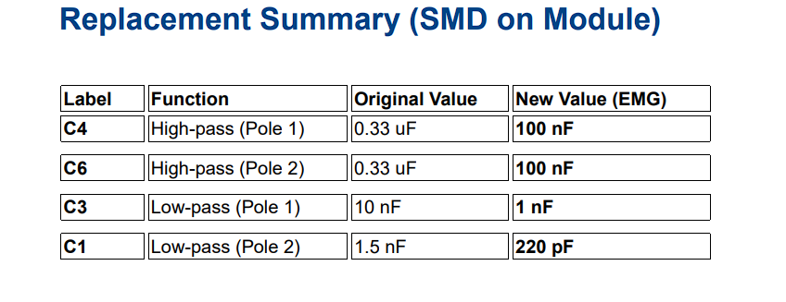
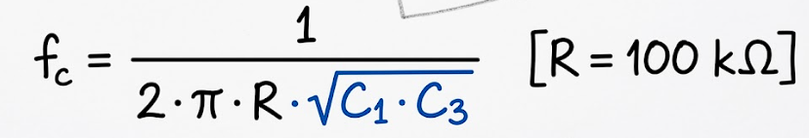
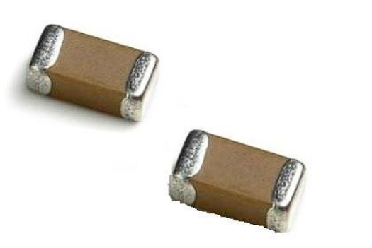
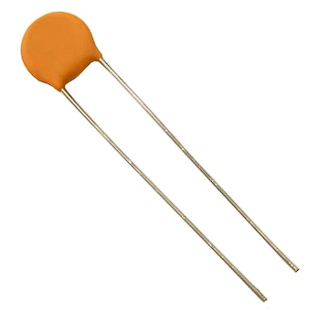
Hardware Engineering: AD8232 EKG to sEMG Modification
The Core Engineering Bottleneck:
• Stock AD8232: Factory ECG Bandwidth (0.5 Hz – 40 Hz Passband)
• sEMG Signal Requirement: 10 Hz – 450 Hz Power Spectrum
• Problem: 40 Hz Filter Clips > 90% of Motor Unit Action Potentials !
Sallen-Key LPF Rework (40 Hz → 410.9 Hz):
• Cutoff Formula:
• C3 Rework: 10 nF → 1.0 nF (SMD 0603 / Disc"102")
• C1 Rework: 1.5 nF → 150 pF (SMD 0603 / Disc "151" / "221")
• Result: Preserves 1100x System Gain & Unlocks Full 410.9 Hz sEMG Band
High-Pass Filter Stage (Motion Artifact Rejection):
• C4 & C6 (SMD 0805): 0.33 µF → 10 nF Shifts HPF Cutoff to 15.9 Hz
• Software Fallback: 20 Hz 2nd-Order Butterworth HPF on ESP32-S3
Ceramic Disc Capacitor Choice:
• Unmarked SMD Ambiguity Solved: Leaded Capacitors with Clear "102" & "151" Stamps
• Easy Verification: Guarantees Visual Verification of Values
???

Slide 8
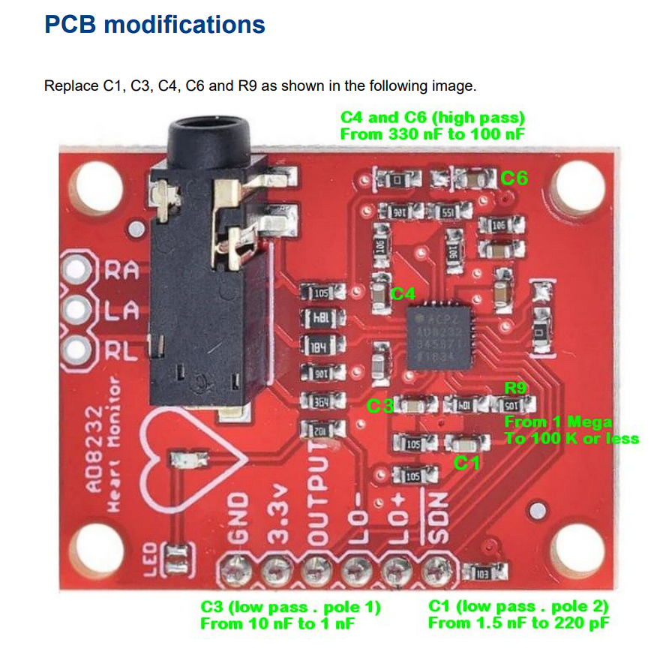
Circuit Layout Verification
Open-Source Hardware Validation: The module used is a 1:1 hardware clone of the SparkFun AD8232 breakout board. We cross-examined the official SparkFun open-source repository, reviewing the schematic (.sch) and PCB layout (.brd) files to verify component placement and passive component values.
Datasheet & Parameter Cross-Check: Component tolerances and operating parameters were validated with a web-based AD8232 datasheet documentation.
Bandwidth & EMG Feasibility Verification: Since the AD8232 default reference design is optimized for ECG (~0.5–40 Hz), we evaluated the circuit's cutoff frequency response against the required sEMG bandwidth (up to 450–500 Hz). By referencing comparative component placement and filter design resources, we confirmed the hardware stage's passband characteristics and overall signal integrity before deployment.

Slide 9
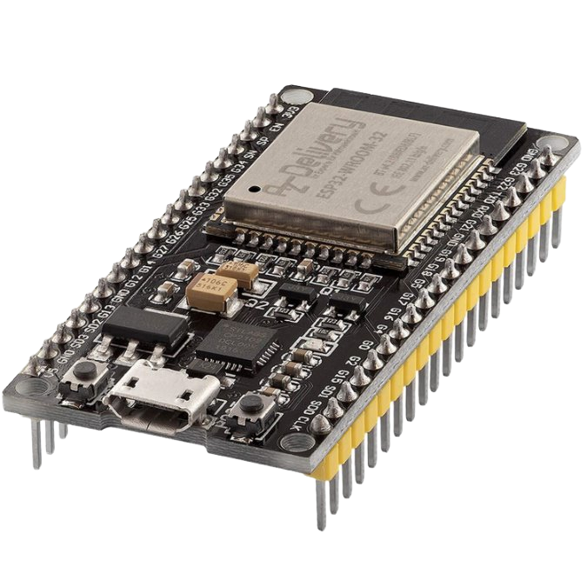
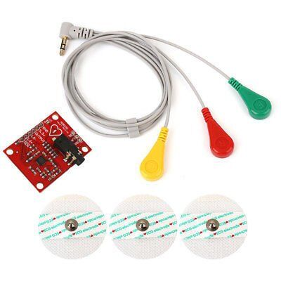
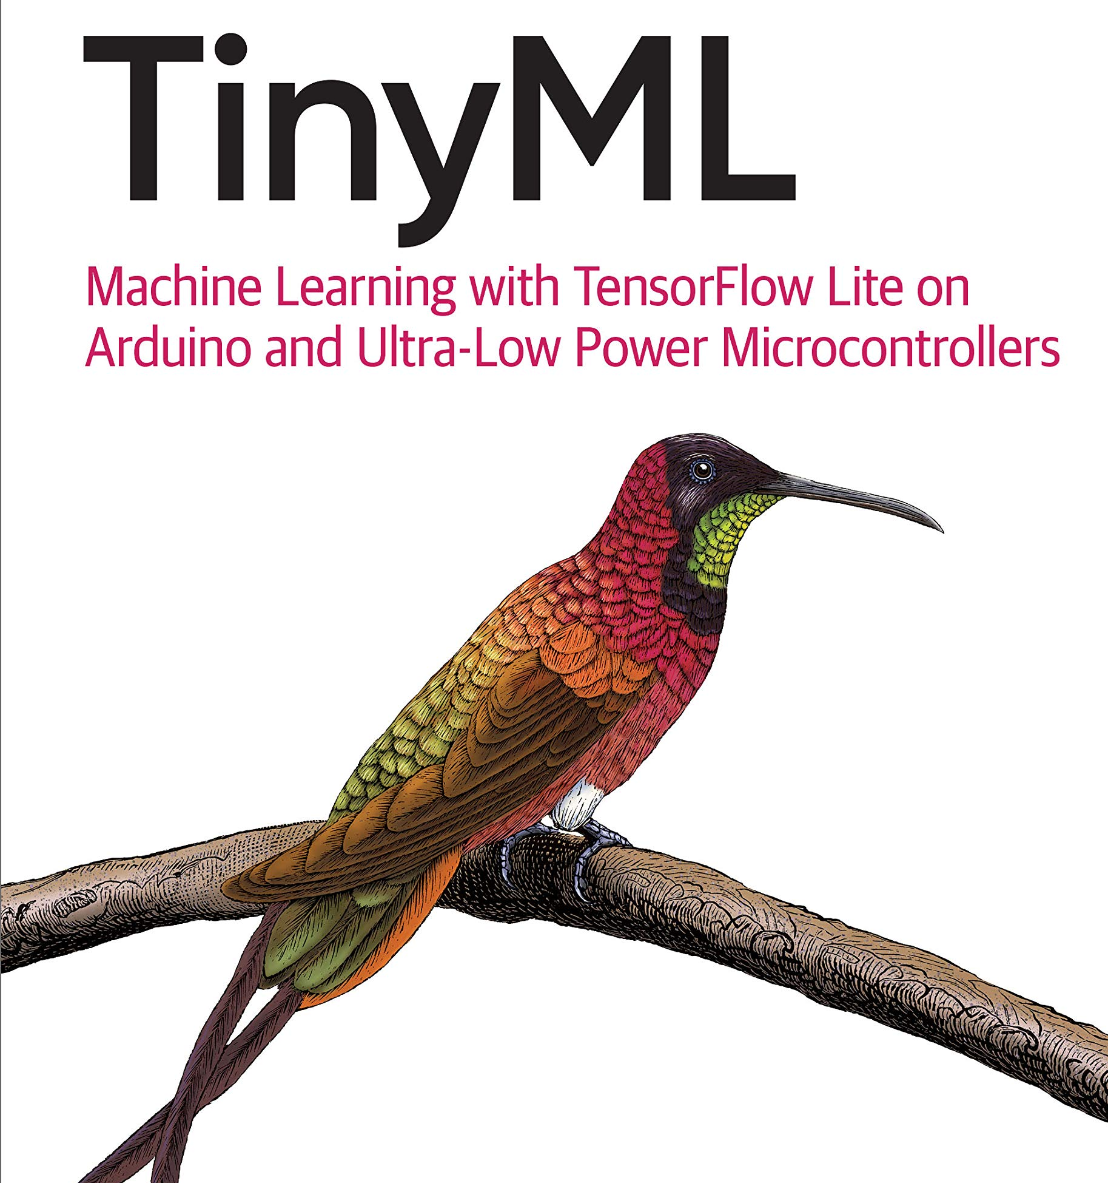
Project Requirements
1. Hardware Components & Instrumentation:
• Microcontroller: ESP32-S3-DevKitC-1 N16R8 (Dual Xtensa LX7 @ 240 MHz, 16 MB Flash, 8 MB PSRAM)
• Analog AFE: 4x AD8232 Biopotential Modules (1 Modified Prototype + 3 Scaled Units)
• Kinematics: 1x GY-521 MPU-6050 6-Axis IMU Module (I2C Fast-Mode 400 kHz)
• Custom Electrodes: Elastic Velcro Armband (8x Stainless Snaps + 1000 ml Conductive Gel)
2. Software Frameworks & Toolchains:
• Embedded OS: ESP-IDF / FreeRTOS (Dual-Core Tasks, DMA ADC1 Driver)
• TinyML Engine: TensorFlow Lite for Microcontrollers (TFLM INT8) + ESP-NN Vector Acceleration
• Signal Processing: Python (SciPy DSP, Scikit-learn, Hudgins Feature Extraction)
• Simulation: Three.js / WebGL 3D Digital Twin (Real-Time WebSocket Telemetry)
3. Experimental & Laboratory Resources:
• Subject Cohort: Measuring right hands of subjects(for prototype purposes)
• Electronics Lab: Soldering magnifying glass, Temp-Controlled Soldering, Multimeter

Slide 10
Concrete & Testable Success Criteria
Criterion 1: Gesture Classification Accuracy (5 Classes) (Nuri Ziya Kırtepe)
• Offline 10-Fold Cross-Validation: ≥ 90% Accuracy across Subject Cohort
• Real-Time On-Device Inference: ≥ 88% Accuracy on Continuous Unseen Live Trials
Criterion 2: System Latency & Real-Time Responsiveness (Nuri Ziya Kırtepe)
• On-Device TinyML Inference Time: ≤ 25 ms on ESP32-S3 Core 1
• Total End-to-End Latency: ≤ 75 ms (Sampling + DSP + ML ) — Below Human Threshold (100–150 ms)
Criterion 3: Limb Position Invariance (Evrim Doğa Solmaz)
• Arm Elevation Invariance: ≥ 85% Accuracy maintained at -45°, 0°, and +45° Positions
• Sensor Fusion Verification: Pitch/Roll Angles Fused into TinyML Feature Vector via MPU-6050
Criterion 4: Power Consumption & Battery Autonomy (Evrim Doğa Solmaz)
• Operating Current: ≤ 250 mA @ 3.3V (Standby: ≤ 0.85 W, Active Servos: ≤ 1.5 W)
• Continuous Battery Runtime: ≥ 6 Hours on a Single 1200 mAh Li-Po Cell
Criterion 5: Hardware Cost & Environmental Sustainability (Joint: Nuri Ziya Kırtepe & Evrim Doğa Solmaz)
• Total Electronics BOM: Strictly <~₺3500
• Sustainable Electrodes: 100% Reusable Snap Armband (< 50 kΩ Impedance, Zero Single-Use Pad Waste)

Slide 11
Work Breakdown & Team Responsibilities
Nuri Ziya Kırtepe
Specialization: High-Speed Sampling, Hard Real-Time OS & Deep TinyML
1. Hard Real-Time OS & Embedded Drivers (ESP32-S3 Core 1):
• Continuous DMA ADC1 Driver: 2000 Hz 4-ch signal acquisition
• Hard Real-Time Tasks: EMG Sampling & TinyML Inference pinned to Core 1
• ISR Synchronization: wakeups triggered by DMA buffer-ready interrupts
• Inter-Core IPC: thread-safe FreeRTOS Queues streaming windows to Core 0
2. Edge-AI & Machine Learning Engine:
• Deep TinyML: Quantized 1D-CNN temporal classifier via TensorFlow Lite Micro (TFLM)
• Vector Acceleration:enabling vector acceleration
• Model Profiling: INT8 post-training quantization, Tensor Arena & heap memory optimization
3. Primary Success Criteria & Milestones Ownership:
• Criterion 1: Gesture Classification Accuracy (≥ 90% CV, ≥ 88% live on-device trials)
• Criterion 2: System Latency & Real-Time Responsiveness (≤ 25 ms Core 1 inference)
Multi channel signal routing
Evrim Doğa Solmaz
Specialization: Real-Time DSP Filters, Kinematic Fusion, Soft Real-Time OS & Telemetry
1. Soft Real-Time OS & Communication Layer (ESP32-S3 Core 0):
• Periodic RTOS Tasks: IMU Sampling & Telemetry
• Wireless Networking Stack: FreeRTOS network tasks for low-latency Wi-Fi UDP
• Cross-Core IPC Consumer: Thread-safe queue receiver feeding DSP filter & telemetry pipelines(from core 1)
• Power Management: FreeRTOS idle & low-power wireless telemetry scheduling
2. Embedded DSP & Kinematic Sensor Fusion:
• Embedded DSP Filters: Real-time C++ IIR bandpass (20–450 Hz) and 50 Hz notch cascades
• IMU Kinematic Fusion: I2C MPU-6050 driver + Complementary/Madgwick Pitch & Roll filter
• Feature ML Engine: Real-time Hudgins extractor (MAV, RMS, WL, ZC) + C SVM classifier (emlearn)
3. Primary Success Criteria & Milestones Ownership:
• Criterion 3: Limb Position Invariance (≥ 85% accuracy across -45° to +45° arm elevation)
• Criterion 4: Power Consumption & Battery Autonomy (≤ 250 mA current, ≥ 6h runtime)
• Digital Twin Simulation: Low-latency Three.js WebGL 3D hand telemetry (< 50 ms)
Collaborative : Collecting data from cohort, making the band, communication of the cores...
CSE496 – First Presentation
12.10.2026
11

Slide 12
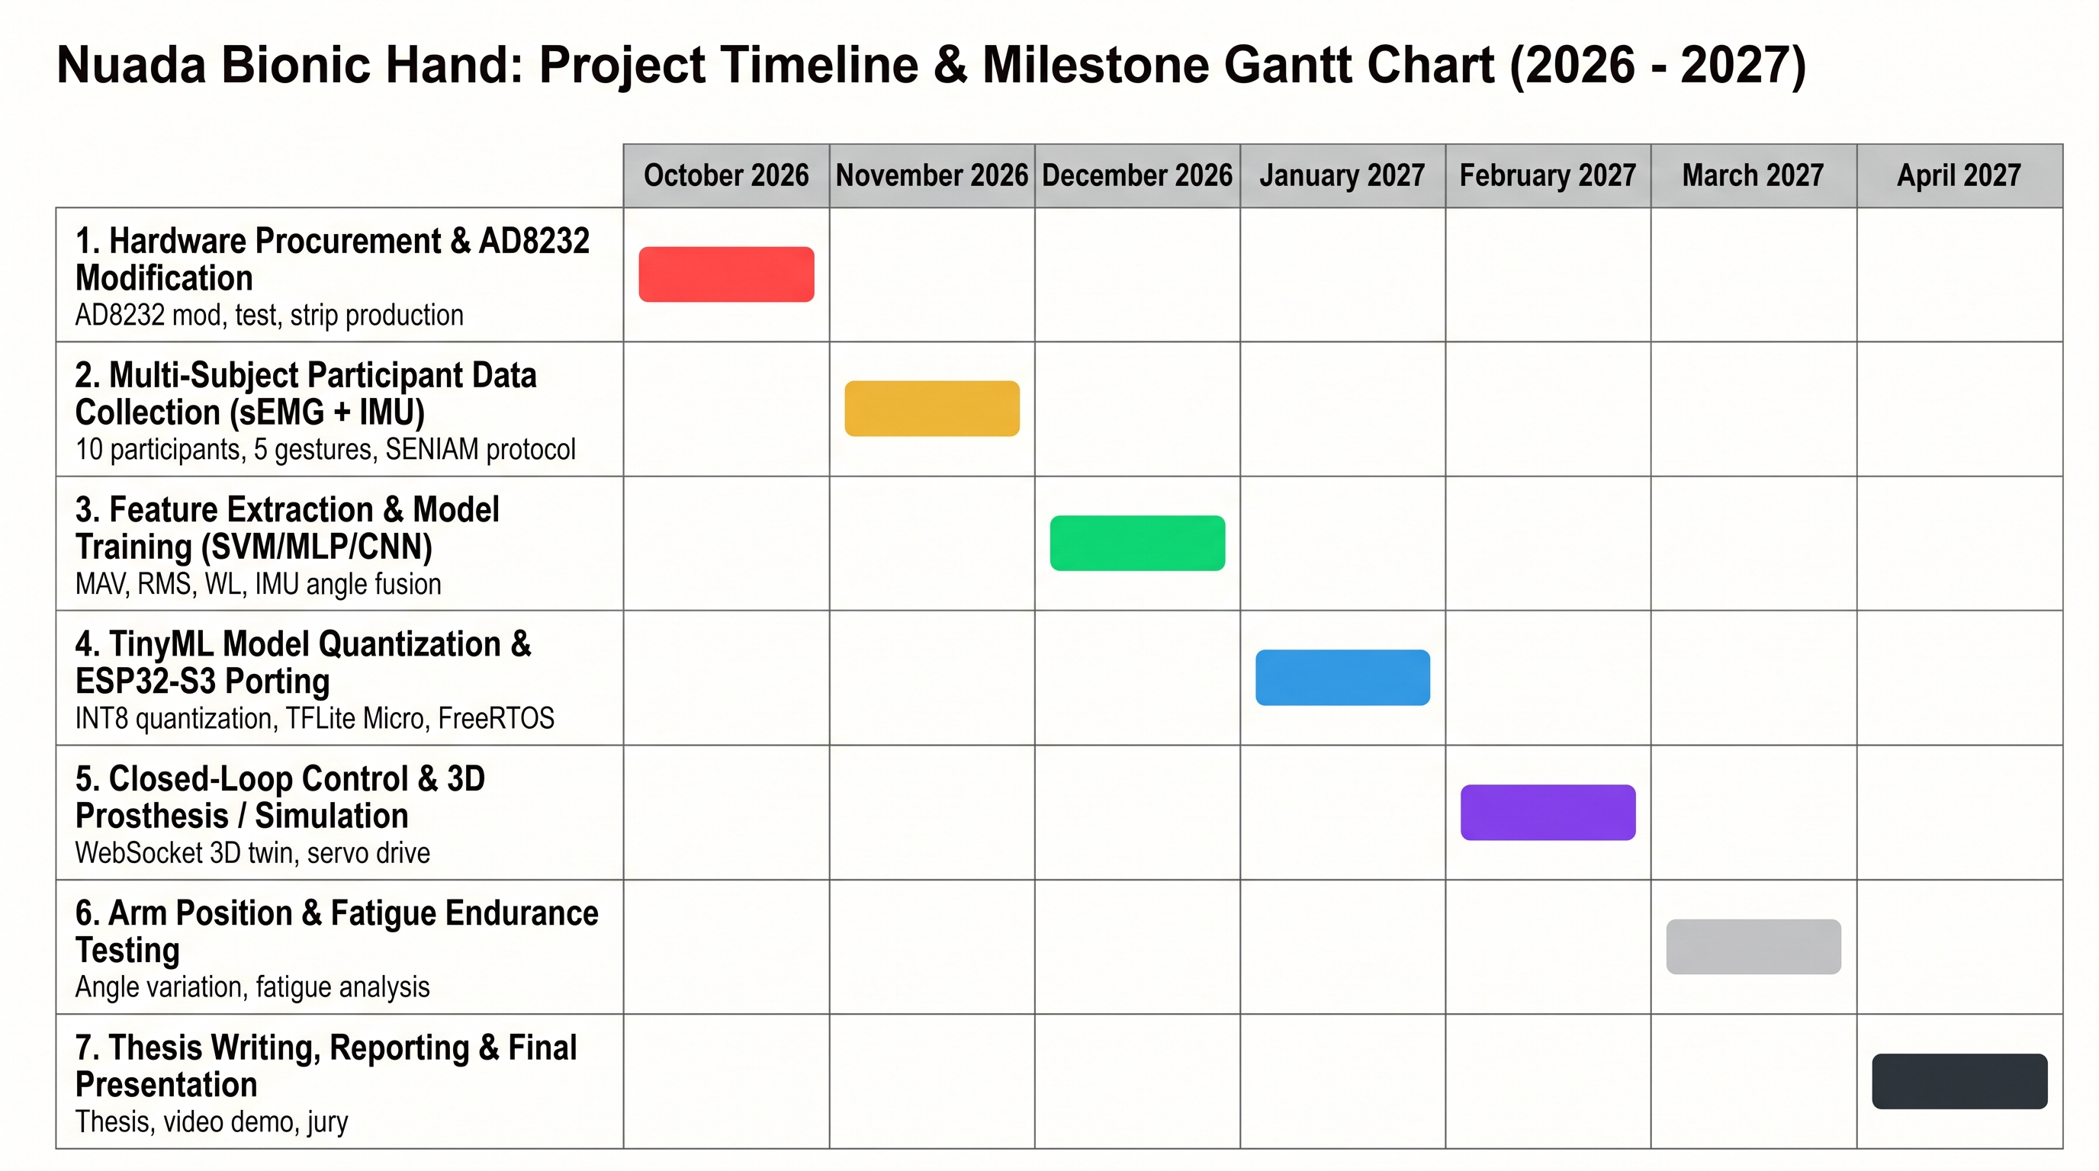





Slide 13
References
1. Hermens, H. J., Freriks, B., Disselhorst-Klug, C., & Rau, G., “Development of recommendations for SEMG sensors and sensor placement procedures (SENIAM)”,
Journal of Electromyography and Kinesiology, 10(5), 361-374, 2000.
2. Analog Devices Inc., “AD8232: Single-Lead, Heart Rate Monitor Front End Data Sheet”, Rev. A, Analog Devices, Norwood, MA, 2013.
3. SparkFun Electronics, “SparkFun Single Lead Heart Rate Monitor (SEN-12650) Hardware Design Files, Eagle Schematics and Board Layouts”, Open-Source Hardware, 2014.
4. Phinyomark, A., Phukpattaranont, P., & Limsakul, C., “Feature extraction and selection for machine learning with applications to myoelectric signal classification”,
International Conference on Biomedical Engineering (ICBME), 2012.
5. Radmand, A., Scheme, E., & Englehart, K., “High-density surface EMG-based gesture classification for prosthetic control: evaluation of limb position and orientation
effects”, IEEE Transactions on Neural Systems and Rehabilitation Engineering, 24(7), 808-817, 2016.
6. Warden, P., & Situnayake, D., “TinyML: Machine Learning with TensorFlow Lite on Arduino and Ultra-Low-Power Microcontrollers”, O'Reilly Media, Sebastopol, CA, 2019
7. https://www.theremino.com/wp-content/uploads/files/AD8232_for_EMG_ENG.pdf
8. https://cdn.sparkfun.com/datasheets/Sensors/Biometric/AD8232_Heart_Rate_Monitor_v10.pdf
9. https://github.com/sparkfun/AD8232_Heart_Rate_Monitor

Slide 14
Project Summary & Core Innovations
Key Innovations of Nuada:
• Ultra-Affordable Bionic Control: Cheaper Complete Kit Disrupting Expensive Market
• Hardware Selection (ESP32-S3): Vector AI instructions & dual-core FreeRTOS
• Kinematic Sensor Fusion: 4-Ch sEMG + Forearm IMU Eliminates Gravitational Drift
• Hardware Rework (AD8232 Mod): $3.50 ECG to 410.9 Hz sEMG Delivers 10x Cost Savings
• Sustainable Multi-Subject Armband: Reusable Snaps + Gel (100+ Trials, Zero Pad Waste)
• Standalone Edge Computing: Dual-Core FreeRTOS on ESP32-S3 (< 25 ms, Zero Cloud)
Expected Deliverables:
• 3D Digital Twin: Interactive Three.js WebGL Simulation via Real-Time WebSockets
• Academic Thesis: Comprehensive CSE 495/496 Capstone Report & Benchmark Dataset

Slide 15
Questions & Discussion
Thank You for Your Attention!
Nuada: Bionic Hand Movement Estimation via TinyML
CSE 495/496 - Graduation Project Proposal
Researchers:
Nuri Ziya Kırtepe
Evrim Doğa Solmaz
Advisor: Prof. Dr. Erkan Zergeroğlu
Department of Computer Engineering, Gebze Technical University
We welcome your questions, feedback, and committee guidance.

