Slide 1
Nuada: Bionic Hand Movement Estimation via TinyML
Edge-AI Hand Gesture Classification via Multi-Channel sEMG and IMU Fusion
CSE 496 - Graduation Project Proposal Presentation
Researchers: Nuri Ziya Kırtepe & Evrim Doğa Solmaz
Advisor: Asst. Prof. Alp Arslan Bayrakci
Department of Computer Engineering, Gebze Technical University
October 2026

Slide 2
Contents
1. Project Definition & Motivation (Affordable Bionic Hand Control)
2. Project Design & System Architecture (Dual-Core FreeRTOS Pipeline)
3. Hardware Selection & Cost Optimization (AD8232 vs. MyoWare 2.0)
4. Hardware Engineering: AD8232 EKG to sEMG Modification (10x Savings)
5. Circuit Layout Verification & Safe Laboratory Soldering Protocol
6. Project Requirements (Hardware, Software, Subject Protocol)
7. Concrete & Testable Success Criteria (Quantitative Thresholds)
8. Project Timeline & Monthly Milestones (Oct 2026 – Apr 2027)
9. References & Discussion

Slide 3
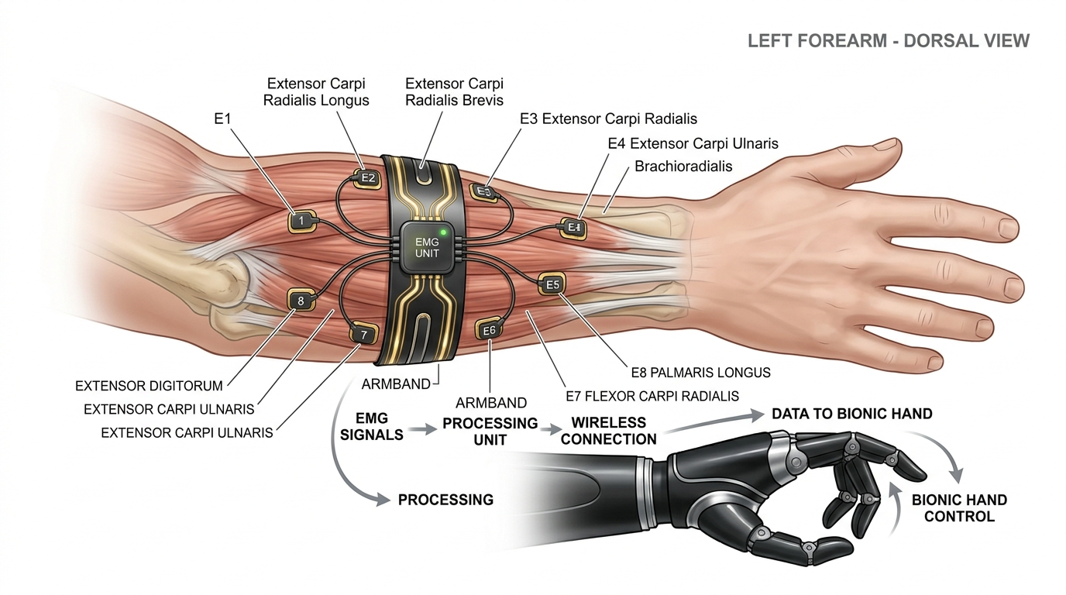
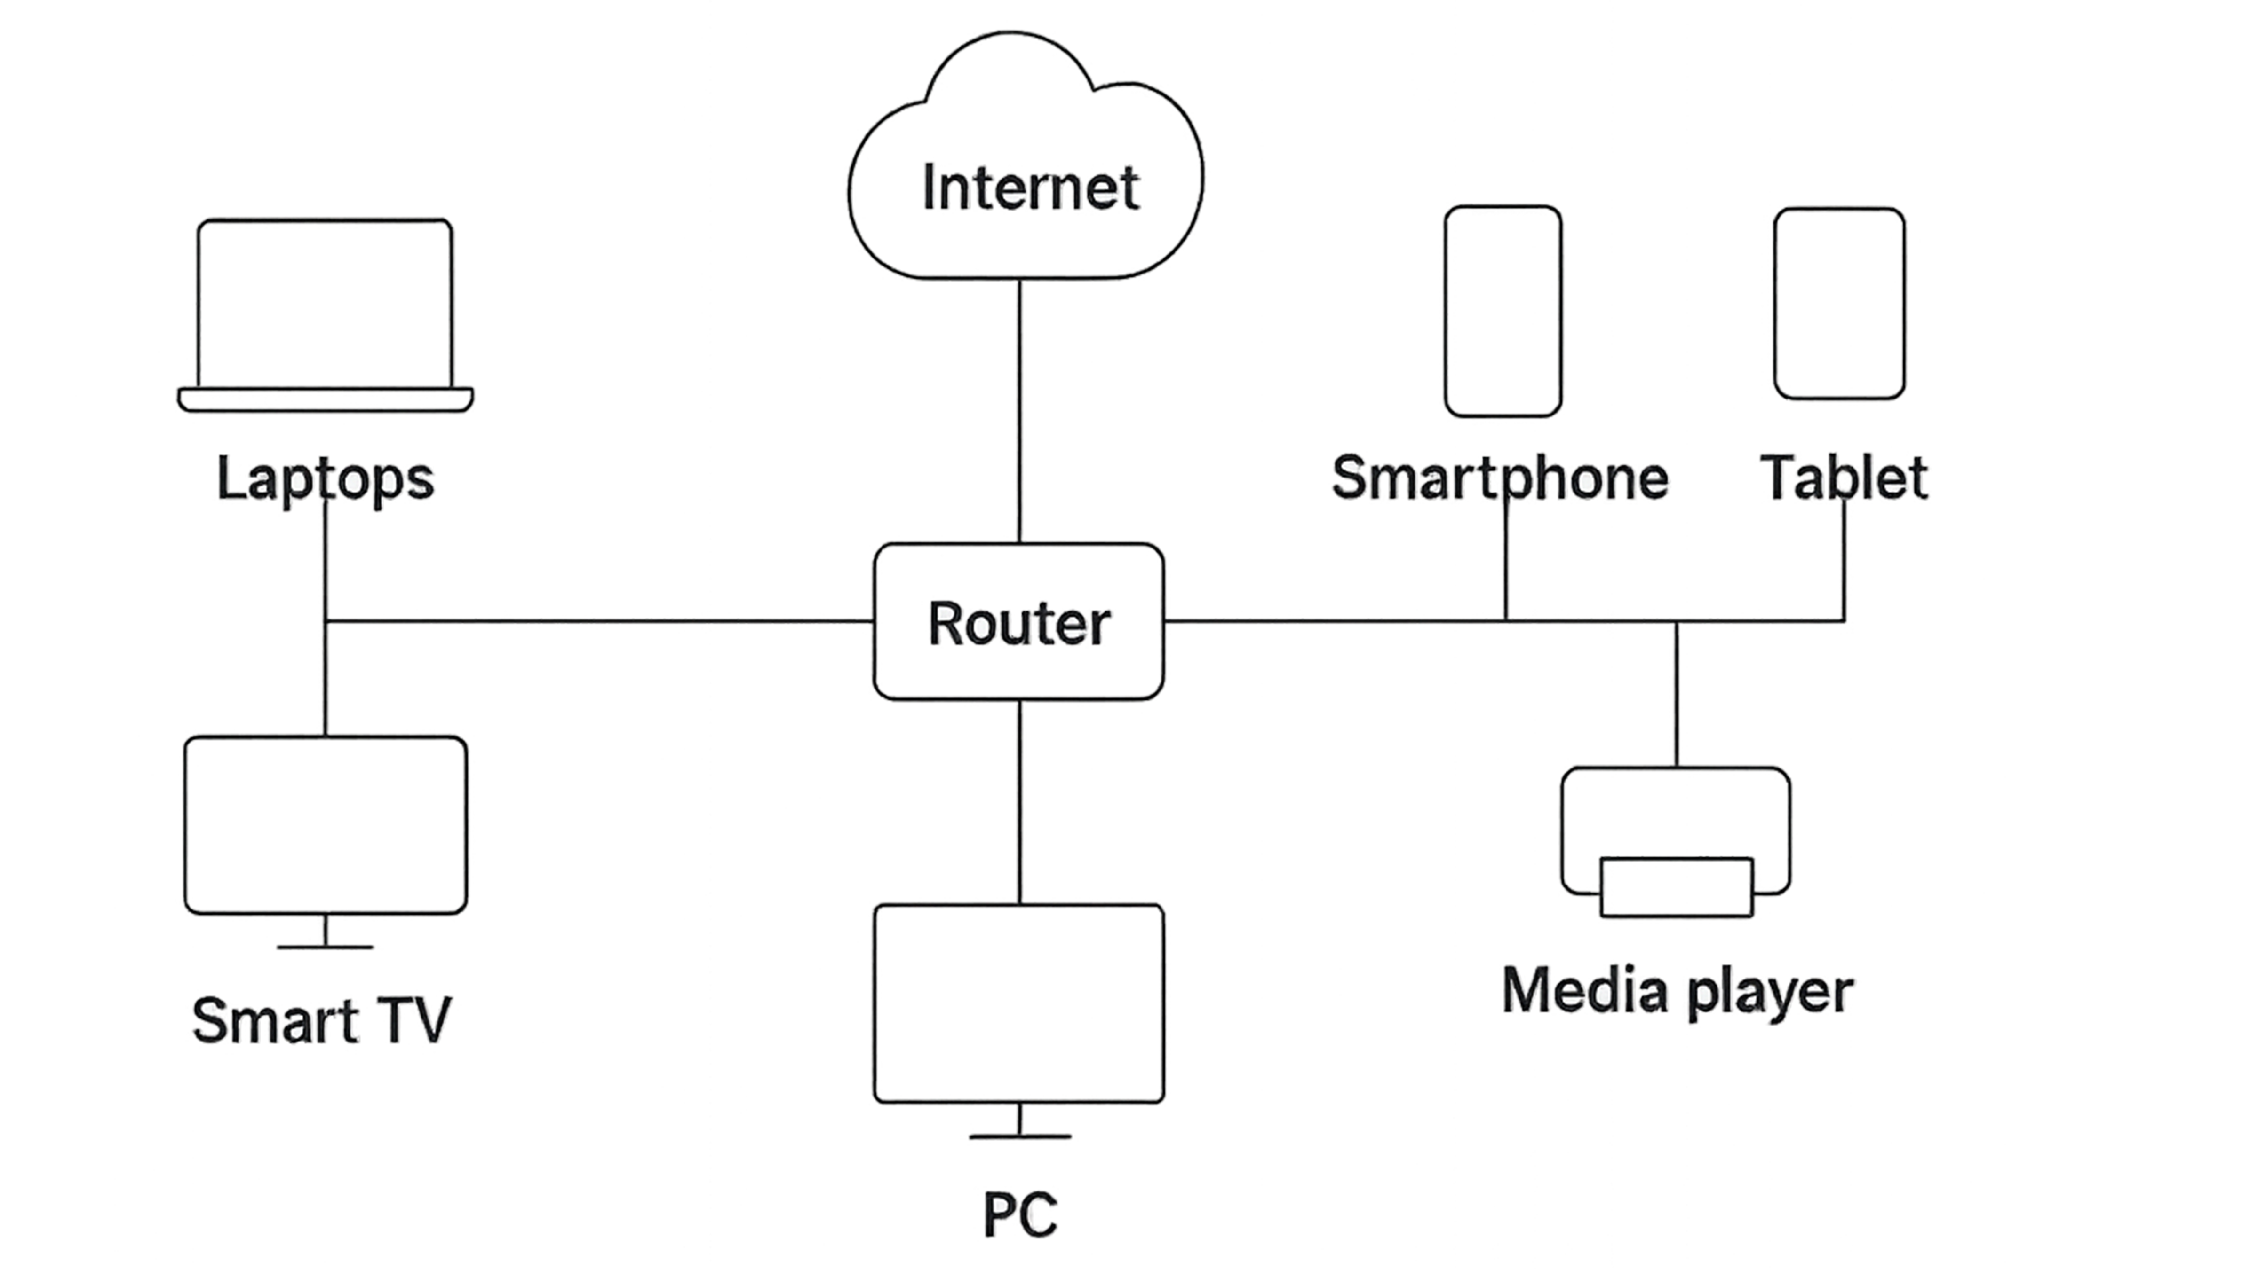
Project Definition & Motivation
Economic Problem & Need:
Commercial active myoelectric prostheses cost between $10,000 and $50,000, creating an insurmountable economic barrier for over 90% of amputees globally.
Nuada Project Vision:
An ultra-affordable (< $30 total hardware kit), wearable, real-time hand gesture recognition system for bionic hand actuation.
Dual-Sensing Modality (Overcoming Limb Position Drift):
• 4-Channel sEMG: Surface electrodes capture motor unit action potentials from forearm flexor/extensor muscle groups.
• 6-Axis IMU on Forearm: Tracks arm elevation (Pitch/Roll) to cancel gravity-induced EMG pattern distortion.
Zero Cloud Latency & Standalone Edge Intelligence:
• Quantized TinyML models execute directly on-device on an ESP32-S3 microcontroller (< 25 ms inference time).
• 5-Class Functional Gestures: Rest, Power Grasp, Open Hand, Pinch, Point mapped to a 3-finger (Thumb, Index, Middle) bionic hand and WebGL 3D Digital Twin.

Slide 4
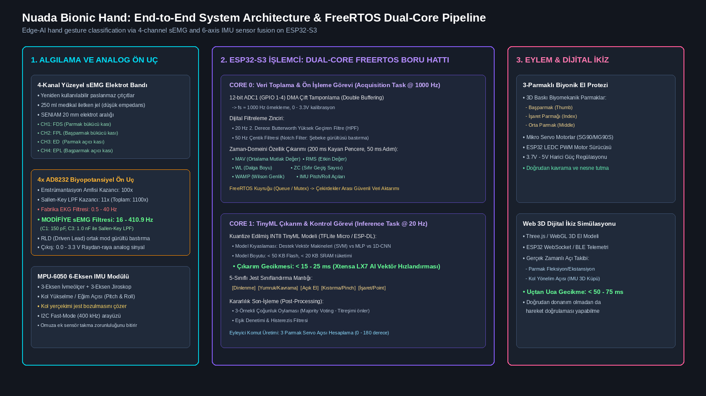
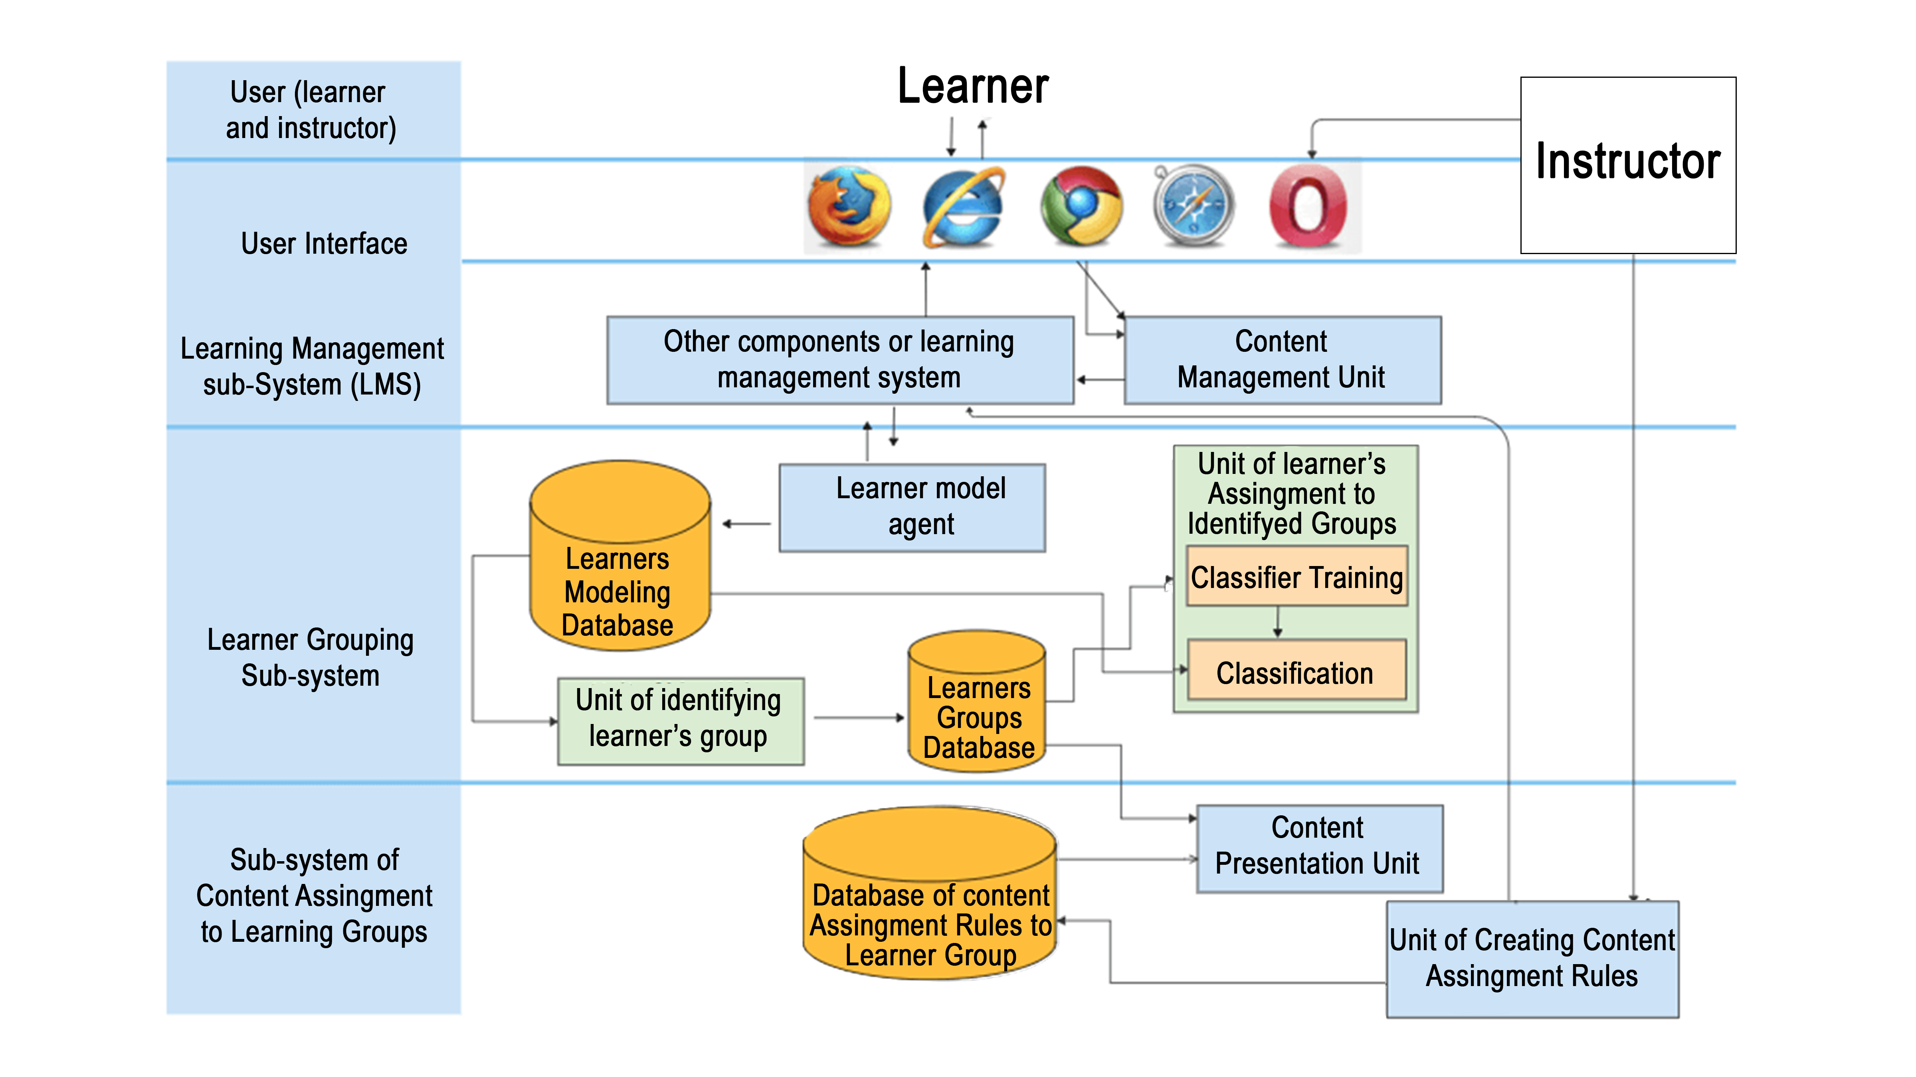
Project Design & System Architecture
End-to-End System Breakdown:
1. Front-End Acquisition & Sensing Layer:
• 4x AD8232 front-ends (1100x gain, modified 410 Hz LPF).
• 1x MPU-6050 6-axis IMU over I2C Fast-Mode (400 kHz).
• Reusable snap armband + medical conductive gel.
2. Dual-Core FreeRTOS Pipeline on ESP32-S3:
• Core 0 (Acquisition & DSP Task @ 1000 Hz):
- 12-bit ADC1 DMA double-buffering.
- 20 Hz HPF + 50 Hz Notch digital filtering.
- 200 ms sliding window feature extraction (MAV, RMS, WL, ZC, WAMP, Pitch/Roll).
• Core 1 (TinyML Inference Task @ 20 Hz):
- Quantized INT8 model inference (TFLite Micro).
- 5-Class gesture classification + majority voting.
3. Actuation & Digital Twin Telemetry:
• PWM servo driving 3D bionic fingers (Thumb, Index, Middle).
• WebSocket telemetry to Three.js 3D WebGL Digital Twin (< 50 ms).

Slide 5
Hardware Selection & Cost Optimization (AD8232 vs MyoWare)
1. 10x Front-End Cost Reduction (AD8232 vs. MyoWare 2.0):
• Commercial Standard (MyoWare 2.0): ~$45 / channel -> 4 channels = ~$180 (~6,000 TL), proprietary snap shields, costly replacement.
• Nuada Strategy (AD8232 Breakout): ~$3.50 / channel -> 4 channels = ~$14 (~440 TL). Over 10x cost reduction for equivalent biopotential instrumentation specs!
2. Sensor Fusion Solves Limb Position Bias Without Extra Shoulder Sensors:
• Raising/lowering the arm introduces gravity-induced muscle shift and gesture misclassification.
• Rather than adding 2-4 expensive shoulder EMG sensors ($90-$180), we fuse 1x MPU-6050 6-axis IMU ($2.50) on the forearm, feeding pitch/roll angles into the TinyML feature vector.
3. Sustainable Multi-Subject Protocol (Snap Armband + Gel):
• Disposable medical gel pads cost ~$15 per 50-pack and deplete in 6 subject sessions.
• We custom-built an elastic armband with stainless-steel snap buttons + 250 ml conductive gel tube ($1.50) -> Reusable across 100+ subjects with zero ongoing consumable cost.
4. Standalone Edge Intelligence (ESP32-S3):
• Dual-Core Xtensa LX7 @ 240 MHz + AI vector instructions ($7.50) eliminates external PC or Raspberry Pi ($50-$100).
• COMPLETE HARDWARE KIT COST: Strictly under $30 (~₺950) vs. $300 - $500 commercial standard (> 90% savings!).

Slide 6
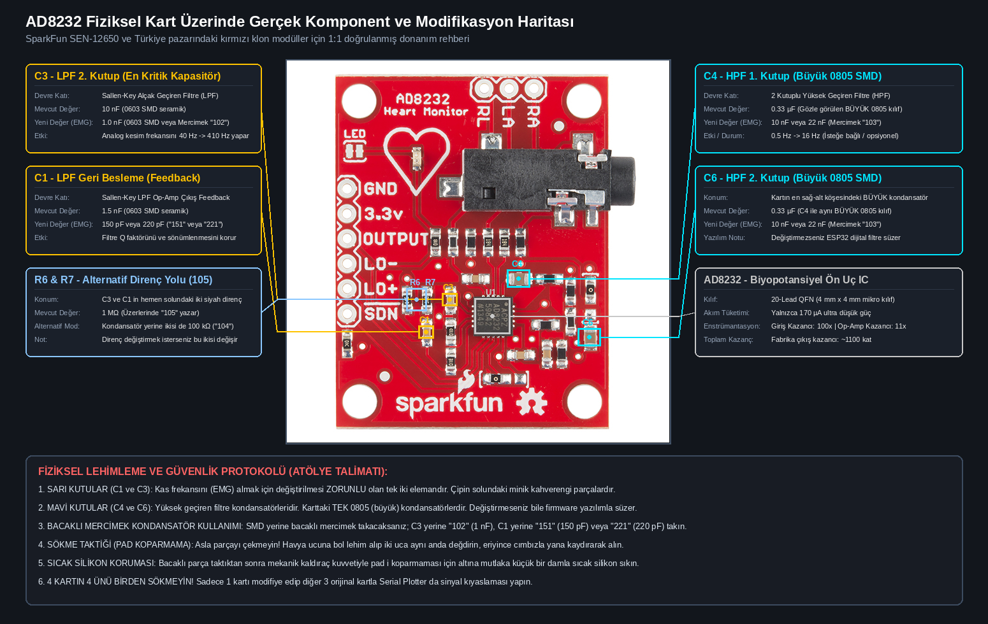
Hardware Engineering: AD8232 EKG to sEMG Modification
The Core Engineering Bottleneck:
• AD8232 is factory-tuned for heart ECG with a 0.5 Hz – 40 Hz passband.
• Surface EMG spectral power spans 10 Hz – 450 Hz. A 40 Hz filter clips > 90% of motor unit action potentials (MUAP)!
Sallen-Key Low-Pass Filter Rework (40 Hz -> 410.9 Hz):
• Theoretical Formula: fc = 1 / (2 * pi * R * sqrt(C1 * C3))
• C3 (0603 SMD / Mercimek 102): 10 nF -> 1.0 nF (Mandatory)
• C1 (0603 SMD / Mercimek 151/221): 1.5 nF -> 150 pF (Mandatory)
• Preserves system gain (1100x) and Q factor while opening the full sEMG bandwidth to 410.9 Hz.
High-Pass Filter Stage (Motion Artifact Rejection):
• C4 & C6 (Large 0805 SMD): 0.33 µF -> 10 nF shifts cutoff from 0.5 Hz to 15.9 Hz.
• Alternatively, kept stock and motion artifacts rejected via software 20 Hz Butterworth HPF on ESP32-S3.
Through-Hole Mercimek Capacitor Innovation:
• Unmarked SMD capacitors cause inspection ambiguity. Using leaded capacitors with visible printed codes ("102" & "221") guarantees 100% visual verification.

Slide 7
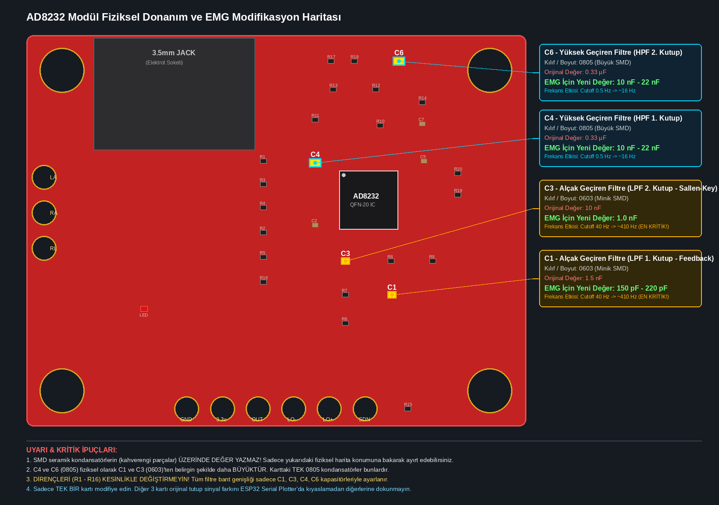
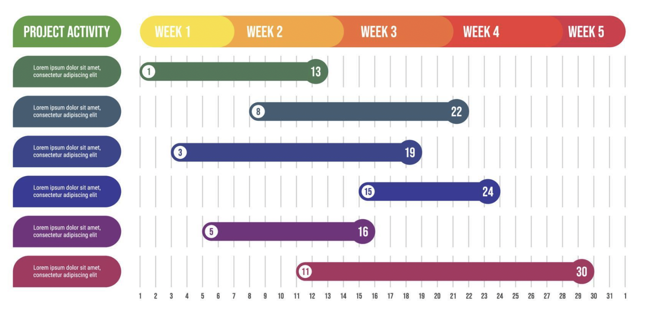
Circuit Layout Verification & Laboratory Protocol

Slide 8
Project Requirements
1. Hardware Components & Instrumentation:
• Microcontroller: ESP32-S3-DevKitC-1 N16R8 (Dual Xtensa LX7 @ 240 MHz, 16 MB Flash, 8 MB PSRAM).
• Analog Front-Ends: 4x AD8232 Biopotential Modules (1 modified prototype, 3 comparative).
• Inertial Unit: 1x GY-521 MPU-6050 6-Axis IMU Module (I2C Fast-Mode).
• Custom Electrodes: Elastic Velcro Armband with 8x Stainless Snap Fasteners + 250 ml Conductive Gel.
• Actuation: 3-Finger 3D-Printed Bionic Hand Mechanism + 3x Micro Servos (SG90/MG90S).
2. Software Frameworks & Toolchains:
• Embedded: ESP-IDF v5.1 / Arduino-ESP32, FreeRTOS dual-task scheduler, ESP32 ADC1 DMA driver.
• TinyML Engine: TensorFlow Lite for Microcontrollers (TFLite Micro) / ESP-DL.
• Machine Learning Pipeline: Python 3.10+, PyTorch, Scikit-learn, SciPy (DSP filtering & feature extraction).
• 3D Simulation: Three.js / WebGL Web Application with bi-directional WebSocket telemetry.
3. Experimental & Laboratory Resources:
• Human Participants: 10 healthy subjects (diverse forearm circumferences) under SENIAM 20 mm protocol.
• Electronics Lab: Stereo microscope, temperature-controlled soldering station, digital multimeter, hot glue gun.

Slide 9
Concrete & Testable Success Criteria
Criterion 1: Gesture Classification Accuracy (Verifiable & Quantitative)
• Target: Offline 10-fold cross-validation accuracy >= 90% across 5 gesture classes.
• On-device real-time prediction accuracy >= 88% on unseen continuous evaluation trials.
Criterion 2: System Latency & Real-Time Control Threshold
• Target: On-device TinyML inference time <= 25 ms on ESP32-S3.
• Total end-to-end pipeline latency (sampling + DSP + inference + servo command) <= 75 ms (well below human perceptual delay threshold of 100 - 150 ms).
Criterion 3: Robustness to Arm Elevation & Orientation (Limb Position Invariance)
• Target: Classification accuracy maintained at >= 85% when the arm is positioned at -45°, 0°, and +45° elevation, verified through MPU-6050 sensor fusion.
Criterion 4: Power Consumption & Battery Autonomy
• Target: Total operating current <= 250 mA @ 3.3V (power <= 0.85 W standby, <= 1.5 W active servo actuation).
• Minimum continuous battery runtime >= 6 hours on a single 1200 mAh Li-Po cell.
Criterion 5: Hardware Cost & Sustainability Constraint
• Target: Total electronic hardware BOM strictly under $30 (~₺950). 100% reusable snap-electrode armband with < 50 kΩ skin-electrode impedance and zero single-use pad waste.

Slide 10
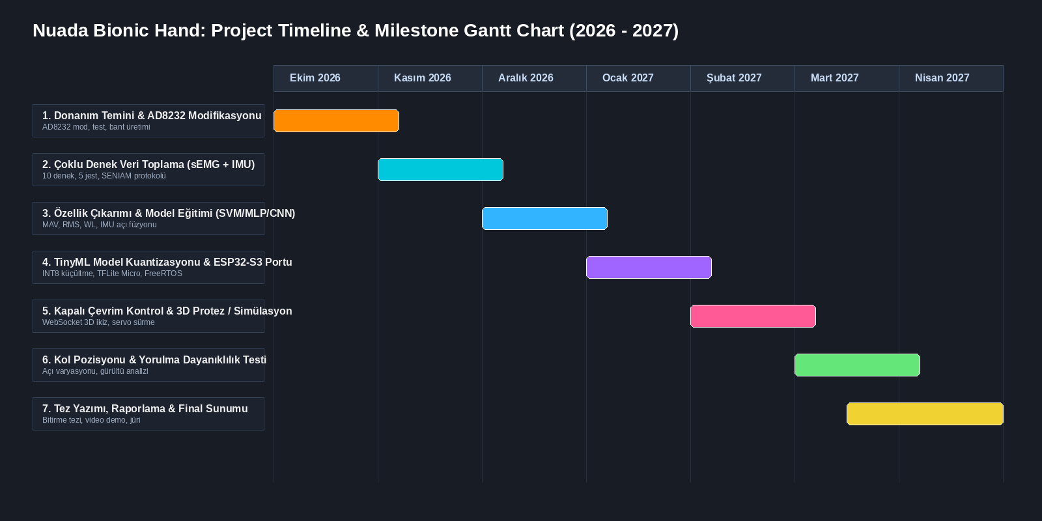
Project Timeline & Milestone Gantt Chart

Slide 11
References
1. Hermens, H. J., Freriks, B., Disselhorst-Klug, C., & Rau, G., “Development of recommendations for SEMG sensors and sensor placement procedures (SENIAM)”, Journal of Electromyography and Kinesiology, 10(5), 361-374, 2000.
2. Analog Devices Inc., “AD8232: Single-Lead, Heart Rate Monitor Front End Data Sheet”, Rev. A, Analog Devices, Norwood, MA, 2013.
3. SparkFun Electronics, “SparkFun Single Lead Heart Rate Monitor (SEN-12650) Hardware Design Files, Eagle Schematics and Board Layouts”, Open-Source Hardware, 2014.
4. Phinyomark, A., Phukpattaranont, P., & Limsakul, C., “Feature extraction and selection for machine learning with applications to myoelectric signal classification”, International Conference on Biomedical Engineering (ICBME), 2012.
5. Radmand, A., Scheme, E., & Englehart, K., “High-density surface EMG-based gesture classification for prosthetic control: evaluation of limb position and orientation effects”, IEEE Transactions on Neural Systems and Rehabilitation Engineering, 24(7), 808-817, 2016.
6. Warden, P., & Situnayake, D., “TinyML: Machine Learning with TensorFlow Lite on Arduino and Ultra-Low-Power Microcontrollers”, O'Reilly Media, Sebastopol, CA, 2019.

Slide 12
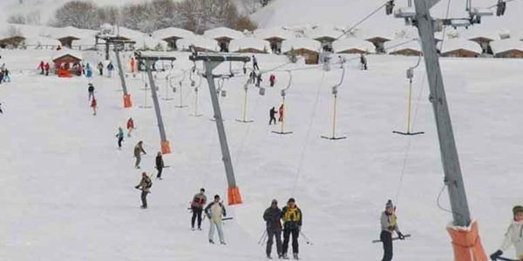
Project Summary & Core Innovations
Key Innovations of Nuada:
• Ultra-Affordable Bionic Control: Demonstrated feasibility of a strictly < $30 hardware kit replacing $10,000+ commercial prostheses.
• Inertial Sensor Fusion: Fusing 4-channel sEMG with 6-axis IMU solves the fundamental limb position problem without adding bulky shoulder sensors.
• Hardware Engineering (AD8232 Mod): Converting $3.50 ECG front-ends to 410 Hz sEMG delivers 10x savings over commercial MyoWare sensors.
• Sustainable Multi-Subject Protocol: Reusable snap-button armband + conductive gel eliminates consumable waste across 100+ subjects.
• Standalone Edge Computing: Dual-core FreeRTOS pipeline on ESP32-S3 guarantees < 25 ms inference with zero cloud dependency.
Expected Deliverables:
• Fully functioning 3-finger (Thumb, Index, Middle) 3D-printed bionic hand reacting in real time (< 75 ms end-to-end).
• Interactive WebGL 3D Digital Twin simulation accessible from any browser via WebSocket.
• Comprehensive academic graduation thesis and comparative benchmark dataset.

Slide 13
Questions & Discussion
Thank You for Your Attention!
Nuada: Bionic Hand Movement Estimation via TinyML
CSE 496 - Graduation Project Proposal
Researchers:
Nuri Ziya Kırtepe (nuriziyak@gmail.com)
Evrim Doğa Solmaz
Advisor: Asst. Prof. Alp Arslan Bayrakci
Department of Computer Engineering, Gebze Technical University
We welcome your questions, feedback, and committee guidance.
Thank You for Your Attention!
Nuada: Bionic Hand Movement Estimation via TinyML
CSE 496 - Graduation Project Proposal
Researchers:
Nuri Ziya Kırtepe (nuriziyak@gmail.com)
Evrim Doğa Solmaz
Advisor: Asst. Prof. Alp Arslan Bayrakci
Department of Computer Engineering, Gebze Technical University
We welcome your questions, feedback, and committee guidance.

