Slide 1
MOVIES DATA ANALYSIS
By: Kelvin Nzomo

Slide 2
OUTLINE
Introduction
Objectives
Tools use
Data analysis work done
Conclusions
Recommendations

Slide 3
Introduction
Business Problem:
Microsoft intends to create original video content.
They will create a new movie studio
Need data analysis to determine the best films at the box office
Head of Microsoft's new movie studio requires data driven help to decide what type of films to create
Notes:
Microsoft sees all the big companies creating original video content and they want to get in on the fun.
They have decided to create a new movie studio, but they don’t know anything about creating movies.
You are charged with exploring what types of films are currently doing the best at the box office.
You must then translate those findings into actionable insights that the head of Microsoft's new movie studio can use to help decide what type of films to create

Slide 4
Business Objectives
Determine the most profitable genres of films
Establish the relationship between movie ratings and profitability
Determine the most popular genre of films
Notes:
1. Determine the most popular genre of films 2. Determine the most profitable genres of films 3. Establish the relationship between movie ratings and profitability

Slide 5
Tools used
Pandas module
Seaborn module
Matblotlib module
Numpy module
Github
Python language

Slide 6
Data analysis work done
1
Data exploration
2
Data Cleaning
3
Data aggregation
4
Data Visualization
5
Share Data Driven Action
Notes:
Data exploration 2. Data Cleaning 3. Data aggregation 4. Data Visualization

Slide 7
Conclusions
Popular movie genres
Drama
Comedy,Drama
Documentary
Comedy
Adventure,Animation,Comedy
Comedy,Romance
Drama,Thriller
Action,Adventure,Sci-Fi
Comedy,Drama,Romance
Drama,Romance
2. The most profitable movie genre was drama, followed closely by comedy,drama
3. It was observed that the genres with a high rating also had the highest total profit.

Slide 8
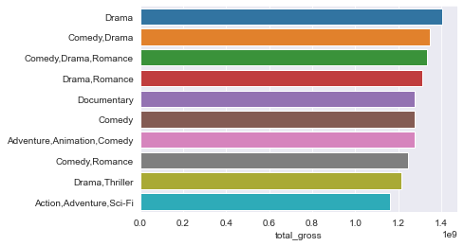
Conclusions…
The most profitable movie genre

Slide 9
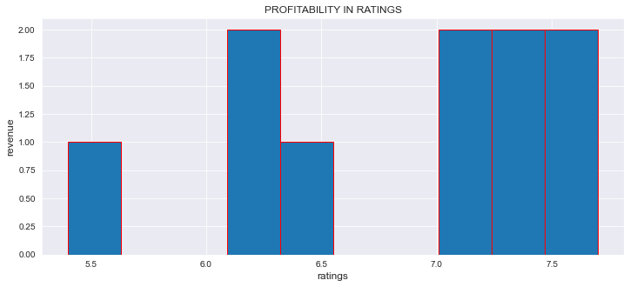
Conclusion…
Profit In Movie Ratings

Slide 10
Recommendation
We recommend the following to Microsoft:
Movie production genre: Drama and comedy,drama
Reason:
Drama - most profitable genre
Comedy,drama – most popular genre

