Slide 1
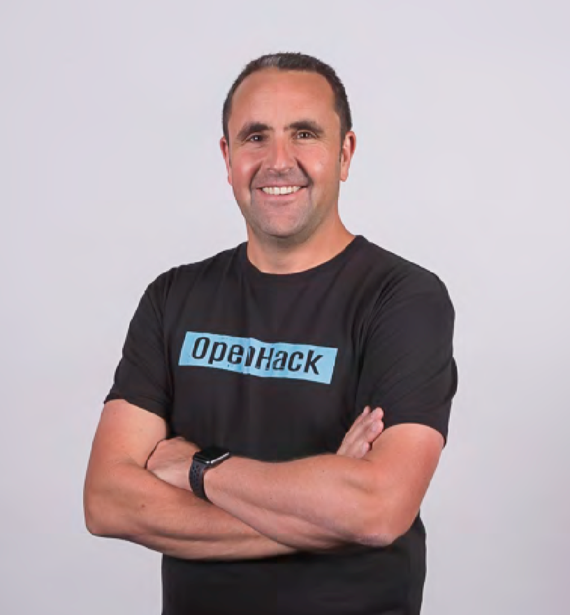

Move legacy apps to Windows Containers (to take advantage of modern infrastructure and orchestration)
Regan Murphy
Software Engineer
Microsoft
@nzregs

Slide 2
Why modernise?
Reasons to modernise
Benefits of modernisation
Aging infrastructure
Low efficiency and reliability
High operational costs and CapEx
Growing security/audit requirements
Stagnant Architecture
Legacy stack and code
Long deployment times
Hard (or impossible) to add new functionality
Turn CapEx into OpEx
Increased Operational Efficiency
Get out of the data center business
Meet security and compliance requirements
Reduce time and budget spend on infrastructure management
Rapid Innovation
Ship new capabilities faster
Achieve Scalability with confidence
Better collaboration across Business, Ops, IT, and Dev teams

Slide 3
Why containers?
Traditional (Virtual) Machines
Benefits of containers
Complex deployments – multiple components share same server
Highly inefficient – especially if you deploy app-per-VM
Slow scale – takes time to add/remove instances
Better agility – ship apps faster
Portability – easily move workloads
Density – achieve resource efficiency
Rapid scale – scale easily to meet demand

Slide 4
The container advantage
Traditional virtualized environment
VM
VM
Low utilization of resources
Apps and their dependencies separated for portability, collocated for density
Application
App1.
App2.
Application
App3.
App4.
App1 and App2 must share dependencies. App1 rollout will affect App2 stability
Hypervisor 2
Host OS
Hardware

Slide 5
The container advantage
Containerized environment
Migrate apps and their dependencies into containers and consolidate on underutilized VMs for improved density and isolation
VM
VM
App1.
(Con.)
App2
(Con.)
Decommission unused resources for efficiency gains and cost savings
App3.
(Con.)
App4.
(Con.)
Container is lighter weight and faster to scale dynamically
Docker Engine
Host OS
Hardware

Slide 6
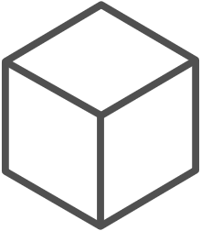
The container advantage
Fast iteration
Agile delivery
Immutability
Cost savings
Efficient deployment
Elastic bursting
For developers
For IT

Slide 7

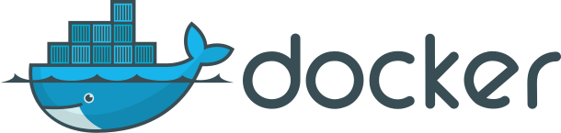
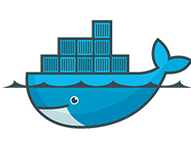


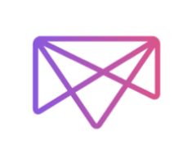


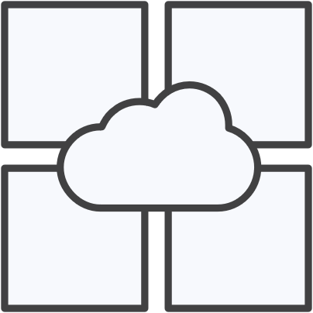
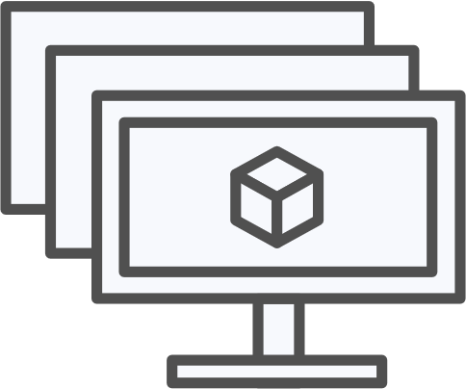


Works on my machine!
Azure Kubernetes Service
Azure Container Instances
Azure Batch
Service Fabric
Azure App Service
Virtual Machines (VM+ VMSS)
Partner Offerings
Works on Microsoft Azure
and more

Slide 8
Windows Server Containers

Slide 9
What is a container?
Containers = operating system virtualization
Traditional virtual machines = hardware virtualization
OS
Application
VM
VM
VM
Applications
Container
Container
Container
App
App
App
Kernel
OS
OS
OS
OS
Hardware
Hardware
Windows Server containers: maximum speed and density
Hyper-V containers: isolation plus performance
Container
Container
Container
Container
Container
Container
Kernel
Kernel
Kernel
Hardware
Hyper-V

Slide 10
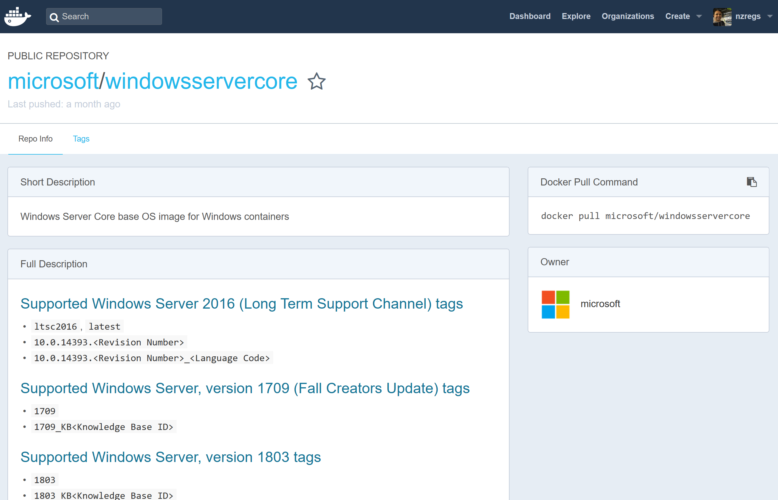
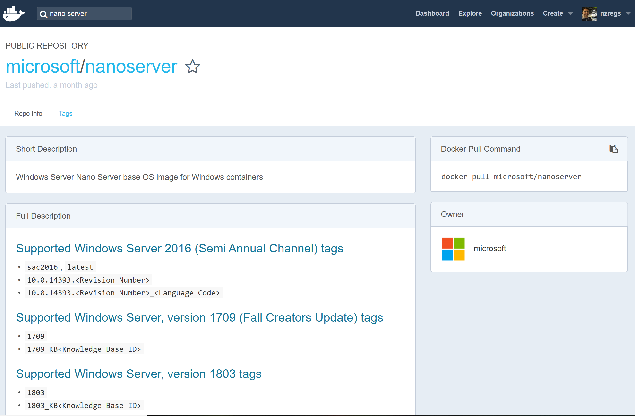
Windows Server container versions
Windows Server Core
Use for legacy application
Includes full .NET framework
Can run IIS and Windows Services
Larger Container Sizes (GBs)
Nano Server
Use for cloud-first applications
Optimised for .NET Core
Powershell Core, .NET Core, and WMI not included
Available as container image only from 1709

Slide 11
Getting started

Slide 12

Migrate? Rewrite? Redeploy? Maintain?
Before starting on any project to ‘containerize’ an application, weigh up the pros/cons of the various options.
Migrate – to windows containers
Rewrite – in modern version of .net, or .net core, then containterize
Maintain – maybe keeping a legacy VM is the best path forward
Redeploy - to a PaaS service such as Web Apps on Azure

Slide 13

.net application?
consider re-writing or re-targeting your application for .net core
you could then use .net core on either linux or windows nanoserver containers

Slide 14
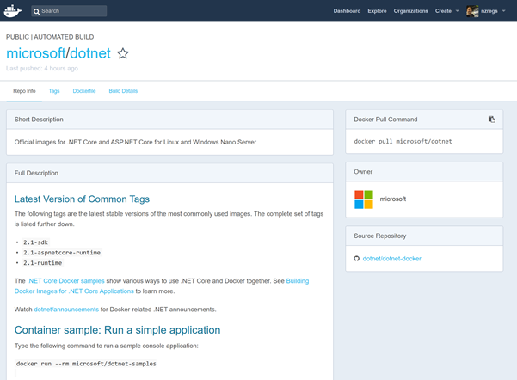
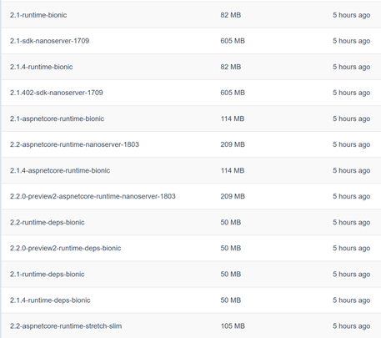
Broad support for .net core!
microsoft/dotnet images are maintained for both windows and linux
there are SDK and runtime images for alpine and bionic linux distros, windows nanosever
you can also build your own images

Slide 15
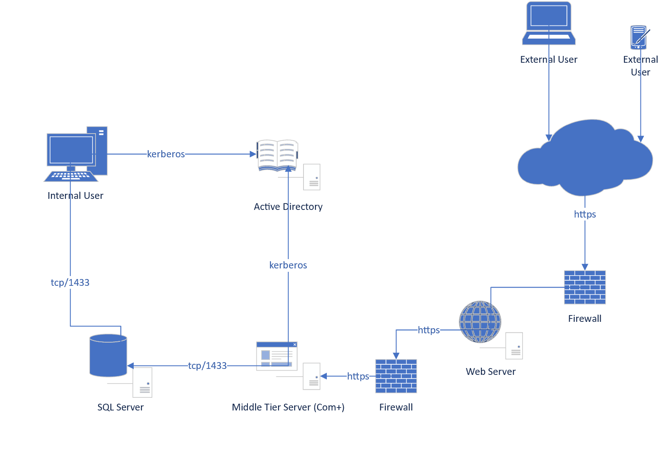
A Legacy Application
A traditional application consisting of:
Client-Server “Fat Client” where the internal user connects directly to the SQL Server
3-Tier Application for Web Clients
This is a real CRM application, from approx. 2002 – and still deployed as-is today.

Slide 16


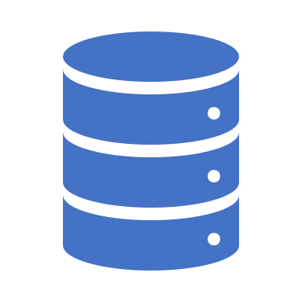

Which components into containers?
Active Directory Server
No.
SQL Server
This is not a good candidate for a number of reasons.
Middle Tier Application Server
The middle tier application can scale-out and is stateless.
Could be tricky as there is a COM+ component that relies on Windows Authentication.
Web Server
The web server is an excellent candidate for containerization.
There are multiple websites co-hosted on one server that could be split into separate containers
The web server can easily be scaled out (but be careful of session state in the websites).
Classic ASP? DCOM? No worries!

Slide 17
Get stuck in!

Slide 18

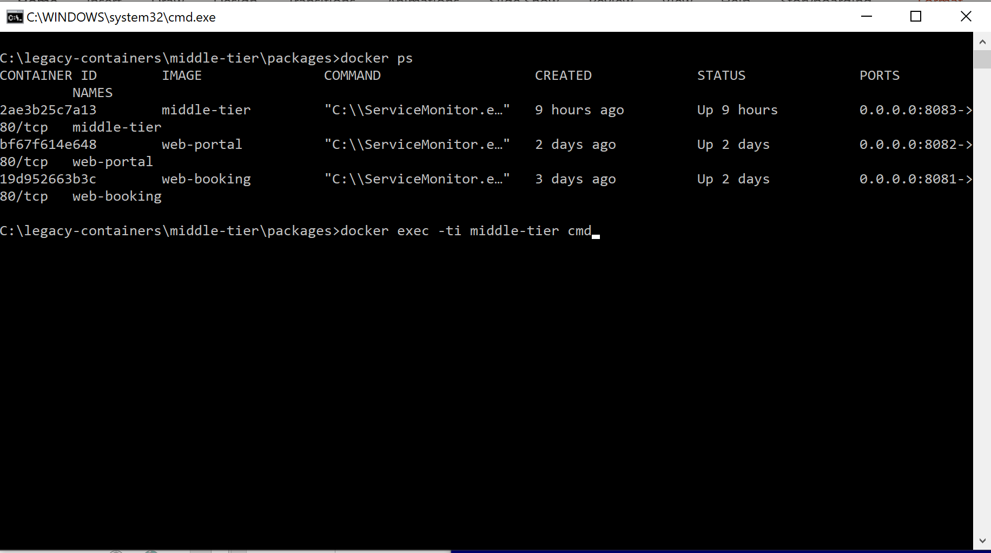
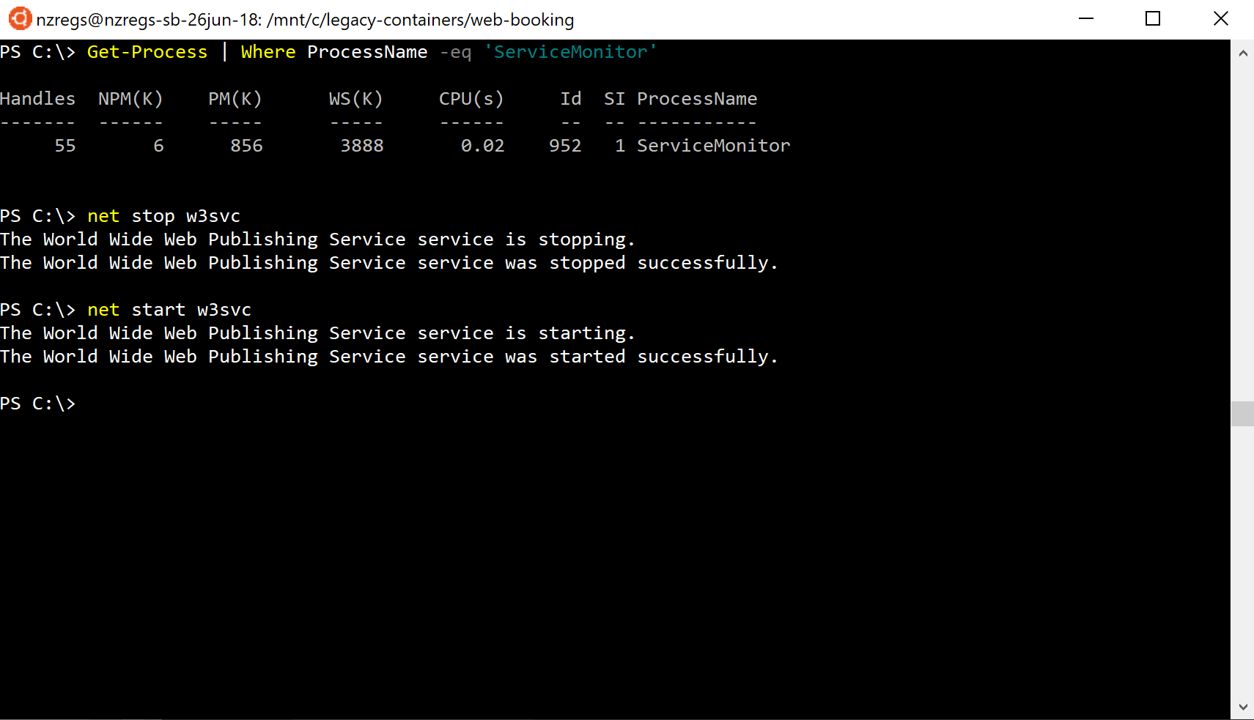
no GUI!
There is no GUI in a Windows Server container.
You can connect to a running container – e.g. docker exec or kubectl exec - and access a cmd or powershell shell – but this should be for development test/debug only.
Persist commands in a Dockerfile (or orchestrator equivalent) instead.

Slide 19
Learn cmd and powershell
Command Line Utils
tasklist: show running tasks
icacls: set file/folder permissions
appcmd.exe: configure IIS site settings
dism.exe: windows features installer
msiexec.exe: installing packaged apps
regsvr32.exe: register COM/DCOM components
Powershell
Add-WindowsFeature, Enable-WindowsOptionalFeature: add/install windows features
Get-Process: show running tasks
Start-Process: start an app or cmd
Invoke-WebRequest: downloading files or making REST calls

Slide 20
Deploying legacy packaged apps
A lot of legacy apps have installers wrapped up in a “setup.exe” file.
Need to learn how to silently install from setup.exe.
Sometimes the setup.exe doesn’t handle silent installs. You can then try and extract MSI packages and perform silent install from msiexec.
Installs go a lot smoother if you pre-install any pre-requisites – this avoids multi-step installs.
It helps to set logging to ‘verbose’ when testing/debugging installs
Extract MSI (multiple methods)
setup.exe /extract_all:”c:\temp\extract”
setup.exe /extract:”c:\temp\extract”
Try 7zip or other utility
Install with verbose logs:
setup.exe /s /v”/qn L*V logfile.log”
msiexec.exe /qn /lv “logfile.log”

Slide 21
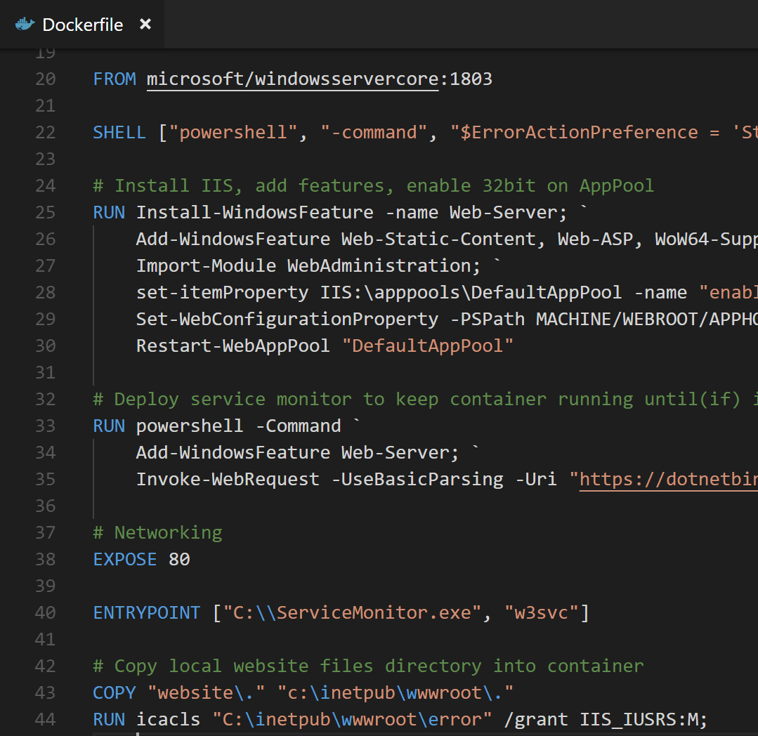
Dockerfile
Declarative way of building container
Containers should be immutable
ENTRYPOINT is what runs when container is started up. Can be an exe or a script
If your container starts and finishes a task, it will exit. We set the ENTRYPOINT to “ServiceMonitor.exe” in this example which will watch the IIS web worker and terminate if it stops
Images build with “docker build” command

Slide 22
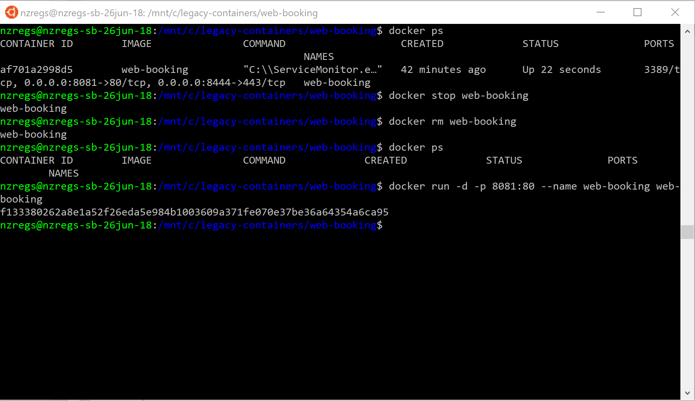
Build/Start/Connect/List/Stop/Remove container
Build image from Dockerfile in current directory and name/tag web-portal
docker build . –tag web-portal
Start detached, map port 8081 to container port 80, give it name/tag web-portal, use v1 of the web-portal image
docker run –d –p 8081:80 –name web-portal web-portal:v1
Connect to running container, hold “tty” for cmd/powershell:
docker exec –ti web-portal cmd.exe
docker exec –ti web-portal powershell.exe
Show running/all containers:
docker ps | docker ps –a
Stop Container:
docker stop web-portal
Remove container:
docker rm web-portal
Remove image:
docker rmi web-portal

Slide 23
DEMO
Windows Server container IIS + Classic ASP + ActiveX

Slide 24
Kubernetes

Slide 25
Why Kubernetes?
Originally came from Google, is now run by Cloud Native Computing Foundation (CNCF)
Becoming the default orchestrator – and at a recent dockercon, Docker announced native support for Kubernetes alongside the existing support for their own orchestrator Docker Swarm
First class support on public clouds. E.g:
Microsoft Azure Kubernetes Service- AKS
Google Kubernetes Service – GKS
Catalyst (as you heard this morning)
Amazon Elastic Container Service for Kubernetes
Rich ecosystem of supporting tools – like Helm, Draft, Brigade, Kashti
Open source

Slide 26
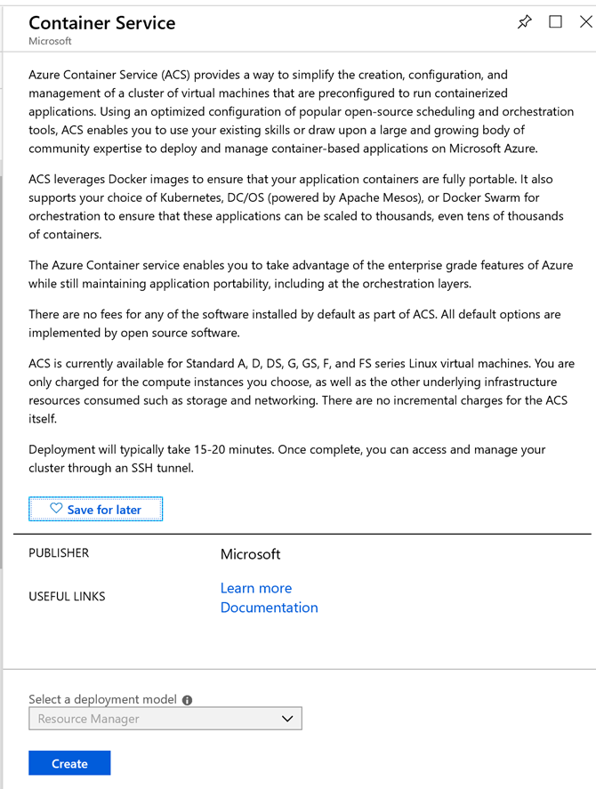
Create a kubernetes cluster with Windows Server nodes in Azure
Via the portal – look for “Container Service” and choose Kubernetes as orchestrator (other options are Swarm and DC/OS)
Via script using acsengine https://github.com/Azure/acs-engine/blob/master/docs/kubernetes/windows.md

Slide 27
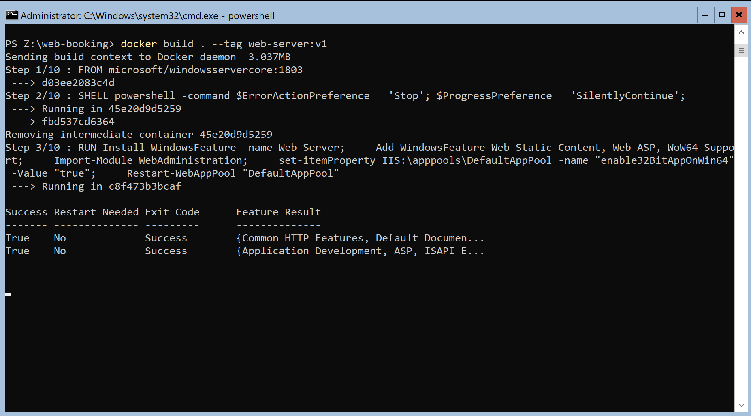
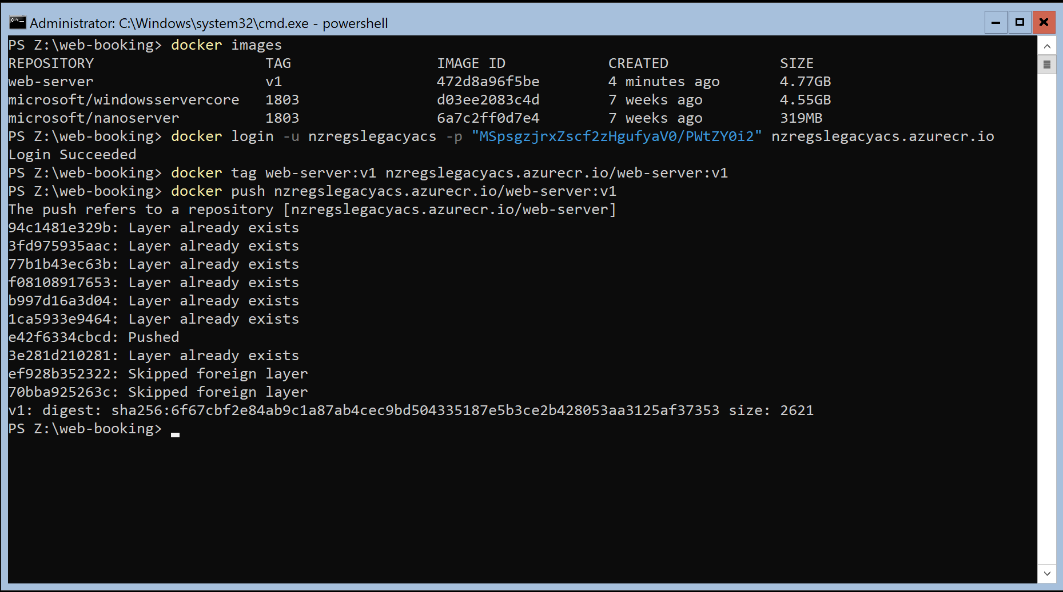
Build and Push image to container registry
Pushing a windows server core container means sending ~5GB!
Push to a private registry

Slide 28
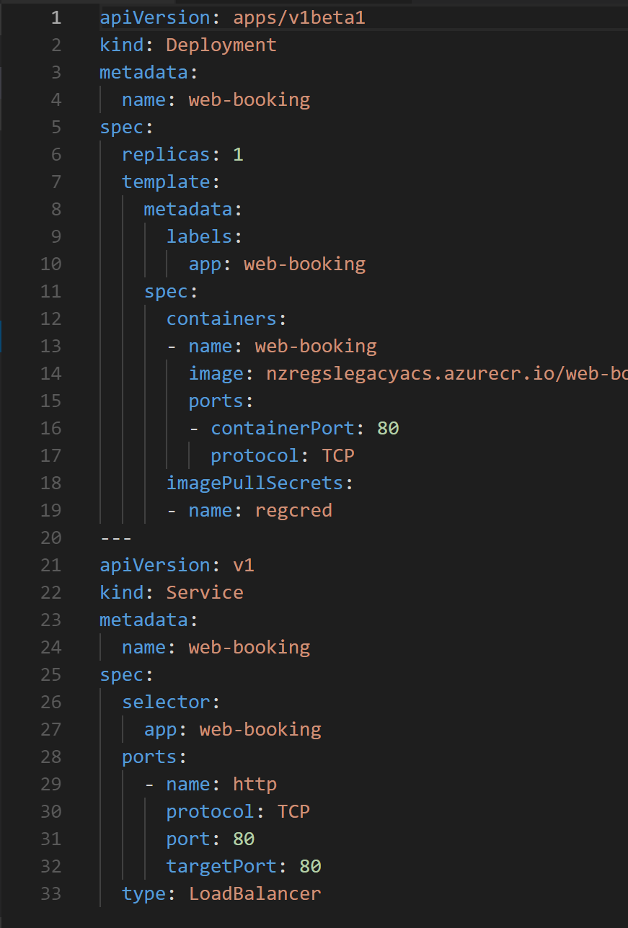
Create YAML Deployment
Because we are pulling from a private registry that requires a login, first create the secret on kubernetes (using the service principal that was deployed with k8s in this case):
kubectl create secret docker-registry regcred --docker-server nzregslegacyacs.azurecr.io --docker-username 88d6ca05-****-****-****-75df****d4f2 --docker-password ejhhewe********//plkZbLcmxUKcSeQ+JF7+Uo= --docker-email regan.murphy@example.com

Slide 29
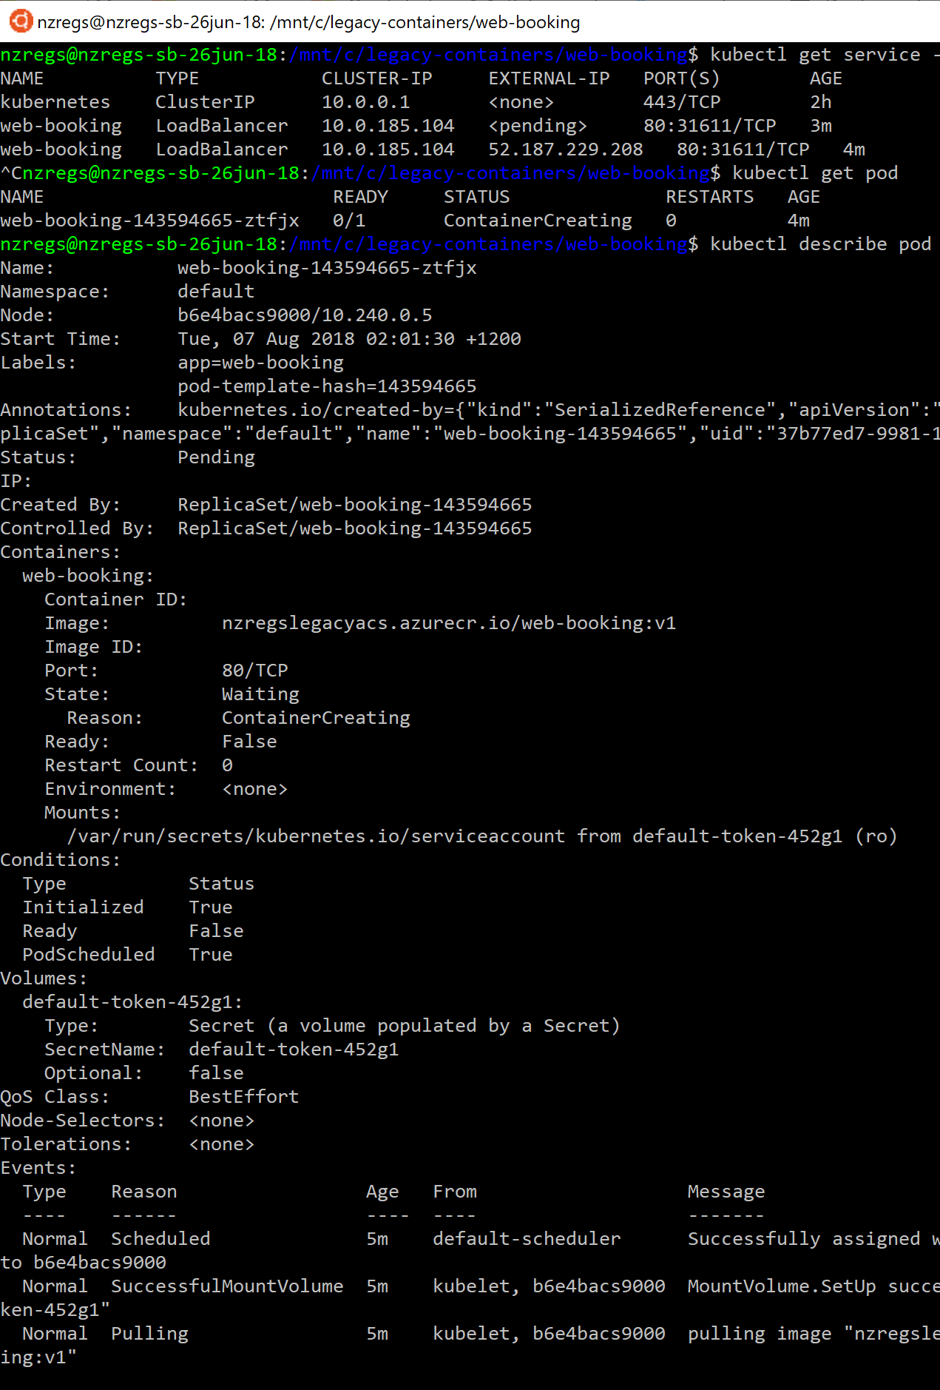
Apply deployment to Kubernetes Cluster
Apply the deployment file
Watch the pods and services
Useful commands:
kubectl get service –-watch
kubectl get pods
kubectl describe pod <PODNAME>

Slide 30
DEMO
Container orchestration using kubernetes

Slide 31

Authentication
Domain join inside of containers is not supported.
When Windows Authentication needed:
Can use gMSA – group managed service account
Must domain-join container host
Supply extra argument to start container
All “NETWORK SERVICE” will assume the gMSA
Still a “roadmap” item for k8s – possible with docker swarm

Slide 32
Enable gMSA on Container Host
# ON THE CONTAINER HOSTS
## Install the gMSA
Enable-WindowsOptionalFeature -FeatureName ActiveDirectory-Powershell -online -all
Get-ADServiceAccount -Identity container_gmsa
Install-ADServiceAccount -Identity container_gmsa
Test-AdServiceAccount -Identity container_gmsa
## Create credential spec file
Invoke-WebRequest "https://raw.githubusercontent.com/Microsoft/Virtualization-Documentation/live/windows-server-container-tools/ServiceAccounts/CredentialSpec.psm1" -UseBasicParsing -OutFile $env:TEMP\cred.psm1
import-module $env:temp\cred.psm1
New-CredentialSpec -Name Gmsa -AccountName container_gmsa -Domain (Get-ADDomain -Current LocalComputer)
##This will return location and name of JSON file
Get-CredentialSpec

Slide 33
Start a container with gMSA credentials
docker run -d -p 8080:80 --security-opt "credentialspec=file://Gmsa.json" --name web-booking nzregslegacy.azurecr.io/web-booking:v3
To verify if the gMSA is working inside a container, the commands are useful:
docker exec –it web-booking cmd
nltest /parentdomain
There is a good walkthrough of gMSA available here:
https://github.com/artisticcheese/artisticcheesecont
ainer/wiki/Using-Group-Managed-Service-Account-(GMSA)-to-connect-to-AD-resources

Slide 34
Whats coming up?

Slide 35

Running Linux Containers on Windows with LinuxKit
“Starting with Docker for Windows version 18.03.0-ce-win59 the Linux Containers on Windows (LCOW) is available as an experimental feature”
https://blogs.msdn.microsoft.com/premier_developer/2018/04/20/running-docker-windows-and-linux-containers-simultaneously/

Slide 36
Roadmap: Windows Server 2019 (H2 2018)
Improved container support
Kubernetes support—improvements to compute, storage and networking components of a Kubernetes cluster
Red Hat open-shift container platform
Optimized images for Server Core and Nano Server
Improved Linux support
Linux containers on Windows host
Support for tools such as open SSH, Curl, Tar
Windows Subsystem for Linux

Slide 37

Next steps?
If you’re new to Windows containers, you might like to check out the Windows Containers Workshop built by my colleague Paul Bouwer for Container Camp AU & UK:
https://github.com/paulbouwer/windows-containers-workshop
If you’re new to Containers and/or Kubernetes, then lookout for a “Containers Open Hack” near you. The next one is in Auckland, NZ, on November 14-16. There are also events coming up in US and Europe and there was a recent one in Sydney
http://aka.ms/NZopenhack

Slide 38
Move legacy apps to Windows Containers (to take advantage of modern infrastructure and orchestration)
Regan Murphy
Software Engineer
Microsoft
@nzregs

