Slide 1
Benchmark Classification for GC Tuning
DS5220
Olivier Flückiger
4/9/18

Slide 2

Data Collection
36’000 Runs

Slide 3
Data Collection black_scholes
Darker = Takes more Time

Slide 4
Data Collection matrix addition

Slide 5
Classification

Slide 6
Classification
1. Model Benchmark Response
Execution Time Best Run -3% SVM Model

Slide 7
Classification
1. Model Benchmark Response
2. K-Means of Model Coefficients

Slide 8
Random Cluster 1
Binary Trees 2 Binary Trees List ICA lapply
(not too bad...)

Slide 9
The “Noisy” Cluster
Pidigits N Body Fasta … … …
(By far the biggest cluster)

Slide 10
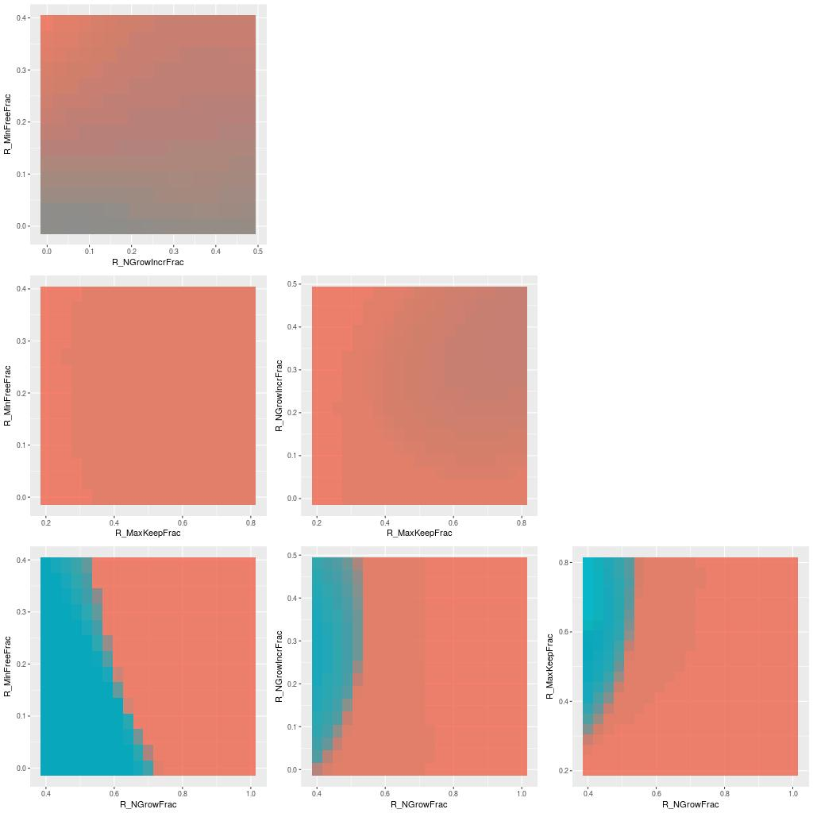
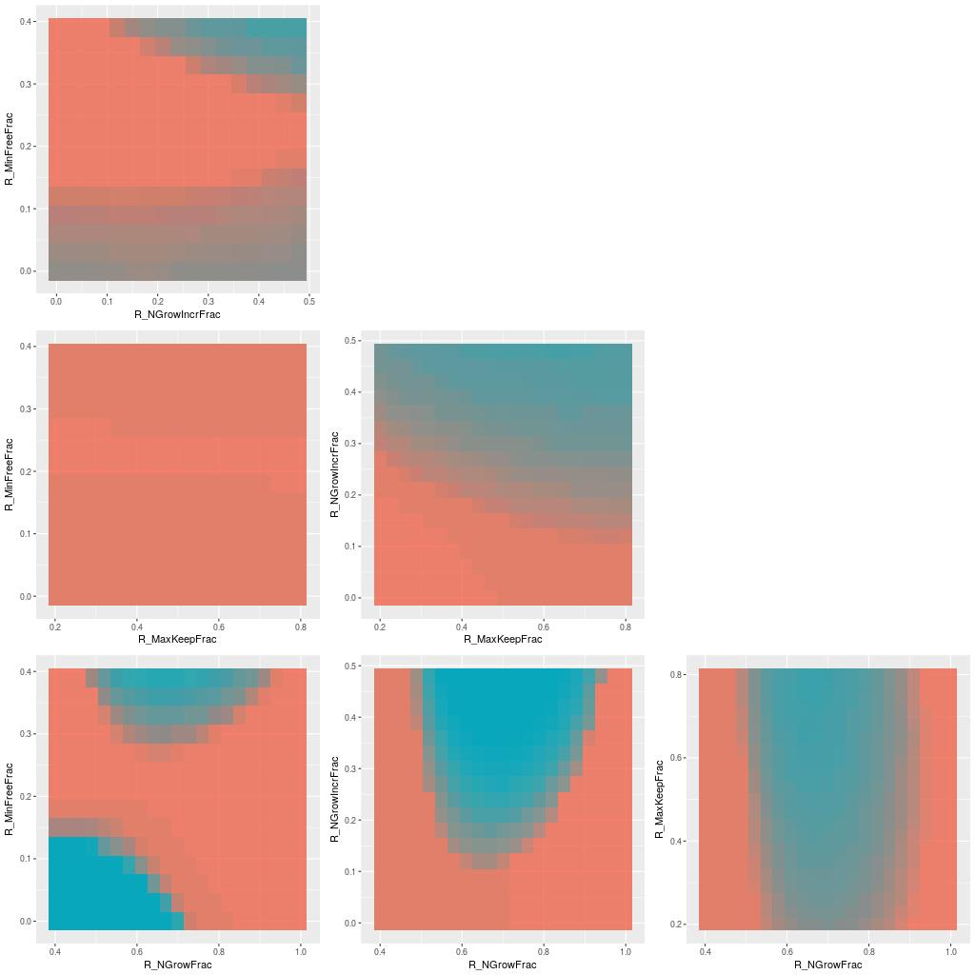
Bad Cluster
k-means badly clusters the k-means benchmarks ;)
k-means 1D k-means
(even with k=15 the clusters aren’t very homogeneous)

Slide 11
Prediction
Evaluate the precision against a particular GC Tuning

Slide 12
Prediction

Slide 13
Prediction
noisy

Slide 14
Prediction
small classes
noisy

Slide 15
Prediction
small classes
noisy

Slide 16
Prediction
Similar response, but details matter!

Slide 17
Prediction
Similar response, but details matter!
Never Retire a Benchmark

