Slide 1
Benchmark Classification for GC Tuning
DS5220
Olivier Flückiger
3/12/18

Slide 2
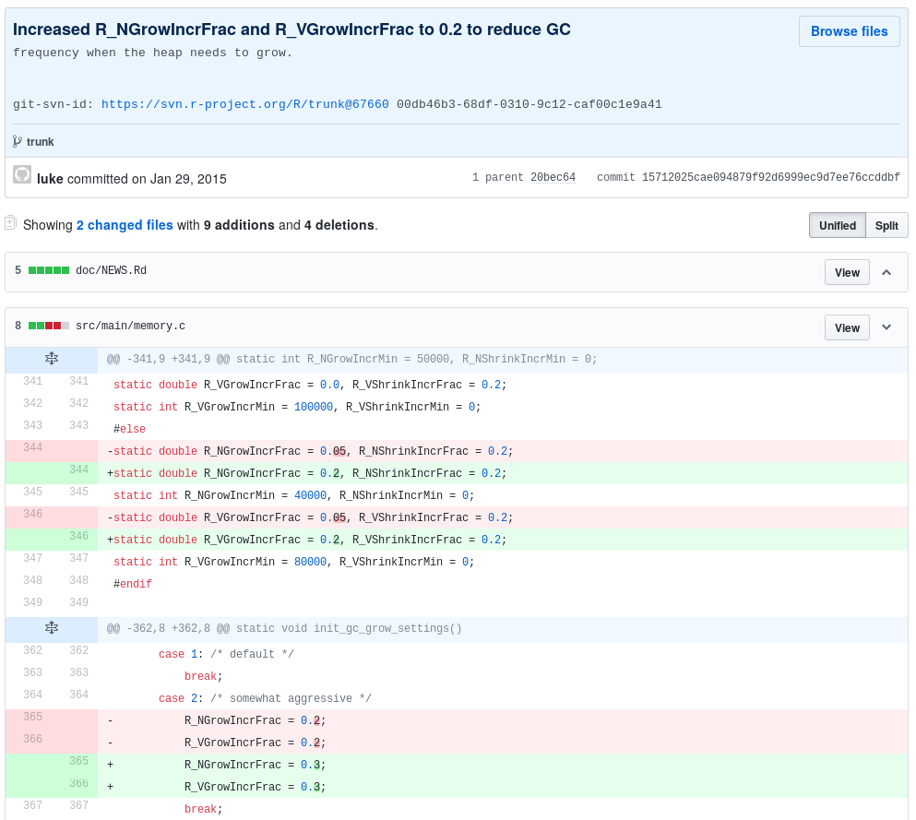

Slide 4
How many Benchmarks do I need?
Different parameters for
different Programs?
What kind of Programs are there from
the GC’s point of view?

Slide 5
for each benchmark
Param B
fastest choice
Param A

Slide 6
for each benchmark
Param B
within 10%
Param A

Slide 7
for each benchmark
Param B
SVM
Param A

Slide 8
similar classification
=
similar benchmark
for each benchmark
Param B
SVM
Param A

