Slide 1
Pinocchio on Speed

Slide 2
Implementing
Smalltalk in Smalltalk

Slide 3
a + b
MessageDictionary
+
Message
a
b
Integer
Integer

Slide 4
Late binding
someRandomObject do: this

Slide 5
Late binding
someRandomObject do: this
???

Slide 6
foo do: bar
Dictionary>>at: aMessage
  selector := symbolTable lookup: aMessage.
  ...

Slide 7
foo do: bar
Dictionary>>at: aMessage
  selector := symbolTable lookup: aMessage.
  ...

Slide 8

MessageDictionary>>at: #at

Slide 9
foo do: bar
Dictionary>>at: aMessage
  symbolTableLookup: aMessage
  ...
SymbolTable>>lookup: aString
  ...

Slide 10
This looks like....
...an Inline Cache

Slide 11
foo do: bar
Dictionary>>at: aMessage
  invoke: #lookup on: symbolTable class
  ...

Slide 12
foo do: bar
Dictionary>>at: aMessage
  invoke: #lookup on: symbolTable class
  ...
Object>>invoke: aMessage on: aClass
  f = lookup: aMessage for: aClass.
  rewireInlineCache.
  call: f

Slide 13
Dictionary>>at: aMessage
  call: *f expect: SymbolTable
  ...
Object>>invoke: aMessage on: aClass
  f = lookup: aMessage for: aClass.
  rewireInlineCache.
  call: f

Slide 14
foo do: bar
Dictionary>>at: aMessage
  call: *f expect: SymbolTable
  ...

Slide 15
foo do: bar
Dictionary>>at: aMessage
  call: *f expect: SymbolTable
  ...
SymbolTable>>lookup: aString
  if receiver_class != SymbolTable
    invoke: #at on: receiver_class
  ...

Slide 16


Slide 17
From late to early binding...
Prefill some inline caches!

Slide 18
From late to early binding...
<fixedType: #class as: #Behavior>
<type: #methodDictionary as: #MethodDictionary>
  [ class == nil ] whileFalse: [
    methodDictionary := class methodDictionary.
    method := methodDictionary at: selector.
    method == nil ifFalse: [ ^ self inlineCacheAndCall ].
    class := class superclass ].

Slide 19
The Compiler Framework

Slide 20
foo
^ self + 1
PEGParser
AST
Processor
Assembler
Binary Generation
Liveness Analyzation
TAC
ELF
Register Allocation
Register Swapping
Post Processing
Linker
cmp %rax,%rdi
jne 9 <foo+0x9>
push %rbx
push %r10
mov 0x0(%rip),%rbx
mov %rsi,%r10

Slide 21
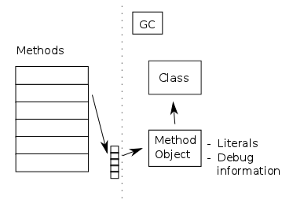
Memory layout

Slide 22
Why compile native code?

Slide 23
Because it's easy...
linearScanRegisterAllocation
liveness do: [ :interval |
self expireIntervalsBefore: interval start.
( active size == self numberOfRegisters )
ifTrue : [ self spill: interval ]
ifFalse : [
self nextFreeRegisterFor: interval variable.
active add: interval ]].

Slide 24
Demo....

