Slide 1
Capstone Project Final Report - AG
Assessing Development and Investment Potential of Tulsa Zip Codes

Slide 2
Business Problem
Identifying prime locations for investment in housing.
Finding opportunities for developing the surrounding up-and-coming areas.

Slide 3
Data: 2 Main Sources
One with zip code coordinates, but containing outdated information from 2010 (regarding population, population per square mile and average income per household).
One with updated information on the zip codes for every month from June 2020 to June 2016 . This data held such variables as median and average listing price, total listing price, listing price per square feet and so on.

Slide 4
Visualizataions

Slide 5
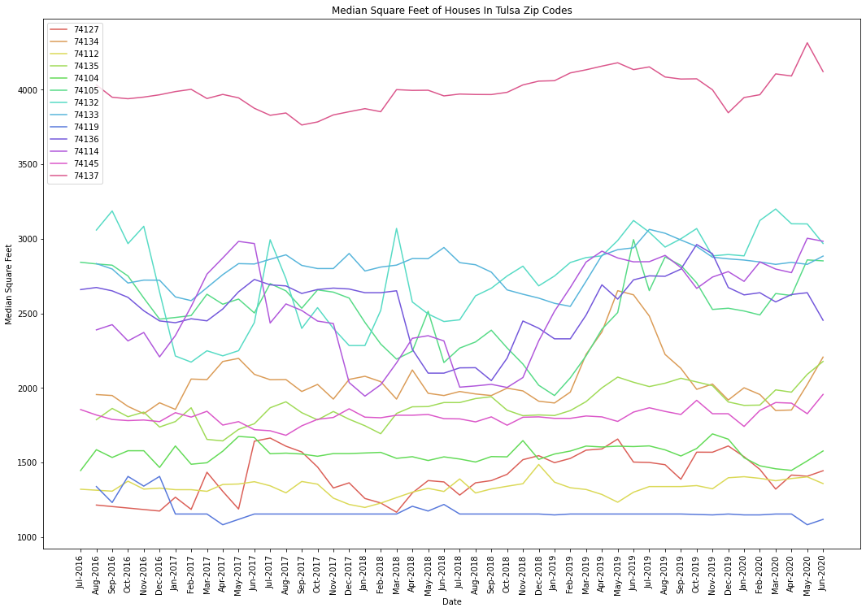
Differences in the median square feet of each zip code

Slide 6
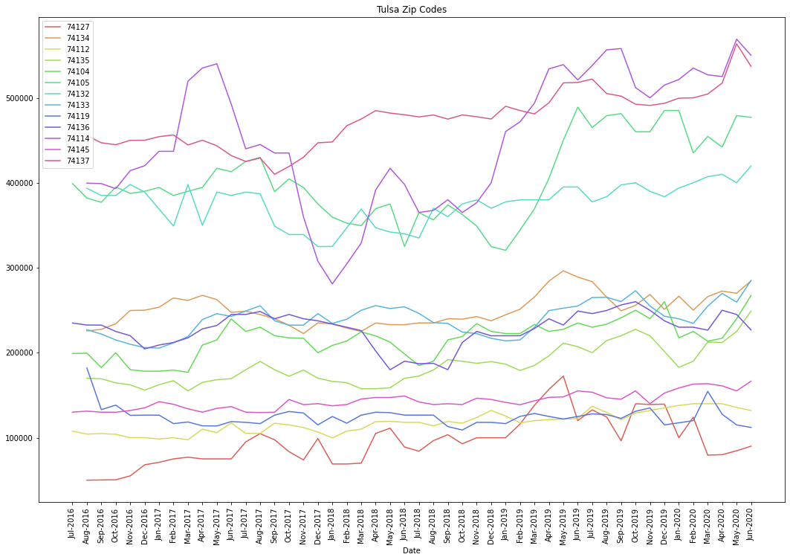
Comparison between the zip codes on median listing price

Slide 7
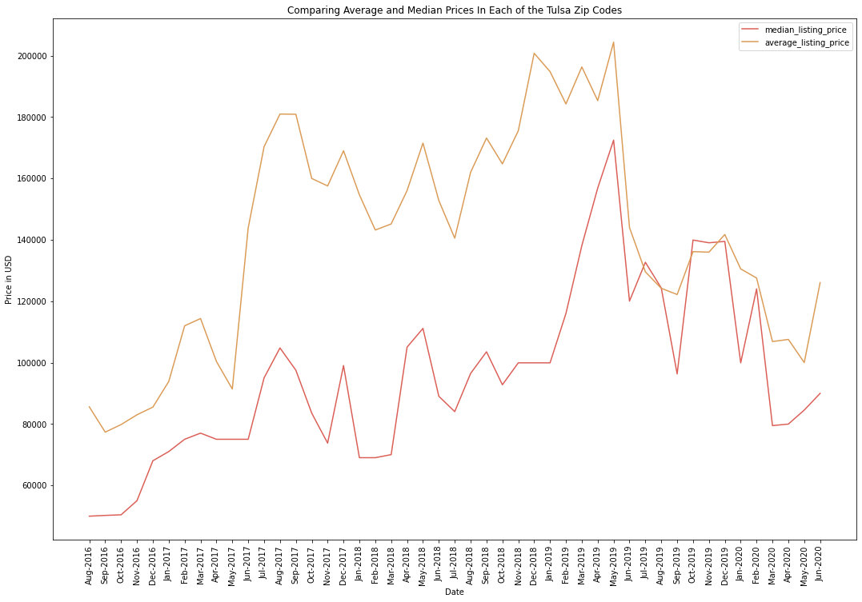
Comparison between the average and median listing price of zip code 74127

Slide 8
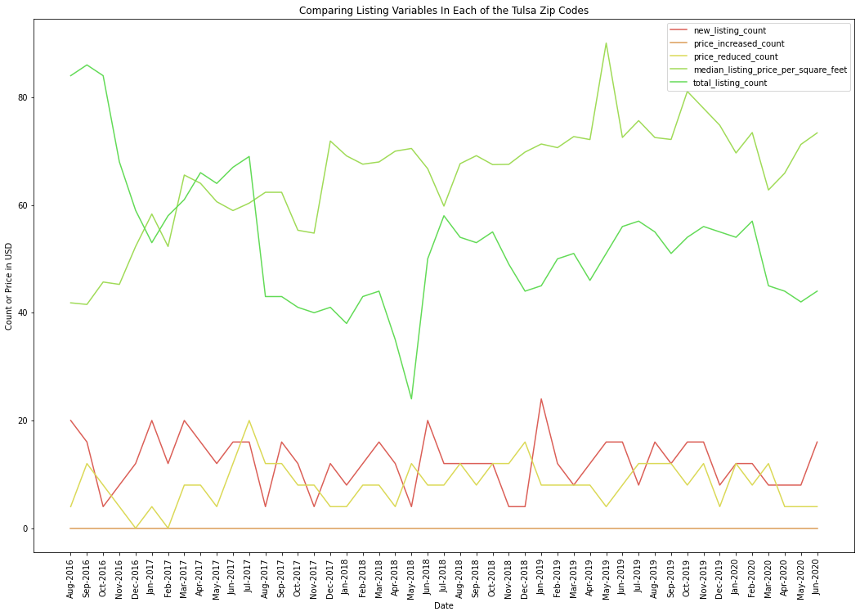
Comparison between the remaining variables for zip code 74127

Slide 9
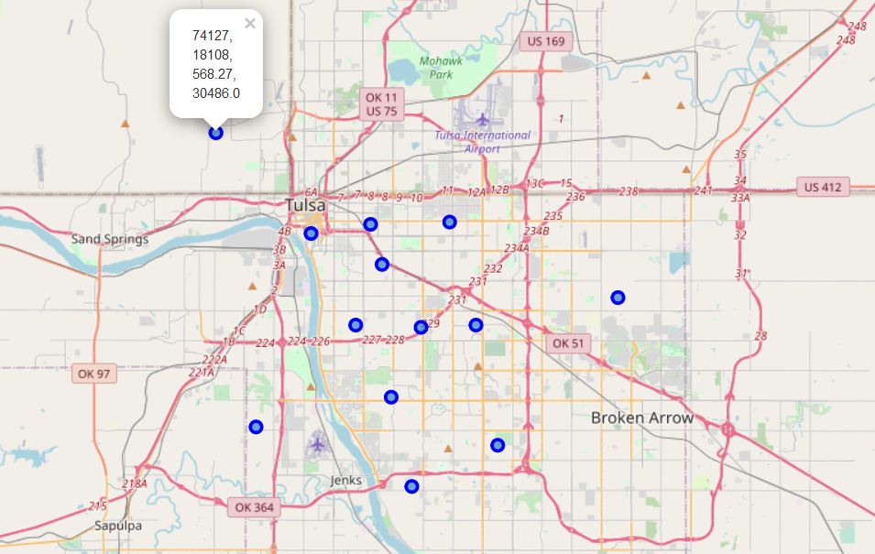
Map of Tulsa with markers indicating the zip code, population, the population per square mile and the average household income

Slide 10
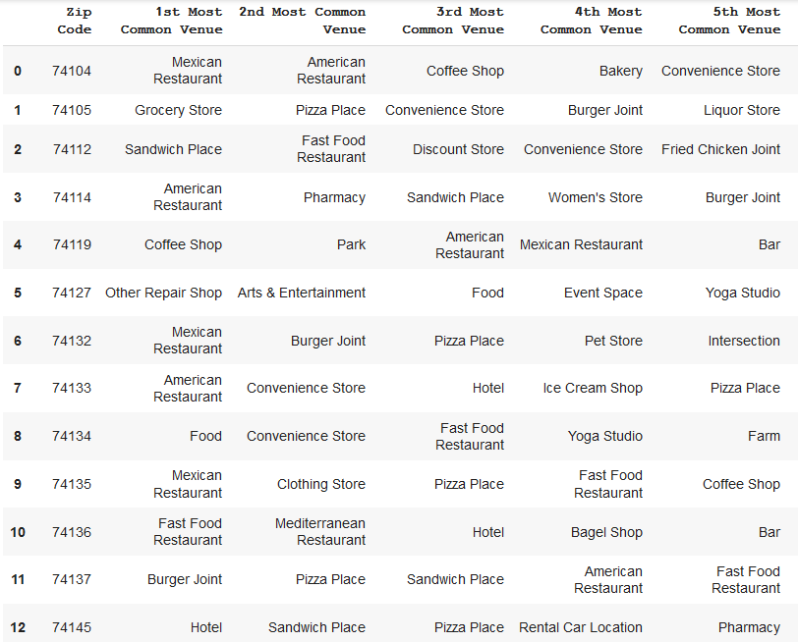
Most visited venues in each zip code

Slide 11
Discussion – main points
Looking at zip code 74127, over time both the listing prices and the price per square foot are increasing. Investing in bigger houses for future profits is recommended.
The most visited places in zip code 74137 are food related. It is recommended to consider building a new establishment that is food focused in that area.

Slide 12
Closing remarks
The graphs are interactive, and can be used to cycle through the other zip codes / variables. Viewing the notebook is highly encouraged.
Once the data for the 2020 census is published, a repeat of this project can present up to date information, and would provide insights of greater accuracy.

Slide 13
Thank you for reviewing this project!

