Slide 1









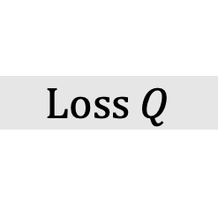
$$Loss Q$$
$$Y$$
$$X^{\left(L+1\right)}$$
$$W^{\left(L\right)}$$
$$X^{\left(L\right)}$$
$$W^{\left(L−1\right)}$$
$$⋮$$
$$X^{\left(2\right)}$$
$$W^{\left(1\right)}$$
$$X^{\left(1\right)}$$

Slide 2
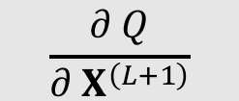
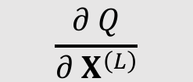
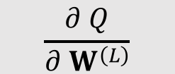
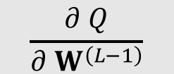
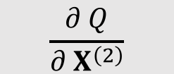
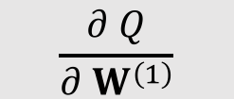

$$Loss Q$$
$$\frac{∂ Q}{∂ X^{\left(L+1\right)}}$$
$$\frac{∂ Q}{∂ W^{\left(L\right)}}$$
$$\frac{∂ Q}{∂ X^{\left(L\right)}}$$
$$\frac{∂ Q}{∂ W^{\left(L−1\right)}}$$
$$⋮$$
$$\frac{∂ Q}{∂ X^{\left(2\right)}}$$
$$\frac{∂ Q}{∂ W^{\left(1\right)}}$$
$$\frac{∂ Q}{∂ X^{\left(1\right)}}$$
(This derivative is not useful)

