Slide 1
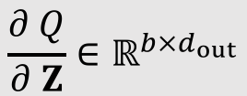
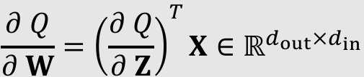





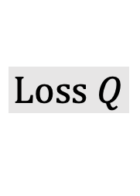

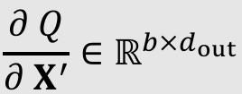
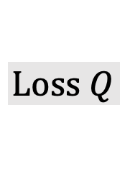

$$Loss Q$$
$$Loss Q$$
$$⋮$$
$$⋮$$
$$X^{′}=σ\left(Z\right)∈ℝ^{b×d_{out}}$$
$$\frac{∂ Q}{∂ X^{′}}∈ℝ^{b×d_{out}}$$
$$\frac{∂ Q}{∂ Z}∈ℝ^{b×d_{out}}$$
$$Z=XW^{T}∈ℝ^{b×d_{out}}$$
$$\frac{∂ Q}{∂ W}={\left(\frac{∂ Q}{∂ Z}\right)}^{T}X∈ℝ^{d_{out}×d_{in}}$$
$$\frac{∂ Q}{∂ X}=\frac{∂ Q}{∂ Z}W∈ℝ^{b×d_{in}}$$
$$W∈ℝ^{d_{out}×d_{in}}$$
$$X∈ℝ^{b×d_{in}}$$

