Slide 1
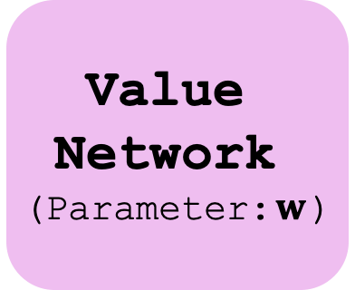


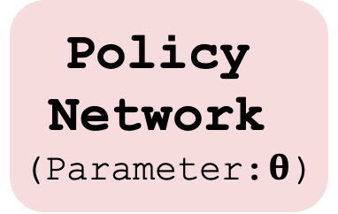
Value Network
(Parameter:$w$)
Policy Network
(Parameter:$θ$)
value
$$q\left(s, a;w\right)$$
action
state s
$$a=π\left(s;θ\right)$$

