Slide 1
Localization for Startups
Localization World
Santa Clara 2015
Oleksandr Pysaryuk,
Brian McConnell
Notes:
1

Slide 2
Agenda
Introduction
Theoretical part
Localization & internationalization term and definitions
Startups term and definitions
To be or not to be: To localize or not to localize
International Product Management
Setting up a Localization function in a small company
Introduction for LMM
Introduction to l10n
Practical part
Notes:
2

Slide 3
Welcome!
Tell us:
Your name
Where you are coming from
Which company are you working with
Your expectations from the workshop
One thing that you did (unrelated to work / l10n etc.) which no one would believe you actually did
Notes:
3

Slide 4
Think!
WORLD INTERNET USAGE AND POPULATION STATISTICS June 30, 2012
World Regions | Population ( 2012 Est.) | Internet Users Dec. 31, 2000 | Internet Users Latest Data | Penetration (% Population) | Growth 2000-2012 | Users % of Table
Africa | 1,073,380,925 | 4,514,400 | 167,335,676 | 15.6 % | 3,606.7 % | 7.0 %
Asia | 3,922,066,987 | 114,304,000 | 1,076,681,059 | 27.5 % | 841.9 % | 44.8 %
Europe | 820,918,446 | 105,096,093 | 518,512,109 | 63.2 % | 393.4 % | 21.5 %
Middle East | 223,608,203 | 3,284,800 | 90,000,455 | 40.2 % | 2,639.9 % | 3.7 %
North America | 348,280,154 | 108,096,800 | 273,785,413 | 78.6 % | 153.3 % | 11.4 %
Latin America / Caribbean | 593,688,638 | 18,068,919 | 254,915,745 | 42.9 % | 1,310.8 % | 10.6 %
Oceania / Australia | 35,903,569 | 7,620,480 | 24,287,919 | 67.6 % | 218.7 % | 1.0 %
WORLD TOTAL | 7,017,846,922 | 360,985,492 | 2,405,518,376 | 34.3 % | 566.4 % | 100.0 %
Internet User Distribution
Source: http://www.internetworldstats.com/stats.htm
Notes:
4 years ago North America used to be 17%
Think about Facebook: 82% of users are outside North America
Think about the 40 languages of Google in 2007/2008

Slide 5
Culture is Everywhere
“If I'm selling to you, I speak your language.
If I'm buying, dann müssen Sie Deutsch sprechen (then you must speak German)”
Willy Brandt
Notes:
5

Slide 6
Localization terms and definitions
Notes:
6
6

Slide 7
L10n terms and definitions
Globalization (g11n)
Adaptation of marketing strategies to regional requirements of all kinds
To understand requirements (for going global)
Internationalization (i18n)
Engineering of a product to enable efficient adaptation of that product to local requirements
To enable products to meet requirements
Localization (l10n)
Localization is the process of adapting a (software) product and accompanying materials to suit a target-market locale
To fulfill requirements
c13n (culturalization), r13n (regionalization ) …..This workshop is presented by a2x and b3n
Notes:
7
Internationalization -> Generalization
Localization -> Customization

Slide 8
L10n terms and definitions
Language:
French – France? Canada? Switzerland?
Commination of Language and Geographic Region
Fr-FR, fr-CA, FR-CH
Es-US, ru-IL
Region Formats
Date, numbers, sorting and collation, and more
12/31/2014, 31/12/2014/ 12/11/10
Fr-FR and different from fr-CA
Notes:
8
Army, israel es-US (icu local fallback)
English/United States/Military locale is separate from the regular English/United States locale since the US military writes times and dates differently than most of the civilian community.

Slide 9
L10n terms and definitions
Market:
When you ask Siri or Cortana for a pizza, you would like to get a Pizza place in your area.
Sometimes you will have to specify the market too.
You can have 3 (and actually 4 parameters):
Language (as a Locale)
Region format (as Locale)
Market
Currency
Notes:
9

Slide 10
Unicode CLDR – Common Locale Data Repository
The Unicode CLDR provides key building blocks for software to support the world's languages, with the largest and most extensive standard repository of locale data available. This data is used by a wide spectrum of companies for their software internationalization and localization, adapting software to the conventions of different languages for such common software tasks. It includes:
Locale-specific patterns for formatting and parsing: dates, times, timezones, numbers and currency values
Translations of names: languages, scripts, countries and regions, currencies, eras, months, weekdays, day periods, timezones, cities, and time units
Language & script information: characters used; plural cases; gender of lists; capitalization; rules for sorting & searching; writing direction; transliteration rules; rules for spelling out numbers; rules for segmenting text into graphemes, words, and sentences
Country information: language usage, currency information, calendar preference and week conventions, postal and telephone codes
Other: ISO & BCP 47 code support (cross mappings, etc.), keyboard layouts
Notes:
10

Slide 11
Localization
Success
Product appears to be developed in the target market
Failure:
We can easily notice that the program was adapted
Notes:
11
11

Slide 12
Localization vs. Internationalization
Internationalization -> Generalization
Localization -> Customization
Global product with local content
Maximizing the core
Notes:
12
12

Slide 13
Localization vs. Internationalization
Localization
English
Localization
Hebrew
Internationalization
Localization
Chinese
Localization
French
Globalization
=
Internationalization
+
N X Localization
Notes:
13
13

Slide 14
Localization vs. Internationalization
You don’t need to actually read and write 22 languages
i18n is software engineering, not a linguistic process
There are cross-over concepts, however, such as:
Allowing sufficient white space for language growth in documentation
Not hard-coding page references in books
Planning website architecture to support multilingual content and navigation
i10n is mainly project management!
Use proper technology
Notes:
14
14

Slide 15
How the house works
If your house has no electrical wiring, you need to put it in. It can be a messy process; some walls will be broken and rebuilt. Once the wiring is in place, then the light fixtures get planned out. Every light fixture is different. Some are easily plugged into your current circuit. Some lights have special extras that will require changes or upgrades to your circuit.
i18n analogy
Languages are light bulbs and light fixtures.
Localization is the process of installing light fixtures and bulbs onto your i18n wiring.
Internationalization is the process of adding the electric wiring to your platform.
A non-internationalized platform is like a house without electrical wiring.
Notes:
15
15

Slide 16
How i18n works
If your house platform has no electrical wiring i18n infrastructure, you need to put it in. It can be a messy process; some walls components and implementations will be broken and rebuilt. Once the wiring i18n infrastructure is in place, then the light fixtures languages get planned out. Every light fixture language is different. Some are easily plugged into your current circuit i18n infrastructure. Some lights languages have special extras that will require changes or upgrades to your circuit i18n infrastructure.
Notes:
16
16

Slide 17
The 3 layers approach
String Externalization
Collation (Luz Vs. Llama)
Normalization (Ü Vs. U¨ , ç Vs. c ̧ )
Numerical Format (10.5 Vs.10,5)
String Length (Redo Vs. Wiederherstellen)
Date / Time format (01/07/2006)
Calendars
The first day of the week (Monday? Sunday?)
year length
Week numbers (ISO? Other?)

Slide 18
The 3 layers approach
Encoding (Unicode, S-JIS, BIG5, Latin-X etc.)
Shared messages
Bi-Directional scripts
Fonts (Unicode, Vertical vs. Horizontal)
Color schemes (http://finance.cn.yahoo.com/_
Segmentation (the Japanese example – no white spaces!)
Alphabets (Traditional vs. Simplified)
Morphology (how to perform search in Hebrew, Russian?)
Decompounding (how to perform search in German?)

Slide 19
The 3 layers approach
Politics (Judea and Samaria? Palestinian Authority? occupied territories? Which City is the capital of Israel?)
Time zone (Midnight? Where? When?)
Paper sizes (A4 Vs. Letter)
Measurements (Inch, CMs)
Cultural issue (the OK gesture)
Casing (Turkish uppercase of the Latin lower case (i) is ”İ” )
IDN: www.דניאל.com
Functional Localization

Slide 20
The 3 layers approach
The i18n and l10n problem is a mixture of:
Technical Issues
Cultural Issues
Political Issues
Language / Linguistic Issues
Esthetical Issues
Notes:
20
20

Slide 21
The 3 layers approach
Layer 1 – Data integrity (“handle with care” sticker)
Moving data from A to B
Storing data
Usually not locale dependent
Notes:
21
21

Slide 22
The 3 layers approach
Layer 2 – Application
Doing something with the data (e.g. sorting, searching casing, date/time format etc.)
Usually locale dependent
Notes:
22
22

Slide 23
The 3 layers approach
Layer 3 – Display
Presentation layer
Localization readiness (resources externalization)
Usually locale dependent
Notes:
23
23

Slide 24
Jargon
g11n
i18n
L10n
Sim ship
MLV
SLV
SLA
Translation Memory (TM)
Segment
Matching (100%, ICE, Partial, Fuzzy)
Leveraging
Alignment
Glossary, Glossary building
Terminology management
Machine Translation
Localizing Marketing
Localization Kit
NDA
Software L10n
Resource
Resource ID
Key-value pair
Context
Localization Tool
QA
Linguistic QA
Cosmetic QA
Functional QA
Reviewing
Proofreading
Localization Readiness
Pseudo Localization
Single-sourcing
Word count
CMS
Publisher
Notes:
24
24
How do developers talk? Two stories from Achievers:
Developers don’t say string ID or string text or resource file. Developers were used to: lang key, lang text, lang file.
Developers are so used to using text as variables that to them “hard coding” actual yens using actual text in lang text. For example: “buy more {0}”. To a localizer, this string is formatted incorrectly: in order to translate well, it should be a whole sentence: “buy more points”. To a developer, this is how they always did it. So when they see “buy more points”, they would say the word “points” is actually hard coded into a lang text, and not used as an elegant variable substitution.

Slide 25
Start-ups: terms and definitions
Notes:
25
25

Slide 26
Start-up characteristics
high growth
technology-oriented
high failure rate
first stage of its operations
not sustainable in the long term without additional funding
Start-up clusters
Silicon Valley, Boston, Tel Aviv, since recently - Canada
Notes:
26
Israeli start-up map: http://mappedinisrael.com/
Boston start-up map: http://www.kinvey.com/blog/2455/the-boston-startup-map-visualizing-the-citys-tech-scene
Why start-ups fail: https://medium.com/p/72c6f8bec7df - “Postmortem of a Venture-backed Startup, Lessons Learned from the rise and fall of @Sonar”
Why Startups Fail, According to Their Founders: http://www.entrepreneur.com/article/238088

Slide 27
Start-ups worldwide
Other regions:
Amsterdam, the Netherlands
Bangalore, India
Bogota, Colombia
Dublin, Ireland
Lisbon, Portugal
Nairobi, Kenya
Saint Petersburg, Russia
Stockholm, Sweden
Source: http://www.entrepreneur.com/slideshow/226477#0
Start-ups in a small country have a harder task: they have to sell internationally from the start
EU simulates a single, large domestic market. But …many different languages. So start-ups deal with internationalization from the beginning
Notes:
27

Slide 28
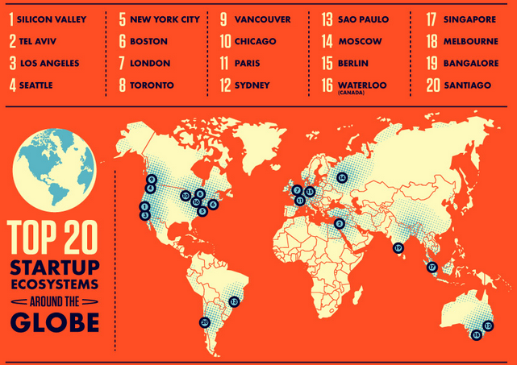
Notes:
28
Source: http://www.betakit.com/wp-content/uploads/2013/08/the-worlds-20-hottest-startup-scenes-1.jpg

Slide 29
Start-up vocabulary
founding team
bootstrapping
accelerator vs. incubator
venture capital
angel
seed round
series a/b/c round (angels, super angels, micro VC, VC)
pivoting
liquidation
scale
exit
hitting a wall
pitch
acquihire
Minimum Viable Product (MVP)
Notes:
29
Bootstrapping noun No investors? No money? No problem, just bootstrap it! Using whatever resources you have available as to avoid finding investors.
MVP
A Minimum Viable Product has just those features that allow the product to be deployed, and no more. The product is typically deployed to a subset of possible customers, such as early adopters that are thought to be more forgiving, more likely to give feedback, and able to grasp a product vision from an early prototype or marketing information.

Slide 30
Incubators, accelerators
Also known as: combinators, coworking spaces, virtual incubators, corporate incubators, idea factories
Examples: YCombinator, Dreamit, TechStars, 500 Startups
What are they for:
fostering early-stage companies
access to financial capital through relationships with financial partners
access to experienced business consultants, executives
access to physical location, hardware, software
access to informational and research resources
relationships with local universities and government entities
provisions of pre-seed investment (usually in exchange for equity)
Notes:
30

Slide 31
Incubators vs. accelerators
Key difference:
incubators focus on infrastructure
accelerators focus on action & getting things done
Goal is one: to nurture small start-ups by providing them with services they are too new, inexperienced, poor, or unconnected to acquire on their own.
Notes:
31

Slide 32
Start-up life expectancy
Although small at first sight, a start-up is not just a “butterfly” project:
First 3 years: get start-up off the ground, establish core team, culture, validate product/market through rapid iteration.
Next 3 years: establish company as a force in market, grow A-team, scale business.
Next few years: become a fast-growing business, look for exit options, stagnate, end up in difficult position, scale back.
Notes:
32
On average, time to exit is 8 years.

Slide 33
Venture capital
Funding in return for a stake in the company.
Probability is equated to getting a lottery.
Most investments are in software industry. Then energy. Then finance. Then biotechnology.
VCs usually invest OPM (Other People's Money).
Spectacular way to make money? No. Only for the top 5-10% investors.
Notes:
33
From Peter Thiel’s CS183
Many people who start businesses never deal with venture capitalists. Founders who do interact with VCs don’t necessarily do that early on. First you get your founders together and get working. Then maybe you get friends, family, or angels to invest. If you do end up needing to raise a larger amount of capital, you need to know how VC works. Understanding how VCs think about money—or, in some cases, how they don’t think about it and thus lose it—is important.
Venture basically works like this: you pool a bunch of money that you get from people called limited partners. Then you take money from that pool and invest it in portfolio companies that you think are promising. Hopefully those companies become more valuable over time and everybody makes money. So VCs have the dual role of encouraging LPs to give them money and then finding (hopefully) successful companies to back.
Most of the profits go back to LPs as returns on their investment. VCs, of course, take a cut. The typical model is called 2-and-20, which means that the VC firm charges an annual management fee of 2% of the fund and then gets 20% of the gains beyond the original investment. The 2% management fee is theoretically just enough to allow the VC firm to continue to operate. In practice, it can end up being a lot more than that; a $200m fund would earn $4m in management fees under a 2-and-20 structure. But it’s certainly true that the real payout that VCs look for come with the 20% cut of the gains, which is called the carry.

Slide 34
Angel investor
Usually investing in the person rather than the viability of the business
Focused on helping business succeed, rather than reaping huge profit from investment
The opposite of a venture capitalist
Can even be family, fiends
Notes:
34

Slide 35
Rounds of financing
Seed funding - earliest stage of funding, serial entrepreneurs at the idea stage
Series A - growing number of customers
Series B - company started making sizable revenues
Series C - company is mature, close to exit
Exit
Positive outcome that returns the money for the investor; 2 types:
company going into stock market IPO (initial public offering)
company getting bought out by another company, acquihire
Notes:
35

Slide 36
IPO
First sale of stock by a private company to the public
Smaller, younger companies seeking the capital to expand
Large privately owned companies looking to become publicly traded
Just another funding event, not a liquidation event
Notes:
36

Slide 37
To be or not to be: To localize or not to localize
Notes:
37
37

Slide 38
Decision
Strategic direction
Tactical need
Nature of product or business
Regulations
“Just do it”

Slide 39
International Product Management
Notes:
39
39

Slide 40
What do Product Managers do?
TALK TO CUSTOMERS!
Identify profitable opportunities
Define product requirements of existing and future product features
Document market issues that impact customer experience
Launch products to market
Tools: usability tests, interviews, surveys, research, competitive intelligence, documentation: BRD, MRD, PRD
Agile (epics, user stories, backlog, sprints)

Slide 41
What do International (Country, Global) Product Managers do?
Think about implications of taking the product beyond local market
Work with experts in target regions, on how product meets needs of users in target regions
Identify profitable opportunities in international markets
Define international product requirements of existing and future product features
Document international market issues that impact customer experience
Launch products to international markets
Tools: usability tests, interviews, surveys, research, competitive intelligence, documentation: BRD, MRD, PRD
Agile (epics, user stories, backlog, sprints)

Slide 42
Odds against intl product management
US product and US market centric anyway…
Identify global requirements? Too long...
Build a global product that must then be localized for the US…?
Challenges for Intl Product Manager
product that will be sold to people he has never met
people that speak a language he doesn’t understand
laws that he isn’t aware of
payment by mechanisms he has never used
Notes:
42

Slide 43
Discovery, data, analytics
Connect with marketing and sales
User demographics, profiles, personas
User behavior, what regions website visitors come from
What languages client companies operate in
What languages customers request, and why
Does competition have international elements
Interview, survey, conduct international usability research
Track relevant developments in key overseas markets
Talk to local competitors, customers, partners, investors
Is this market developing differently from or similarly to the home market?
What local players are emerging that we need to watch?
What user or customer trends offer lessons to improve our product or market strategy?
Protect your IP, register trademarks and domain names in the top world economies.
* Reference: http://john.a16z.com/about/
Notes:
43
Google maps, Bing maps

Slide 44
Software i18n & l10n requirements
I18n Goal: enable localization(s), define general & configurable product so it can be tailored to needs of local geographies
L10n Goal: customize and tailored the product for specific markets and cultures
Includes:
Unicode everywhere, CLDR, ICU…
Locale support
i18n capabilities of platform
Composite messages, text externalization
File and directory structure, release cycle, integration, developer tools
Currency and payment methods, international shipping and delivery
Includes:
Integration into software development methodology (e.g. Agile)
Terminology management
Localizability reviews of early prototypes
Extracting and managing resources
Translating and reviewing strings
Adapting design, fonts, UI
Testing localized versions

Slide 45
Setting up a Localization function in a small company
Notes:
45
45

Slide 46
Axiom
International strategy accelerates growth, opens revenue streams
Hire
Consider making international experience, sales, internationalization and localization experience, and foreign language proficiency the explicit hiring criteria.
What drives hiring decision
strategic direction
tactical need (e.g. urgent requirement from customer)
Notes:
46

Slide 47
What does Localization Manager within a start-up focus on? (1)
People, roles, activities in localization
Horizontal partnership and collaboration
Budget (day-to-day tactical + long term: global hiring, in country operation)
Content (what is being localized, what isn’t, where is localizable, or not-yet-localizable, content created across organization, duplication)
Localization services partners (LSPs)
Localization technologies
Localization at competitors
Plan to scale localization for exit: growth, merger, acquisition
Balance the counter-argument: “building scalability into start-up early is a sign of start-up’s coming death”
Pin your organization on the LMM (Localization Maturity Model)
Notes:
47

Slide 48
What does Localization Manager within a start-up focus on? (2)
Create & maintain roadmap:
software i18n (milestones, effort sizing)
language release (tiers, timing, alignment with marketing and sales strategy)
path along LMM (basic milestones, timing)
International strategy: countries, go-to-market, expansion of start-up team headcount globally.
Marry Localization and Agile.
Notes:
48
Daniel maybe add something…

Slide 49
Introduction for LMM
Notes:
49
49

Slide 50
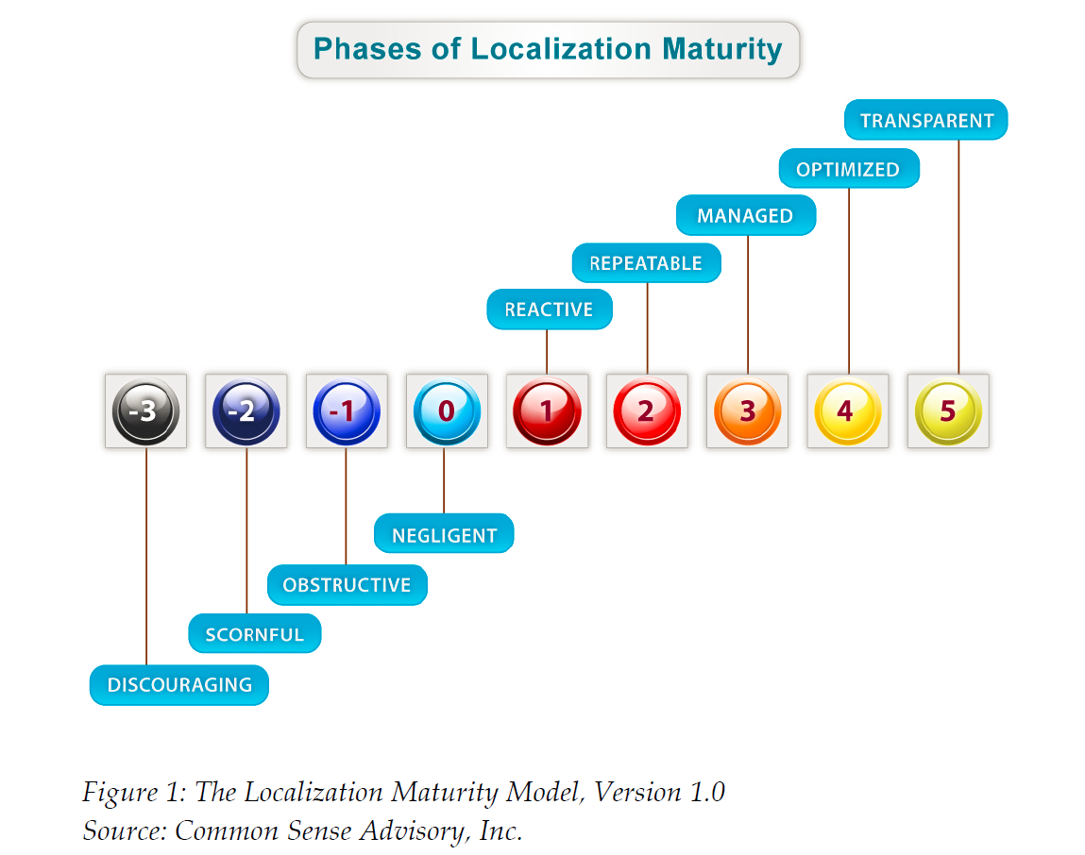
Notes:
50

Slide 51
Localization Maturity Model
Conceptualized by Common Sense Advisory (www.commonsenseadvisory.com)
Capability maturity model integration (CMMI) applied to the practice of localization
Companies move through the various levels of localization maturity:
Reactive: ad hoc, few processes
Repeatable: discovery phase, basic project management
Managed: centralization
Optimized: collecting metrics, content management
Transparent: L10n is part of code and content lifecycle
Notes:
51

Slide 52
Introduction to l10n (a very short one…)
Notes:
52
52

Slide 53
People
content providers (editors, technical writers, R&D teams)
localization project managers (on the buyer and vendor sides)
localization engineers (on the buyer or vendor side)
product managers, internationalization PMs and engineers
translators , reviewers , testers (in-house, freelance, LSPs, sub-contractors)
quality assurance engineers (on the buyer and vendor sides)
moderated and unmoderated communities
finance personnel
program managers
product marketing managers
Technologies
authoring
content management
translation memory
terminology management system
translation management system
workflow management system
machine translation
visual localization
testing, QA, issue tracking systems
Processes
vendor selection
fetching content to be localized
preparing the content (text segmentation, resource extraction)
pseudo localization and proactive i18n QA on core code
leveraging content from existing translations
effort estimation, costing, approval, work assignment, delivery, billing
translation and localization
proofreading/editing/reviewing
quality metrics
testing, functional and “linguistic”
update and maintenance of linguistic assets
Notes:
Spot 9 bugs here:
http://theverybestofstuff.de/loctest/loctest1.html

Slide 54
The (Traditional) Process
Leveraging
Content
providers
Preparing
Effort assessment
Linguistics
assets:
TMs
Terms
Glossaries
Translating
Content
Repository
Content
providers
Reviewing
Packaging and delivery
Updating
Linguistics
assets

Slide 55
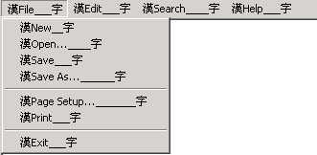
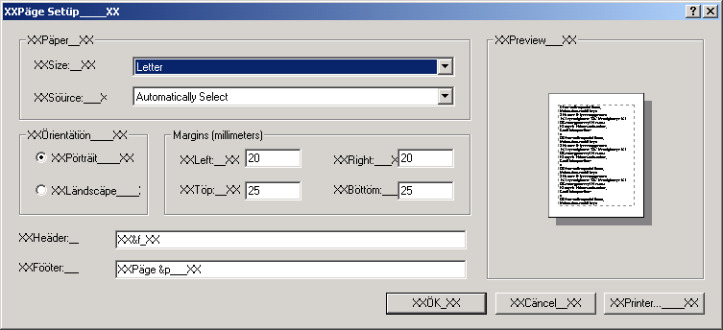
Pseudo-localization
Run a pseudo-localization to test localization readiness
Check:
Externalization of strings
Adaptation of the GUI (length, date, time, currency etc.)
Handling of string concatenations
Software functionality
Data entry, transfer, persistence, and redisplay
and…
Notes:
55
55
Alex will add notes here:
At Achievers, pseudo-localization is used to enable better context for translatros and testers. We provide the ablity for vendors to toggle the UI between string value (text) and string key (ID). This way, a vendor can check what stirng ID corresponds to what UI string text, and can also search by string ID in the resource file using text editor.
We also use pseudo-translaiton for HTML email templates, to review pseudo-localzied emaild for potential layout issues before translation starts.
We also use pseudo-translaiton for early QA of the product, before translation begins.

Slide 56
Translation
Basic premises:
Translation is expensive (but not the most expensive item in the process! Testing, for example) Example:
1 million words = $250,000 per language
A 10 languages localization project easily could incur cost of $2.5M
Glossaries are required
Translation memories are required
Notes:
56
56
This is about 30% of the cost a localization project
Testing
Engineering

Slide 57
Project Management / Workflow Management
Machine Translation Engine
Possible file preparation
Software Localization Tool
Source language files
Target language files
Self- developed tool
API
Translation Memory Tool
Alignment
Terminology Extraction
Term base / term list
Word count tool
QA tool
possible text extraction file conversion
Creation of target language file
DTP
Macros
Editor of TM tool
Notes:
57
57

Slide 58
Translation Memory Tool
SOURCE
TARGET
ORIGINAL
VERSION
The 4-mm tip electrode of the steerable 7 F cryoablation catheter is provided with the refrigerant halocarbon (Freon ®) by a double lumen in the catheter shaft.
La pointe de 4 mm du cathéter de cryoablation (d'un calibre de 7 F) est alimentée en réfrigérant (protoxide d'azote) par un double conduit situé dans la tige du cathéter.
NEW
VERSION
The 6-mm tip electrode of the steerable 7 F cryoablation catheter is provided with the refrigerant nitrogen oxide (N2O) by a double lumen in the catheter shaft.
La pointe de 4 mm du cathéter de cryoablation (d'un calibre de 7 F) est alimentée en réfrigérant (protoxide d'azote) par un double conduit situé dans la tige du cathéter.
Notes:
58

Slide 59
We didn’t speak on…
Translation Memory
Terms, glossaries and terminology management
Alignment
Machine Translation
Project Management and Workflow Tools
Crowdsourcing and community
Notes:
59

Slide 60
Q/A?

Slide 61
FIN

Slide 62
Testing / QA
Notes:
62
62

Slide 63
Testing / QA
5 types of testing:
Before localization
i18n testing
l10n readiness testing (pseudo localization)
After localization
Cosmetic testing
Linguistic testing
Functional testing
Notes:
63
63
Those test should be done during localization
1 or 2 lead languages first and later the others

Slide 64
Testing / QA
Effort Estimations:
i18n QA: the same timeframe as the original acceptance tests
Pseudo localization: the same timeframe as the original acceptance tests Should be done by the dev team
Cosmetic/ linguistic – one pass on all dialogs/ screens/ menus etc. Usually a matter of days. Should be automated as much as possible
Functional testing - the same timeframe as the original full test cycle of the original product
Notes:
64
64
1 or 2 lead languages first and later the others

Slide 65
Testing / QA
In country reviewing:
Resources in or from the country/market, who know the target market and target language to check if localization makes sense
Opportunities for the crowd
Notes:
65
65

Slide 66
Document Quality Control
Document QC is another kind of Quality Control, and is just as important (sometimes).
Issues to watch for:
Linguistic
Technical
Layout
Pagination
Screenshots and surrounding text in sync
Cross-references and hyperlinks
Conditional text
Notes:
66
66
The transaltors vendor should own it
The client should monitor it
Most of the stuff can be automated

Slide 67
Pitfalls
Notes:
67
67

Slide 68
Pitfalls
“We are not doing any localization nor translation. We will give our distributors in each country a discount, and they take care of it”
Careful – consider the following:
Who is in the end responsible for quality?
Who owns the Intellectual Property?
No leveraging of handling the localization for all countries at once.
Notes:
68
68

Slide 69
Pitfalls
“There is no need for a localization process, once we release the product, we will prepare Excel files with the strings to be translated”
Careful – consider the following:
Has your software been prepared for localization?
Be ready for surprises in the code
Consider pseudo localization
Translation out of context can result in errors and/or excessive project management time
Notes:
69
69

Slide 70
Pitfalls
“Philippe, from engineering, speaks French fluently, lets ask him to translated the GUI of our product!”
Careful – consider the following:
Languages are evolving – therefore best translations will be done using in-country translators
What about localization?
What about using translation tools?
Leveraging, Terminology, Glossary?
Notes:
70
70

Slide 71
The problem
Notes:
71
71

Slide 72
The Problem
A known company developed a powerful product for CRM (Customer Relationship Management System)
The first and main market was, as usual, the USA
The board decided that it is time to penetrate new markets: Europe, Far-East, Middle East
The R&D department claimed – no problem, we are fully UNICODE…let’s go!
Notes:
72

Slide 73
The Problem
Ouch…
Notes:
73

Slide 74
The Problem #1 – String Externalization
All the GUI (graphical user interface) had to be translated to the target languages
But lots of strings were hard-coded (written directly into the code)
Notes:
74

Slide 75
The Problem #2 - Sorting
After translating the GUI, the first installation took place in Spain
Some customers were unhappy: Many indexes and lexical orders were corrupted
In Traditional Spanish, the letters “CH “ and “LL” have their own positions in the sort order
A, B, C, CH, D…K, L, LL, M, … etc.
Curioso
Chalina
Luz
Llama
Notes:
75

Slide 76
The Problem
The second installation in Germany had three problems:
The search function didn’t work
The financial and numerical functions were buggy
Many strings were cutoff in the GUI
Notes:
76

Slide 77
The Problem #3 –Collation
Combining characters:
Ü ( Latin Small letter U with diaeresis 0x00DC)
U¨ (Latin Small letter U 0x0055, Combining diaeresis 0x0308)
ç (Latin Small letter with Cedilla 0x00E7)
c ̧ (Latin Small letter C 0x0063, Combining Cedilla 0x0327)
ﬁ=fi
Case sensitive/insensitive
Accent sensitive/insensitive
Upper case ß (Latin Small letter Sharp S)= SS
Notes:
77

Slide 78
The Problem #4 – Numerical format
4.500 (UK) ≠ 4.500 (DE)
4,500 (UK) = 4.500 (DE)
4.500 (UK) = 4,500 (DE)
Notes:
78

Slide 79
The Problem #5 - Length
German strings are usually longer than in most languages
English: Redo German: Wiederherstellen
English: Skip German: Auslassen
English: Exit German: Beenden
English: Edit German: Bearbeiten
Notes:
79

Slide 80
The Problem #6 – Date Format
The client from Spain called after 2 months; the license had expired earlier then expected!
Does 01/07/2012 mean:
“July, first 2012”
Or
“January, seventh 2012”?
Notes:
80

Slide 81
The Problem #6 – Date Format, Calendars
The first day of the week is Monday... or Sunday (weekend)
Year length
Week numbers (ISO? Other?)
Last Monday
Notes:
81

Slide 82
The Problem #7 - Encoding
The installation in Russia was catastrophic:
All imported data from the legacy systems was full of question marks.
All data inserted by the user couldn’t be retrieved from the database
This was the first installation using a non “Western European” encoding!
Cyrillic text is encoded using KOI8-U and other encodings.
Notes:
82

Slide 83
The Problem #8 – Look and Feel
The Chinese customer was confused:
Why positive values were colored in green?
Why negative values were colored in red?

Slide 84
The Problem #8 – Look and Feel
 | RED | Yellow | Green | White | Blue | Black
West | Danger Anger Stop | Caution Cowardice | Safe Sour Go | Purity Virtue | Masculinity Calm Authority | Death Evil
China | Joy Festivity | Honor Royalty | Youth Growth | Humility Mourning | Strength Power | Evil
Japan | Danger Anger | Nobility Childish Gaiety | Youth Future Energy | Death Mourning | Villainy | Evil
Middle East | Danger Evil | Happiness Prosperity | Fertility Strength | Purity Mourning |  | Mystery Evil

Slide 85
The Problem #9 – Politics
The Hebrew website had some minor issues:
When localizing a website for Israel, which map shall we use:
The one with Judea and Samaria
The one with the Palestinian Authority
The one without the occupied territories
“Judea and Samaria” vs. “occupied territories”
Notes:
85
Google maps (we can do bing maps too)

Slide 86
The Problem #10 – Grammar
Singular? Plural?
Male, female, something else?
How to translate concatenated strings?
Notes:
86

Slide 87
The Problem #10 – Grammar
String concatenation example:
The Winfax Installer has found %s.
Case
Microsoft
S=“Outlook”
Netscape
S=“Netscape Mail”
Notes
S=“Notes Email”
Else
that you have no email provider.
Notes:
87

Slide 88
The Problem #11 – Context dependent shapes
Greek – Lower-case Sigma
Hebrew: Kaf, Mem, Nun, Pe, Tsadi
Arabic: most letters have up to four shapes
Indic, Thai – even worse
הלך/הלכה
Rendering? Search?

Slide 89
The Problem
#12 – Diacritics
Hebrew, Arabic
Rendering?
Search?
דניאל/דָנִיאֶל

Slide 90
The Problem #13 – Graphics & Symbols
The OK gesture:
English-speaking: OK
France: zero, nothing, worthless
Mediterranean: a rude sign
Japan: money
Brazil & Germany: vulgar, obscene gesture
Notes:
90

Slide 91
The Problem more issues
Time zone
Paper sizes (A4 vs. Letter)
Phone numbers
Address format
Temperature
Measurements
Notes:
91

