Slide 1

OSC NONRTRIC rApp Manager
NONRTRIC Team

Slide 2
rApp Manager
It manages the lifecycle of rApp.
Uses ONAP ACM as backend.
rApp definition uses an ASD package as an example.
ASD package contains the details required to create and integrate the required services/components.

Slide 3
Assumptions
Each ASD package contains only one rApp.
One rApp can have any number of rApp instances
ASD package do not contain any kubeconfig file.
ASD package contains the configuration required for ACM and SME.
ACM definition get lifecycle managed during priming/depriming of the rApp.
rApp Manager gets registered as AMF and lifecycle managed as part of start/stop of the application.
ASD package contains the SME Provider/Service API/Invoker definitions.
ASD package need to have one ACM composition definition.

Slide 4
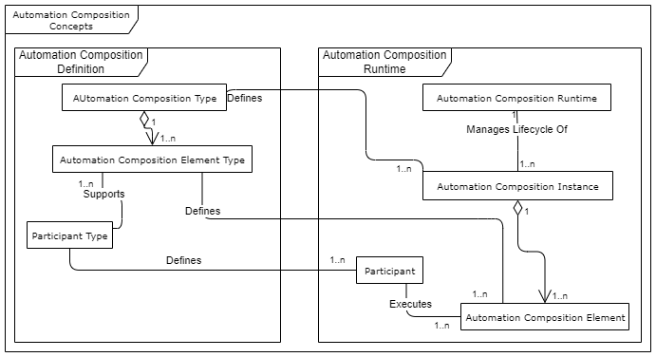
rApps and ACM (Automation Composition Mgmt.)
An ‘App’ is a ‘bundle of stuff’ composed together, not just a micro-service.
ONAP ACM-R is a manager that life-cycle manages a bundle of other parts/stuff (a single 'Composition') together, rather than a user managing the parts individually.
It takes a particular format of package to describe/package all the parts as a single 'Automation Composition’.
Here 'parts' are called 'Automation Composition Elements' and can be microservices, workflows, helm charts (services, configurations, etc ...)
Each 'Automation Composition Elements' type requires a plug-in (ACM 'Participant’) to handle parts of that type in each composition
ACM Runtime delegates/orchestrates support for each 'Automation Composition Element' to appropriate participant.
rApp == 'Automation Composition’
rApp may have 0...n microservice, and 0..n other 'AC Elements'

Slide 5
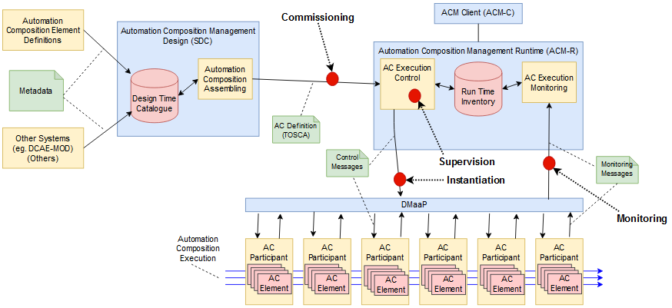
ONAP ACM Architecture
ONAP ACM: https://wiki.onap.org/display/DW/Automation+Composition+Management%3A+Architecture+and+Design

Slide 6
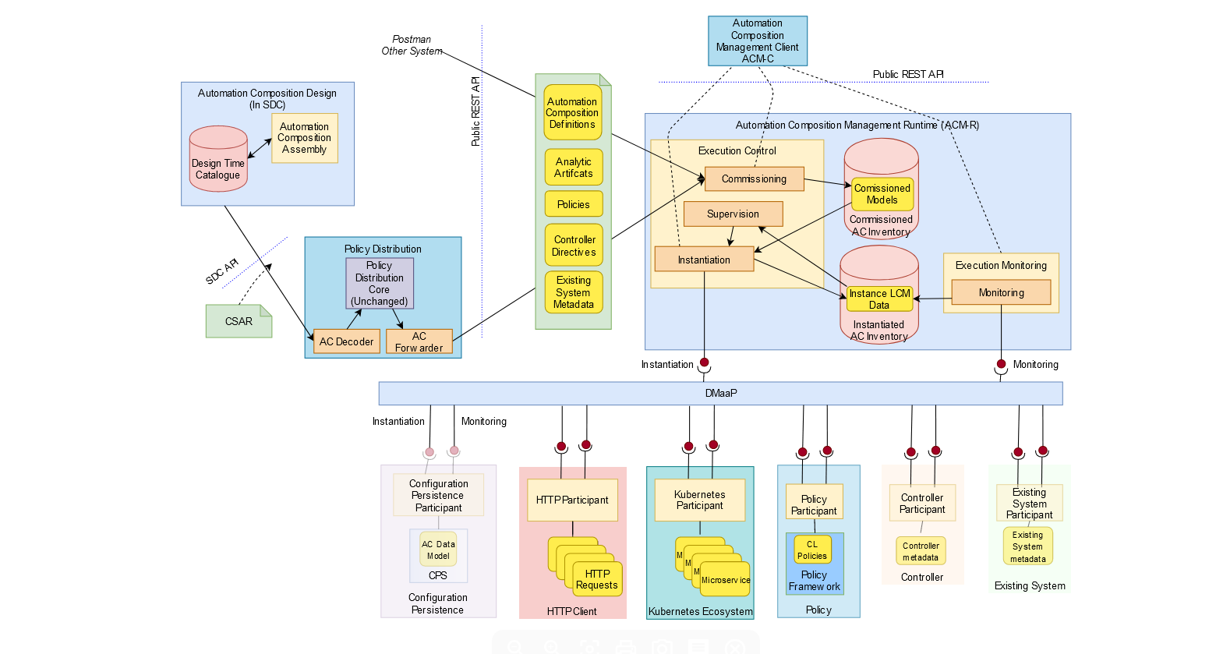
ONAP ACM Architecture
AC Defn. Package (tbc)
Instantiated CL Element
Instantiated CL Element
Instantiated CL Element
Instantiated CL Element
Instantiated CL Element
‘Instantiated’ AC Element
ONAP ACM: https://wiki.onap.org/display/DW/Automation+Composition+Management%3A+Architecture+and+Design

Slide 7
ONAP ACM Architecture
AC Defn. (After Onboarding)
a
a
p
a
c
µ
p
p
µ
c
µ
µ
c
µ
µ
µ
a
c
p
c
µ
ONAP ACM: https://wiki.onap.org/display/DW/Automation+Composition+Management%3A+Architecture+and+Design

Slide 8
SME (Service Management and Exposure)
Provider
AEF
It is the provider of the service APIs and is also the service communication entry point of the service API to the API invokers. Provides access control, logging, charging, provides authentication and authorization support.
APF
It is responsible for the capability to publish the service API information of the API provider to the CAPIF core functions to enable the discovery of APIs by the API invoker.
AMF
It is the entity which registers and maintains registration information of the API provider domain functions.
Service Api
It is the list of API’s exposed by the provider.
Invoker
It is an entity which invokes the service API’s.

Slide 9
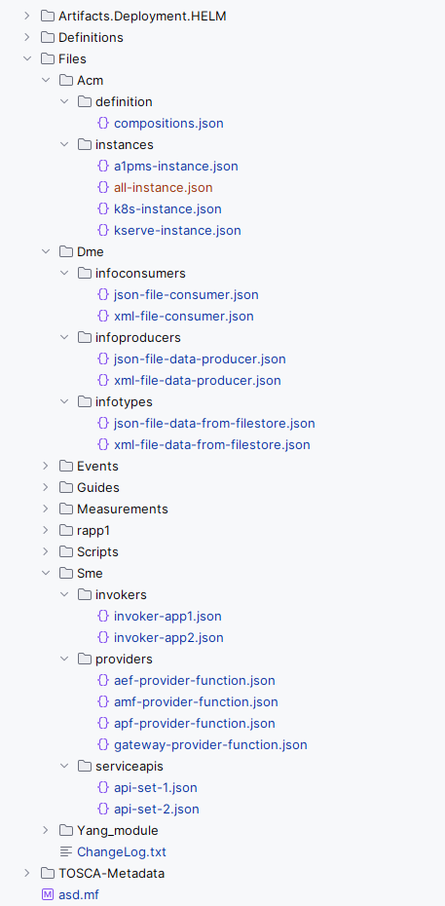
rApp Package Definition (This serves as a prototype and is prone to changes)

Slide 10
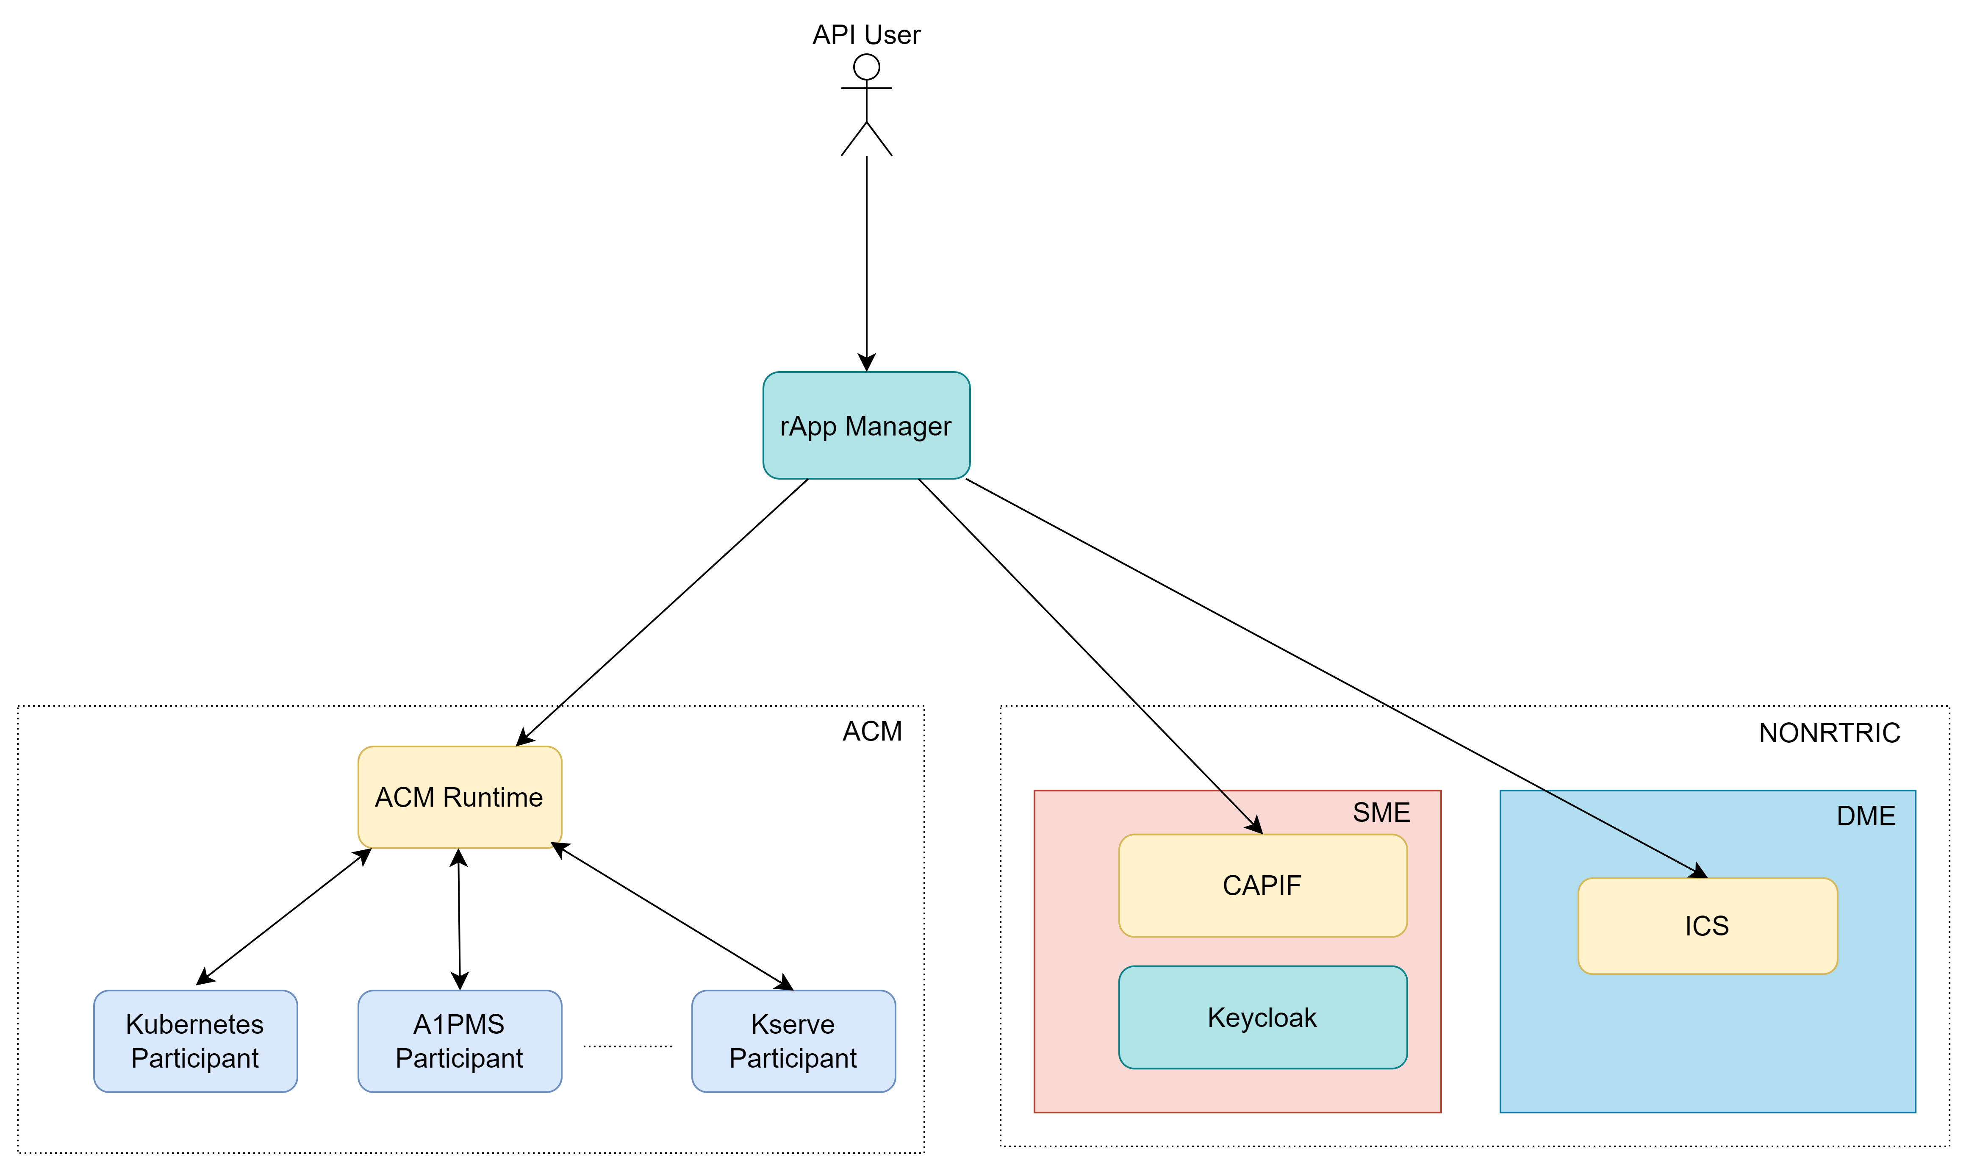
Architecture

Slide 11
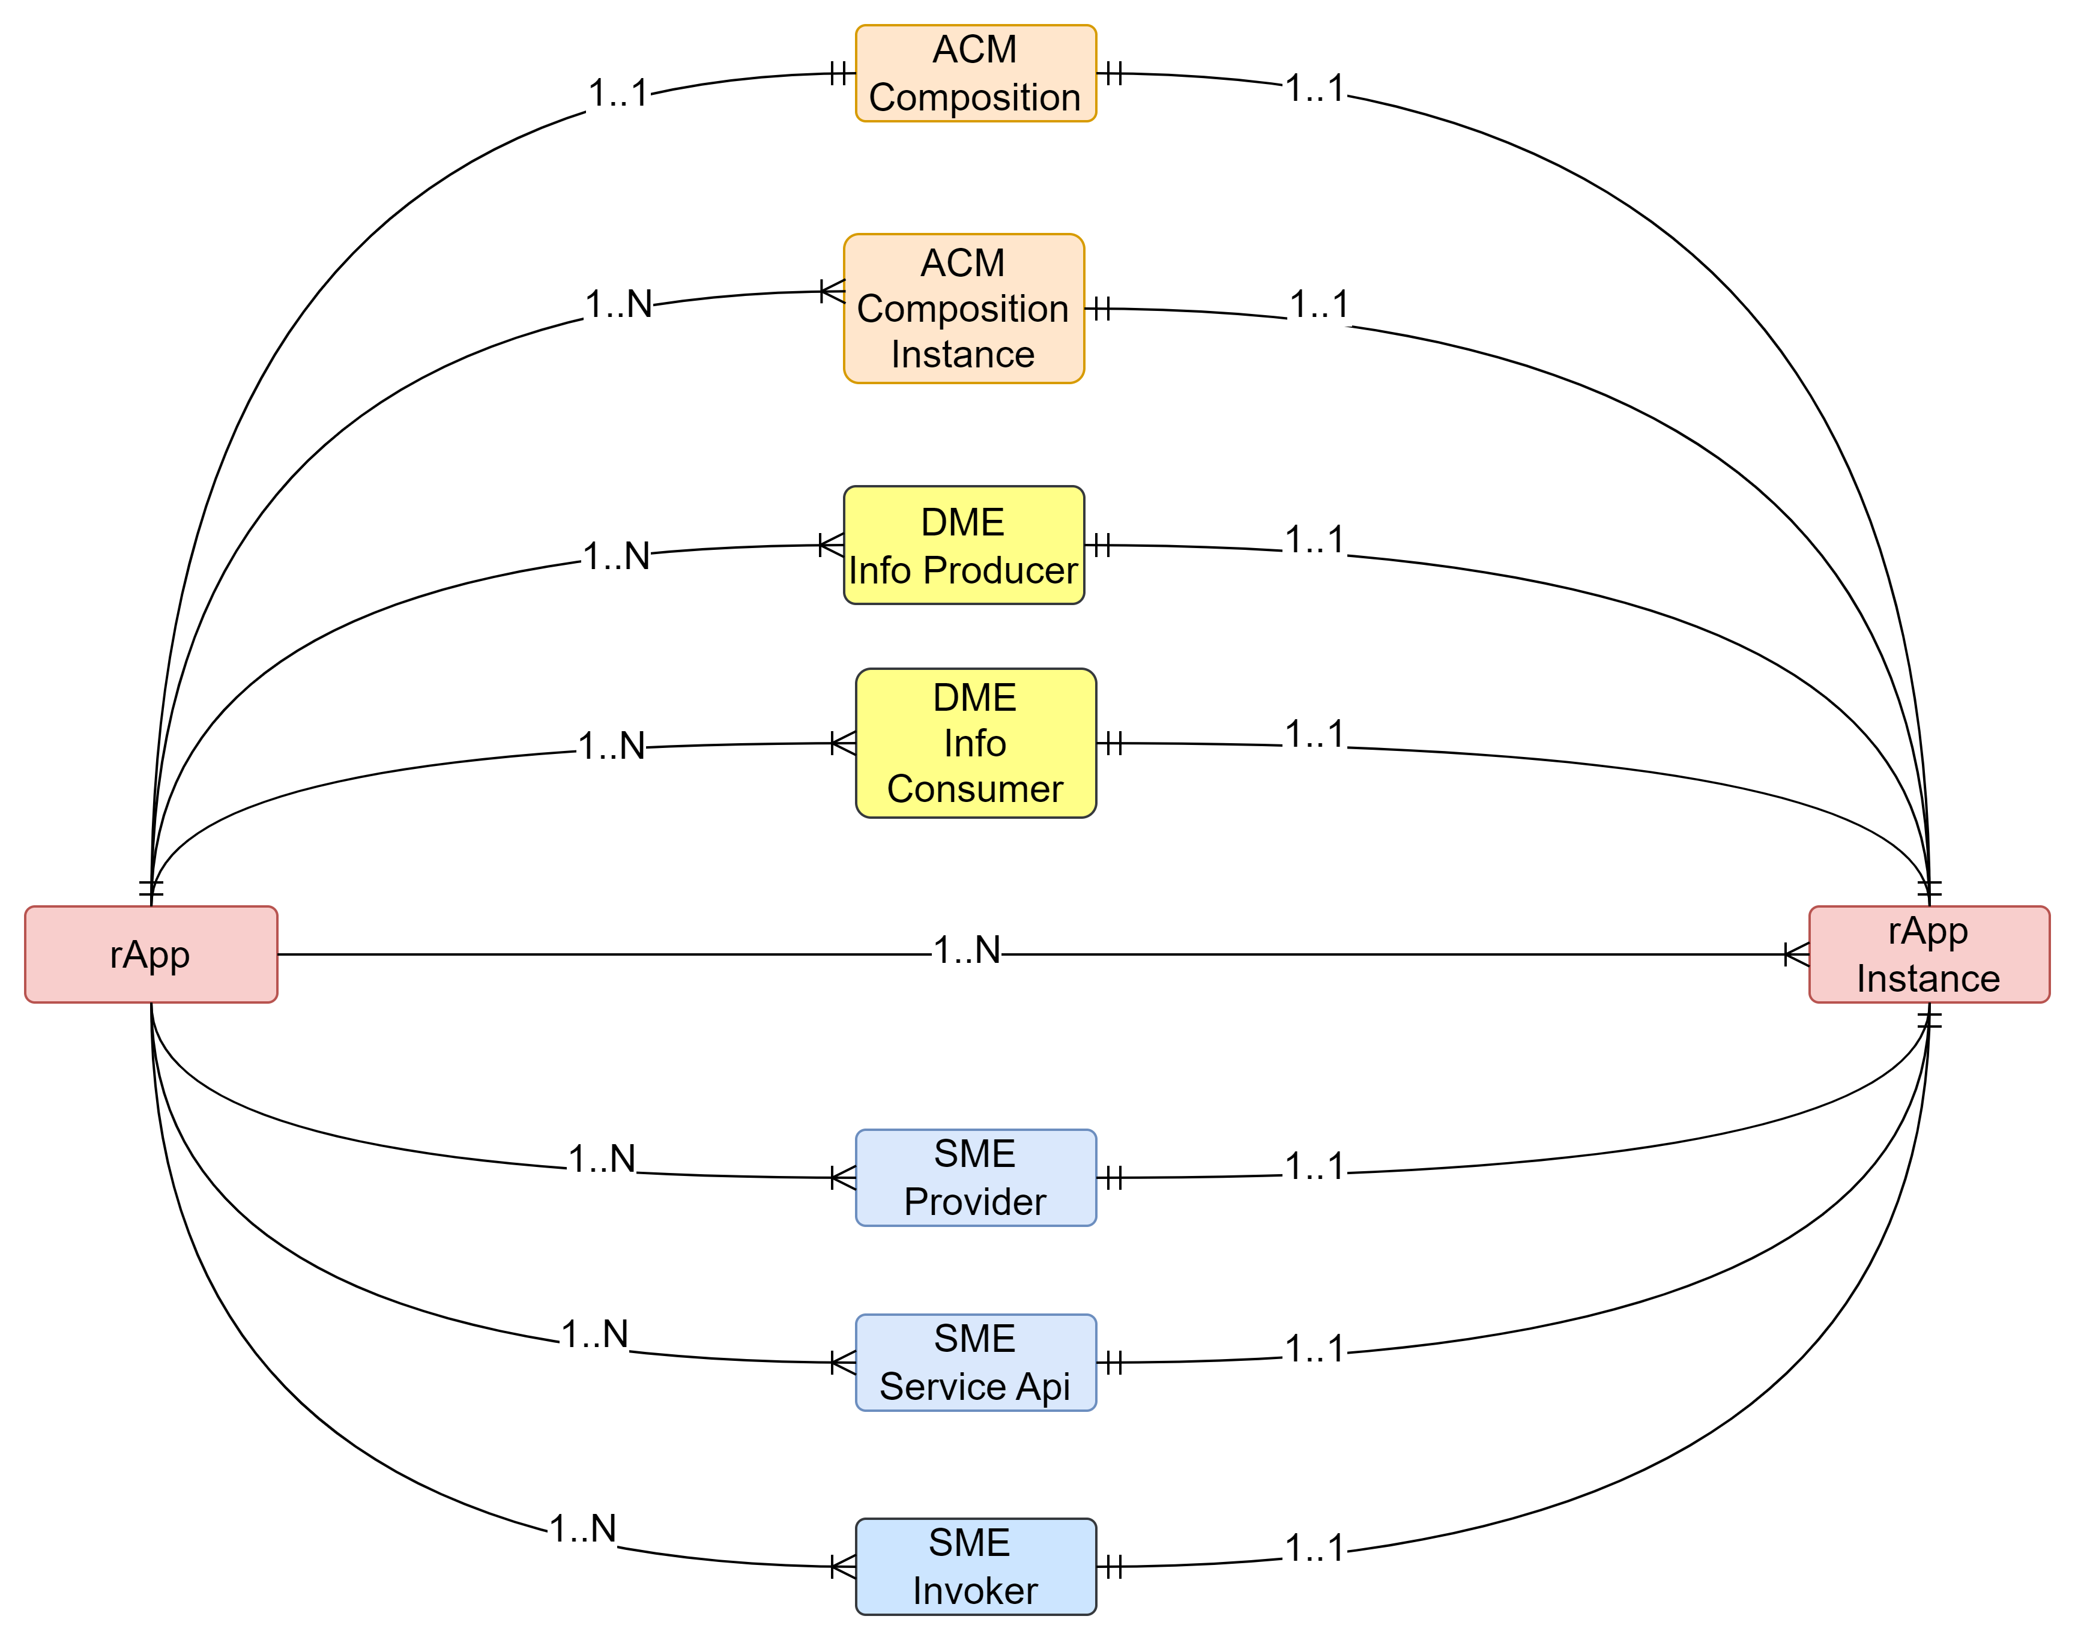
rApp
Entity
Relationship

Slide 12
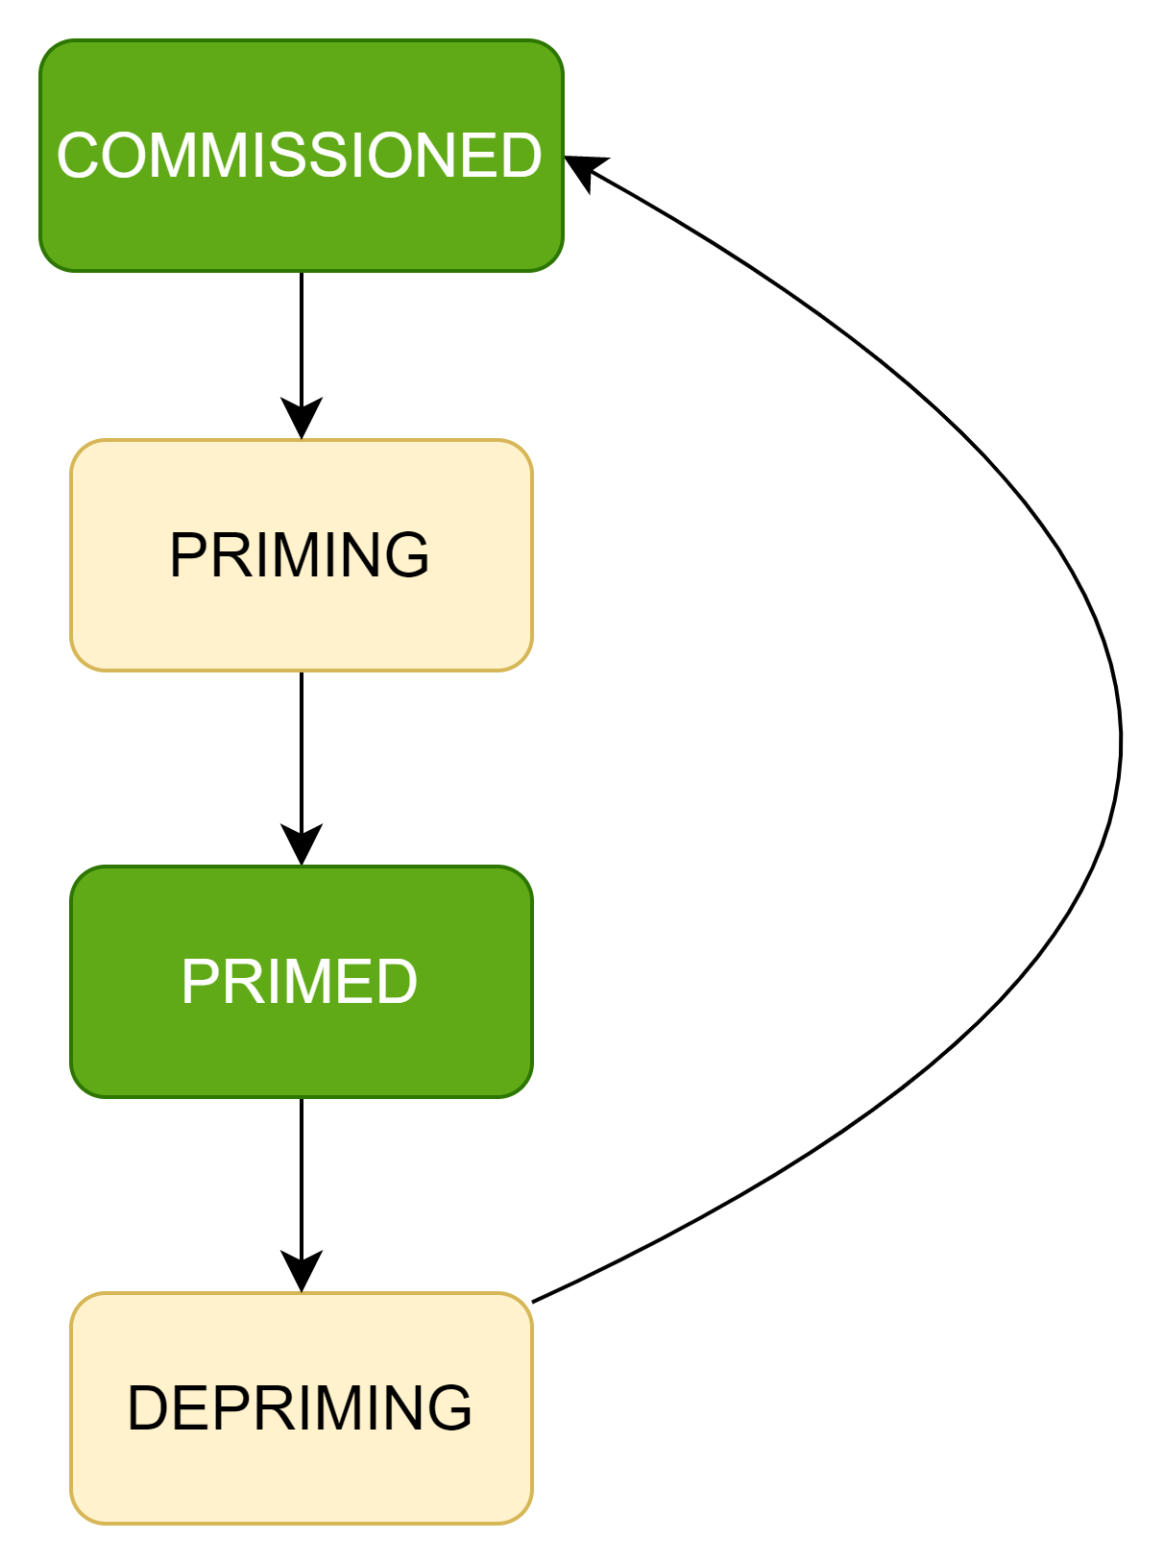
rApp States

Slide 13
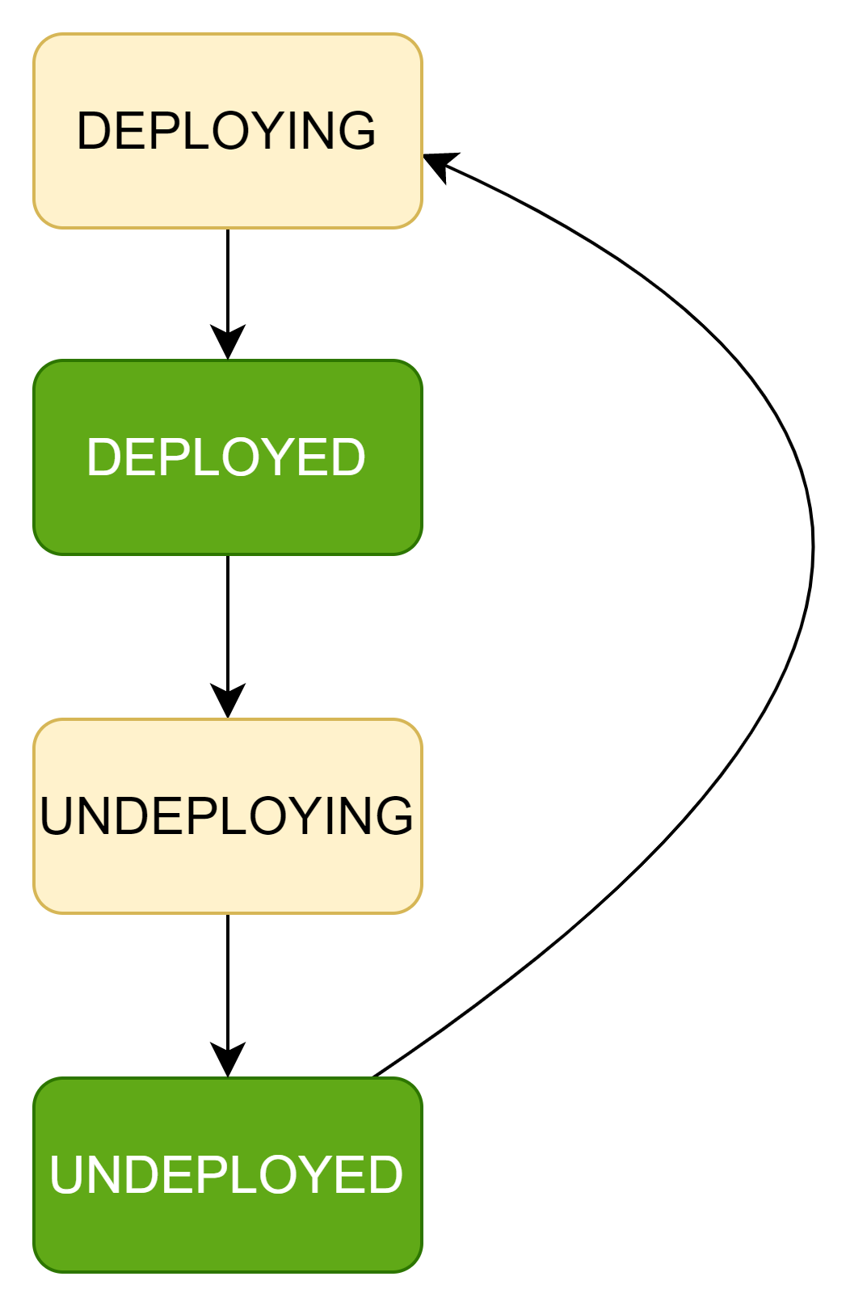
rApp Instance States

Slide 14
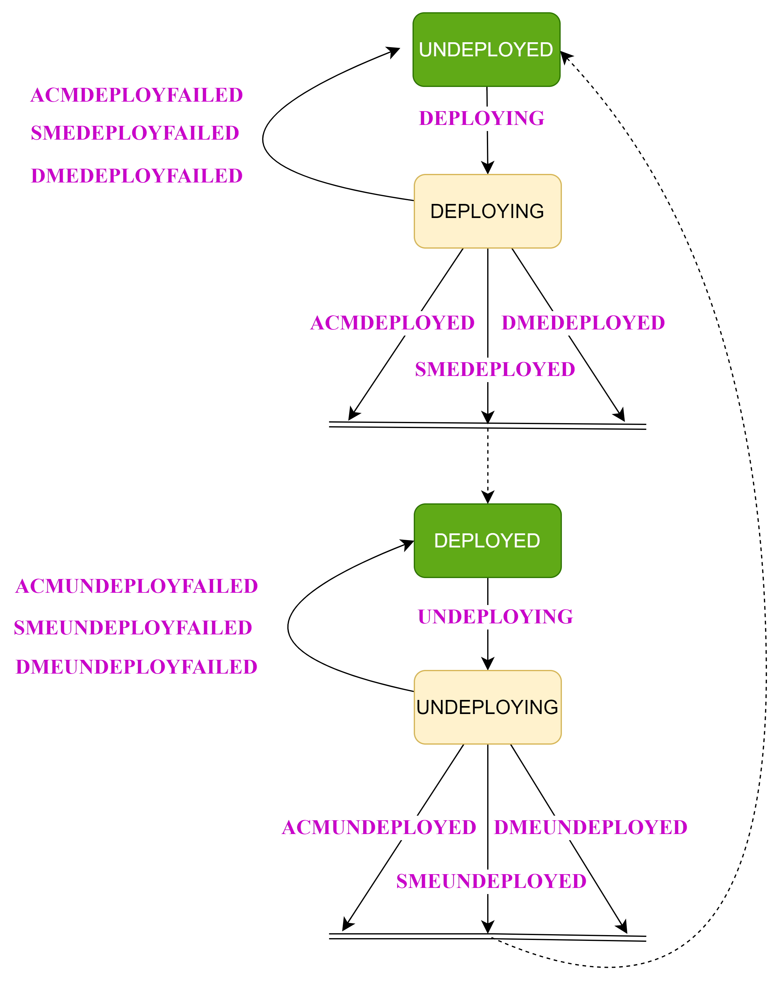
rApp Instance State Events (Internal)

Slide 15
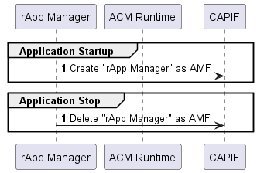
rApp Manager Lifecycle flow

Slide 16
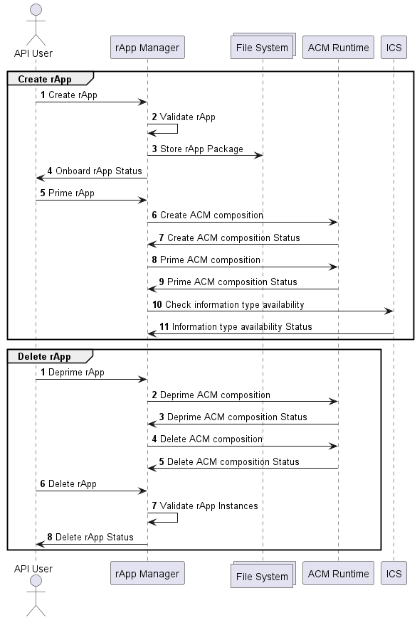
rApp flow

Slide 17
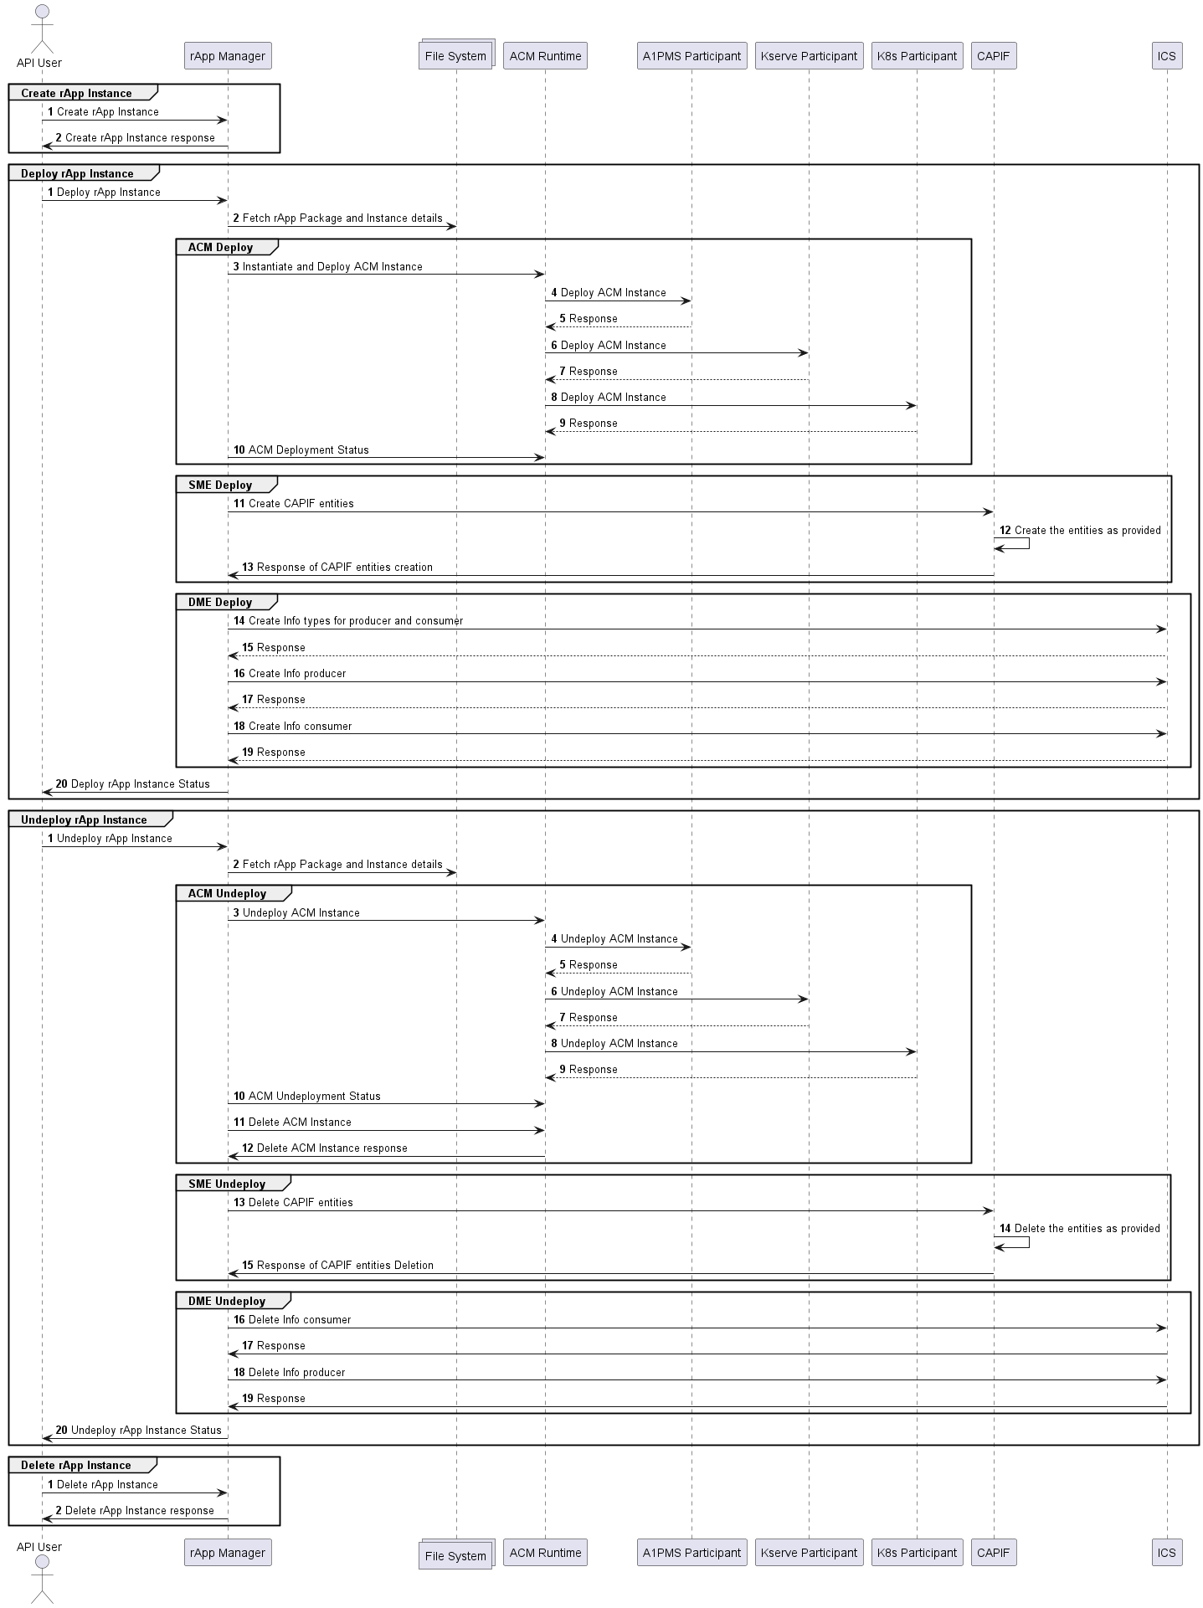
rApp Instance flow

Slide 18


