Slide 1

OSC NONRTRIC rApp Manager
NONRTRIC Team

Slide 2
rApp Manager
It manages the lifecycle of rApp.
Uses ONAP ACM as backend.
rApp definition sampled as ASD package.
ASD package contains the details required to create and integrate the required services/components.

Slide 3
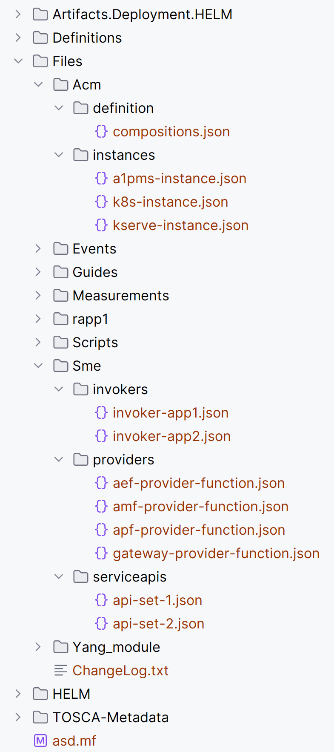
rApp Package Definition (This serves as a prototype and is prone to changes)

Slide 4
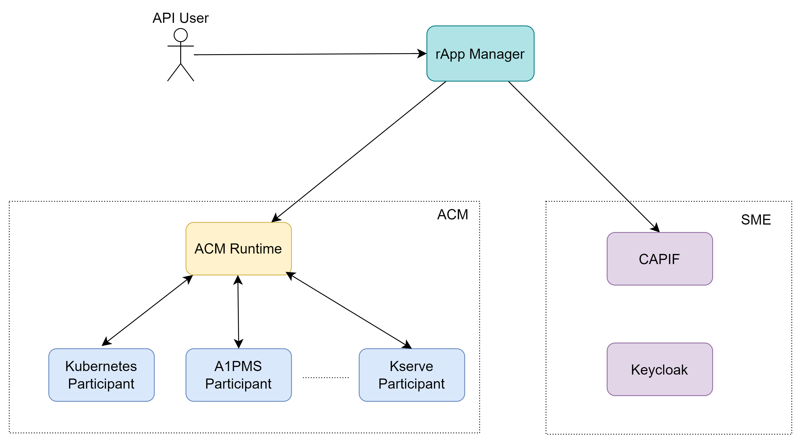
Architecture

Slide 5
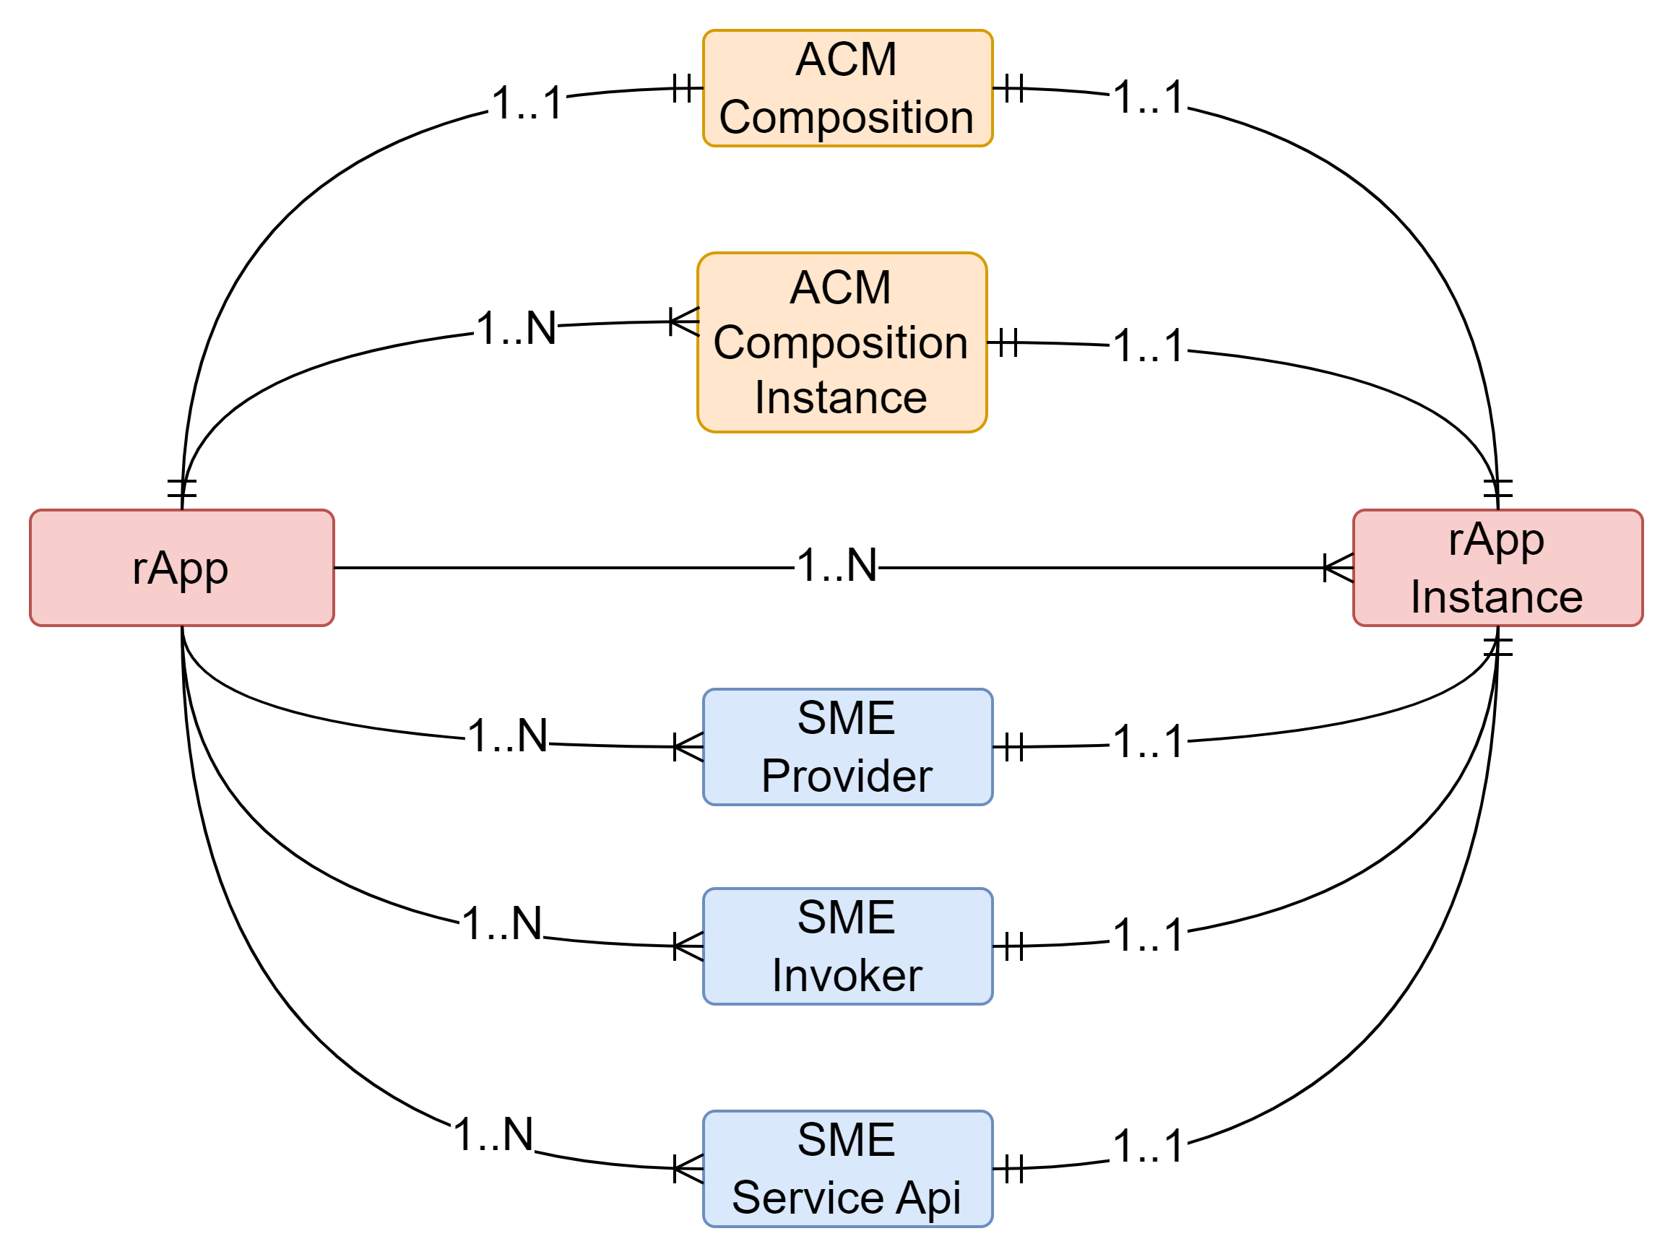
rApp
Entity
Relationship

Slide 6
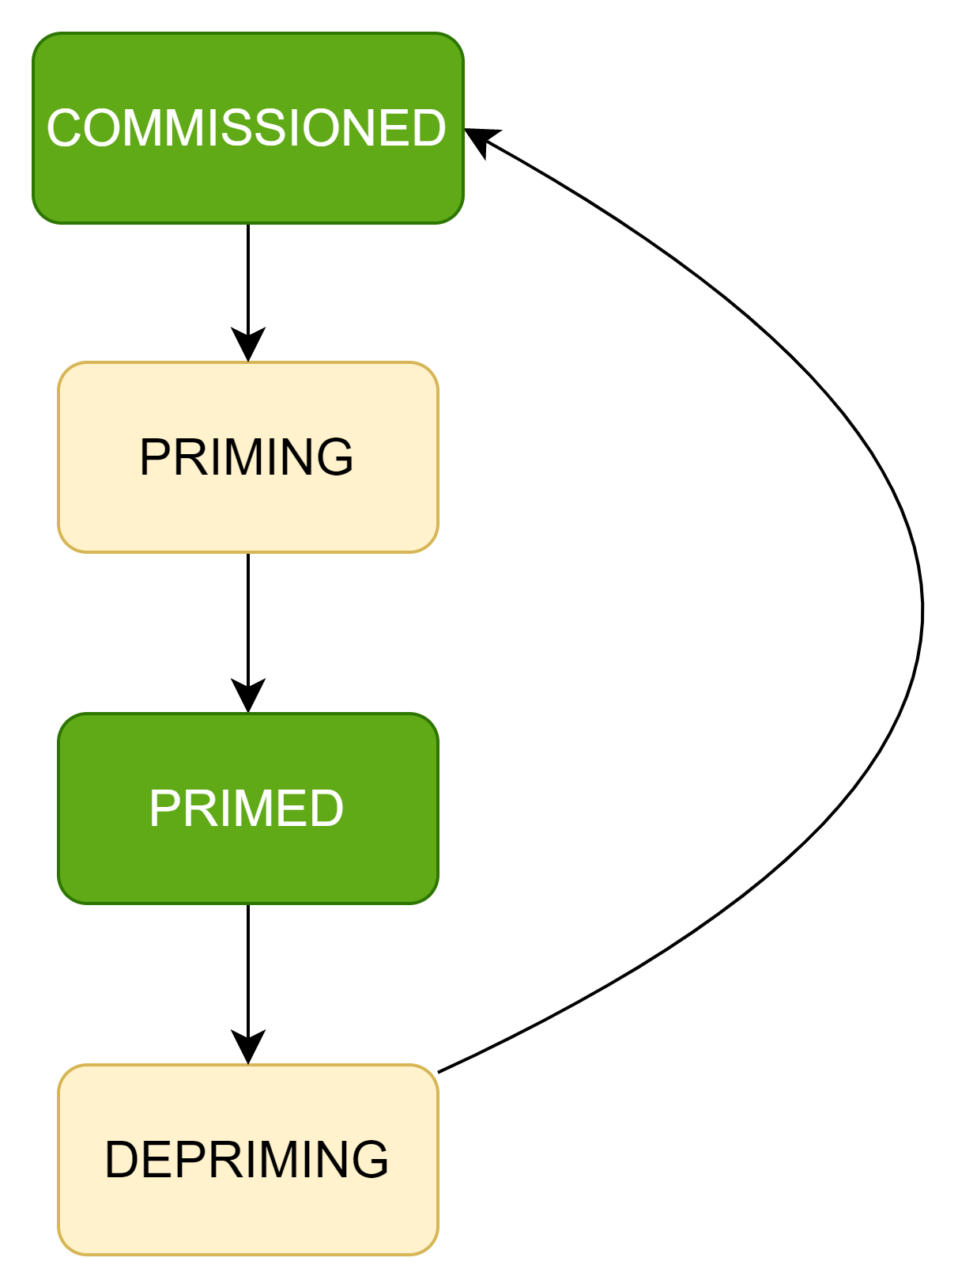
rApp States

Slide 7
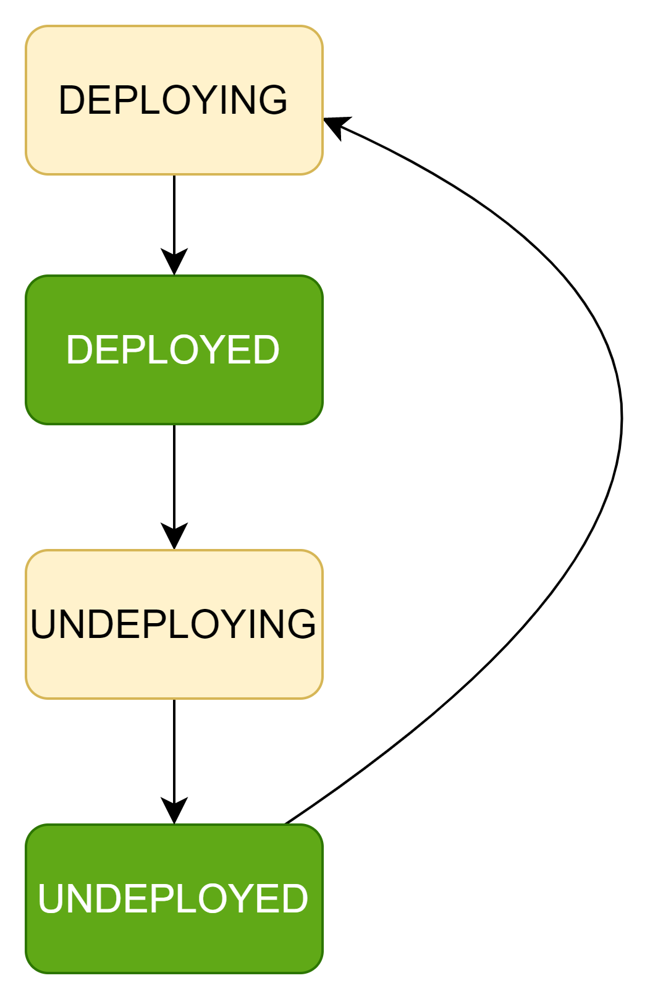
rApp Instance States

Slide 8
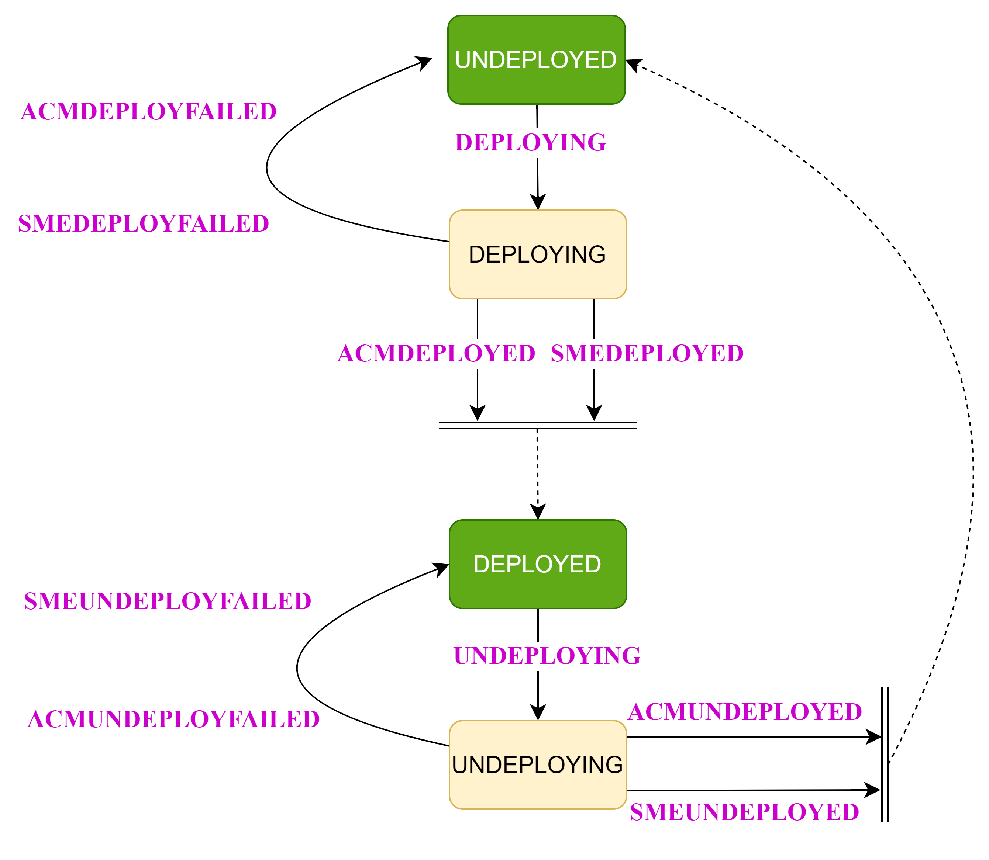
rApp Instance State Events (Internal)

Slide 9
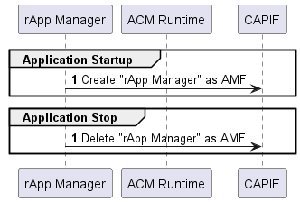
rApp Manager Lifecycle flow

Slide 10
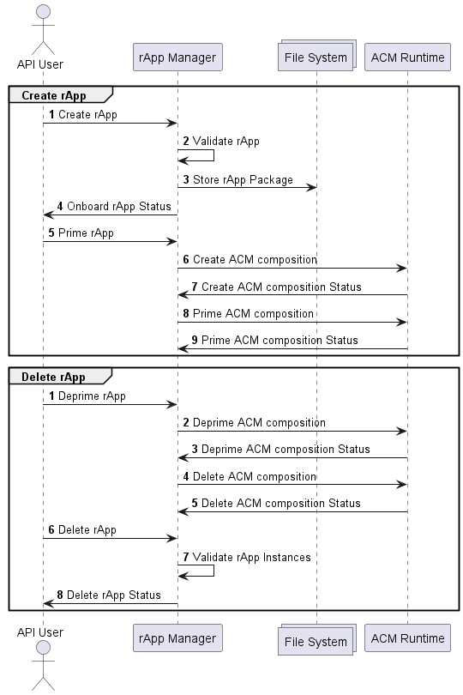
rApp flow

Slide 11
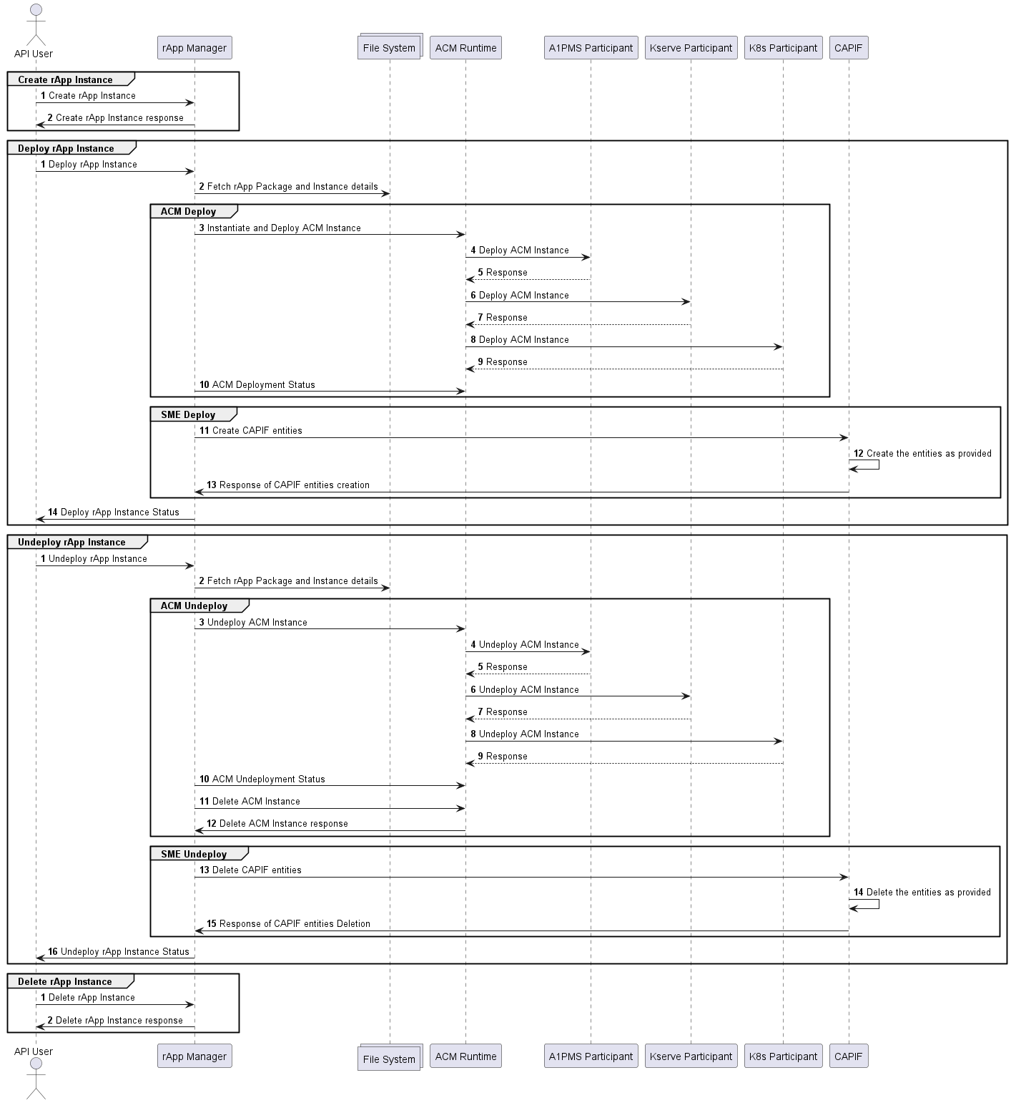
rApp Instance flow

Slide 12
Assumptions
Each ASD packaging contains only one Rapp.
One Rapp can have any number of ACM instances
ASD package do not contain any kubeconfig file.
ASD package contains the ACM instantiation configuration (Yaml).
ACM definition get lifecycle managed during start/stop of the application.
Rapp Manager gets registered as AMF and lifecycle managed as part of start/stop of the application.
ASD package contains the SME Provider/Service API/Invoker definitions.

Slide 13
Assumptions…
ASD package need to have one ACM composition definition.
Rapp can have any number of Rapp Instances.
Rapp Instance can have one resource of each of the following,
ACM instance
SME Provider domain
SME Service API
SME Invoker

Slide 14


