Slide 1
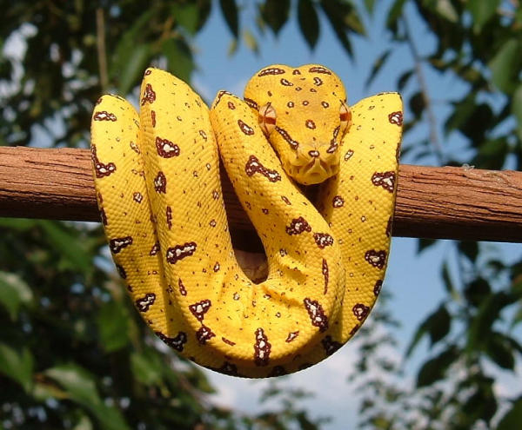
  Measurement Equations, MeqTrees,
  Simulation, Calibration,
  LOFAR, SKA,
  & Who Flagged Away All The UFOs?
Oleg Smirnov
(NWO/ASTRON) smirnov@astron.nl

Slide 2
The Measurement Equation
The M.E. in all its glory:
“Understanding radio polarimetry. Part I: Mathematical Formalism” (J.P. Hamaker, R.J. Sault and J.D. Bregman),
A&A Suppl., 137, 137-147
“Part IV: The full-coherency analogue of scalar self-calibration: Self-alignment, dynamic range and polarimetric fidelity.” (J.P. Hamaker), A&A Suppl., 143, 515-534
See also http://www.astron.nl/~hamaker.
...is actually much simpler!

Slide 3
The Measurement Equation:
Putting The “Meq” Into MeqTrees
The Measurement Equation tells you what you can expect to observe with an interferometer, given a sky and the properties of your instrument.
Absolutely crucial for simulating and calibrating the next generation of radio telescopes; everything literally revolves around it.
Like most great things, is actually rather obvious.

Slide 4
A Wafer-Thin Slice of Physics:
EM Field Propagation

Slide 5
A Wafer-Thin Slice of Physics:
Jones Matrices

Slide 6
A Wafer-Thin Slice of Physics:
Correlations & Visibilities

Slide 7
A Wafer-Thin Slice of Physics:
The M.E. Emerges

Slide 8
And That's The Measurement Equation!
Or in more pragmatic terms:
NB: it is also possible to write the ME with a circular polarization basis (RR, LL, etc.) We'll use linear polarization throughout.

Slide 9
You Already Know All This...

Slide 10
Why Is This Great?
A complete and mathematically elegant framework for describing all kinds of signal propagation effects.
...including those at the antenna, e.g.:
  beam pattern & receiver gain
  dipole rotation
  receptor cross-leakage
Applies with equal ease to heterogeneous arrays, by using different Jones chains.
Effortlessly incorporates polarization:
  think in terms of a B matrix and never worry about polarization again.

Slide 11

The Classical Approach
To Polarization Calibration

Slide 12

Polarization: Self-Calibration vs. Self-Preservation
(With thanks to Huib Jan van Langevelde)

Slide 13
Why Is This Even Greater?
Most effects have a very simple Jones representation:

Slide 14
The ME In Software?
Traditional packages (AIPS, Miriad, NEWSTAR, etc.): some implicit form of the ME
  all sorts of assumptions built in, but has served existing instruments rather well
AIPS++: explicitly implements a fixed form of the ME
  nice try, but still too specific to support future instruments
MeqTrees: build your own ME!

Slide 15
“Trees” = Expression Trees
Any mathematical expression can be represented by a tree.
b
x
b
x
b
x
c
y
*
*
1
+
α
sin
*

Slide 16
A Measurement Equation Tree
subtree for Kq
subtree for Gq
I
Q
U
V
(lmn)
(uvw)p
subtree for B
subtree for Kp
Kp: ...
Kp: ...
Kp: ...
Kp: ...
Kp: ...
Kq: ...
Gq: ...
subtree for Gp
B: ...
Kp: ...
K†q:
ConjTranspose
G†q:
ConjTranspose
Gp: ...
Vpq: MatrixMultiply
...and repeat for all baselines.

Slide 17
Growing MeqTrees
The structure of a tree is declared using TDL (Tree Definition Language), which is built on top of Python
Trees are executed by a C++-based computing kernel
  fast (...within x2 of hand-optimized code)
  multithreaded
  soon to be distributed via MPI
# now define predicted visibilities
for p,q in IFRS:
ns.predict(p,q) << Meq.MatrixMultiply(ns.G(p),ns.K(p),ns.B,ns.Kt(q),ns.Gt(q));

Slide 18
Functions Everywhere...
Everything in MeqTrees can be defined as a function of something else
  e.g., frequency, time, l, m, u, v, ...
  a constant value is just a special case...
  dimensions are propagated automatically: a(t)+b(ν) = c(t,ν)
Everything can be visualized, including any intermediate results
First demo – ionospheric TEC

Slide 19
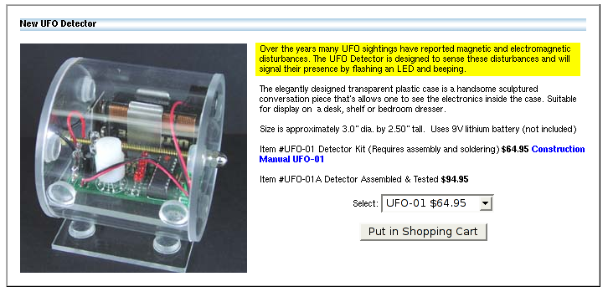
What's Big, Round & Shiny,
And Has l(t),m(t)?
If we were to track a UFO with a radio interferometer, what would we see?

Slide 20
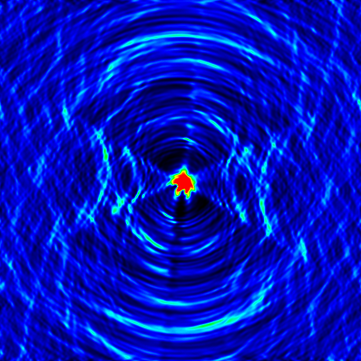
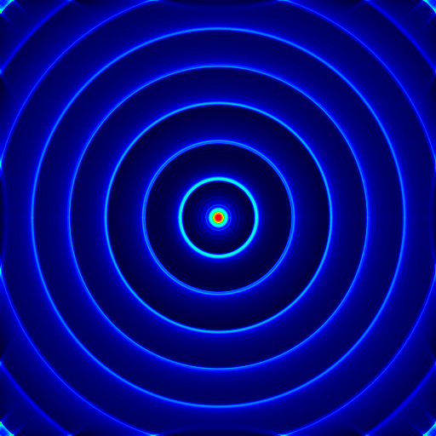
UFOs Over VLA & WSRT
Each frame of the animation corresponds to a full (8- or 12-hour) observation of a UFO. UFO speed increases with each frame.

Slide 21
Why We DON'T
See Any UFOs...
If we were to track a UFO with a radio interferometer, what would we see?
...probably nothing, given a good enough flagger.

Slide 22

Other Things That Move:
The Joys Of LOFAR
MeqTree simulation:
9 point sources on a grid
...corrupted by the model ionosphere from a previous demo
  sine/cosine TEC distribution, amplitude of TEC “waves” increases in time
animation composed of snapshot images
5'

Slide 23

A Self-Calibrated Ionosphere
Let's assume we can selfcal this perfectly...
We still have only one phase term per antenna, so we can only correct for phase at center.
This is the previous simulation, with the center phases divided out (2 lines of Python).
Relative movement is due to phase differences over the field of view.
This is a problem...
5'

Slide 24
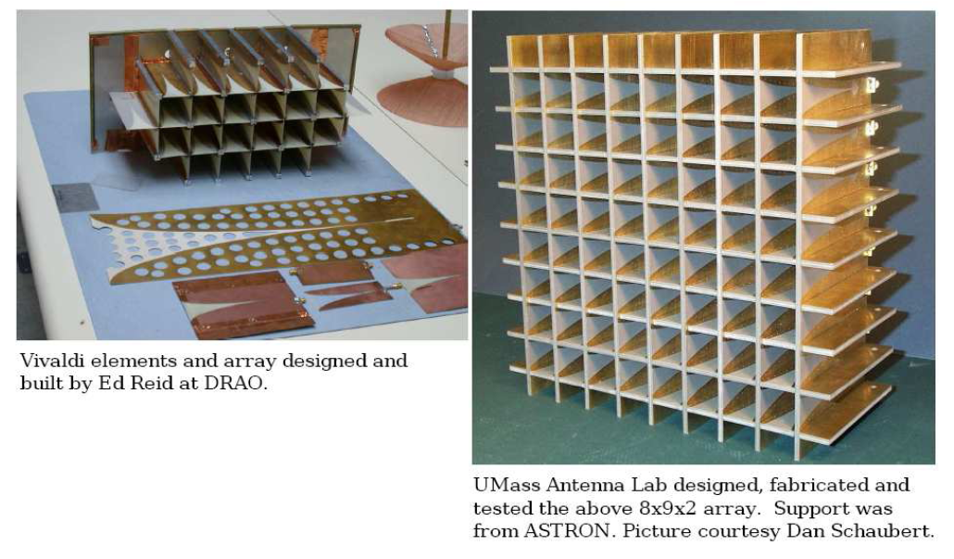
Vivaldi FPA Simulations
(Tony Willis, DRAO/NRC)

Slide 25
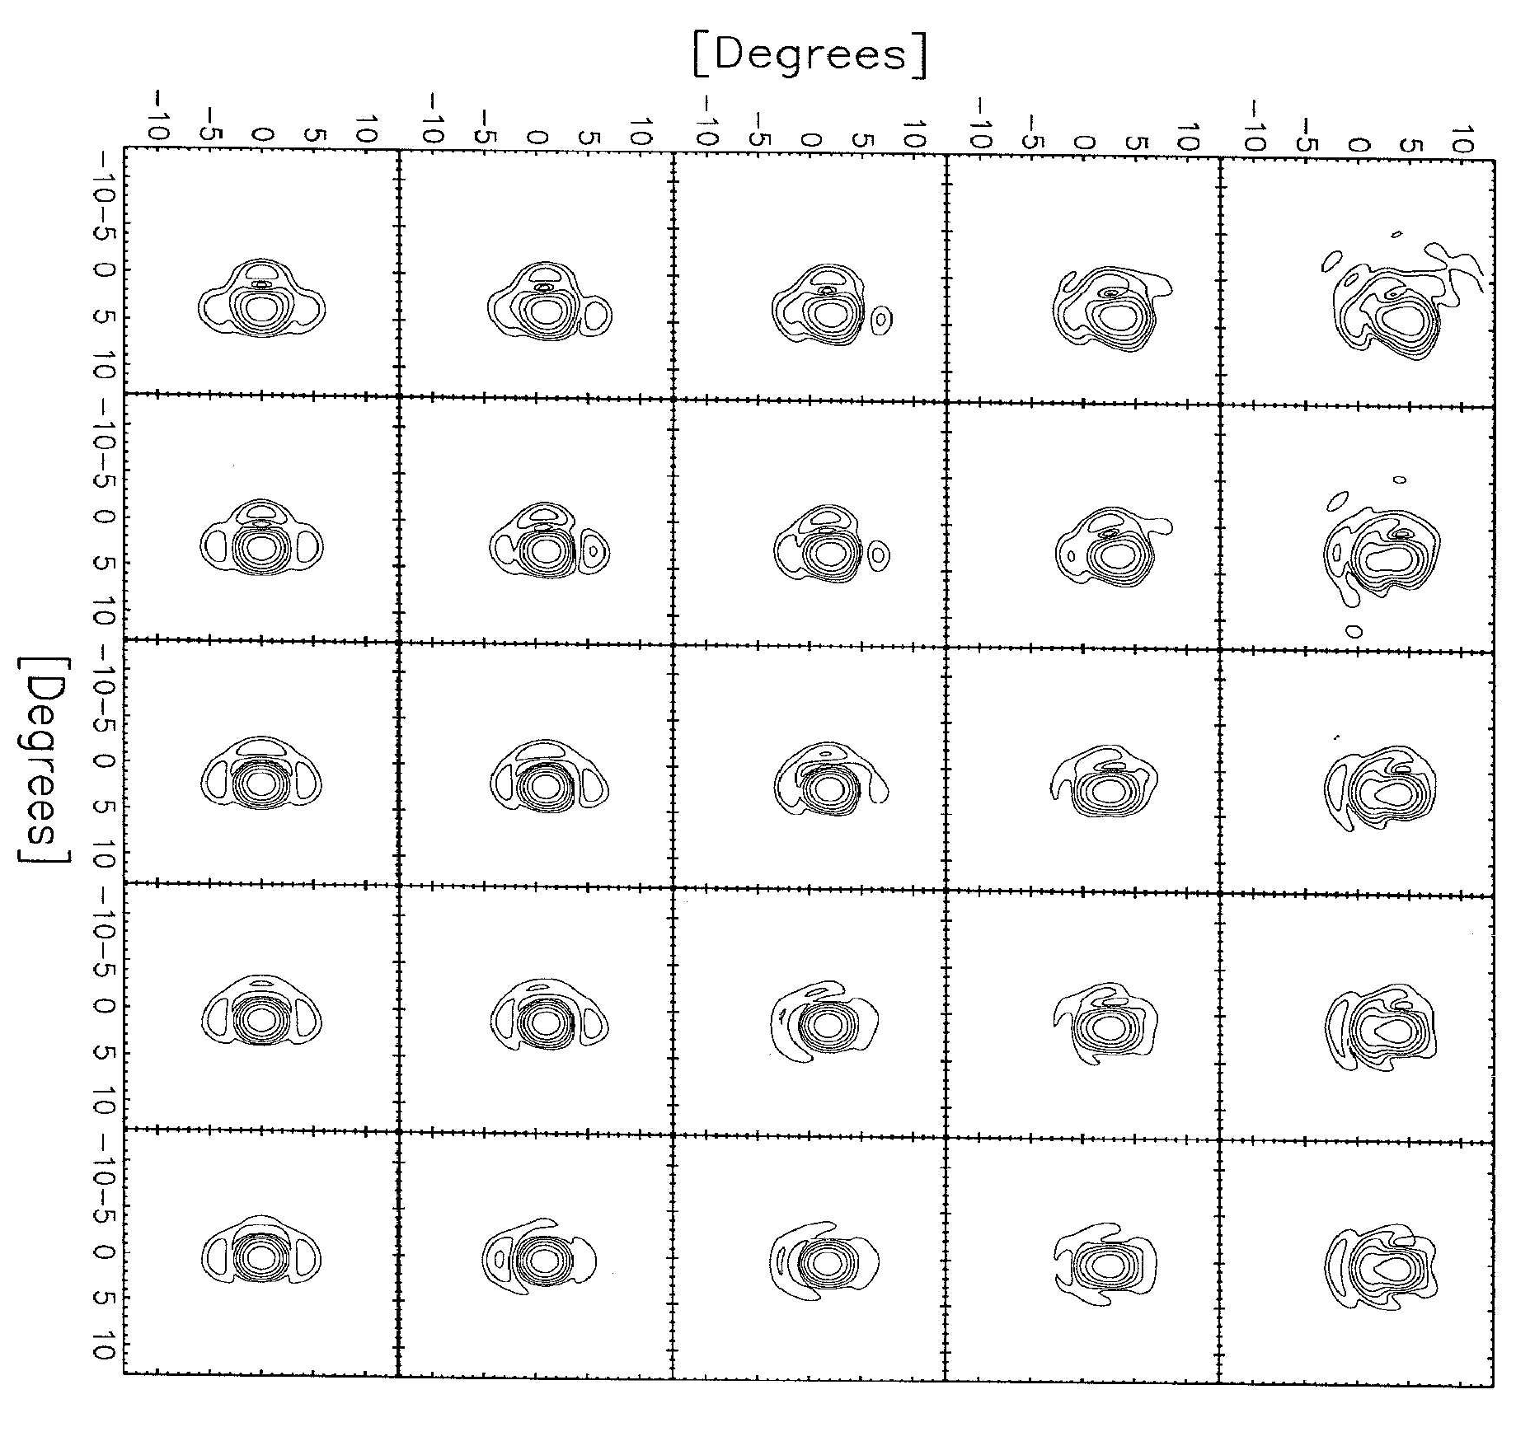
Beams Of Individual Vivaldi Elements (GRASP8 sim)
GRASP8 is an antenna simulations package
Used to computed the beam patterns of every element (W. Brisken, EVLA Memo 69)
  no feed legs...
Beam patterns written out as FITS files
...and can be imported into MeqTrees

Slide 26
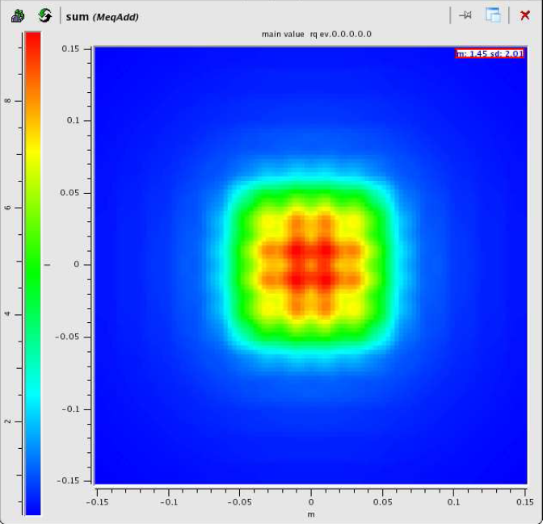
FPA Sky Coverage
(MeqTree simulation)
Simply adding up all the beam patterns gives us an indication of the sky coverage available to the FPA.
We can do beamforming within a ±9 degree region.

Slide 27
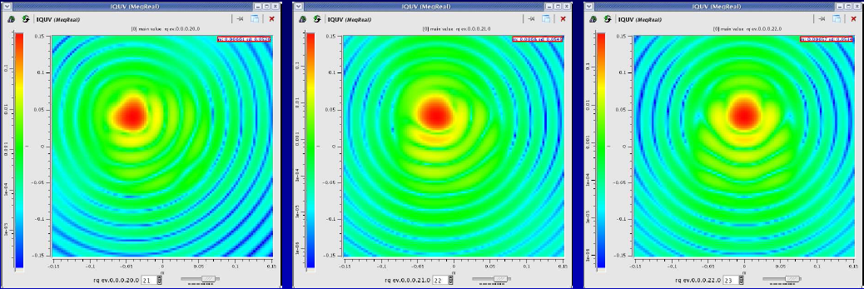
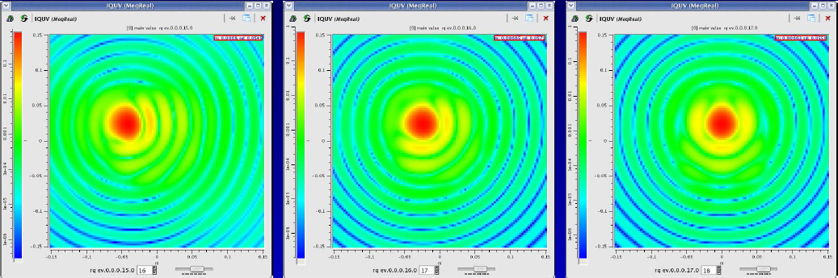
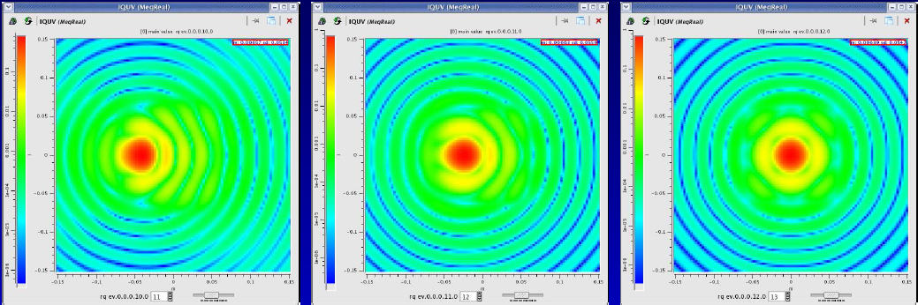
Naïve Beamforming:
Phase Conjugate Weighting
Phase conjugate weighting maximizes beam gain in a particular direction.
We use MeqTrees to simulate this.
Resulting beams have very high sidelobes, and an increasingly nasty shape as we go off-center.

Slide 28
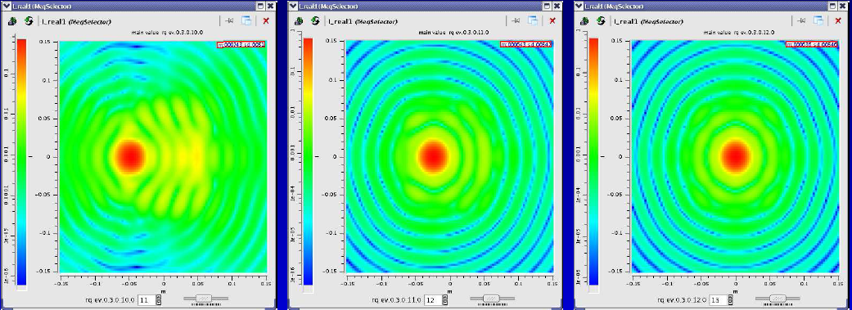
Clever Beamforming:
Optimizing For Beam Shape
Top row: phase-conjugate beamforming
Bottom row: weights optimized to fit a gaussian beam

Slide 29
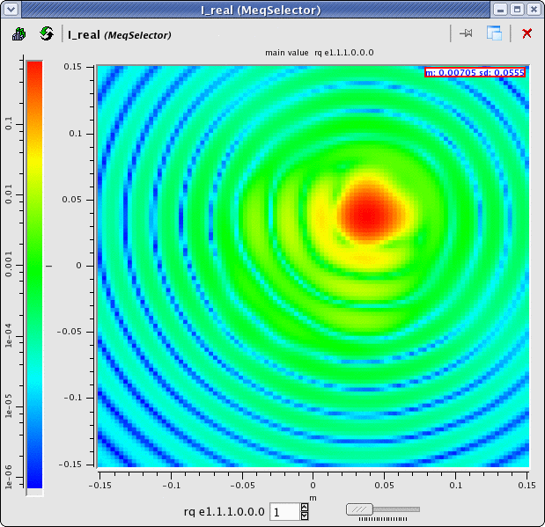
Optimization & Solving
In MeqTrees
Any given tree represents a model with parameters.
You can declare an arbitrary subset of the parameters as solvable.
A special “Solver” node then attempts an LSQ fit of the model to something else (to data, to an ideal model, etc.)
Here, we make the beamformer weights solvable, and try to fit a perfect (gaussian) beam.

Slide 30
Selfcal As An
Optimization Problem
Traditional selfcal: build up a model of the sky+instrument, and fit it to the data
  limited by assumptions about the instrument
Selfcal in MeqTrees: build a measurement equation for the sky+instrument, and solve for its parameters
  model can accommodate any instrumental effect
  The ME provides an elegant mathematical framework for this
Primary development driver for MeqTrees

Slide 31
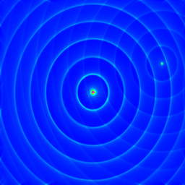
MeqTree Selfcal I:
WSRT 3C343 (Michiel Brentjens)
WSRT observation of 3C343, 1.2GHz
Left: dirty image, uncalibrated data
Field is dominated by two bright sources (3C343 and 3C343.1), making traditional selfcal difficult
We make a sky model with two point sources, and attempt to solve for parameters
3C343
3C343.1
colourmap range: 0~1.5 Jy

Slide 32
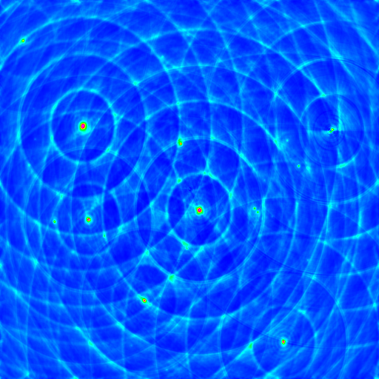
3C343 After Phase/Gain Solutions
Joint solution for two sources, with one complex gain per antenna
The two bright sources have been subtracted
Significant residual from off-center source, caused by gain/phase variations across the field
This is the best you can expect from traditional selfcal
3C343
3C343.1
colourmap range: 0~25 mJy

Slide 33
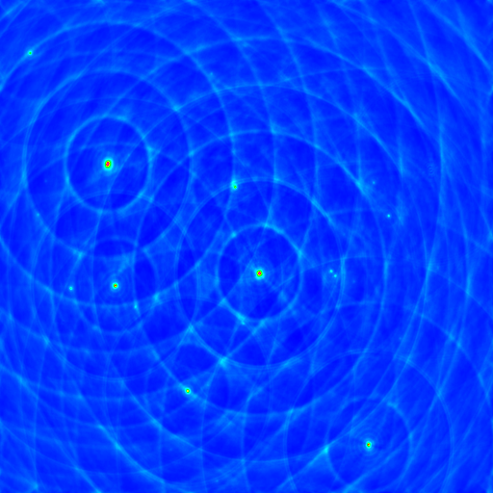
3C343 After Differential Phase/Gain Solutions
Solving for an individual phase/gain term for the off-center source eliminates it completely!
Now we can attempt to solve for the fainter sources
3C343
3C343.1
colourmap range: 0~25 mJy

Slide 34
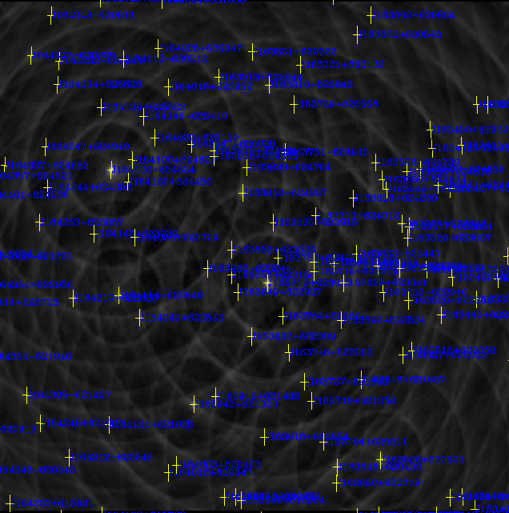
The Local Sky Model
(LSM)
An LSM is a database of sky sources, from which we can automatically build trees.
  developed for LOFAR calibration
This is an LSM for the 3C343 field (60 brightest sources), made from NVSS
We can now attempt to fit all the LSM sources to the observations
colourmap range: 0~25 mJy

Slide 35
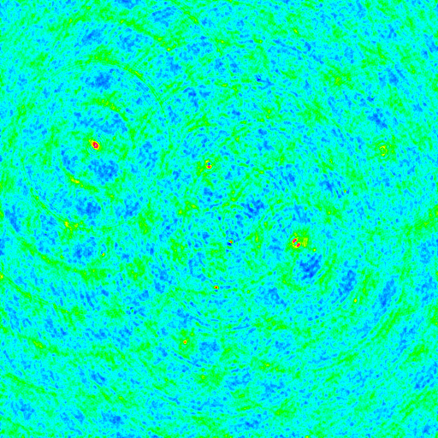
Residuals After
LSM Fitting
After fitting all LSM sources to the data, we subtract them out.
colourmap range: -1~2 mJy

Slide 36
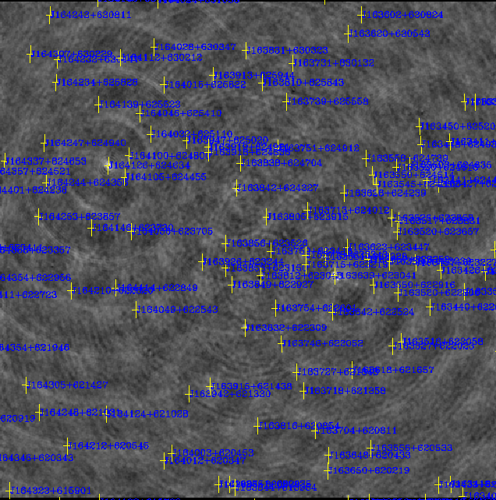
Residuals After
LSM Fitting, With Overlay
Residuals show some differences w.r.t. the NVSS, e.g.:
  incorrect positions
  extended sources
  double sources
colourmap range: -1~2 mJy

Slide 37
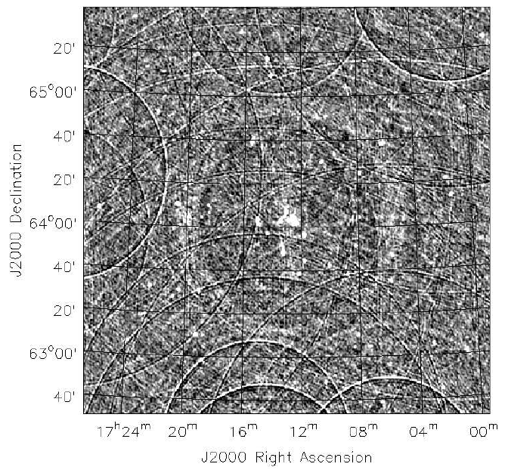
More WSRT Calibration:
Abel 2255 (Sarod Yatawatta)
Abel 2255 cluster, 12 hour × 6 day WSRT observation by Ger de Bruyn & Roberto Pizzo
Strong off-axis sources, complex structure in the center
Subtle off-axis artefacts

Slide 38
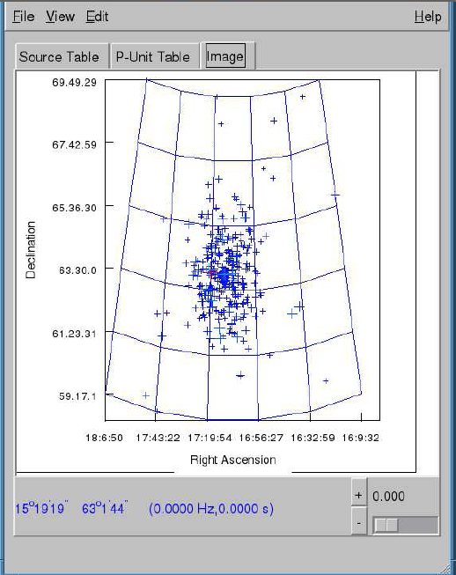
Abel 2255 LSM
Local Sky Model build from NEWSTAR .mdl file.
Contains ~800 sources and clean components

Slide 39
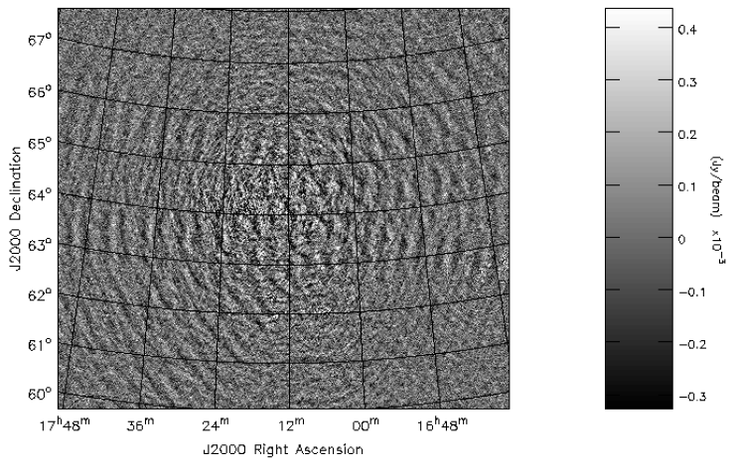
Abel 2255 Q Map,
Without Differential Solutions

Slide 40
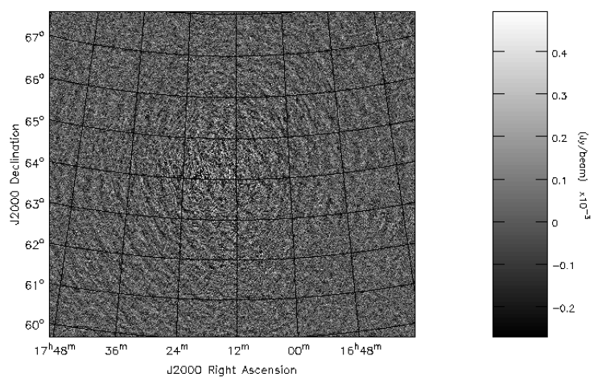
Abel 2255 Q Map,
With Differential Solutions

Slide 41
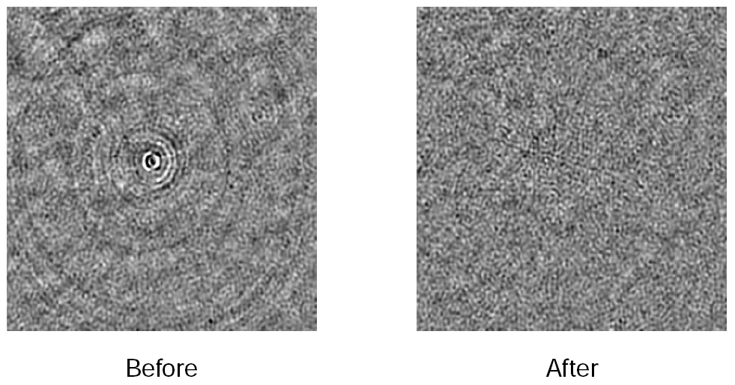
Close-Up: Before & After
Differential Solutions

Slide 42
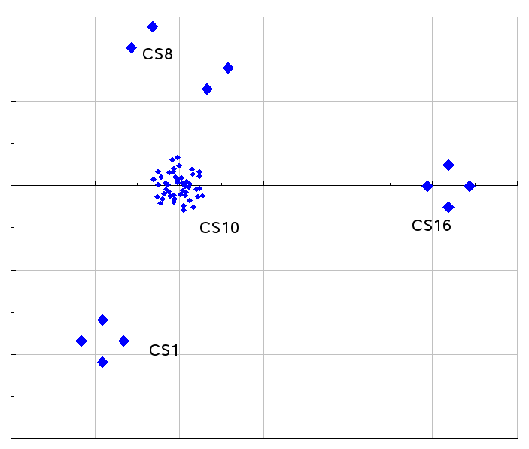
LOFAR CS1
96 dual-dipole antennas
Grouped in 4 clusters:
  1 x 48 dipoles
  3 x 16 dipoles
size ~ 500m
Various testing modes:
  single station
  4 stations
  24 “microstations” of 4 dipoles each

Slide 43
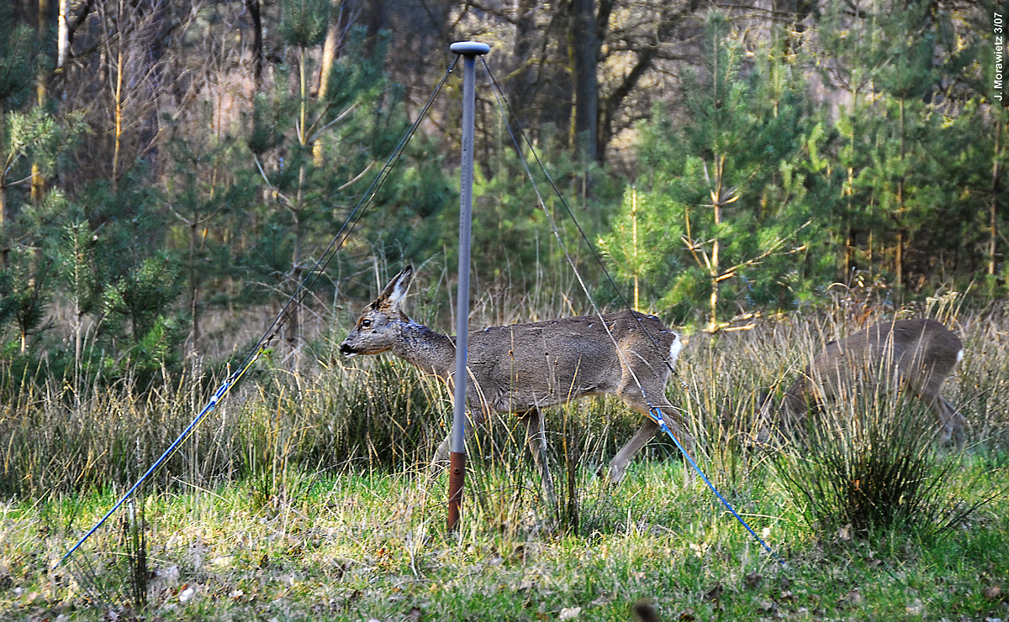
CS1 In Action
(photo: Juergen Morawietz)

Slide 44
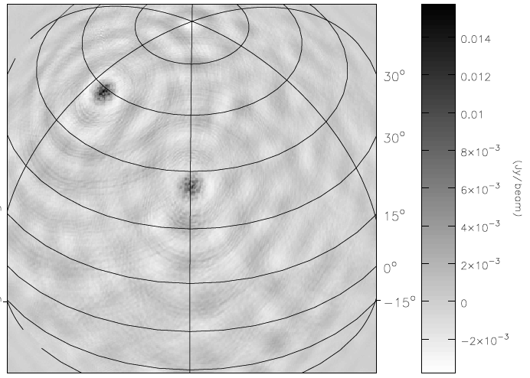
CS1: First Dirty Map
(Sarod Yatawatta)
All-sky image, observed data
CygA and CasA visible

Slide 45
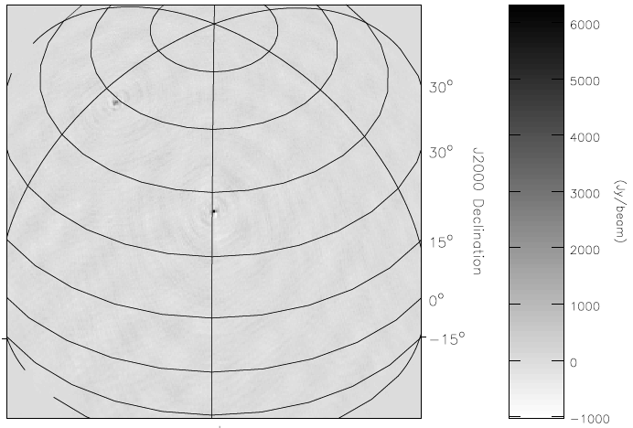
CS1: First Clean Map
(Sarod Yatawatta)
Cleaned & corrected with MeqTrees
Differential gains/phases for CygA and CasA
Correction applied in the direction of CygA

Slide 46
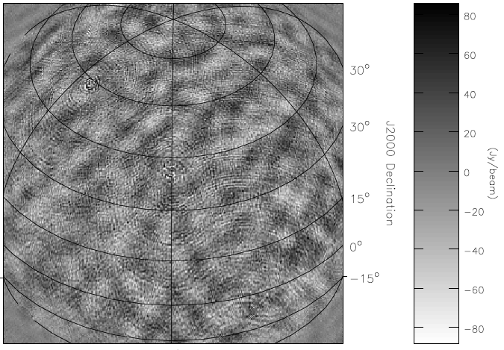
CS1: First Residual Map
(Sarod Yatawatta)
CasA, CygA subtracted

Slide 47
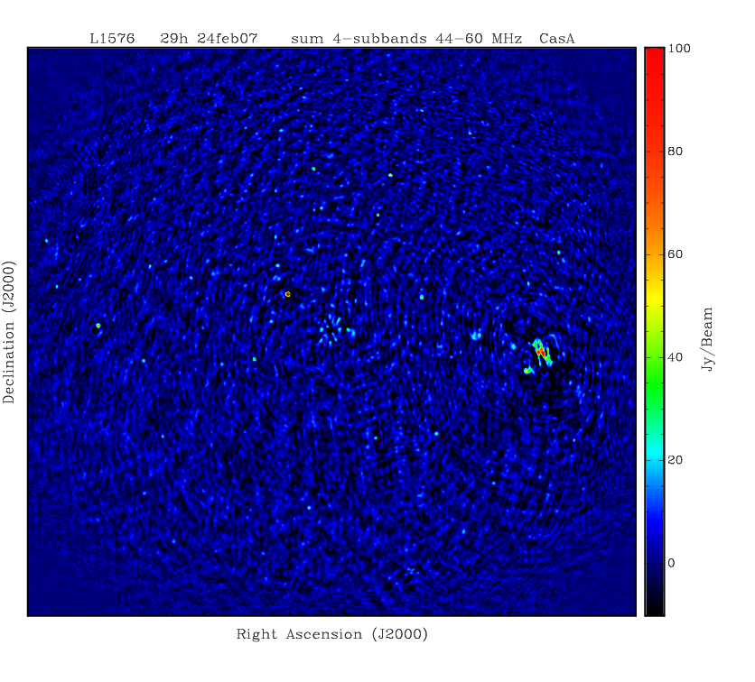
CS1, Latest Map
(Sarod Yatawatta)
29 hour observation
All-sky map
Sky model contains CasA and CygA, these have been calibrated for and subtracted
sum of 4 sub-bands
3C sources are now visible!

Slide 48
Calibrating The Ionosphere
Up till now we've been calibrating for “traditional” things like gains and phases (with a few twists)
For the simulated ionosphere here, we take a different approach:
5'
assume the 9 sources are known calibrators;
model the ionospheric TEC over the array as a whole, using a smooth function with a number of solvable parameters (aka a MIM: Minimum Ionospheric Model);
derive ionospheric phases in the directions of the calibrators;
fit this model to “observed” data, and solve for MIM parameters;
subtract bright calibrators in the uv-plane, using their “calibrated” phases, correct residuals for phase at center

Slide 49
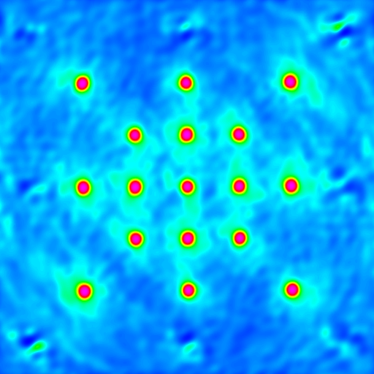
Residuals After Fitting a 2nd-Order MIM
The MIM here is a 2nd-order polynomial TEC distribution (in x and y)
The 9 1 Jy calibrators have been subtracted
  see residual artefacts
Background sources are 1mJy.
Ionospheric phase has been corrected for center.

Slide 50
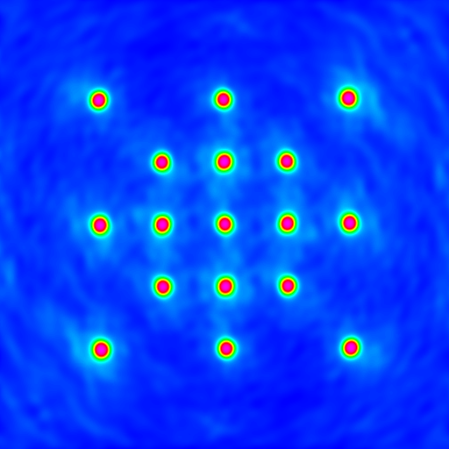
Residuals After Fitting a 3rd-Order MIM
The MIM here is a 3rd-order polynomial TEC distribution (in x and y)
Not surprisingly, it gives a better fit
This should be the way to go for full LOFAR calibration

Slide 51
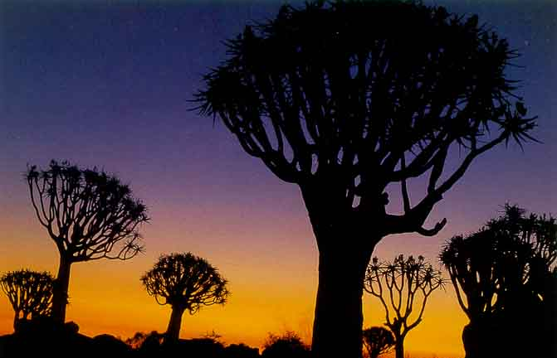
The End
Thanks to Jan Noordam, Sarod Yatawatta, Maaijke Mevius, Tony Willis, Ronald Nijboer, Michiel Brentjens, Cormac Reynolds, Johan Hamaker, and Hans-Rainer Kloeckner.

