Slide 1
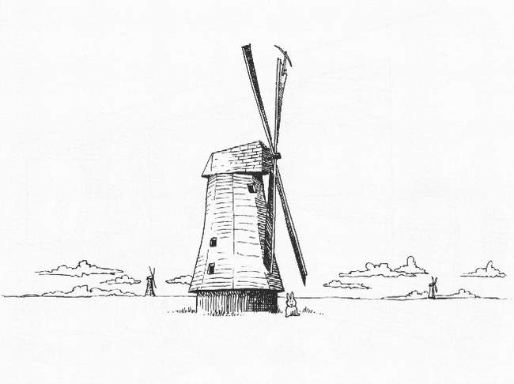
Simulations With MeqTrees

Slide 2
Some Measurement Equations

Slide 3
Why Frameworks?
By having the ME defined in Python, we get endless flexibility...
...and also (as it turns out) endless confusion
  even the simplest ME involves many details to keep track of
  and not everybody wants to be a programmer
On the other hand, the same building blocks are reused over and over again
  sources, Jones matrices, etc.
Frameworks to the rescue...

Slide 4
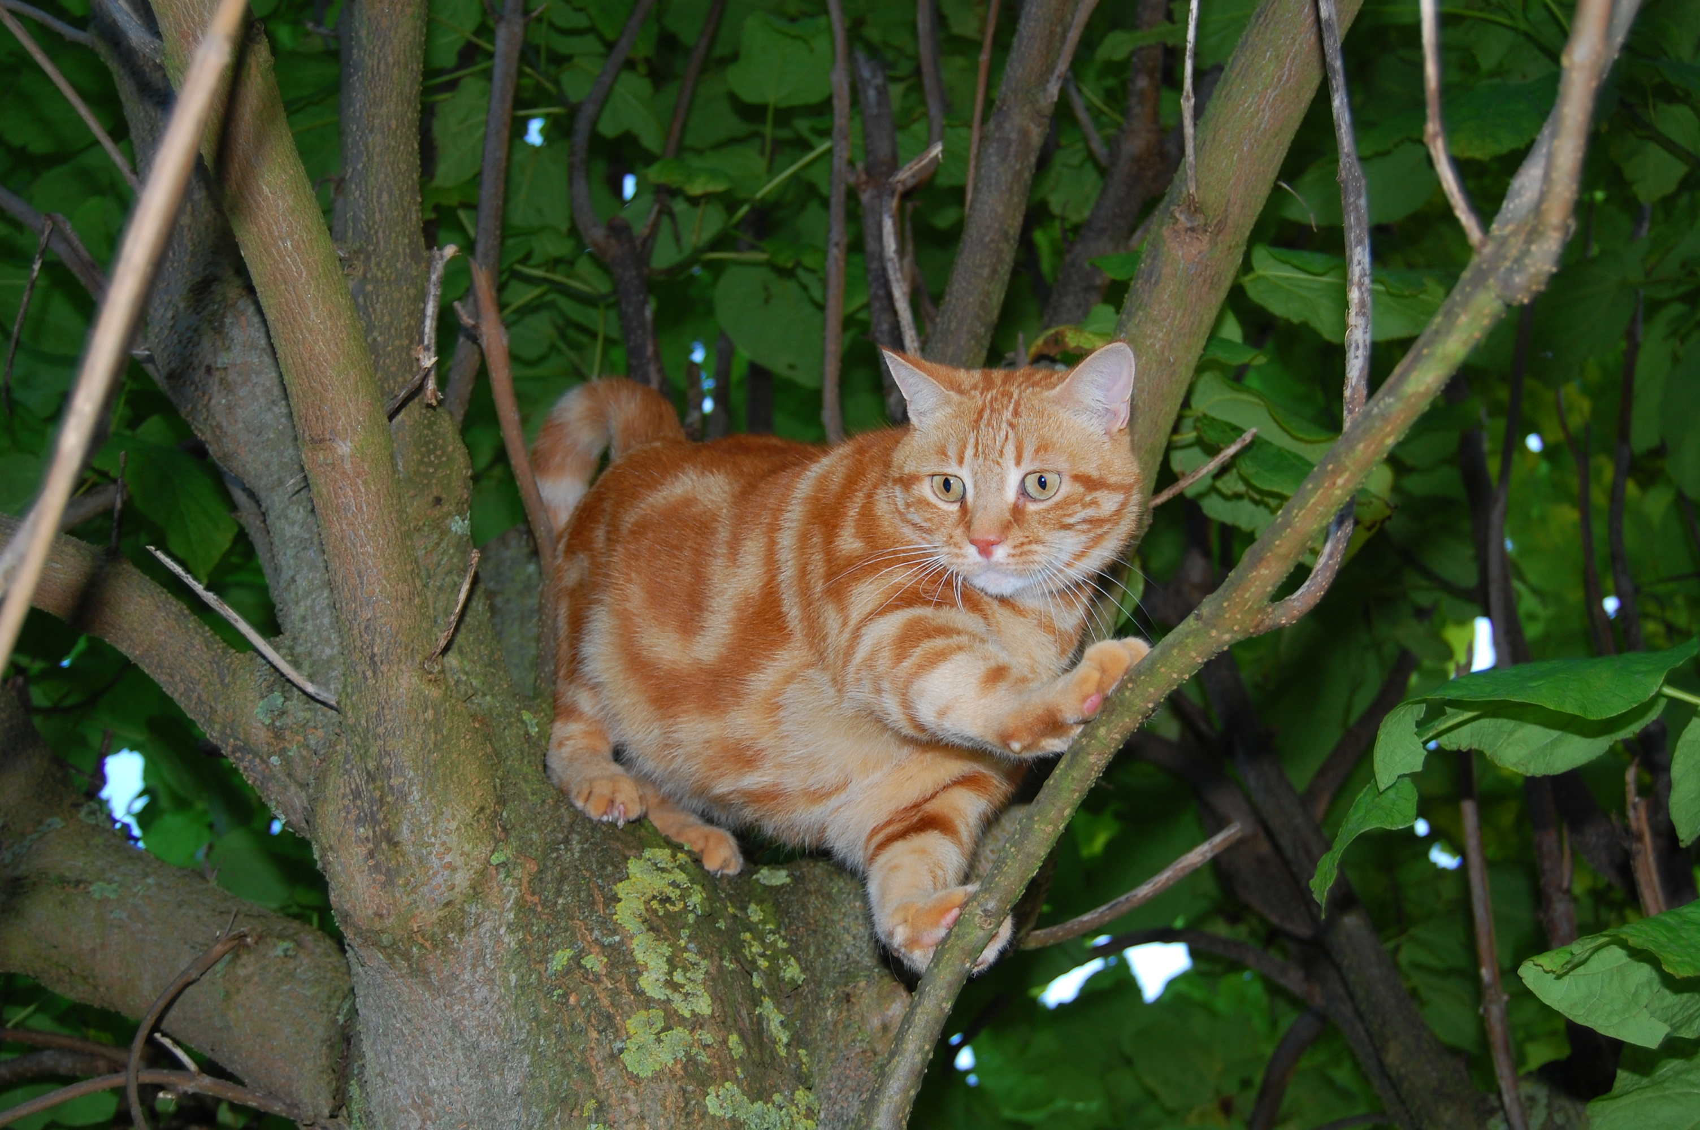
Meow
(Measurement Equation Object frameWork)
software
bloat

Slide 5
Meow
Object-oriented framework for putting together ME-related trees
Better than “pure TDL”
  but still (kind of) low-level
  intended for the advanced MeqTree user
Deals with objects such as Observation, IfrArray, SkyComponent, PointSource, GaussianSource, etc.
Base for higher-level frameworks

Slide 6

Siamese
(Simulations In Your Sleep)
Siamese is a Meow-based simulator framework

Slide 7
Various simulation efforts
LOFAR
  dipole and station beams (S. Yatawatta)
  ionosphere (M. Mevius, J. Anderson)
  Local Sky Model (LSM) (everybody...)
SKADS
  model skies (everybody...)
  ionosphere (I. van Bemmel)
  AA beams, pointing errors (C. Reynolds, S. Sundaram)
  FPA beams (T. Willis)
How to make things just fit together?
  there's actually three kinds of clients...

Slide 8

Three Kinds Of Clients
Developers:
overworked
underpaid
grouchy
...but covered in reflected glory
Developers work on things like implementing Jones matrices, sky models, etc.
programming required...

Slide 9

Three Kinds Of Clients
Power Users:
have more fun
steal glory from developers
Power users collect the modules implemented by developers, and put them together into simulators.

Slide 10

Three Kinds Of Clients
Button-Pushing Astronomers:
have even more fun
...without even learning Python
The ideal astronomer user interface (Tony Willis):
GO
GO FASTER
DO WHAT
I MEAN!

Slide 11
Working With Visibility Data
MeqTrees interface with AIPS++ Measurement Sets
  an MS is a container for visibility data + metadata
For calibration, you already have an MS presumably
  can be converted from UVFITS, etc.
For simulations, an “empty” MS has to be pre-fabricated. This provides a time/frequency grid for our simulations.

Slide 12
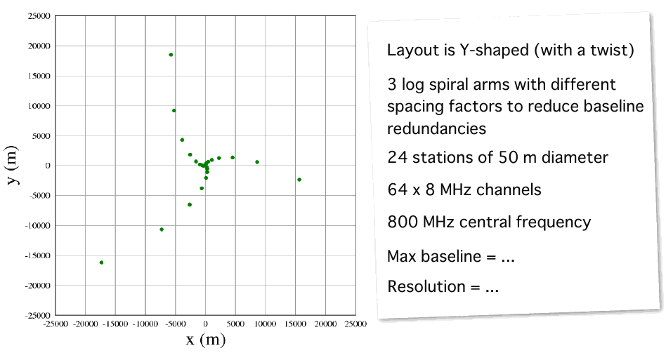
Meet The VLAAA
Very Large Array Of Aperture Arrays, brought to you by Ian Heywood

Slide 13
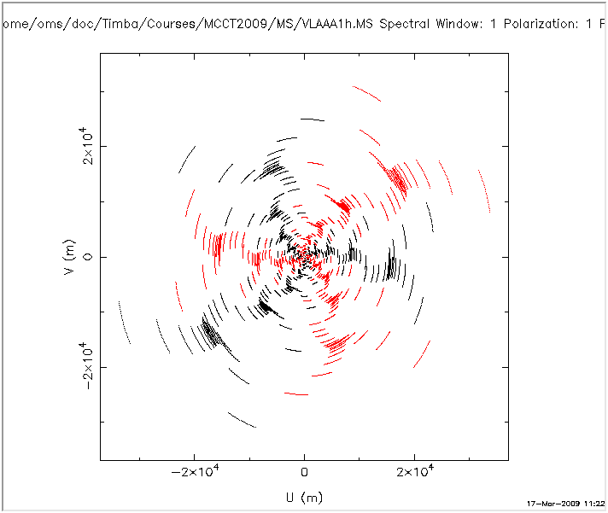
VLAAA uv-coverage
1 hour

Slide 14
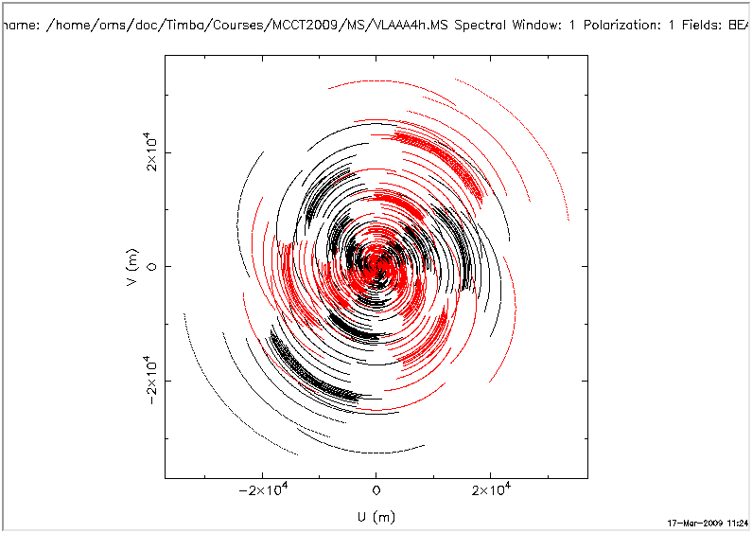
VLAAA uv-coverage
4 hours

Slide 15
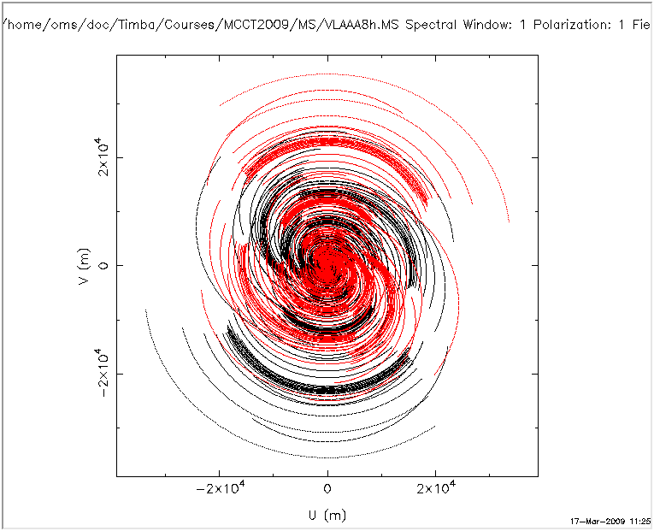
VLAAA uv-coverage
8 hours

Slide 16
How To Make A Mess
$ cd ~/MCCT2009
$ svn up
$ cd MS
$ ./make_ms.sh VLAAA4h
This runs the makems tool to create an empty MS based on:
  a table of antenna positions
  and a .cfg file, see VLAAA4h_makems.cfg.

Slide 17
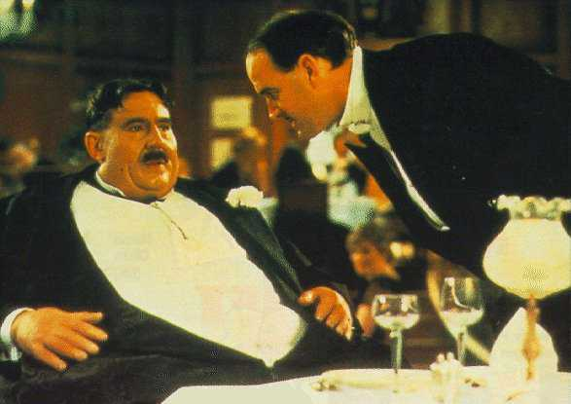
Meet The Sims
$ cd ~/MCCT2009/Sim
Start the browser and load up supersim.py
This is the Siamese “put it all in a bucket, eggs on top” script

Slide 18
PURR
“PURR is Useful for Remembering Reductions”
Start it with the “Purr” button on the browser, or from the command line: purr.py

Slide 19
Exercise: The w-effect
To see the effect of the w-term:
  disable all Jones matrices
  make a 3x3 grid of sources with grid step 60'
  make an image (2048 pixels)

Slide 20
Exercise: Beams & Instrumental Polarization
Set grid step to 20'
Enable the E-Jones
  set beam eccentricity to .1
Open an inspector for E
Make IQUV map (average all channels)
Enable P-Jones
Make another IQUV map.

Slide 21
Exercise: Pointing Errors
Enable pointing errors (see the submenu for E-Jones)
  set to periodic error of 5”
Open inspector for E and for dlm
Make an I map (average all channels)
Observe the difference (or lack thereof...)

Slide 22
So What's The Difference?
It's hard to see all that much in the map
(although you could make another map without pointing error, and subtract it...)
So let's build a differential sim instead, to compute the difference between visibliites with and without pointing errors
Set “simulation mode” to “subtract for MS”, for input column use CORRECTED_DATA, for output use MODEL_DATA.
Make an I map.

Slide 23
Differential Trees
(Or Simulations About Simulations)
Given infinite CPUs, we can implement m.e.'s of arbitrary precision.
In real life, we have to take shortcuts
(e.g. choosing time/freq intervals here).
The main question: how much error does a particular shortcut introduce?
  given infinite mathematical skill, we could work it out analytically...
  ...but given MeqTrees, we don't have to.

Slide 24
Exercise: N-correction
With wide fields, it is difficult to distinguish distortion introduced by the w-effect from other distortions
The “Ncorr-Jones” adds an artifical Jones term of:
This causes the sources to image perfectly
Alternative (slow): enable w-correction in the imager (use 1024 convolution funcs)

Slide 25
And Now For Something Completely Different:
Time & Bandwidth Smearing

Slide 26
And Now For Something Completely Different:
Time & Bandwidth Smearing

Slide 27
Simulating Smearing
The same effect occurs with other Jones terms, such as ionospheric or tropospheric phase, etc. (hence, decohaerency time).
How to simulate?
The brute force approach:
Enable resampling in supersim.py (use 5x5) and observe the results...

Slide 28
Exercise: Smearing
Set grid step to 30'
Disable all Jones terms
Enable resampling (use 5x5 factors)
Make I map (average all channels)
Optional: try this with the ionosphere, etc.

Slide 29
Model Ionospheres
Load up demo-ionosphere.py
Execute the “test forest” job
Load up some bookmarks

Slide 30
Into Siamese
It is fairly straightforward to turn this ionosphere into a Siamese Jones module
See Cattery/Siamese/OMS/oms_ionosphere.py for details
We'll use a low-frequency MS (30~220 MHz): VLAAA4h_LF.MS
Go into ~/MCCT2009/MS/ to create it

Slide 31
Exercise: Wedge
Make a “wedge_model” ionosphere.
  min 0/max .1 delta-TEC in 1 hour
Use a 3x3 grid of sources with 5' grid size
Open up an “inspector:TEC” and “inspector:iono phase” bookmark before you simulate
Make a per-channel (“no averaging”) I map.
Make a movie using:
  ./make_movie.py data=CORRECTED_DATA ms=VLAAA4h_LF.MS channel=16 npix=300 cell=3arcsec

Slide 32
Why Do The Sources Move?

Slide 33
Exercise: TIDs
Make a “sine_tid_model” ionosphere
  Grid size 3, grid step 30'
  TID X/Y amplitudes: 0 at t=0, 0.002 at t=1hr
  TID sizes ~50km, speeds ~50 km/h
Run tree and make a per-channel map
Make a time-slice movie:
  ./make_movie.py data=CORRECTED_DATA ms=VLAAA4h_LF.MS channel=16 npix=300 cell=18arcsec

Slide 34
Why Do The Sources Distort?
Curvature over the field-of-view distorts relative positions of sources
Curvature over the array means that:
  every baseline now sees a different gradient
  so every baseline sees the sources at a different position
  you're seeing the average of that in the image plane

Slide 35
Can We Correct For The Ionosphere?
If we know our instrument to arbitrary precision (G/B/etc.), we can correct our observed visibilities or residuals perfectly.
Does the same hold true for the ionosphere?
If we know the ionosphere to arbitrary precision,
can we correct our data for it?
  A. yes
  B. no

Slide 36
And The Answer Is...
In general, no...
uv-plane effects (the Gs) can be taken out by simple matrix inversion/multiplication
Image-plane effects correspond to convolution in the uv-plane:
  ...with time-variable kernels
  ...and with each baseline's uv-plane sampled along just a single track
(Note: Bhatnagar et al. (EVLA Memo 100) suggest a method for approximate correction during the imaging step. We'll return to this later.)

Slide 37
Correcting At
A Single Point
In general, uv-data can only be “corrected” for a single point on the sky.
This is why we do, e.g., facet imaging.

Slide 38
Taking The Central Phase Out
In Z options, select “Correct for central phase”
  ...effectively doing a perfect ionospheric correction for the center of the field
Rerun the previous sim and make a movie:
  ./make_movie.py data=CORRECTED_DATA ms=VLAAA4h_LF.MS channel=1 npix=300 cell=18arcsec

Slide 39
Exercise: E2E S³ Simulation
1. Querying the S³ Database
http://s-cubed.physics.ox.ac.uk/
Click on “S3-SEX - Database query”
Enter your e-mail
Leave most fields as default, except “Spatial conditions”:
  Minimum X,Y: - 0 : 4 : 0.0
  Maximum X,Y: + 0 : 4 : 0.0
  This selects an 8' x 8' field
Click “Submit”
Follow the provided link and wait for the query to complete (may need to reload)

Slide 40
Exercise: E2E S³ Simulation
2. Making an LSM
Download the query results (.tar.gz file)
Move them to exercise directory:
  $ cd ~/MCCT2009/Sim
  $ mv ~/Desktop/xxx.tar.gz .
Run conversion script:
  $ ./s3_to_LSM_rad.py xxx.tar.gz lsm.txt
Examine lsm.txt
  this contains the 100 brightest sources from your query

Slide 41
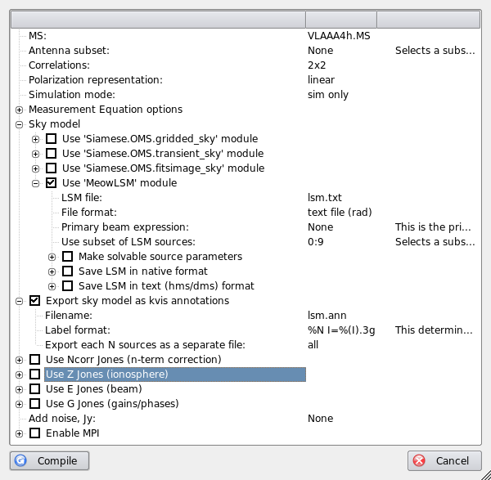
Exercise: E2E S³ Simulation
3. Compiling the simulator
Start meqbrowser, load supersim.py
Setup options
Set LSM subset!!!
Compile the script

Slide 42
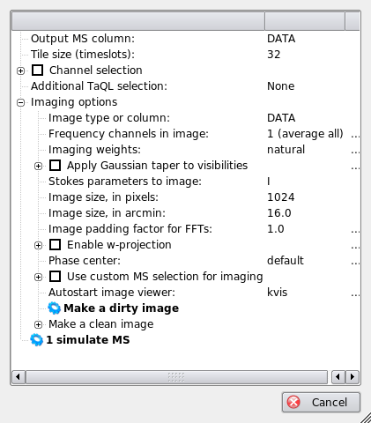
Exercise: E2E S³ Simulation
4. Running the sim
Click on “simulate MS”
Once things finish, click on “Make a dirty image”
Load kvis annotations (Overlay - Load annotations)

Slide 43
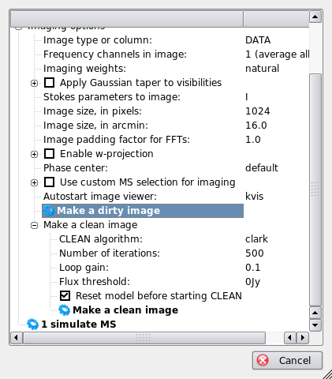
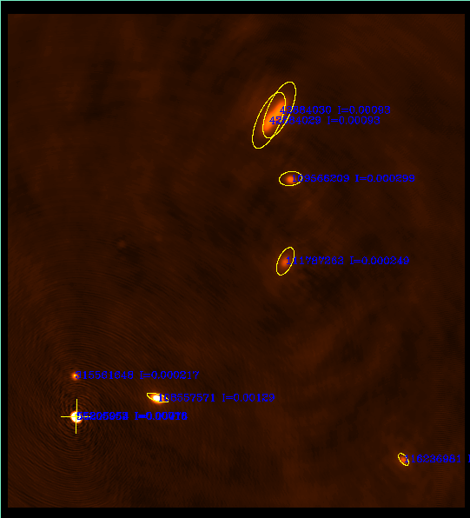
Exercise: E2E S³ Simulation
5. Make a clean image

Slide 44
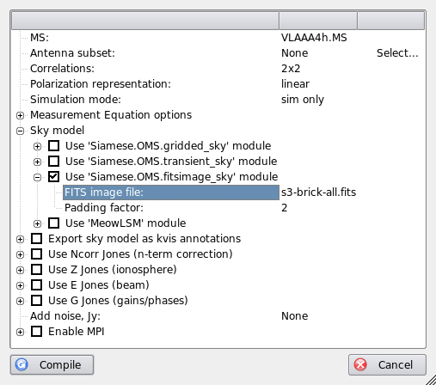
Exercise: E2E S³ Simulation
6. Redo the sim using a brick
Let's use a FITS image for an LSM, instead of a source list
We'll use the 'fitsimage_sky' module
View s3-brick-all.fits using kvis first

Slide 45
Exercise: E2E S³ Simulation
7. Run the brick sim
Compile
Set “Output column” to CORRECTED_DATA
Simulate MS
Make a dirty image, compare to previous
Make a clean image, compare to previous

Slide 46
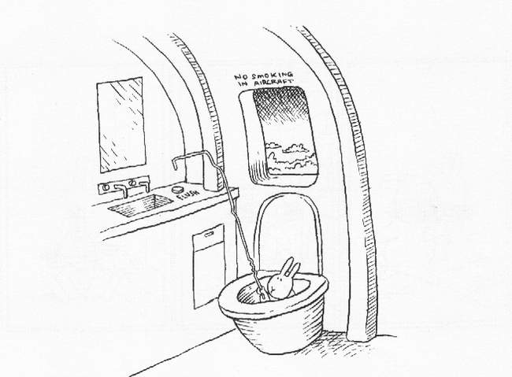
And That's All, Folks!

